Slide 1
Electricity 101
Michelle kleinau
8/3/2021
*Slides adapted from original electricity 101 presentation by john everett

Slide 2
Outline
Alternating Current (AC)
3 Phase AC power
Transformers
One Line Diagram
In Operation

Slide 3
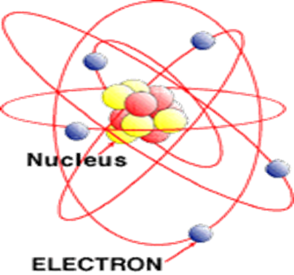
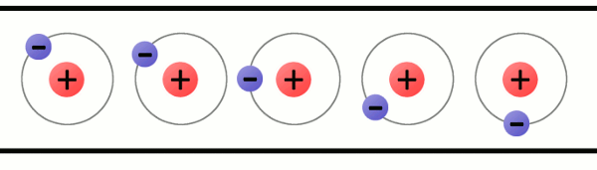
Electricity
Electrons move from atom to atom
Voltage: electrical “pressure” or “potential” or “potential difference”
  Units: Volts (V)
Current: flow of electrons (I)
  Units: Amperes or Amps (A)
Notes:
Voltage: pressure of water in a pipe
Current: flow of water
If pipe is sealed, pressure but no current

Slide 4
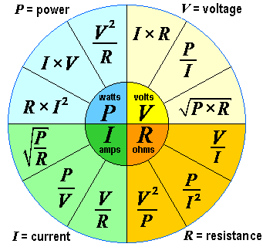
“Power Wheel”
Notes:
Won’t discuss resistance

Slide 5
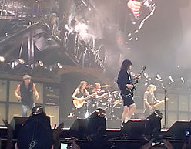

AC vs. DC

Slide 6
War of Currents
Late 1800s
Direct Current (DC)
  Thomas Edison
  Low voltage (~100 Volts) systems
  Distributed generation
Alternating Current (AC)
  Nikola Tesla and George Westinghouse
  Allows high voltage generation
  Easy conversion from higher-to-lower and
  lower-to-higher voltage with transformer
  Transmission much more efficient
Notes:
2 schools of thought when electricity was invented
AC won out

Slide 7
Outline
Alternating Current (AC)
3 Phase AC power
Transformers
One Line Diagram

Slide 8
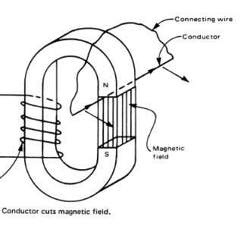
Notes:
Draw picture showing moving vertically vs. horizontally through field

Slide 9
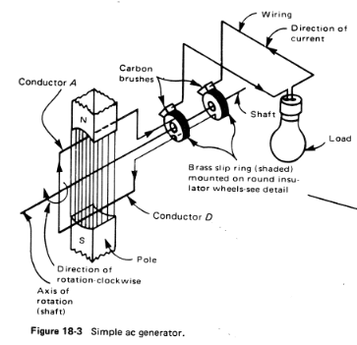
Notes:
Current moving in different direction in 2 wires, but connected in loop

Slide 10
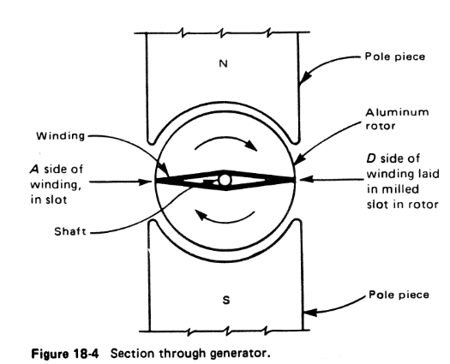

Slide 11
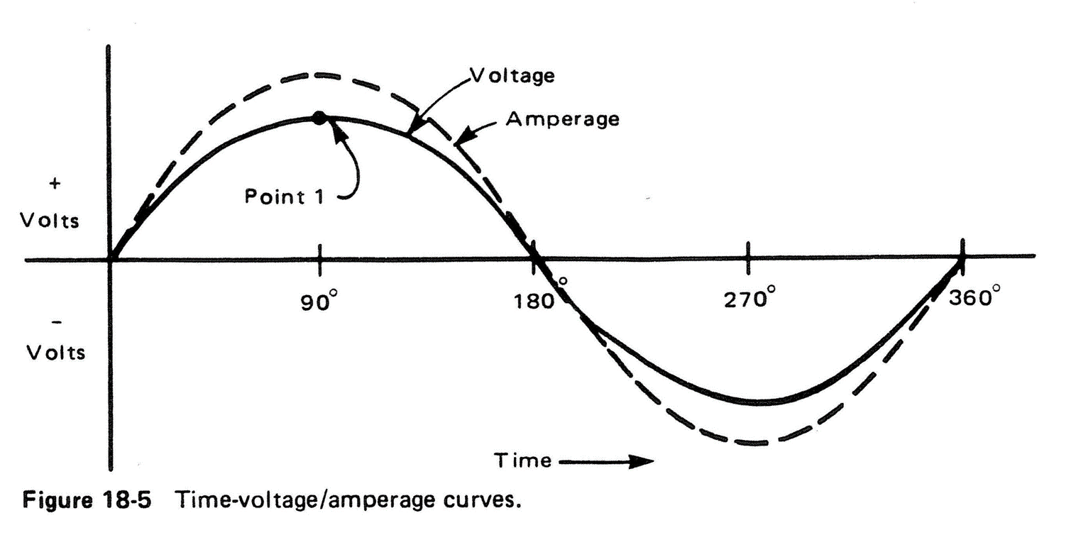

AC Single phase (1Φ)
Frequency = 60 Hertz (Hz) = 60 cycles per second
Notes:
Frequency!

Slide 12
AC Voltage
Voltage:
  Electrical “pressure” or
  “potential difference”
Which way do electrons want to flow?

Slide 13
AC Voltage
Voltage:
  Electrical “pressure” or
  “potential difference”
Which way do electrons want to flow?
Higher voltage to lower voltage

Slide 14
AC Single phase (1Φ)
Line-Ground
Frequency = 60 Hertz (Hz) = 60 cycles per second
Notes:
0=ground

Slide 15
Outline
Alternating Current (AC)
3 Phase AC power
Transformers
One Line Diagram

Slide 16
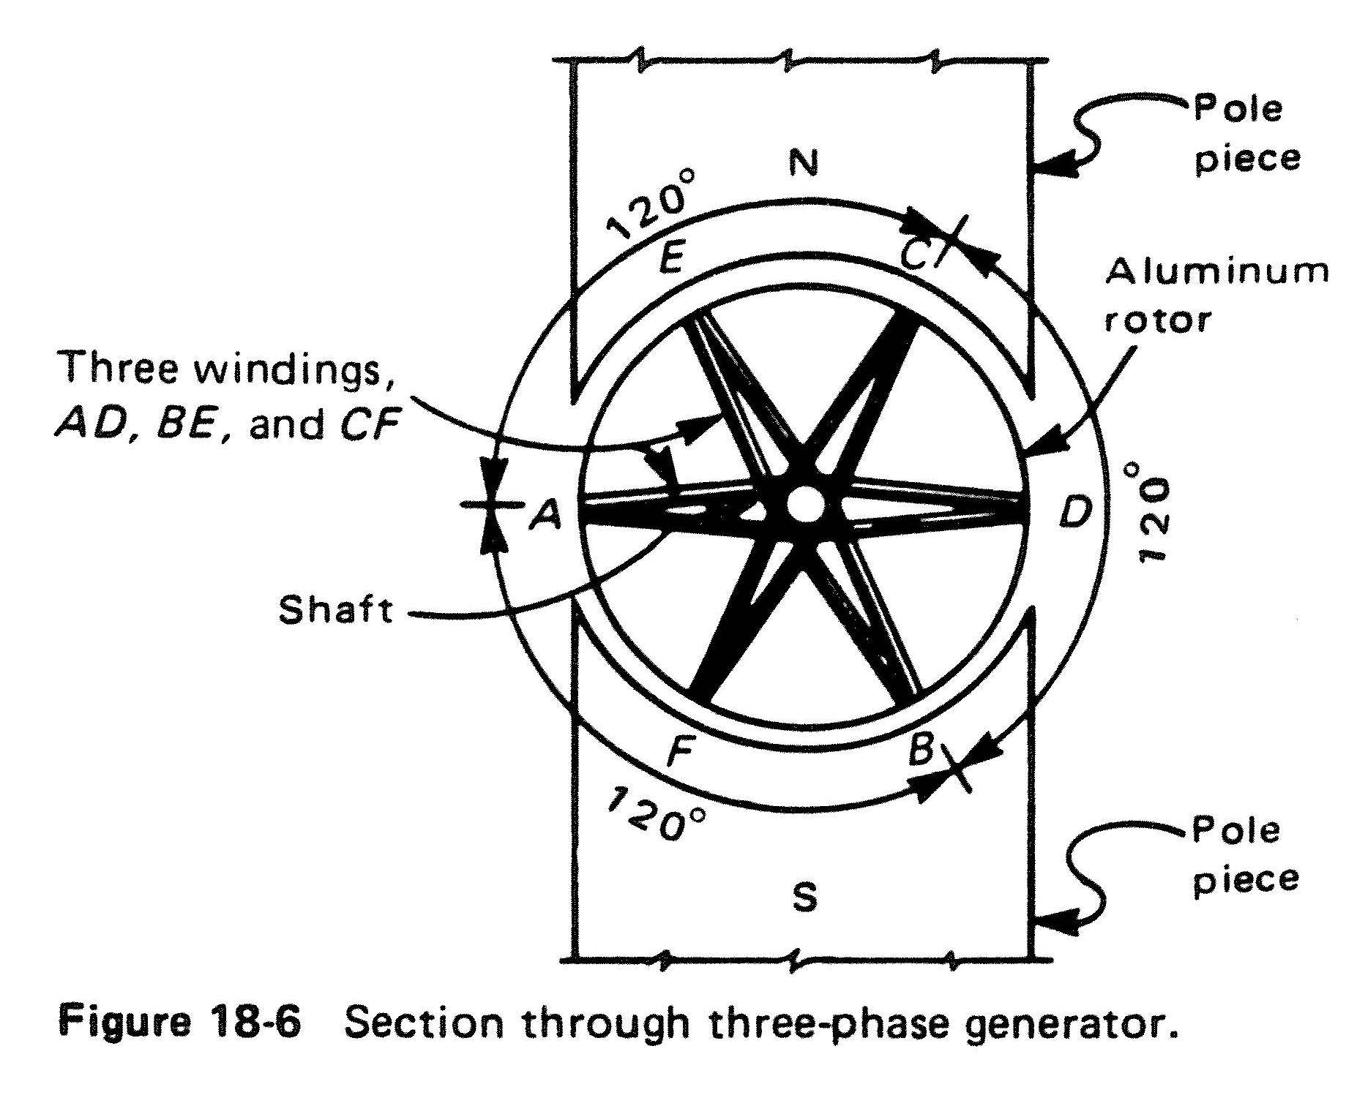

Slide 17
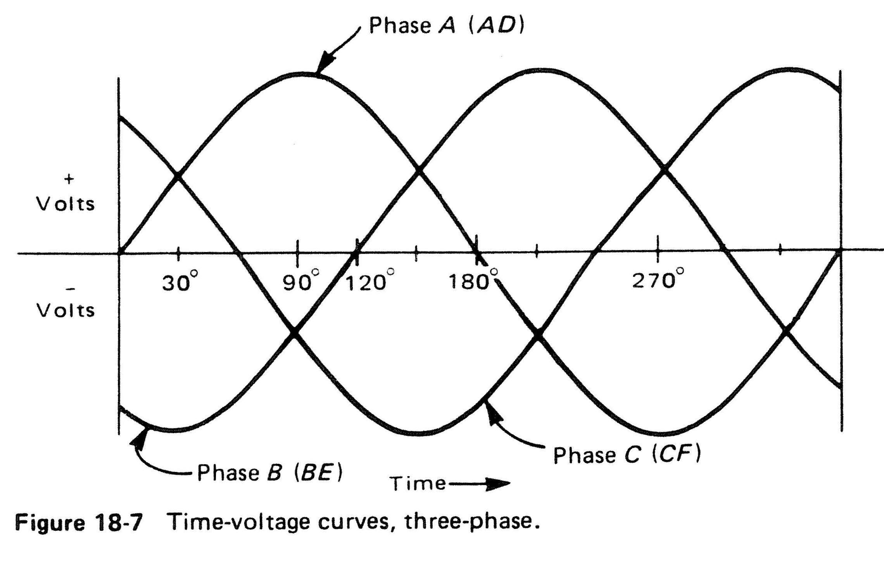

Slide 18
Three Phase (3Φ ) AC Voltage
Voltage:
  Electrical “pressure” or
  “potential difference”
Which way do electrons want to flow?

Slide 19
Three Phase (3Φ ) AC Voltage
Voltage:
  Electrical “pressure” or
  “potential difference”
Which way do electrons want to flow?
Higher voltage to lower voltage

Slide 21
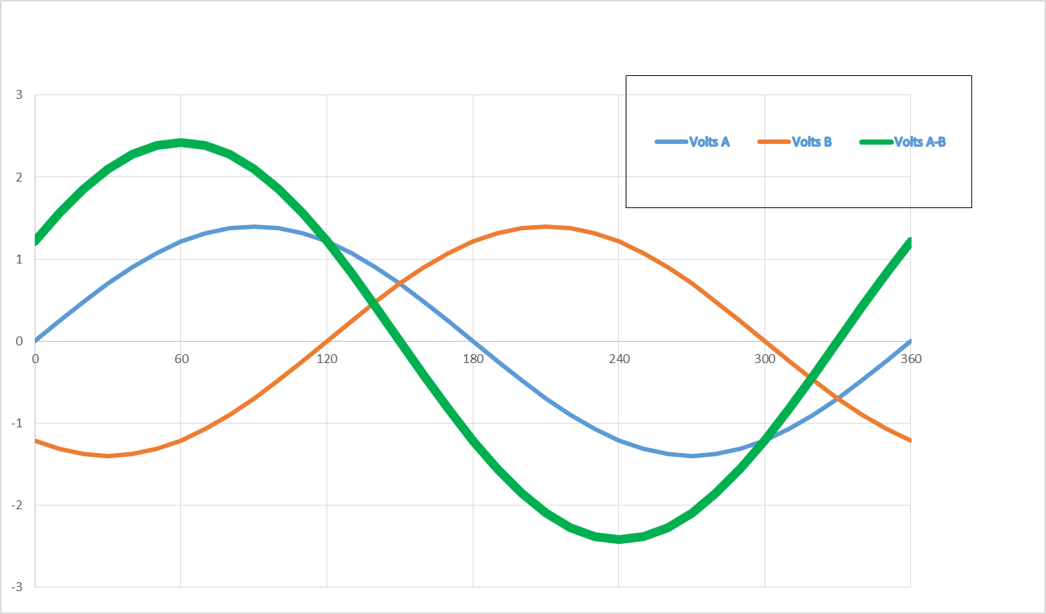
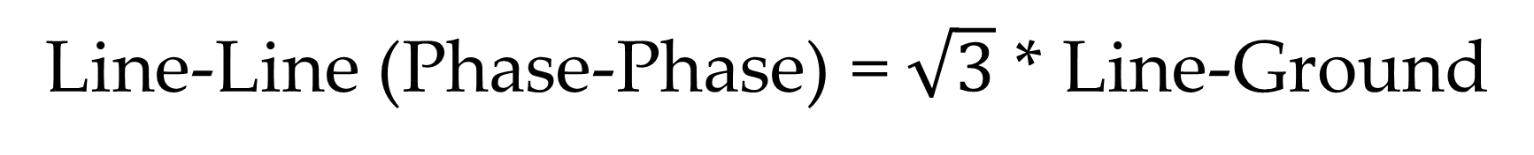
Line-Line (Phase-Phase) = $\sqrt{3}$ * Line-Ground
A-B
A
B

Slide 22
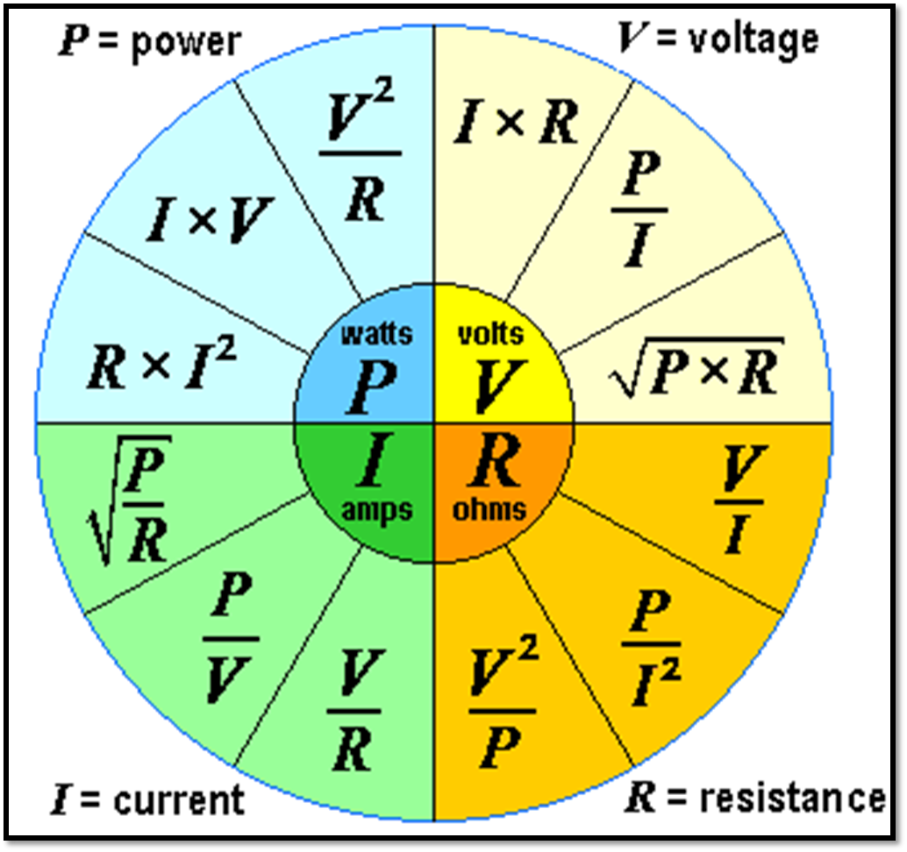
What’s the big deal? Why Three Phase?
Notes:
P=IV

Slide 23
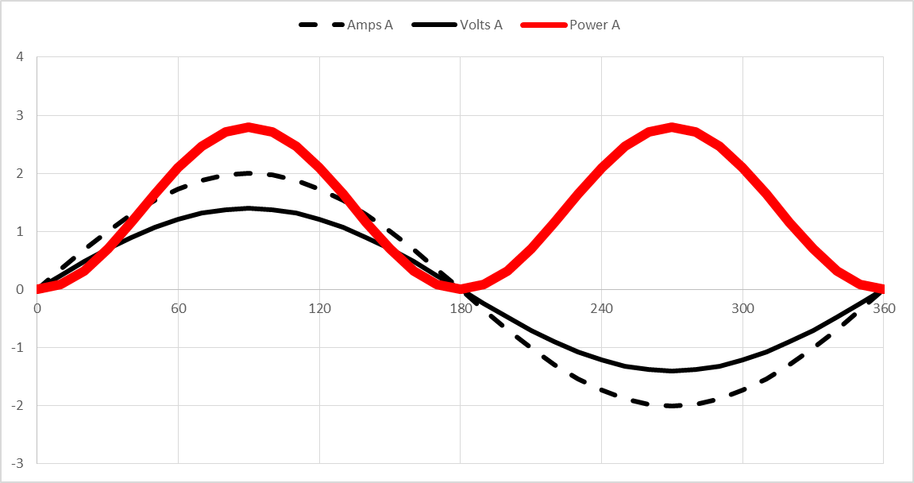
Single Phase
Power (Watts) = Volts * Amps
Notes:
Power is always positive here!

Slide 24
Notes:
Light bulb will flicker

Slide 25
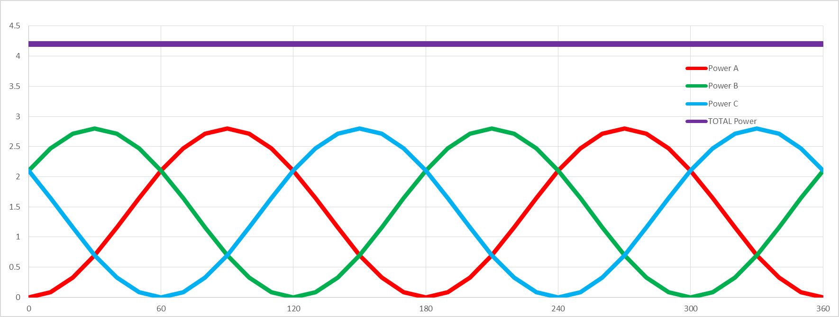
Power in each Phase varies, but
Total Power is CONSTANT
Total Power
A
B
C
Notes:
Add all 3 phases (power) together

Slide 26
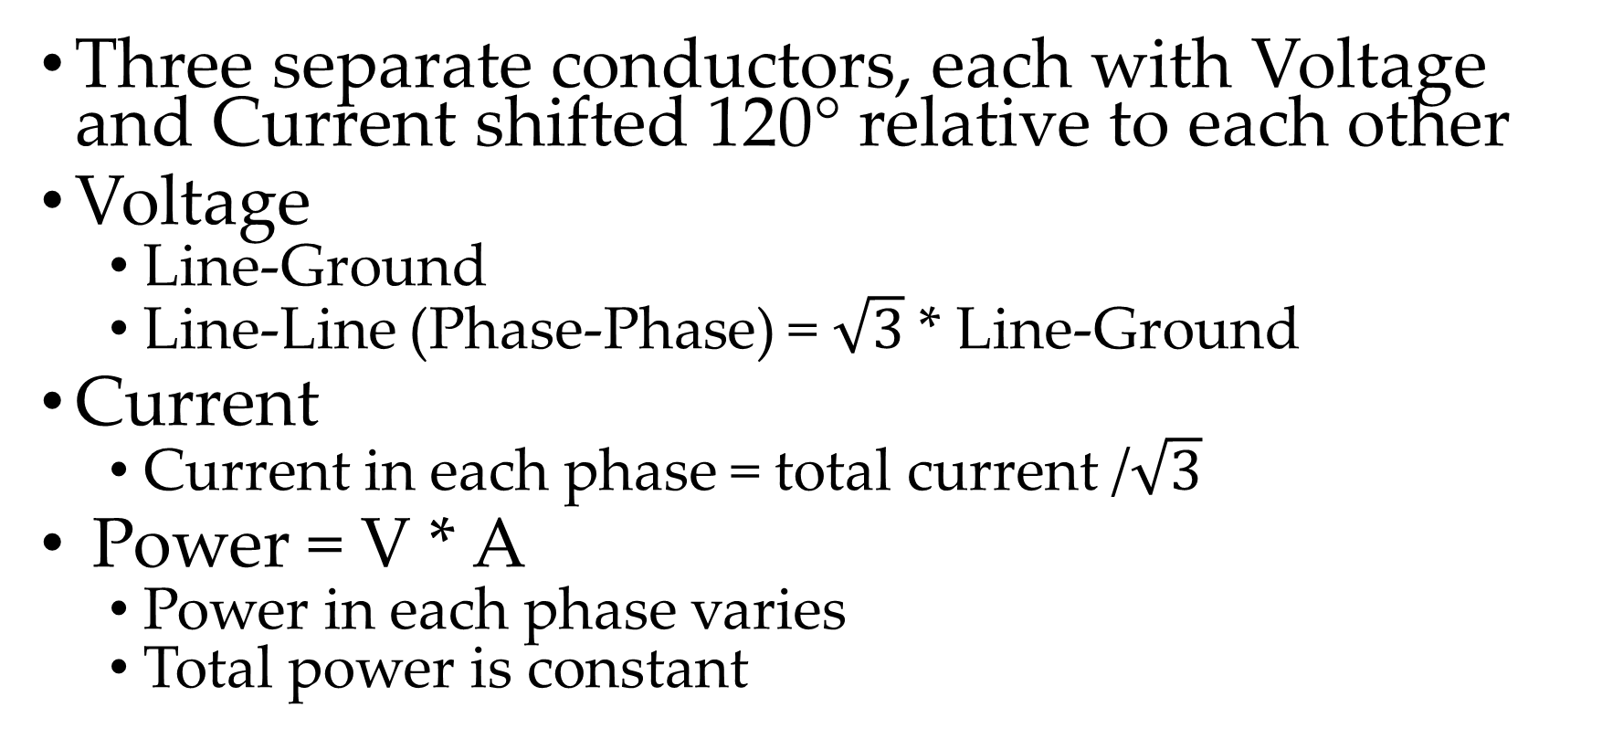
Three Phase (3Φ ) AC
Summary
Three separate conductors, each with Voltage and Current shifted 120° relative to each other
Voltage
  Line-Ground
  Line-Line (Phase-Phase) = $\sqrt{3}$ * Line-Ground
Current
  Current in each phase = total current /$\sqrt{3}$
Power = V * A
  Power in each phase varies
  Total power is constant

Slide 27
Three Phase (3Φ ) AC
Advantages
Total power is constant
With one additional conductor
(3 vs. 2) increase power x 3
Easy conversion from higher-to-lower and lower-to-higher voltage with transformer
Allows high voltage generation
Transmission much more efficient

Slide 28
Outline
Alternating Current (AC)
3 Phase AC power
Transformers
One Line Diagram

Slide 29
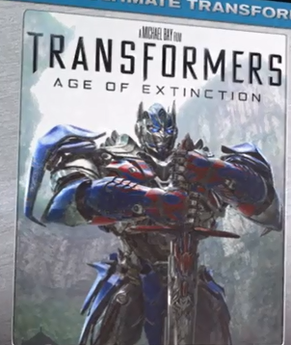

Slide 30
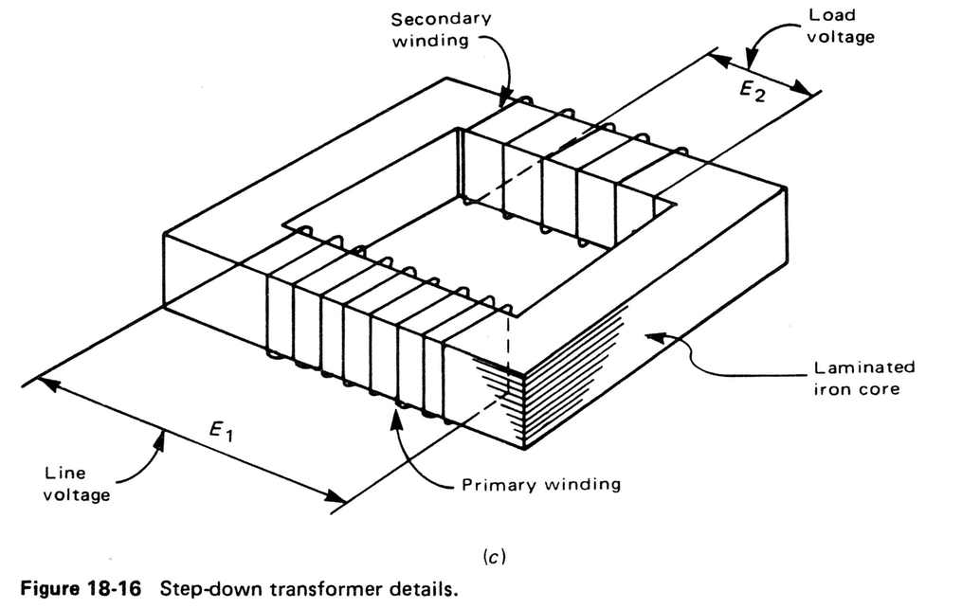
Transformers

Slide 31
Transformers
E₂ / E₁ = N₂ / N₁
or E₂ = E₁*N₂ / N₁
If E₁=4160V; N₂=100; N₁=1733; I₁=15A
Find E₂:
E₂ = 4160V*100/1733 = 240V

Slide 32
Transformers
_{Also}
I₂ / I₁ = N₁ / N₂
or I₂ = I₁*N₁ / N₂
Find I₂:
I₂ = 15A *1733/100 = 260A

Slide 33
Transformers
Find Power = V*A = Watts
P₁ = 4160V * 15A = 62,400 Watts
P₂ = 240V * 260A = 62,400 Watts

Slide 34
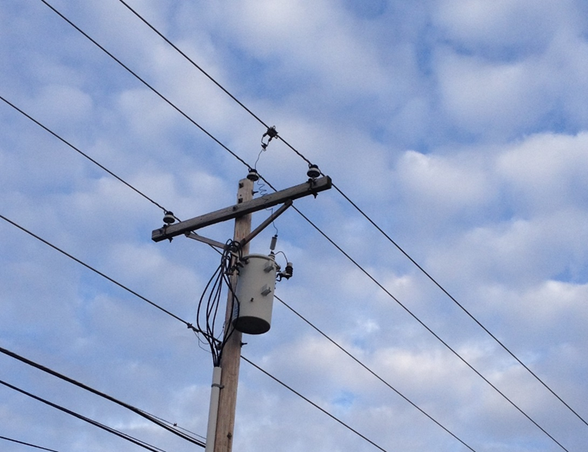
Step down transformer
1Φ

Slide 35
Voltage
Line-to-Line = 4160V
Why 4160V?
Line-to-ground = ?

Slide 36
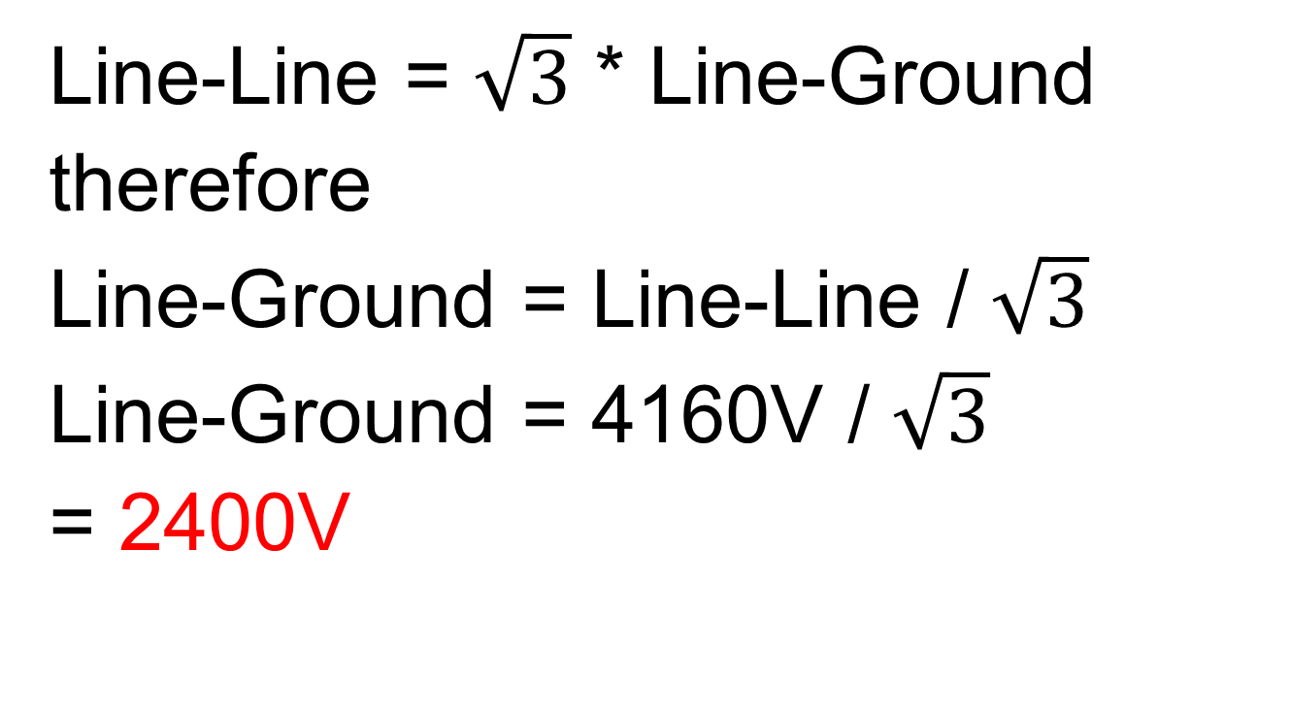
Voltage
  Line-Line = $\sqrt{3}$ * Line-Ground
therefore
  Line-Ground = Line-Line / $\sqrt{3}$
Line-Ground = 4160V / $\sqrt{3}$
= 2400V

Slide 37
Project Voltage
 | Line-to-Line | Line-to-Ground
Lafarge, Harpster | 4160 | 2400
WP Findlay, WP Ottawa, WP Greenville, Haviland, Cooper Farms | 12470 | 7200
Ball (1+2), Valfilm, WP Marion | 34500 | 20000

Slide 38
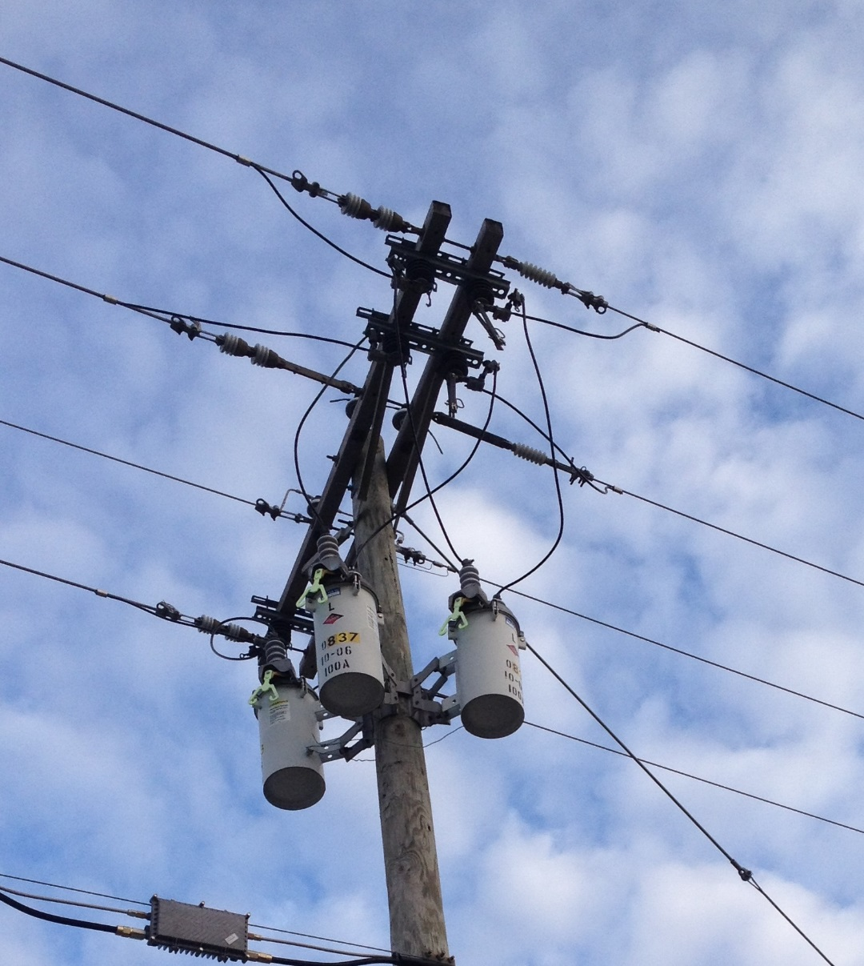
Step down transformer
3Φ

Slide 39
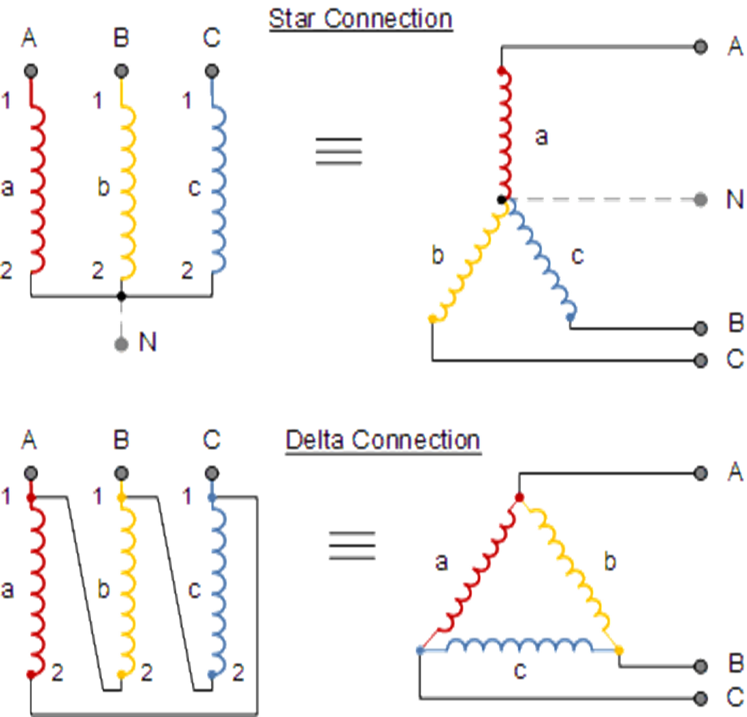
Transformer Connections
(Wye)

Slide 40
Transformer Connections
Delta
Star (Wye)
Less Costly
Filter Harmonics
Operate with One Ground Fault
Protection More Complex
More Costly
Easier Protection
Safer

Slide 41
Step Up Transformer
Why?
Same power in primary and secondary windings (except very small losses)
Why step up voltage?
  Power loss α I² (I = current)
  higher volts → lower amps → lower power loss
  Conductor size based on amps
  lower amps → smaller conductor → lower cost

Slide 42
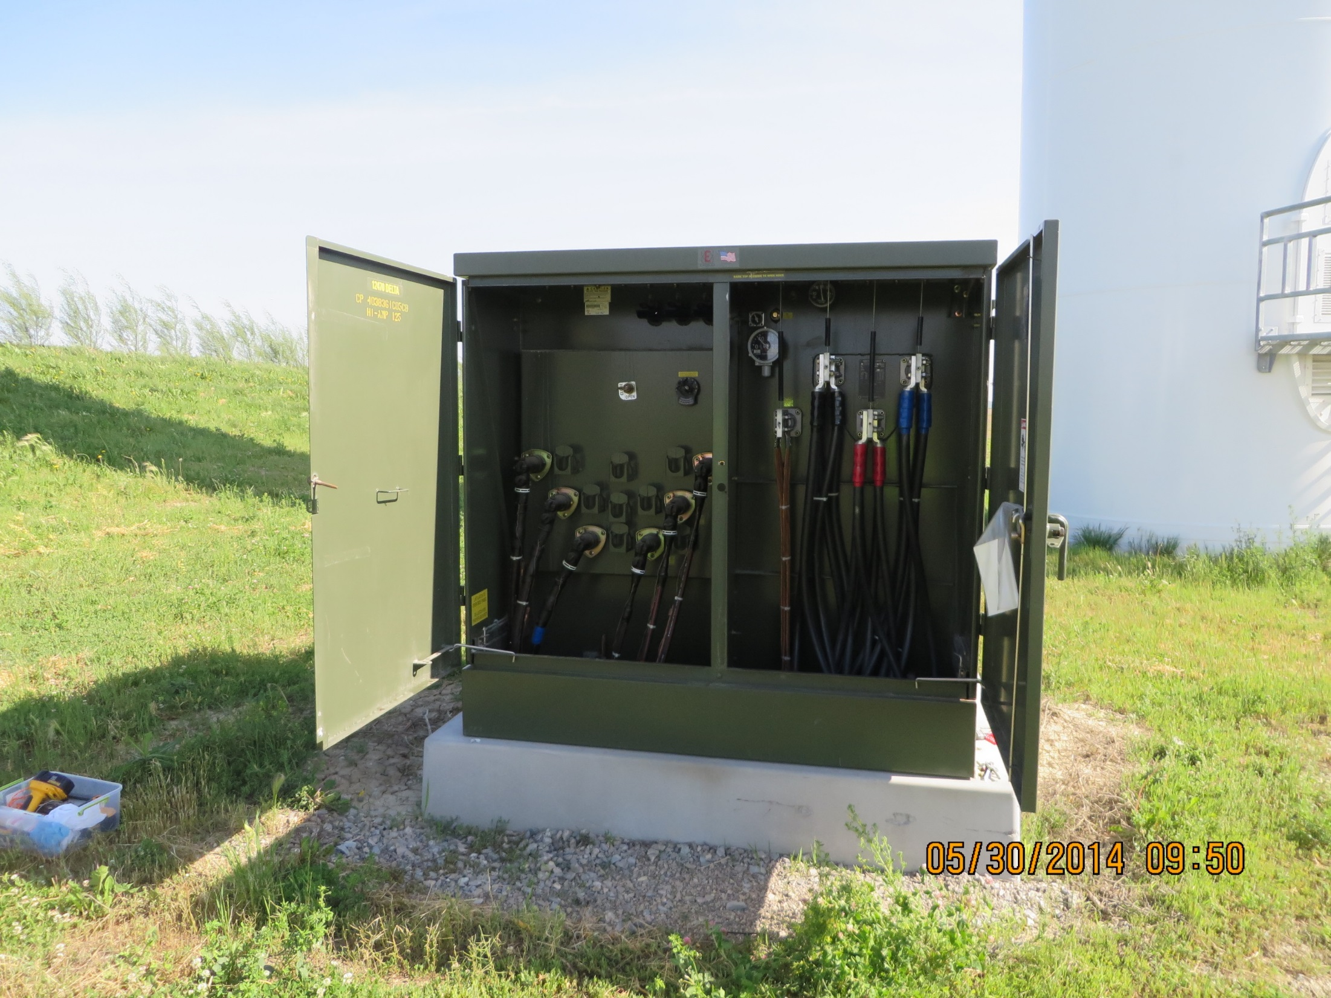

Slide 43
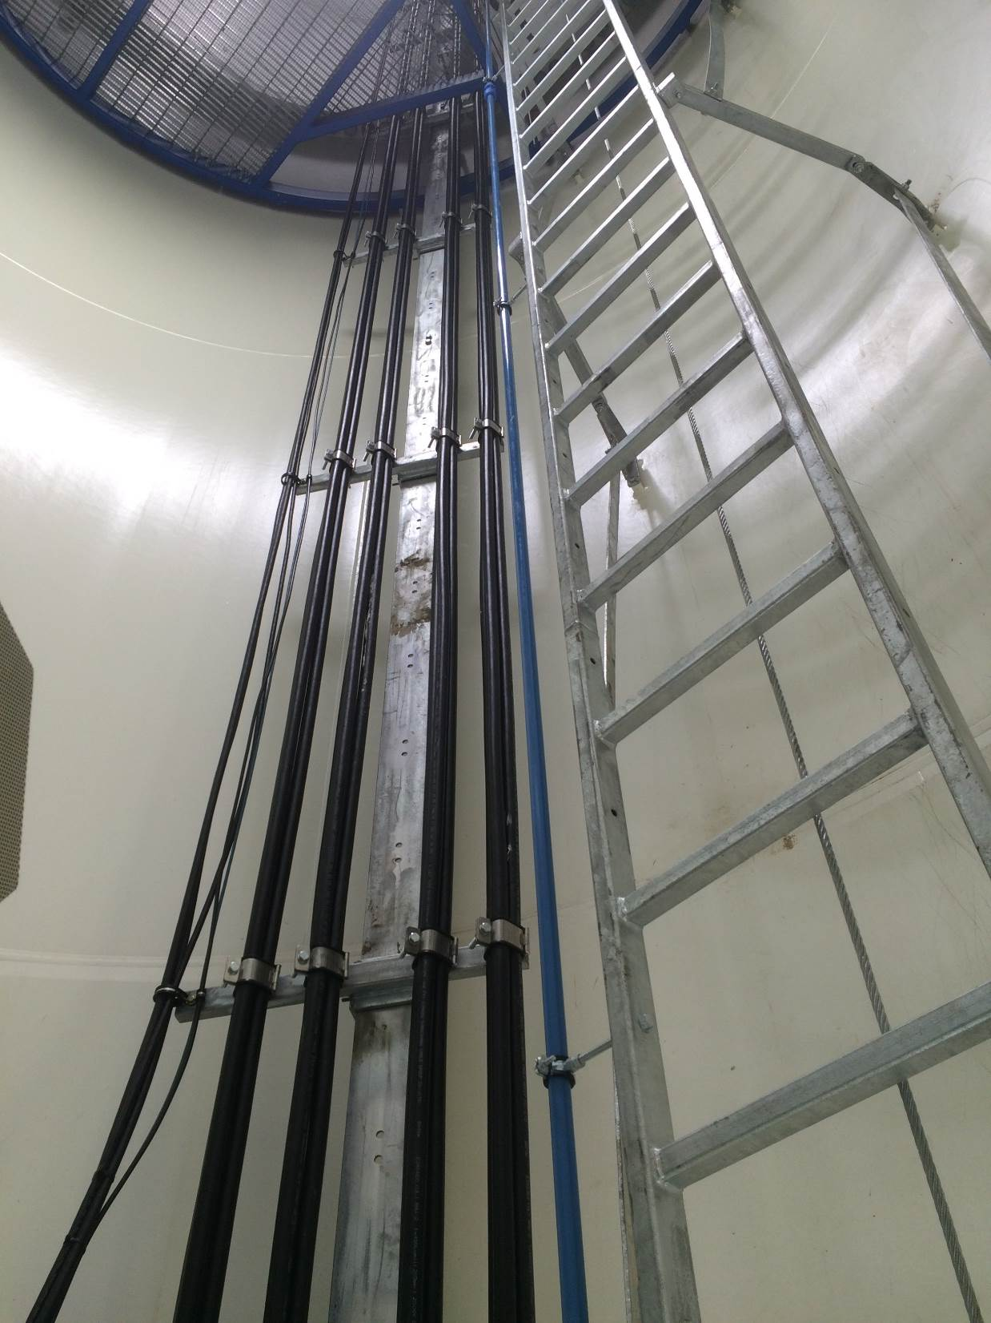
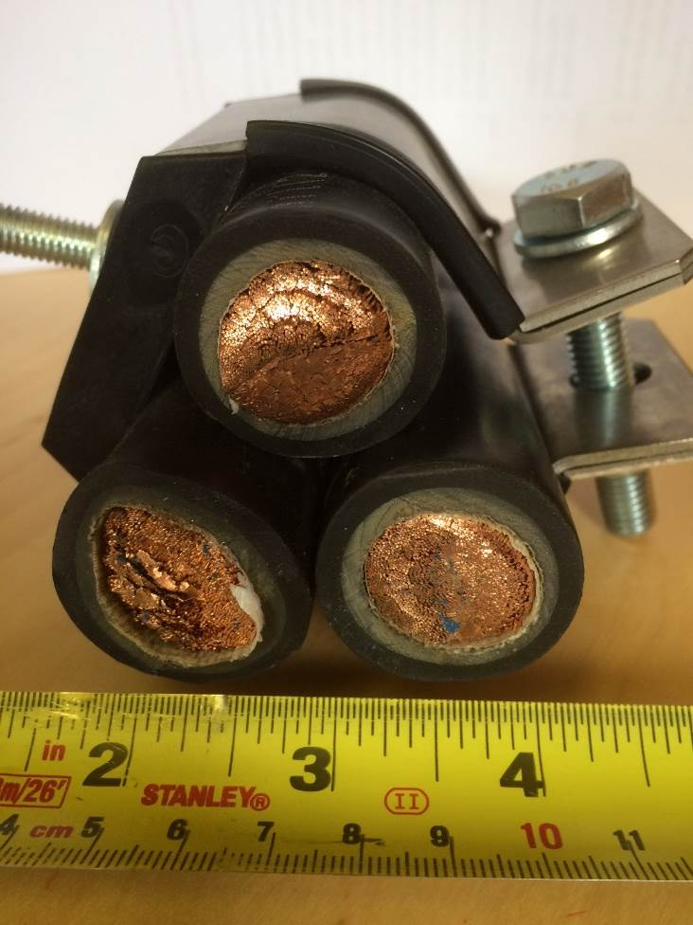

Slide 44
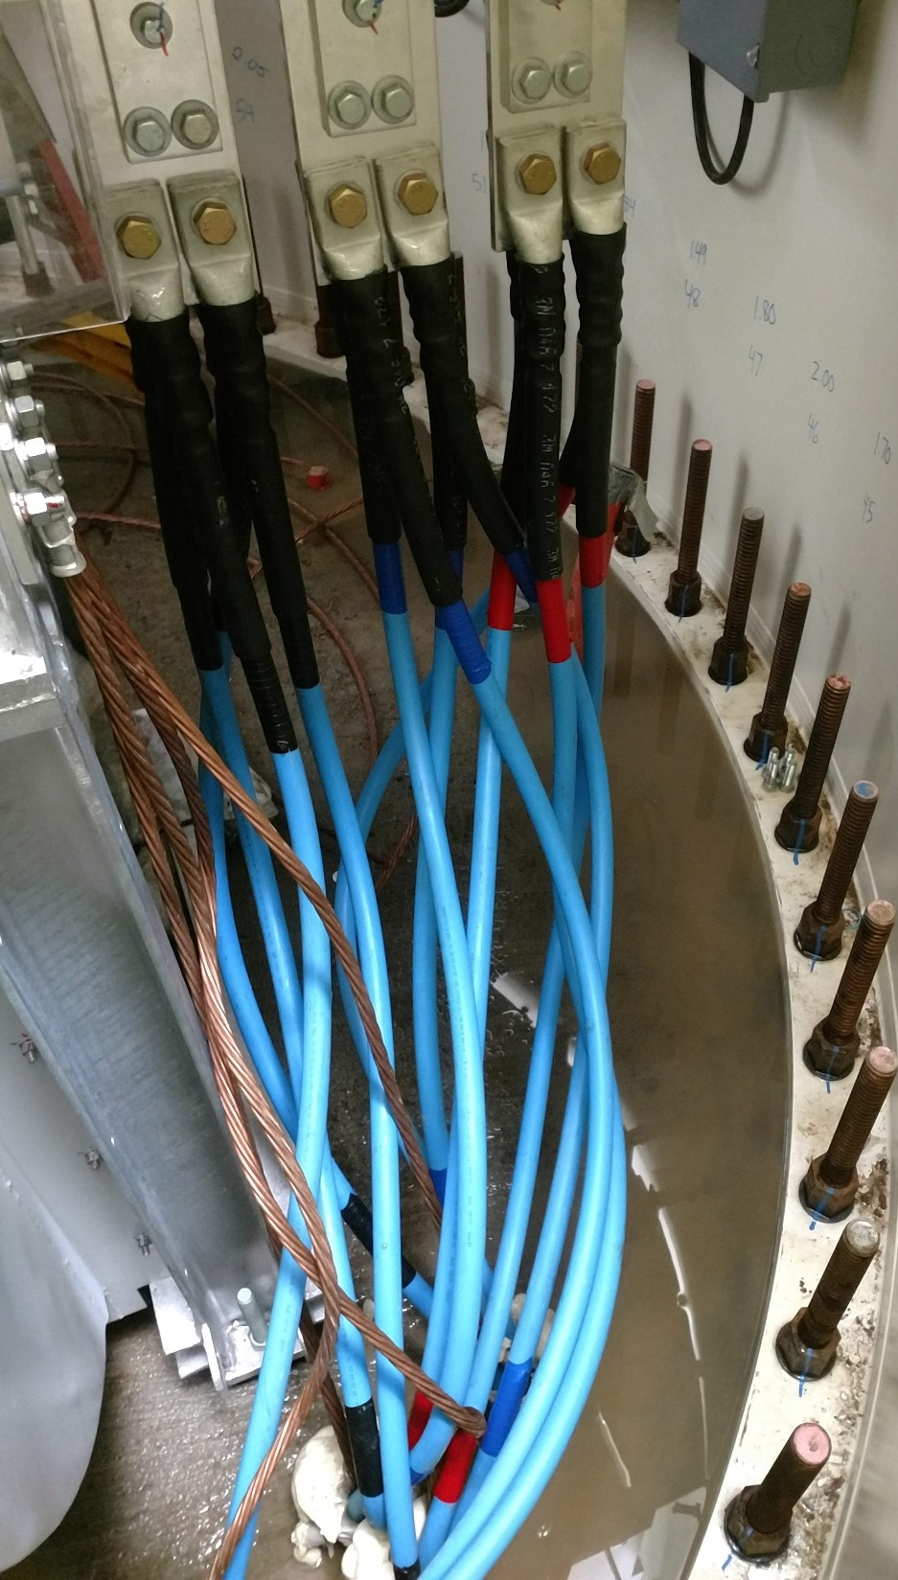
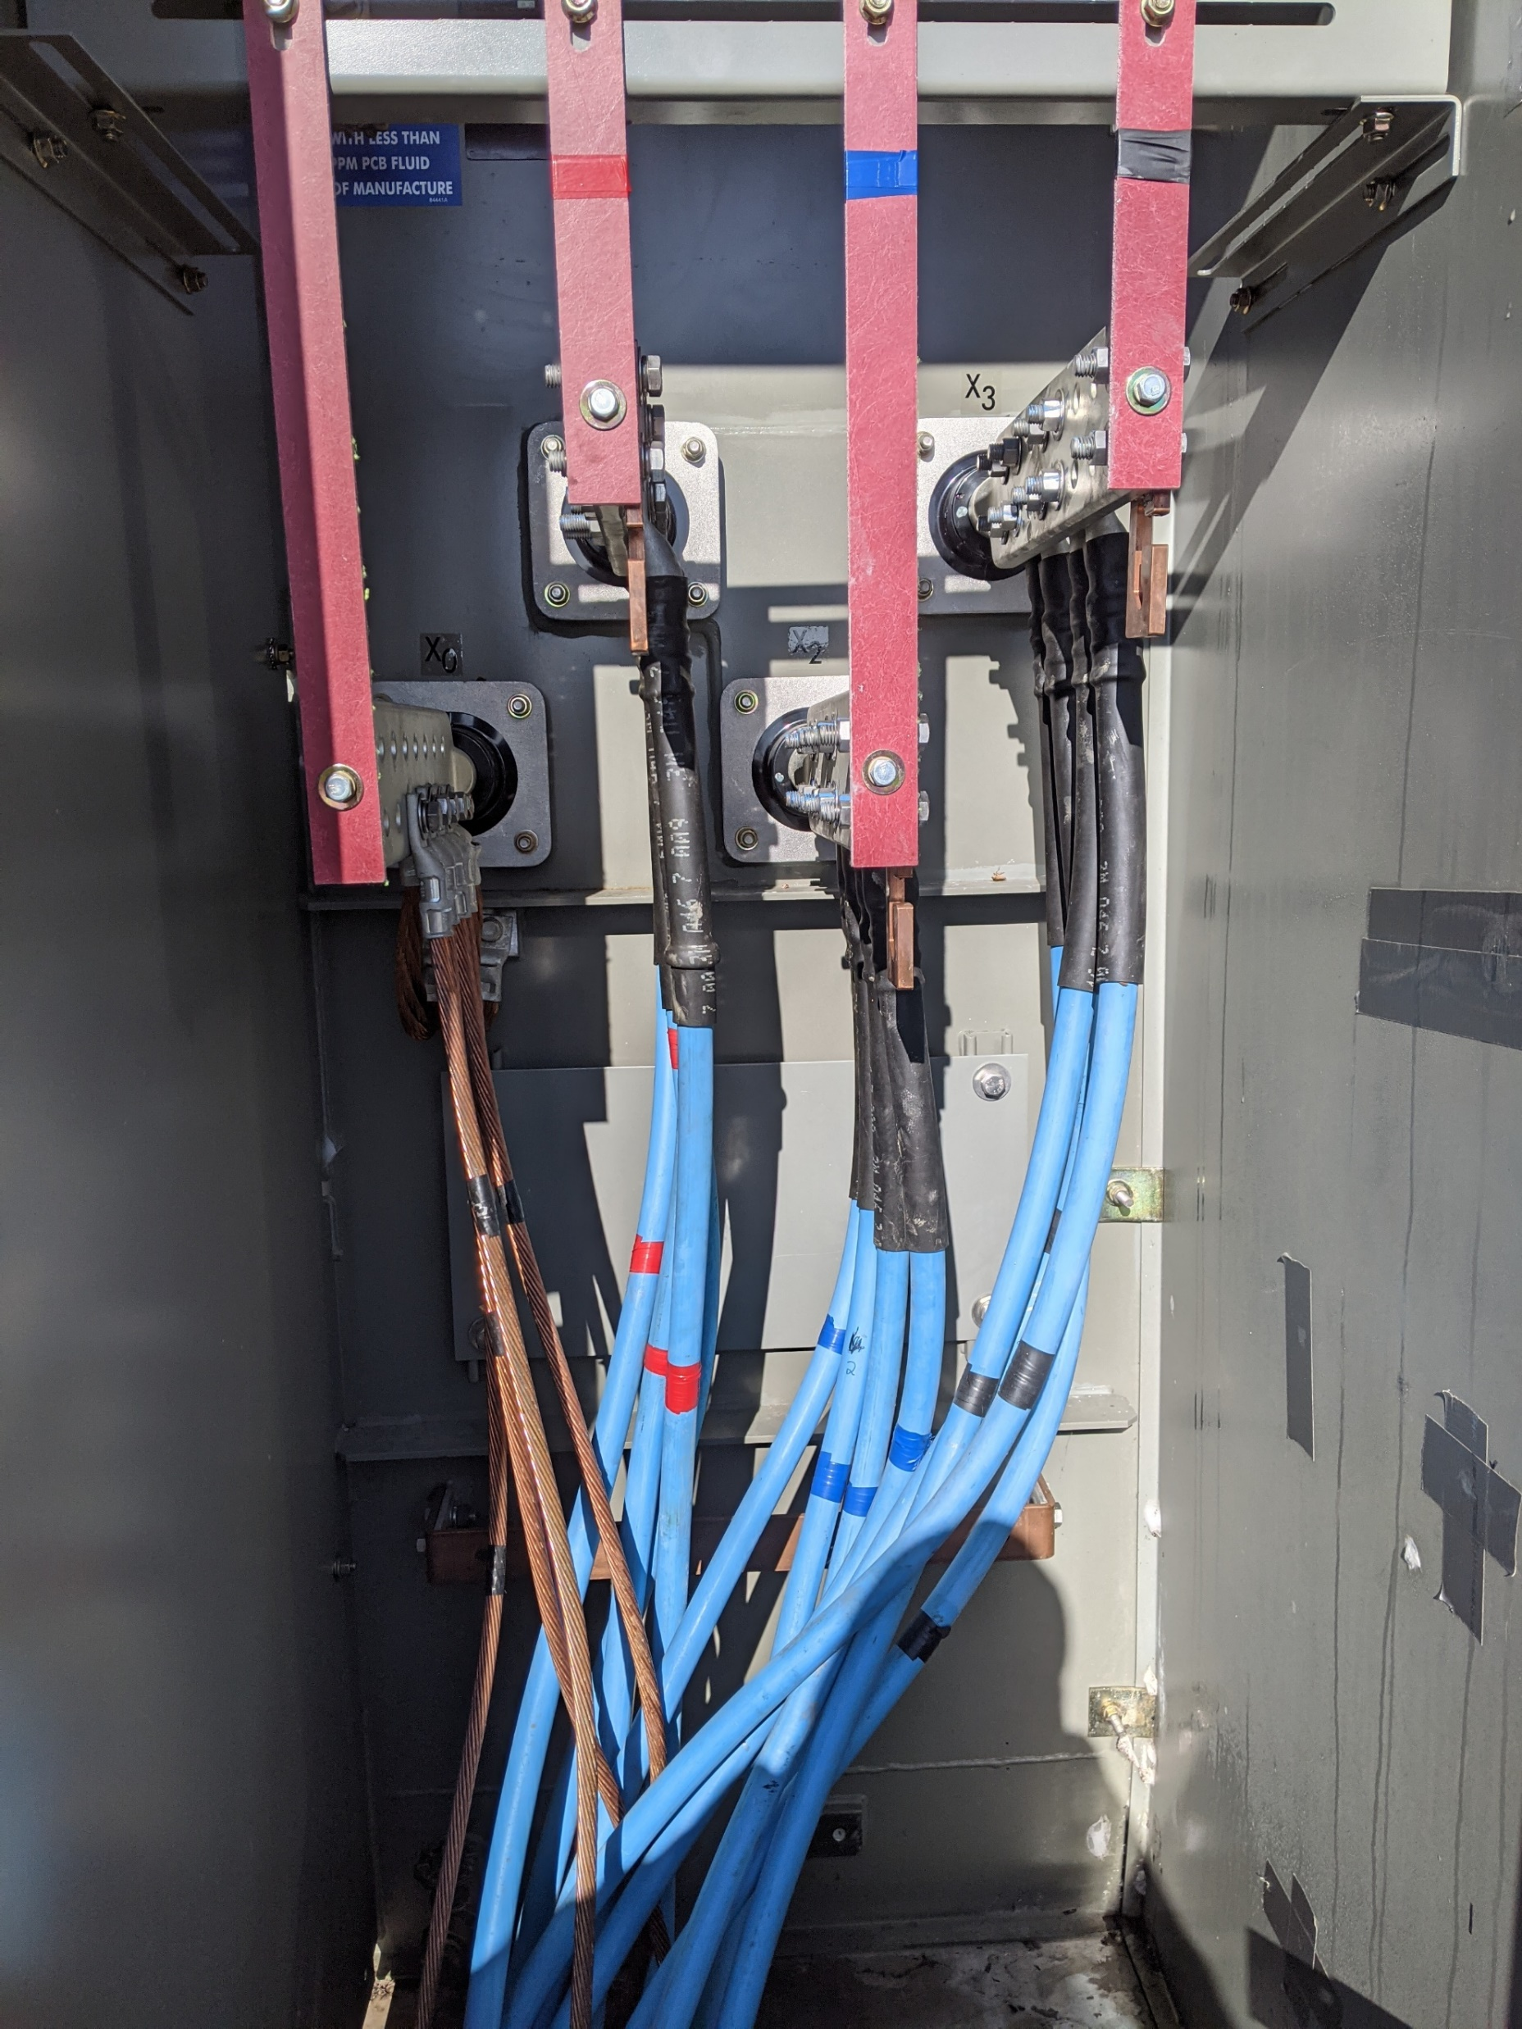

Slide 45
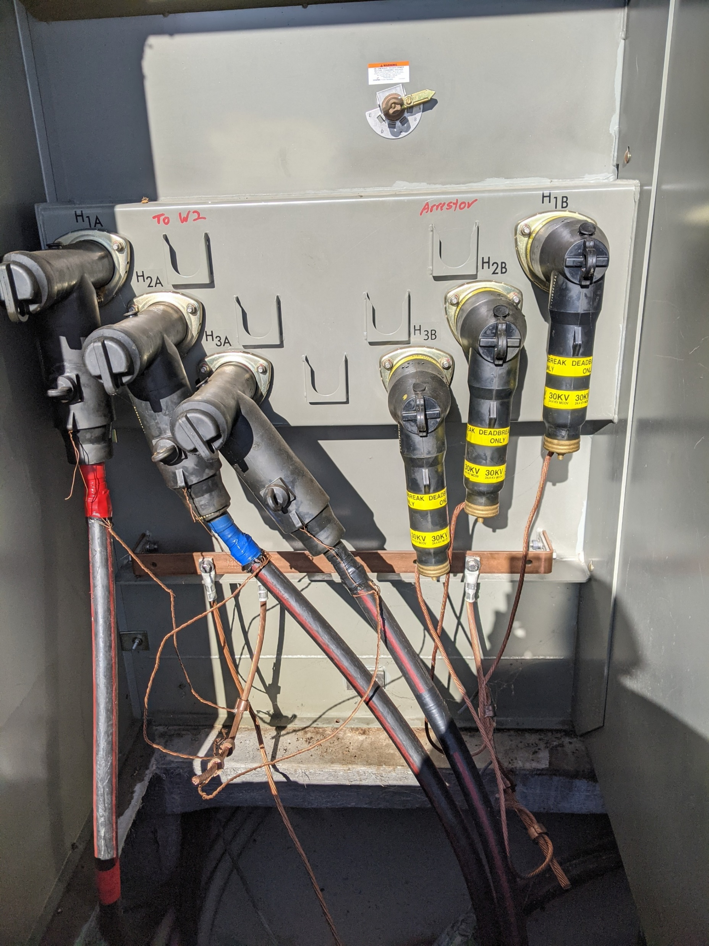

Slide 46
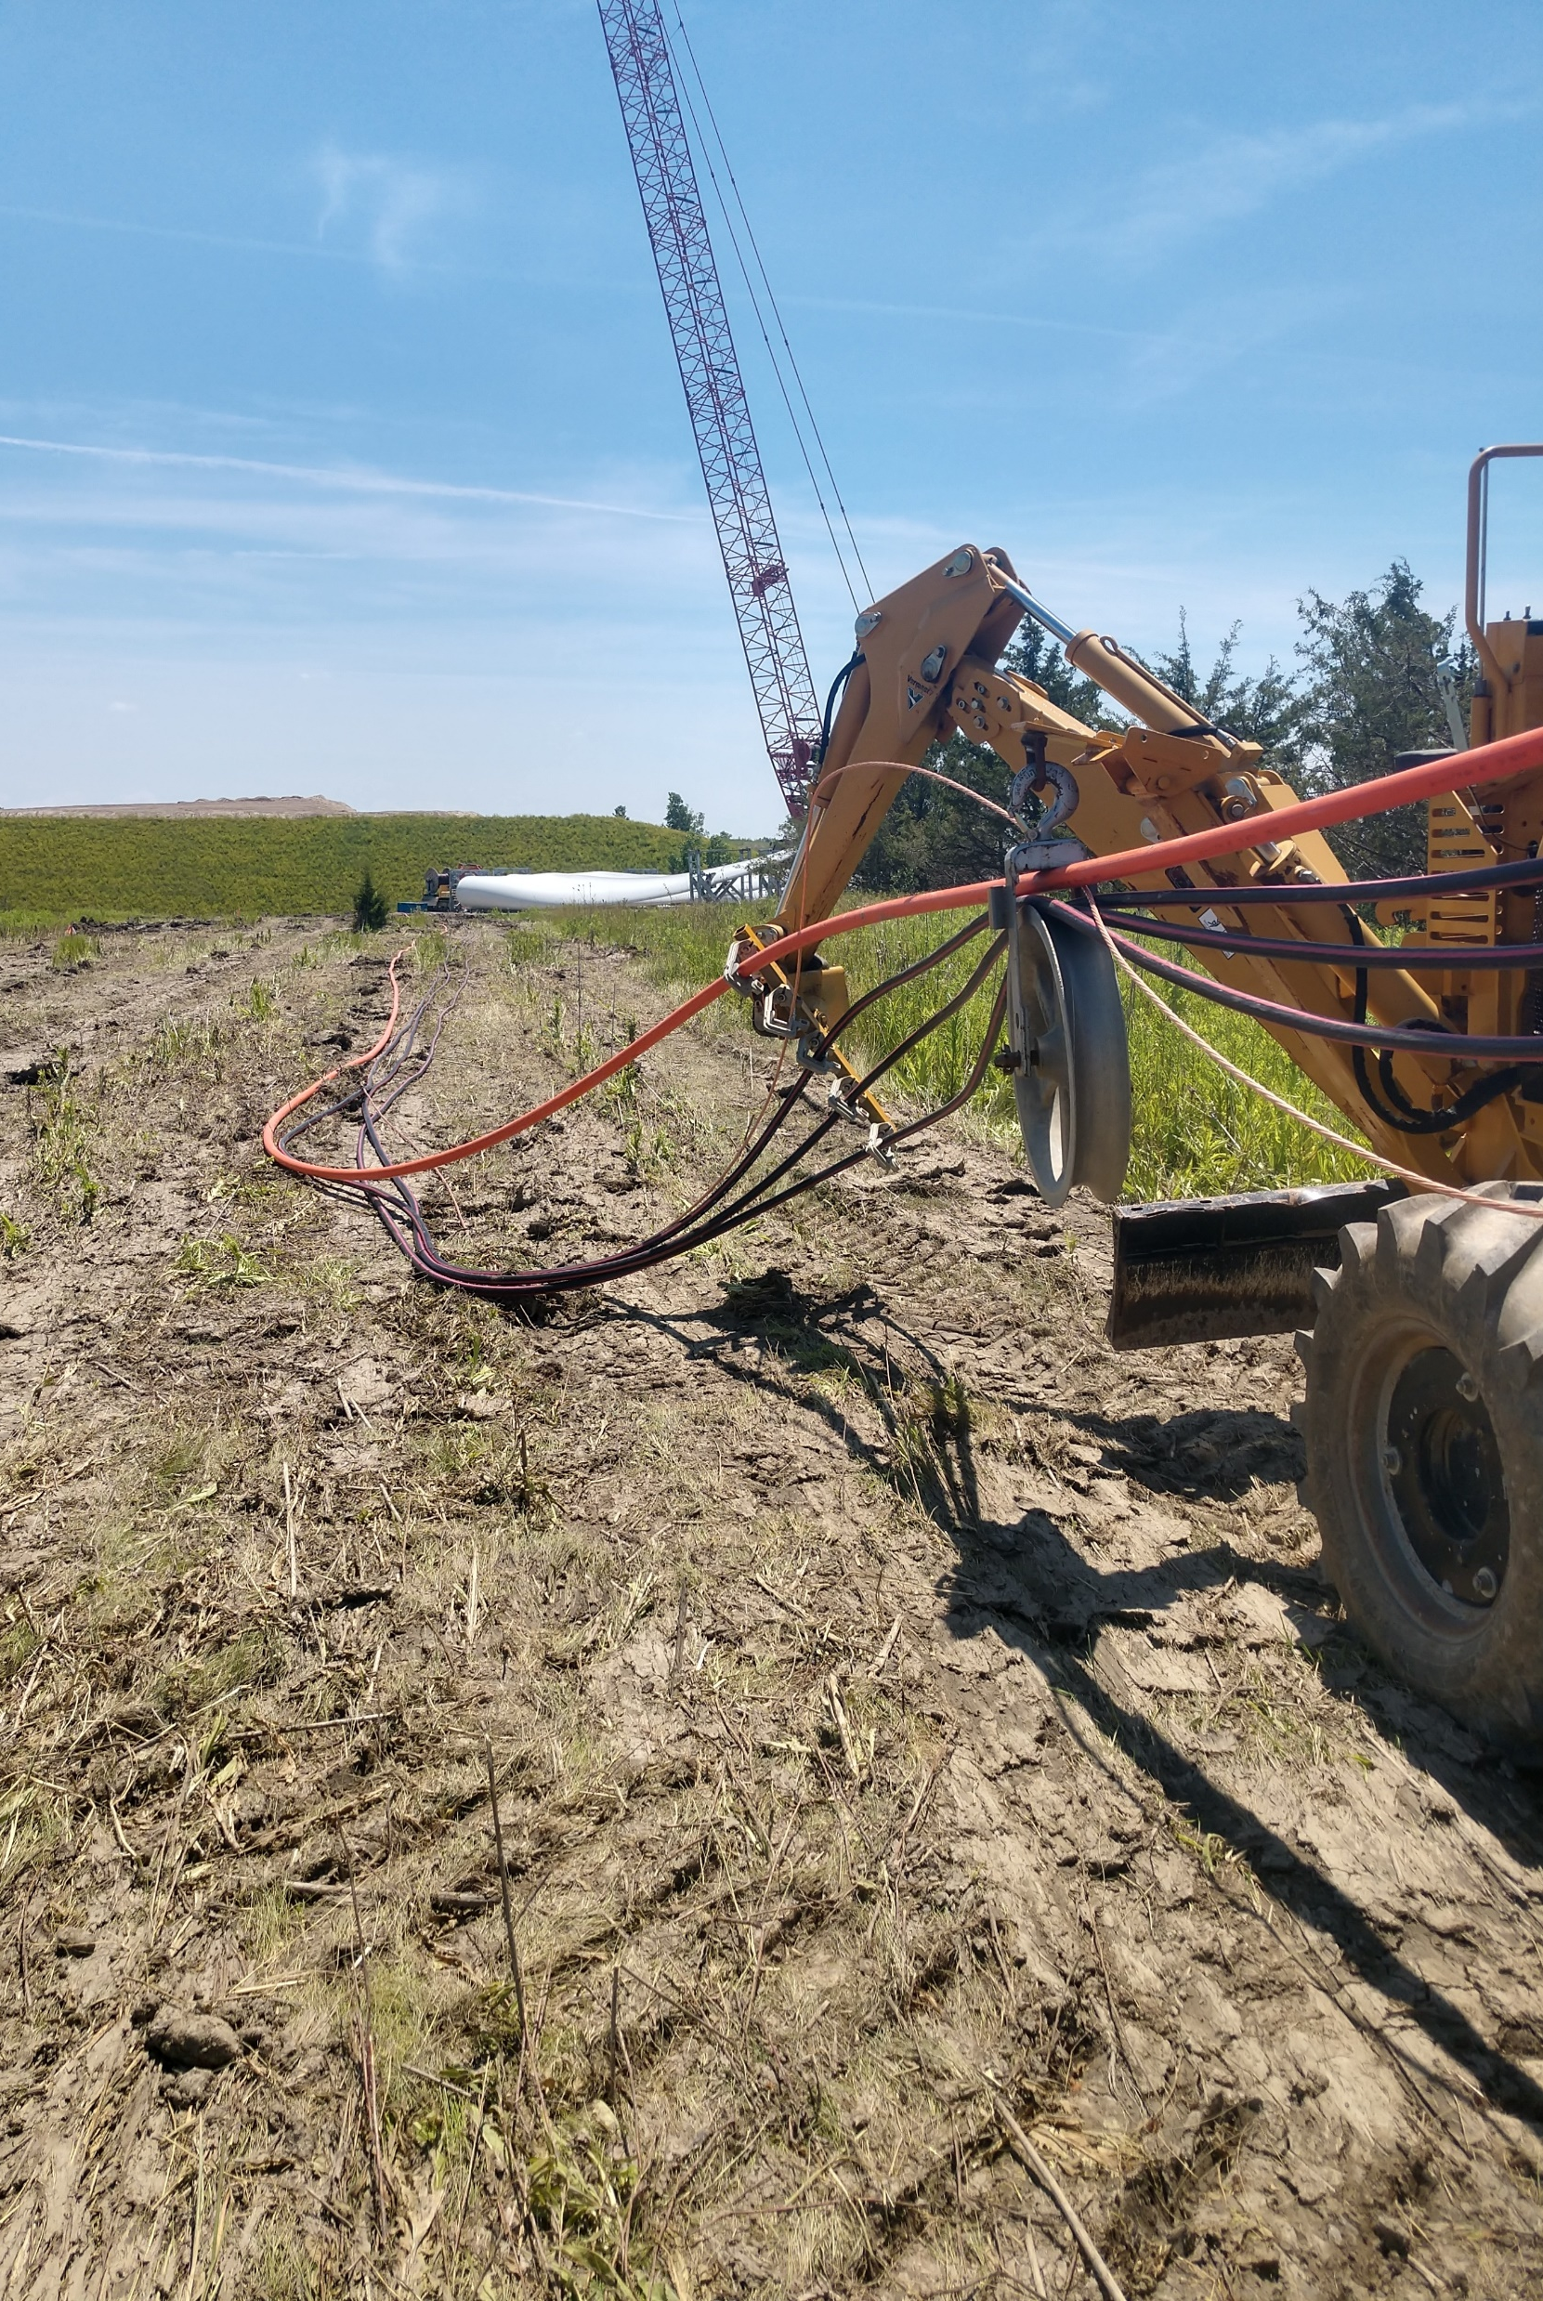
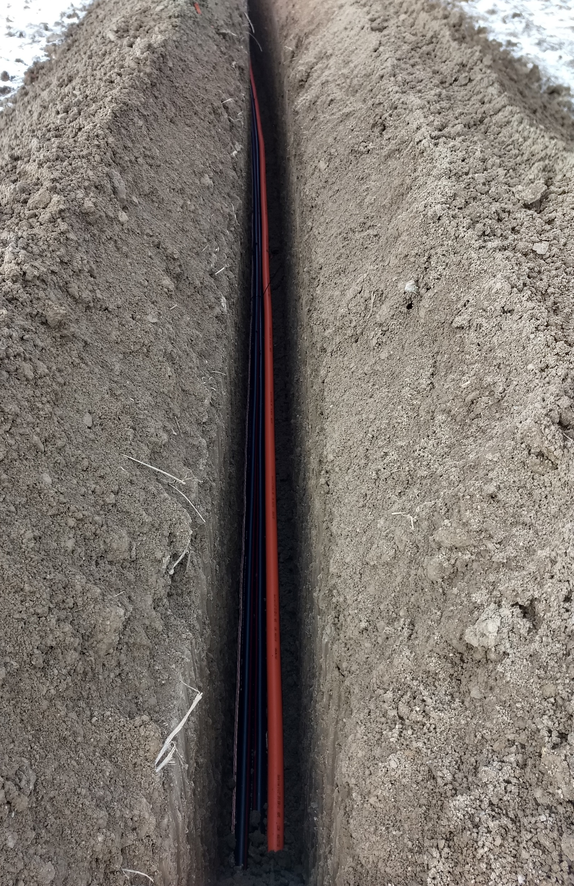

Slide 47
Outline
Alternating Current (AC)
3 Phase AC power
Transformers
One Line Diagram

Slide 48
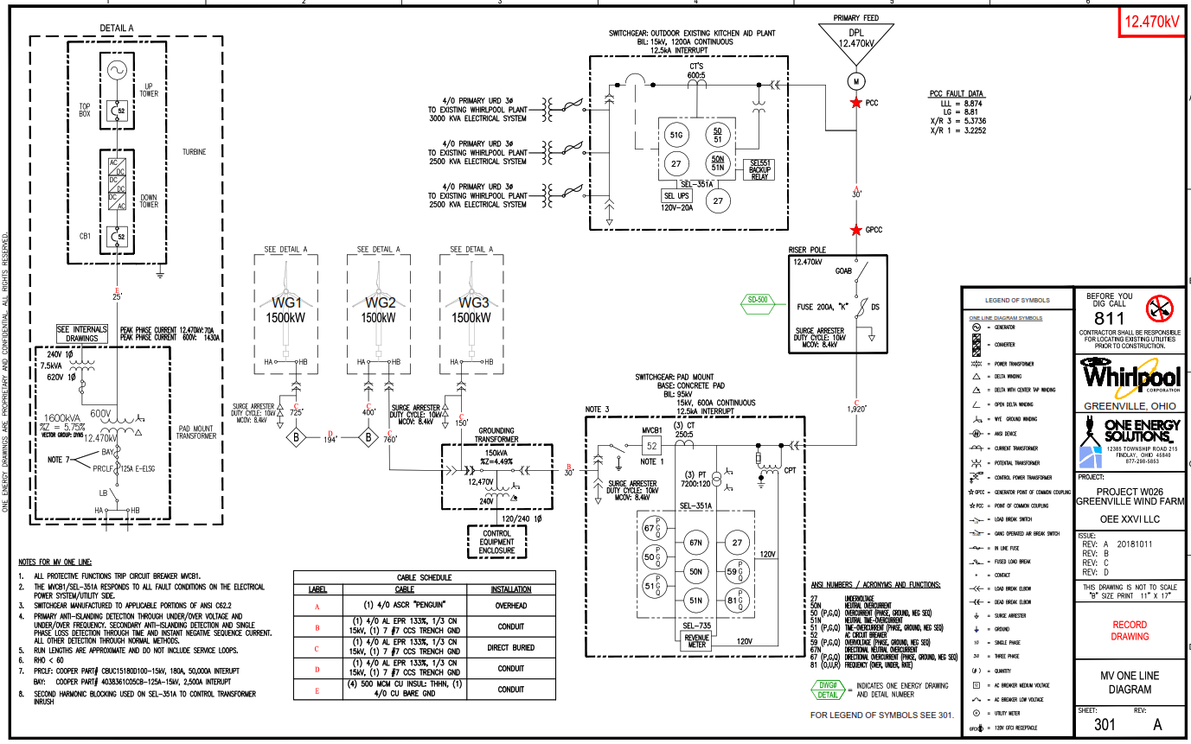
One Line Diagram
Whirlpool Greenville

Slide 49
One Line Diagram

Slide 50
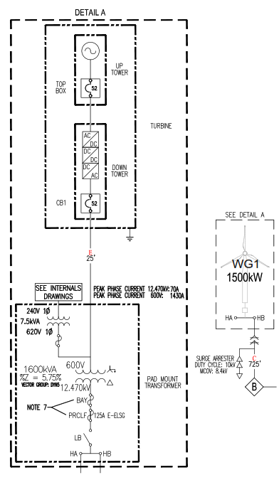
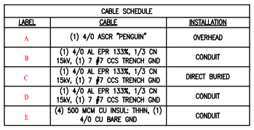
One Line Diagram
Power (per Phase)
12470kV x 70A / √3 = 500kW
600V x 1430A / √3 = 500kW
(4) 500 MCM CU
(1) 4/0 AL
Step Up Transformer:
600V to 12470V
Low = Wye (Star)
High = Delta

Slide 51
One Line Diagram
Switchgear

Slide 52
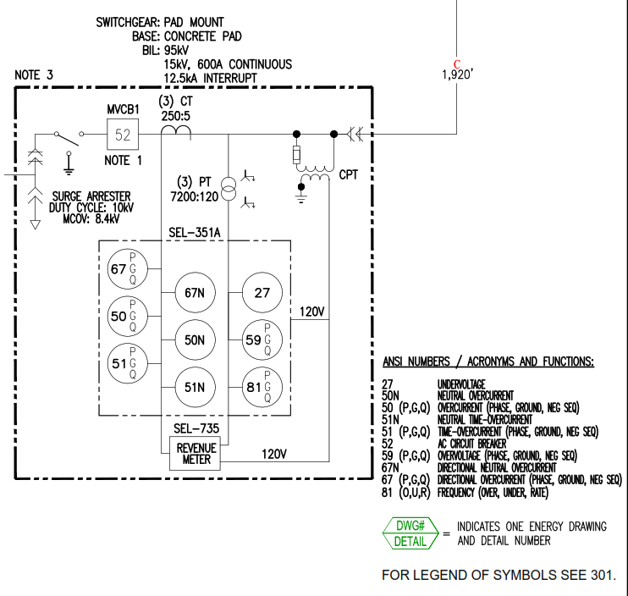
One Line Diagram
Switchgear

Slide 53
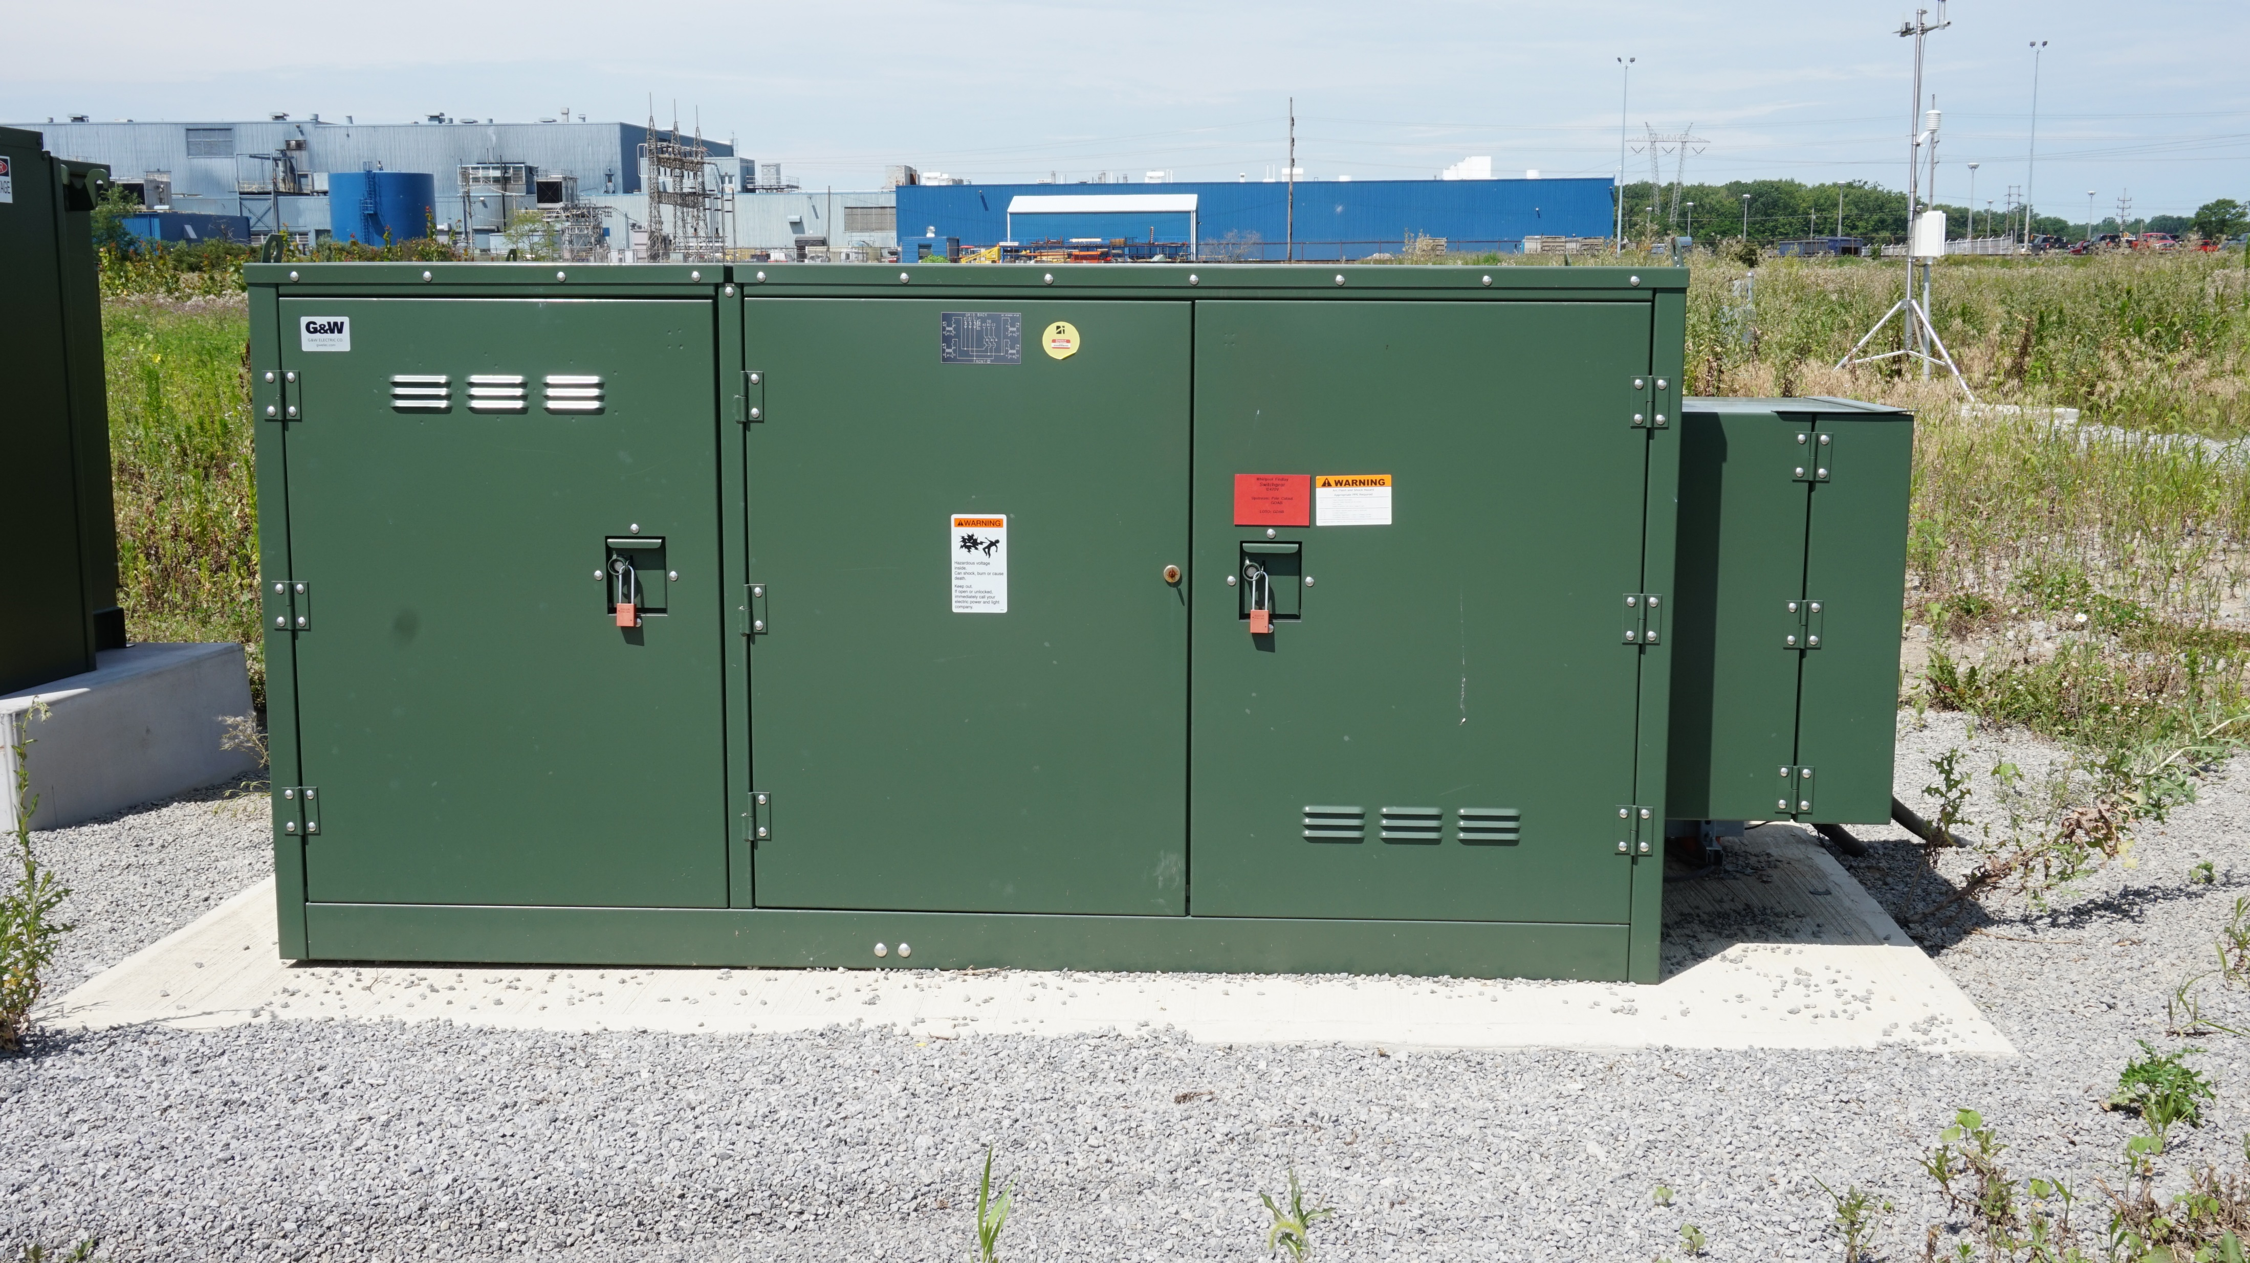
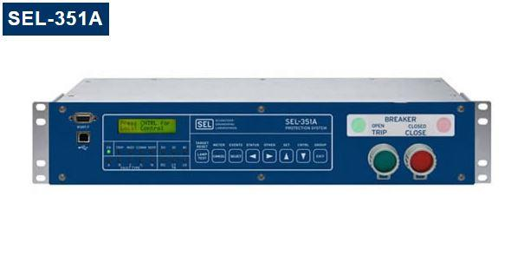
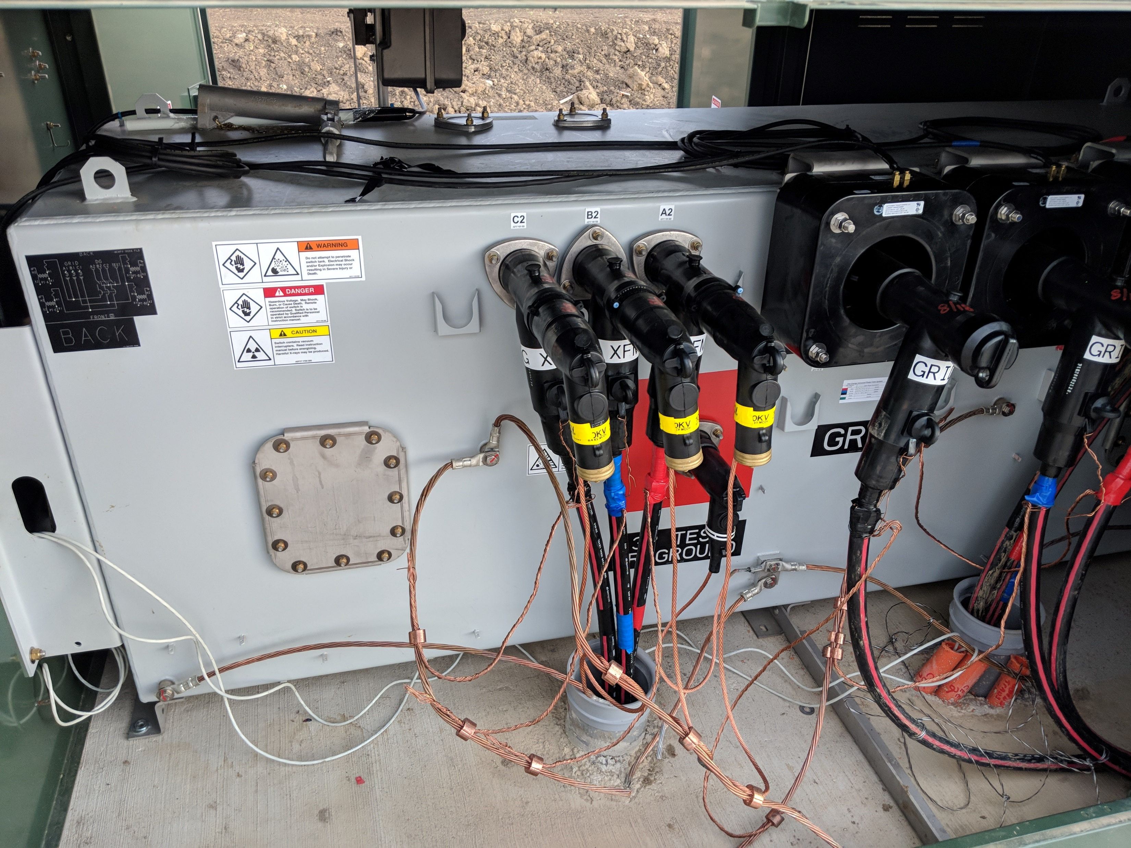
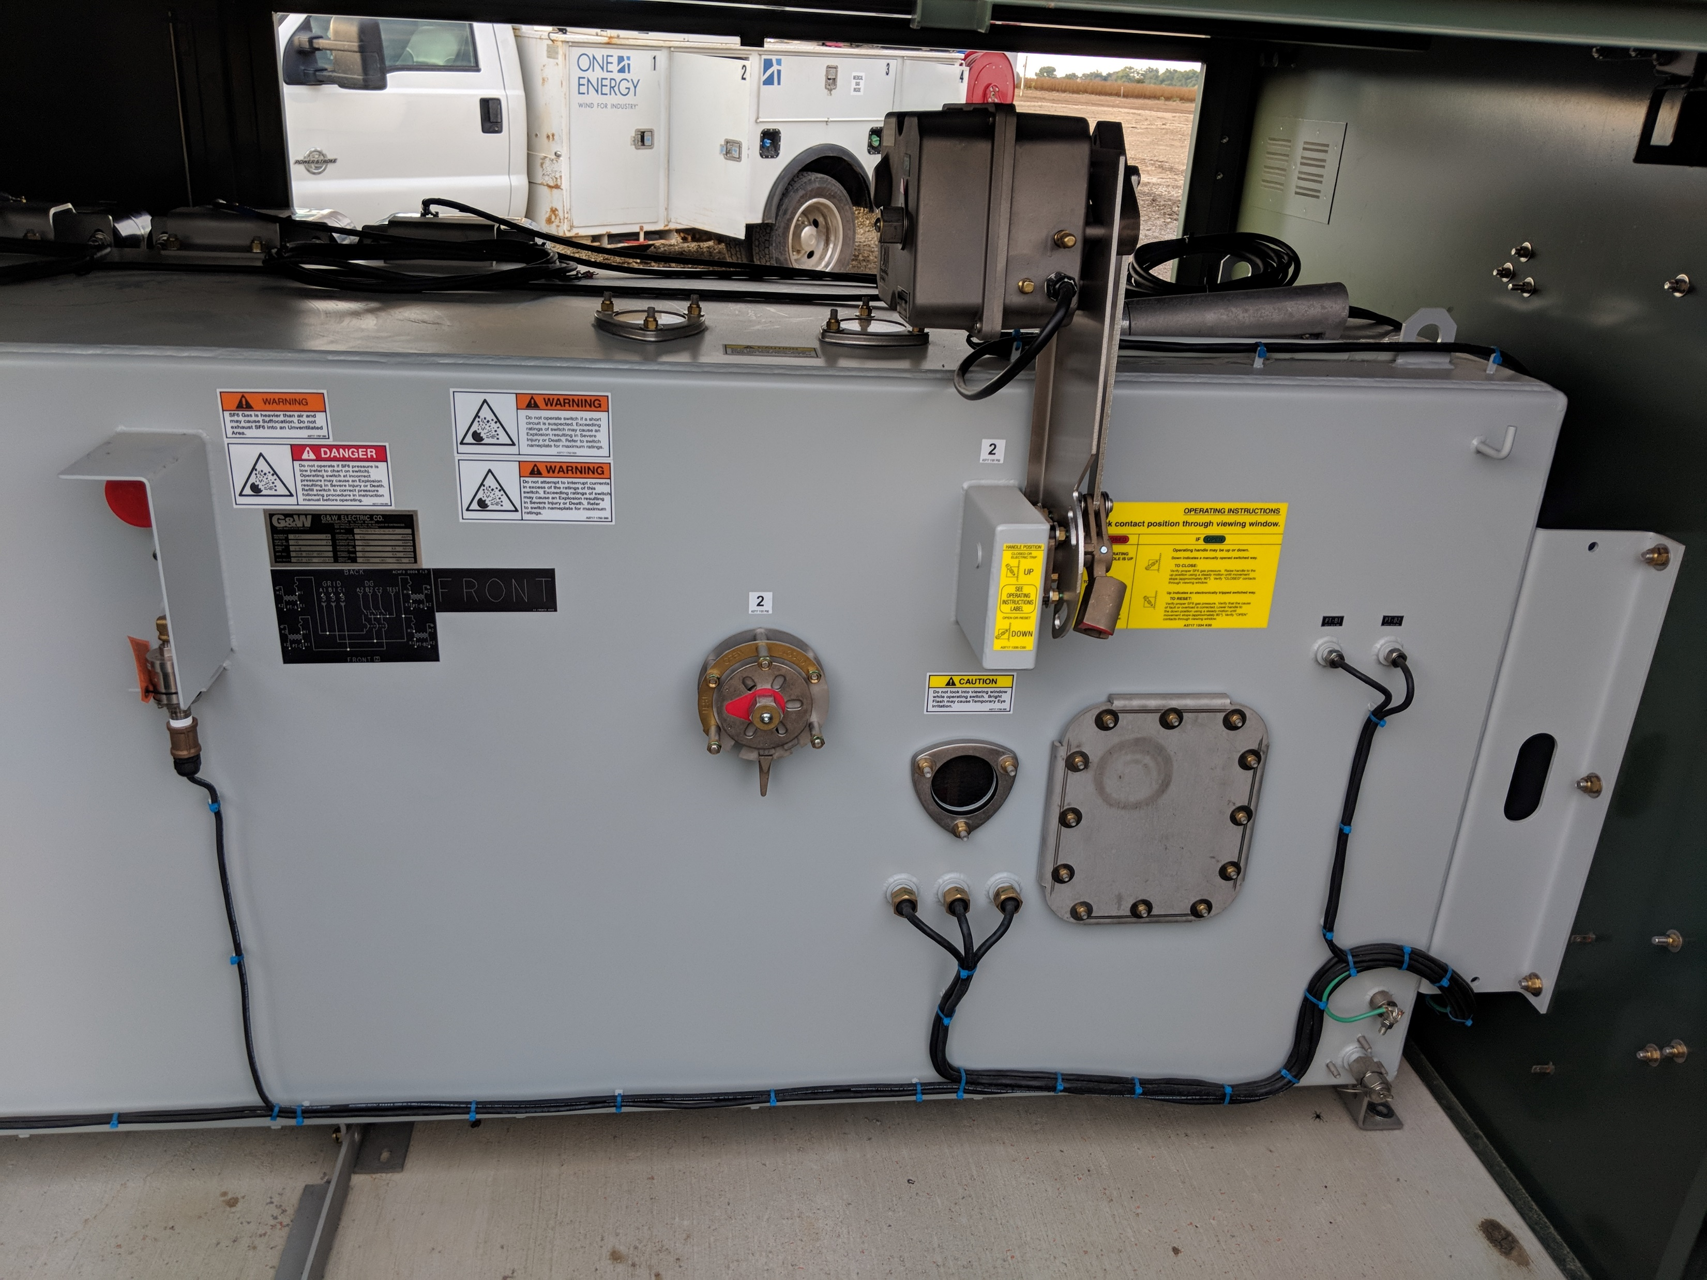
Switchgear

Slide 54
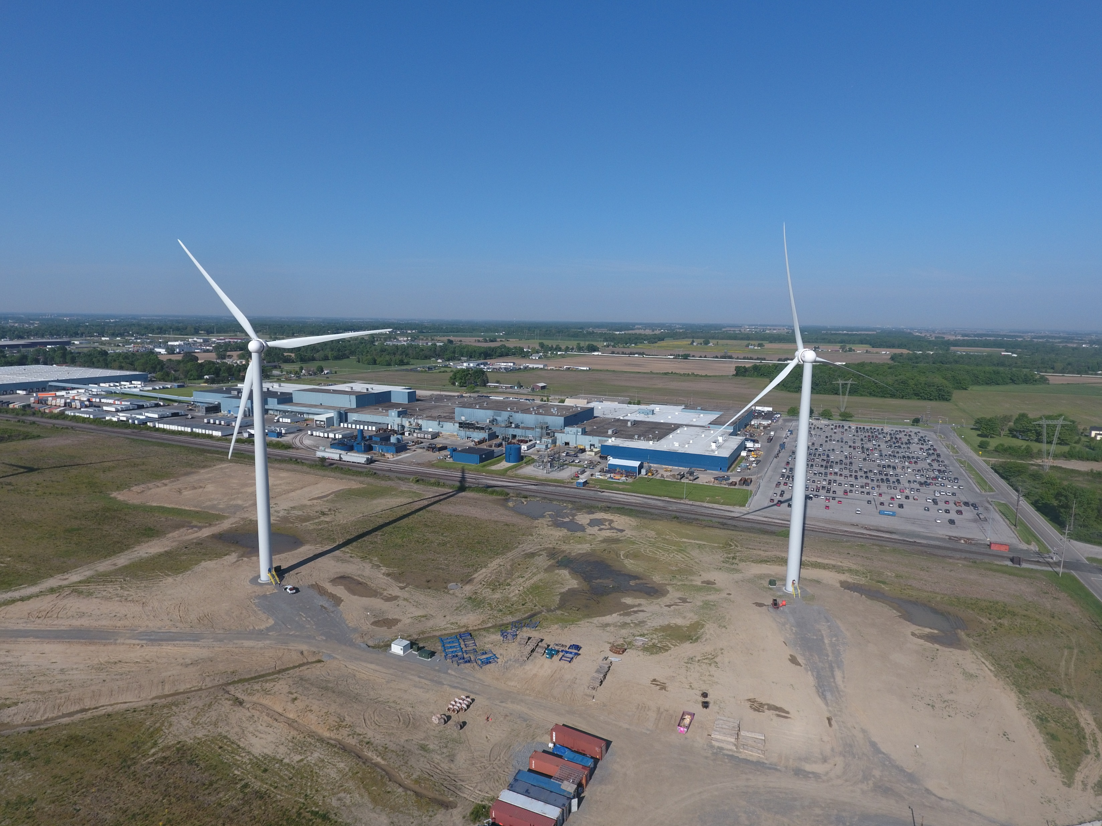
In Operation
Whirlpool Findlay
From Turbine(s)
To Plant
To Switching Station

Slide 55
Questions?

Slide 56
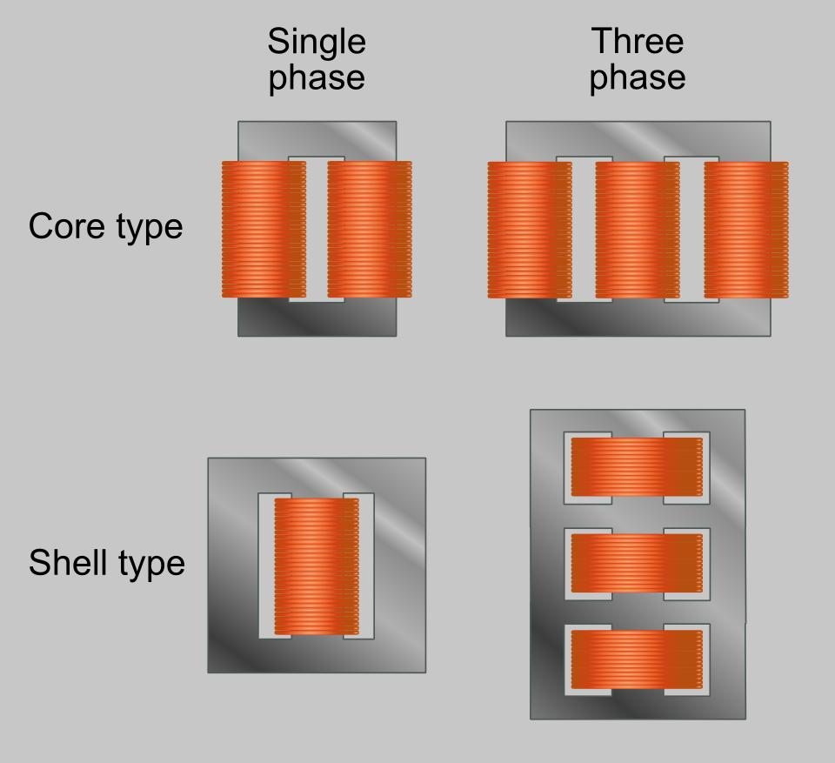
Transformers

Slide 57
