Slide 1
Weather-ops app
On-call meteorologists
June 20, 2018

Slide 2

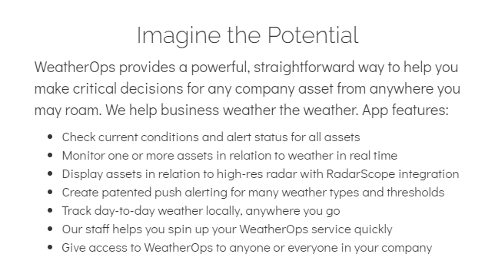
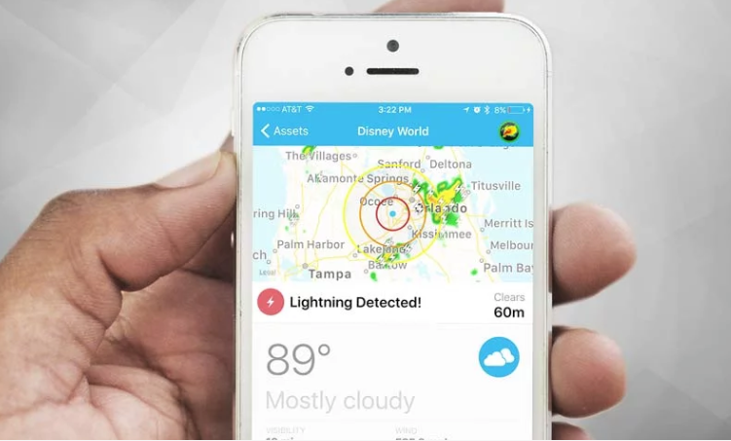

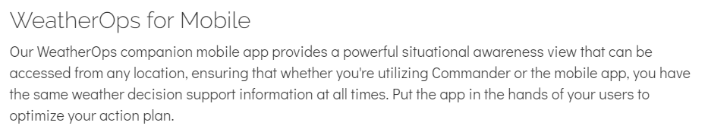
What is weatherops?

Slide 3
Why weatherops?
Safety of OE employees: alerts before a weather threat is imminent
To have one consistent data source for weather events
Allow for On-Call Mets to monitor weather at multiple locations with ease, including construction and operating projects

Slide 4
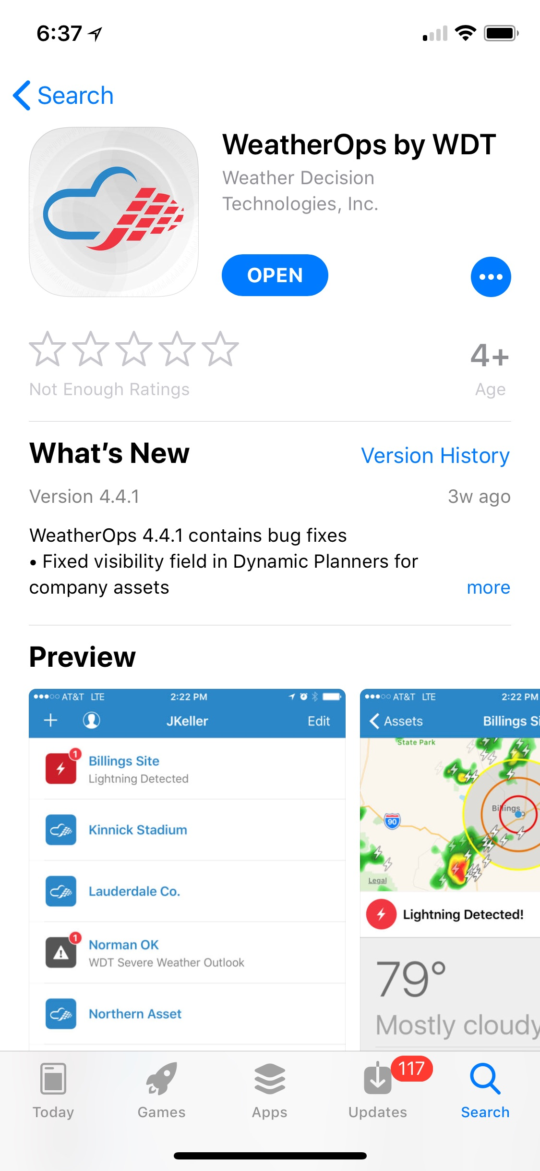
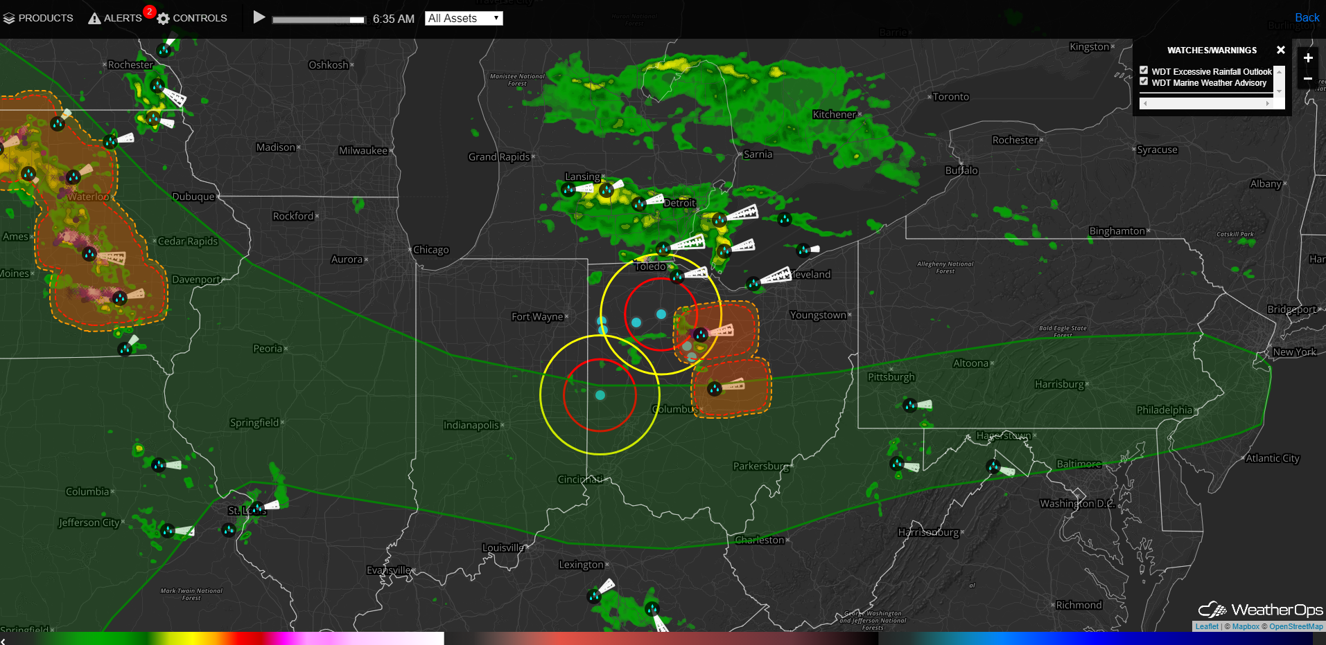
Internet Browser vs App
App: WeatherOps by WDT
https://commander/weatherops.com/login
Use for alerts and forecasts
Setting up your own locations
Radar
This introduction will focus on the App.
Use to change account information.
The online browser has a better radar for display purposes (SCADA Wall).

Slide 5
Assets vs Locations
ASSET
LOCATION
Managed by User
Any location; can be set for current location (using phone’s GPS)
Can set different alerts for Locations
User has ability to turn on/off various types of alerts
Up to 10 locations per user
Managed by OE
OE Projects:
  Construction Assets and Operating Assets
Not adjustable in terms of alert settings

Slide 6
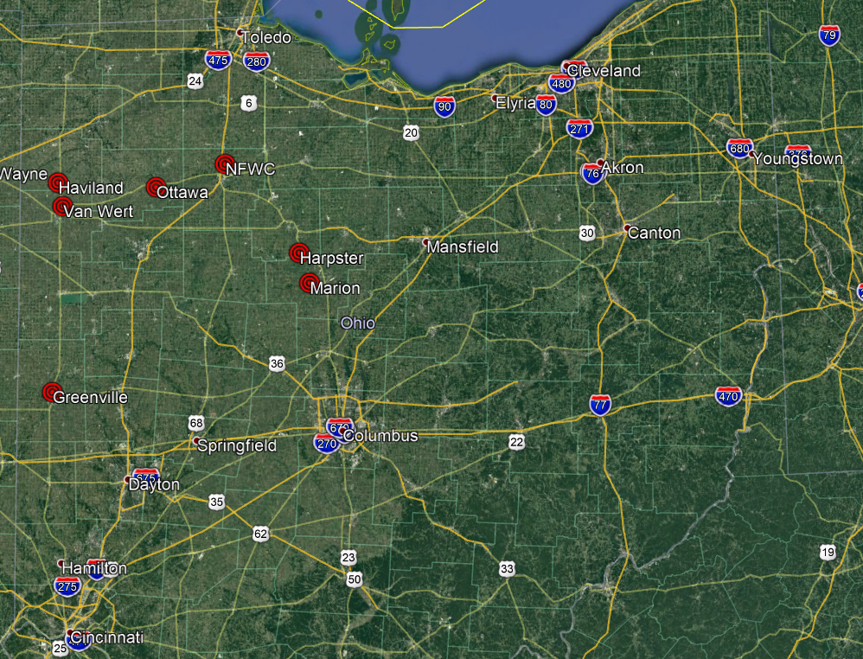
Assets

Slide 7
Assets
Construction Assets
Operating Assets
Greenville
NFWC
Harpster
Haviland
Marion
Ottawa
Van Wert
Additional Assets will be added if they are not near one of our current assets. If a new project in construction is located near an Operating Asset, then that operating asset will move temporarily to a Construction Asset.

Slide 8

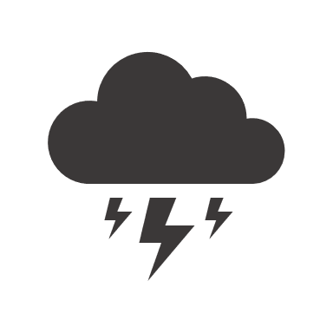




Construction Asset Alerts
Lightning | < 50 Miles | Severe Storms | Severe Thunderstorm Watch/Warning
 | <30 Miles |  | Tornado Watch/Warning
 | All Clear |  | Severe Weather Statement
Wind | High Wind Advisory |  | WDT Severe Weather Outlook*
 | High Wind Watch/Warning |  | *Severe Weather Outlook alerts if severe weather is forecasted or expected in the next couple days
Flood | Flash Flood Watch/Warning
 | Flood Watch/Warning
Heat | Heat Advisory
Winter | Snow Advisory
 | Heavy Snow Warning
 | Ice Storm/Accretion Warning/Watch
For Construction Assets we have more alerts for the safety of our employees working on-site.

Slide 9
Operating Asset Alerts
Wind | High Wind Advisory | Severe Storms | Severe Thunderstorm Watch/Warning
 | High Wind Watch/Warning |  | Tornado Watch/Warning
Winter | Ice Storm/Accretion Warning/Watch |  | Severe Weather Statement
For Operating Assets we have alerts to help us determine when we may need to shut the turbines down during high wind, severe weather, and icing events

Slide 10
How to get alerts
Email
SMS Text Message
Push Notifications
Default is only push notifications for the assets you chose to add to your phone.
If you want email or SMS alerts instead of or in addition to push notifications, please contact an On-Call Met.

Slide 11
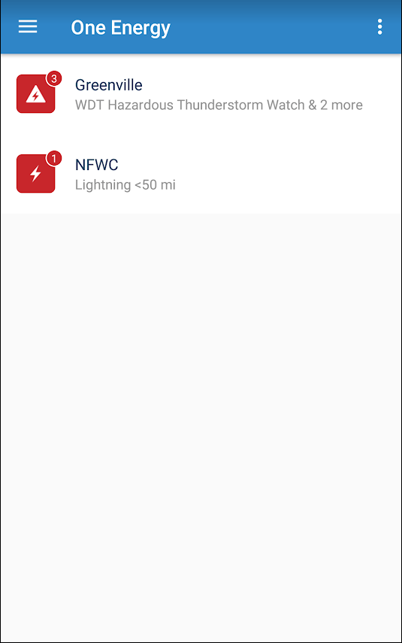
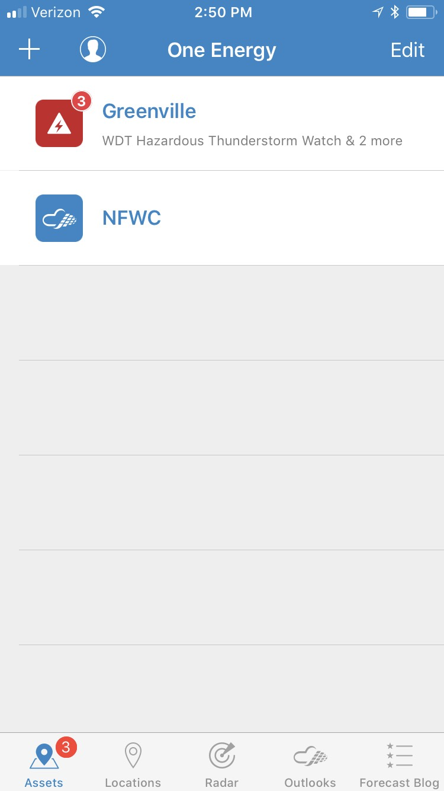
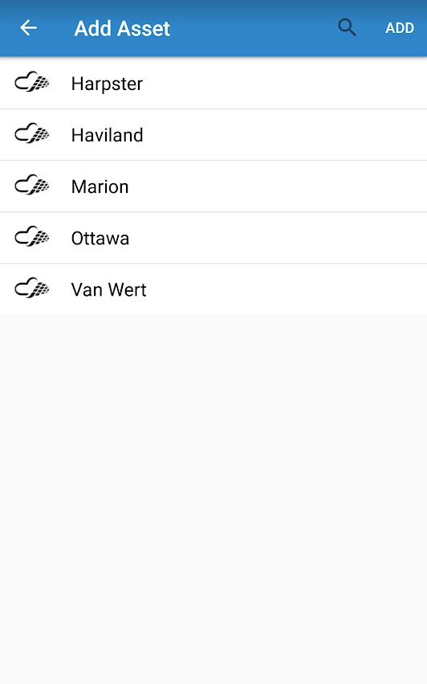
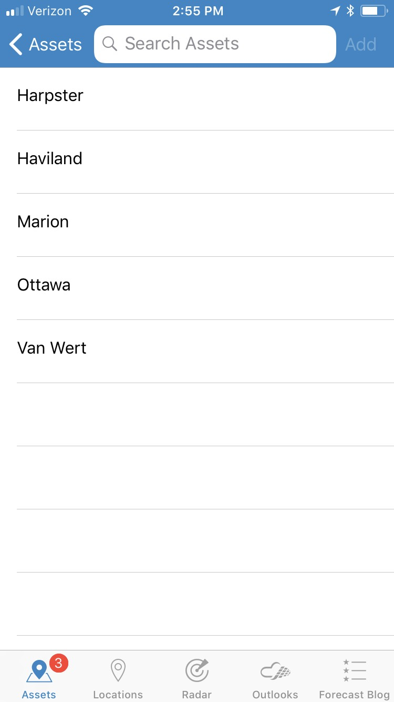
USING THE APP
Step 1: Adding Assets
Android
iPhone

Slide 12
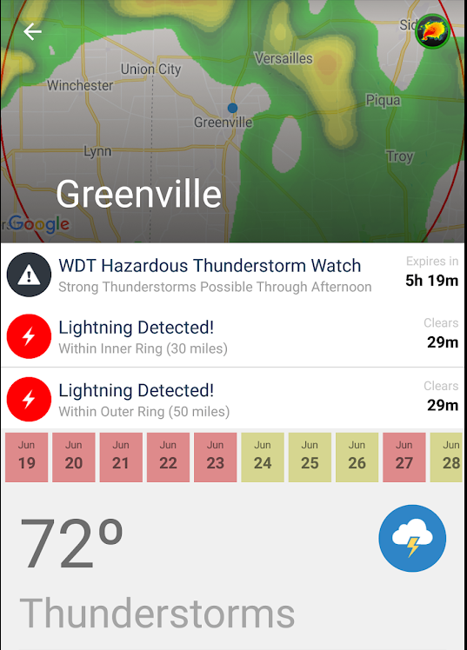
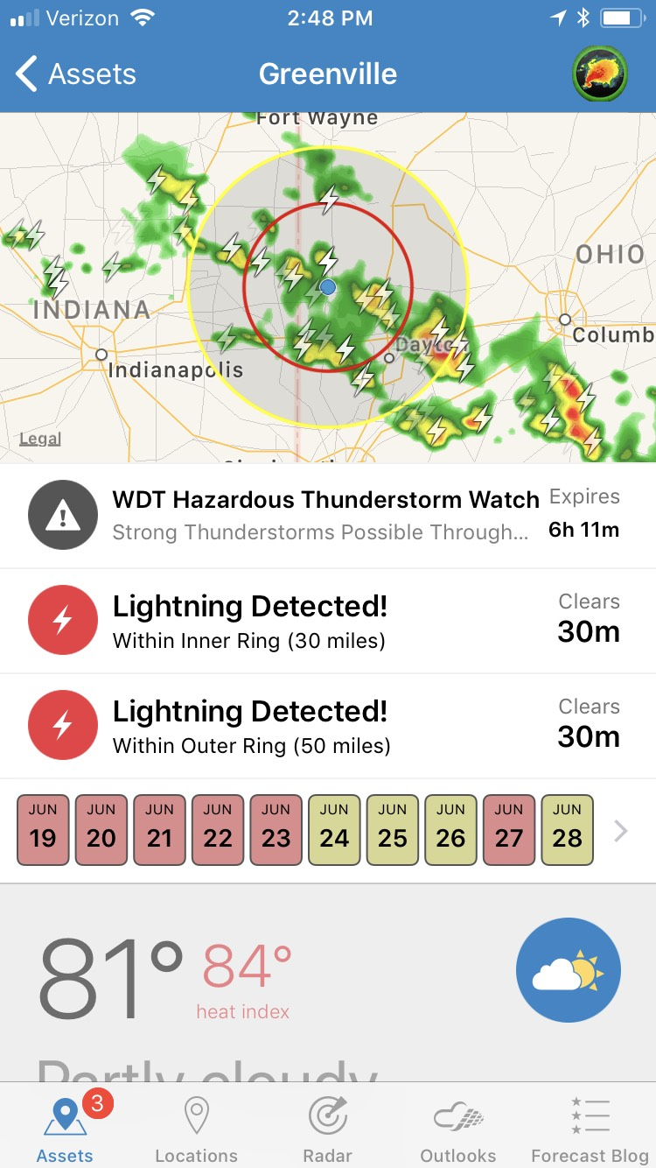
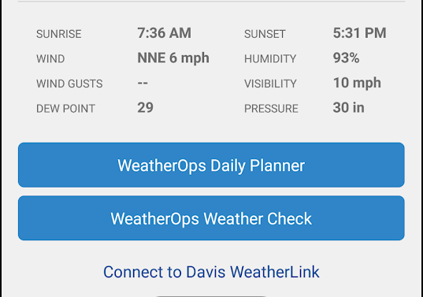
USING THE APP
Asset Tab
Android
iPhone

Slide 13
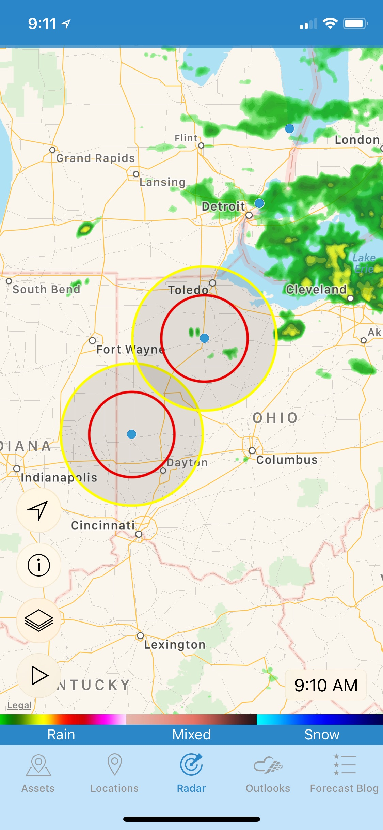
Using the App
Asset Tab & Radar
Radar
KEY
Click the radar on the Asset tab or select the “Radar” tab.
50 Miles
30 Miles
Asset
Track your location
Add layers
Play radar loop

Slide 14
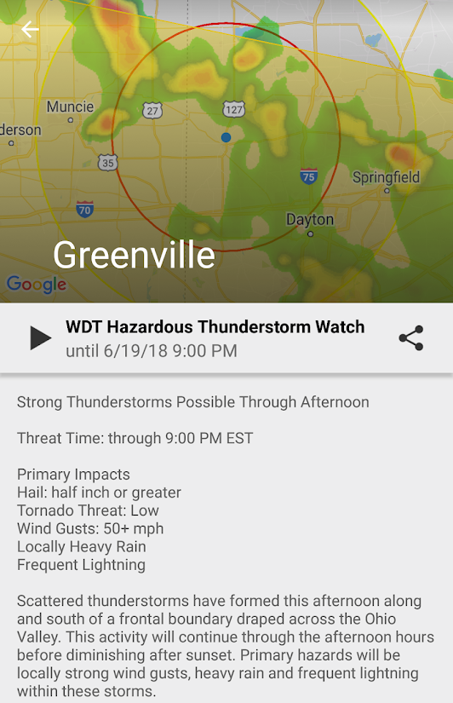
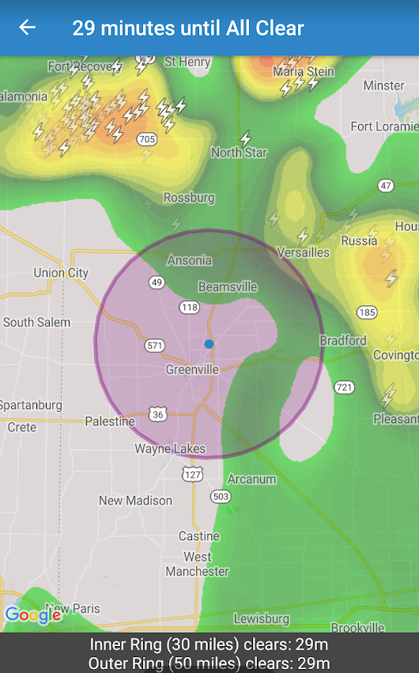
USING THE APP
Asset Tab
Current Warnings at an Asset

Slide 15
Using The App
Asset Tab
Current Conditions

Slide 16
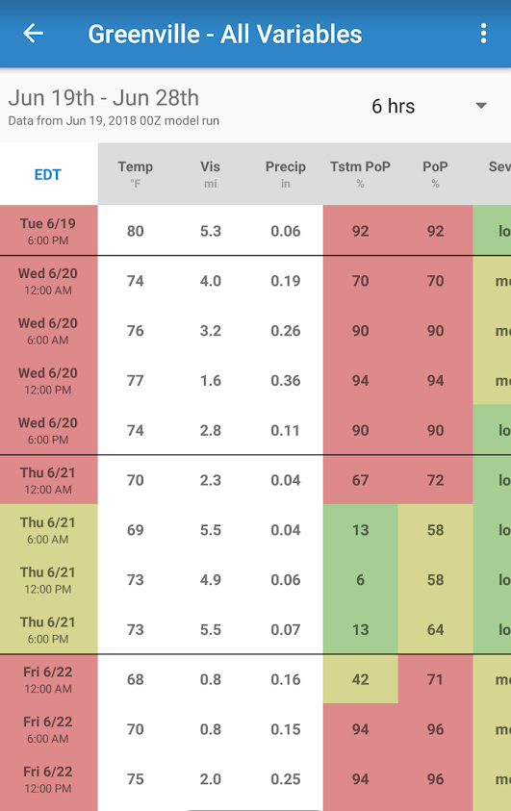
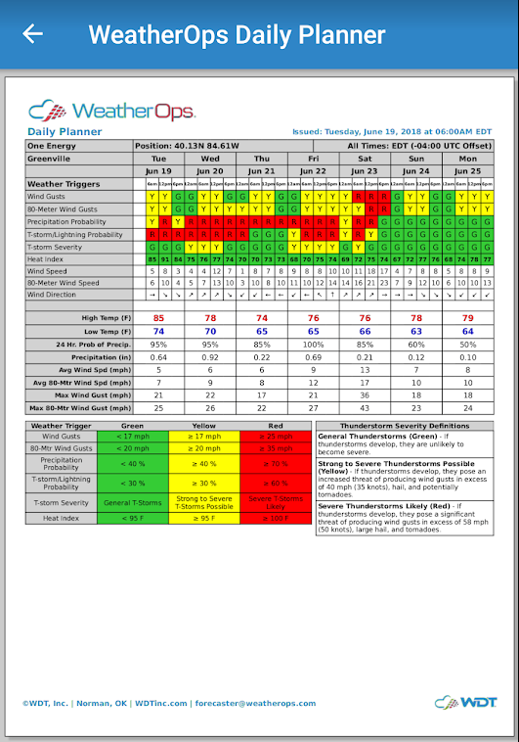
Using the App
Asset Tab
Daily Forecast
Colors are based on predetermined thresholds.
Green = OK
Yellow = Marginal
Red = Poor

Slide 17
Daily Planner
Asset location forecasts in 6 hr intervals for 7 days
Released every morning at 6 AM
Top portion indicates weather triggers for various events
  Good indicator of probability for storm development for next week
Lower portion is wind speed, temperature, 6 hr probability of precip, and accumulated precip for the forecast period
Mainly used for a general daily forecast; overall ‘big picture’ indicator

Slide 18
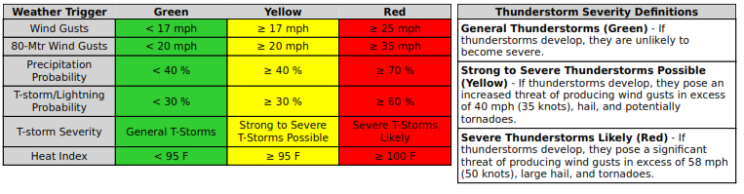
Daily Planner
Color Key
Predetermined thresholds set for each Asset
The Daily Planner is only available for Construction Assets.

Slide 19
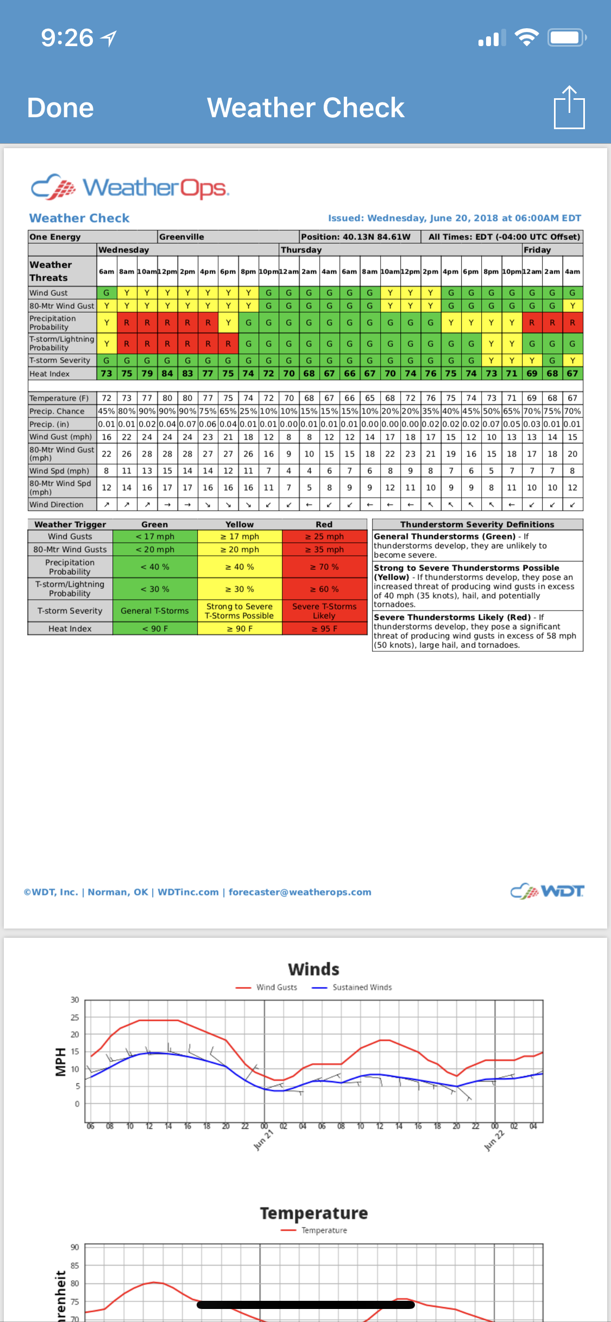
Weather Check
Asset location forecasts in 2 hr intervals for 3 days
Released twice per day: 6AM and Noon but updated every 2 hours
Top portion indicates weather triggers for various events
  Better indicator of timing for weather events
  Same trigger criteria as Daily Planner, just a finer temporal resolution
Lower portion is wind speed, temperature, 2 hr probability of precip, and accumulated precip for the forecast period
Graphs on second page show wind, temperature, and precipitation potential forecasts
Mainly used for real-time forecasting and timing of when storms may develop to allow for ample notice

Slide 20
Weather Check
Color Key
Predetermined thresholds set for each Asset
Weather Check is only available for Construction Assets.

Slide 21
How to use weatherOps
Locations

Slide 22
Locations
Users can add up to 10 personal locations in the app (this does not count Assets)
Location Alerts are personalized by user
All Push Notifications
On-Call Mets recommends a minimum of NWS watches/warnings for severe thunderstorms and tornadoes

Slide 23
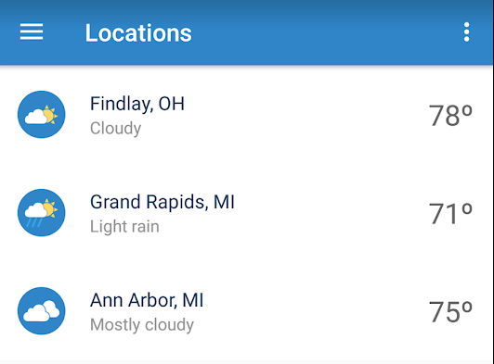
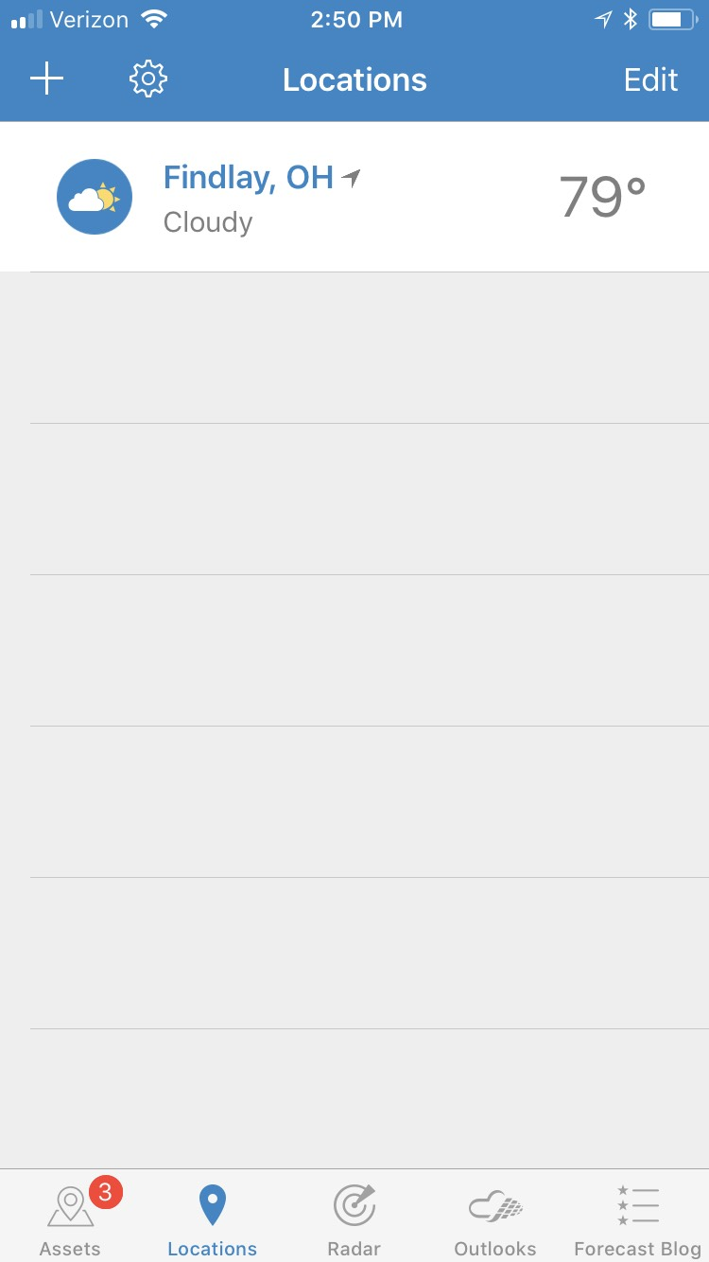
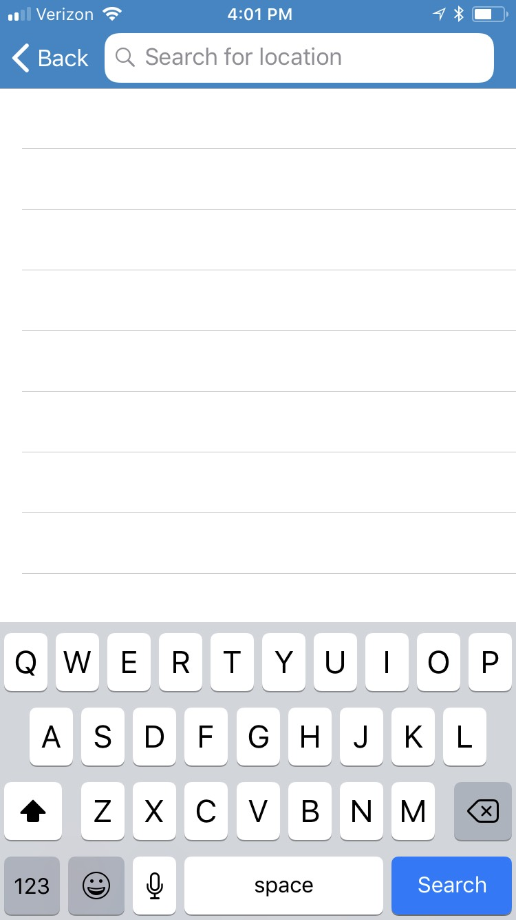
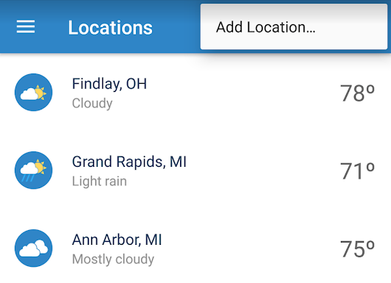
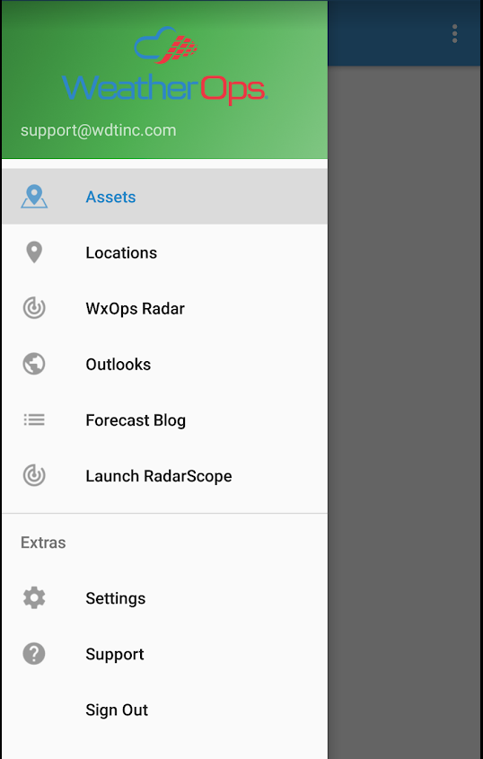
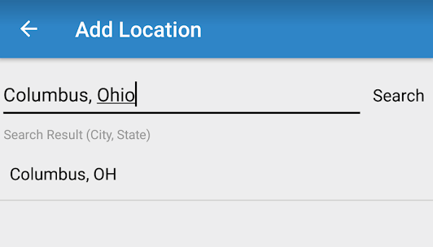
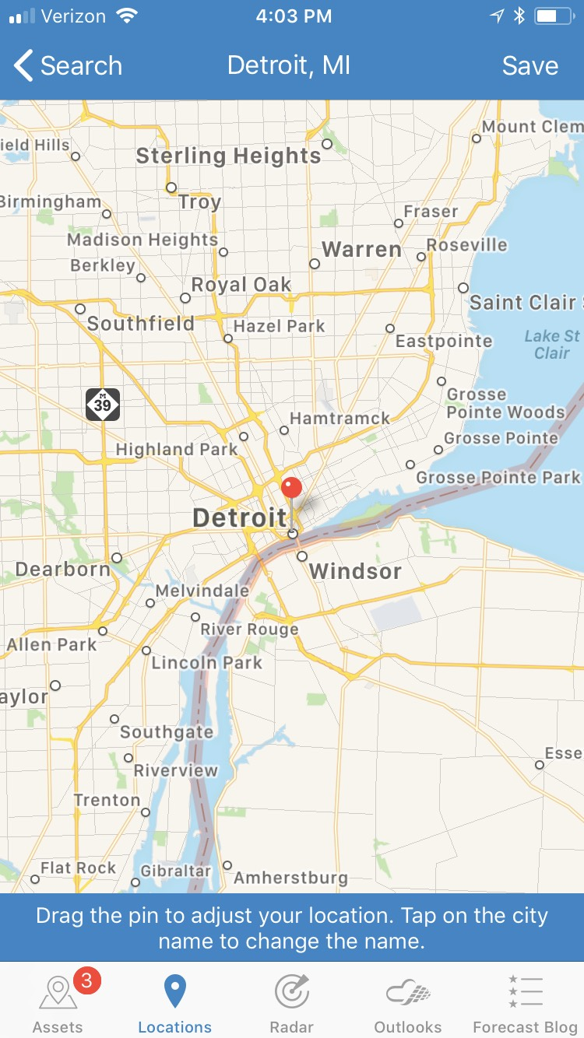
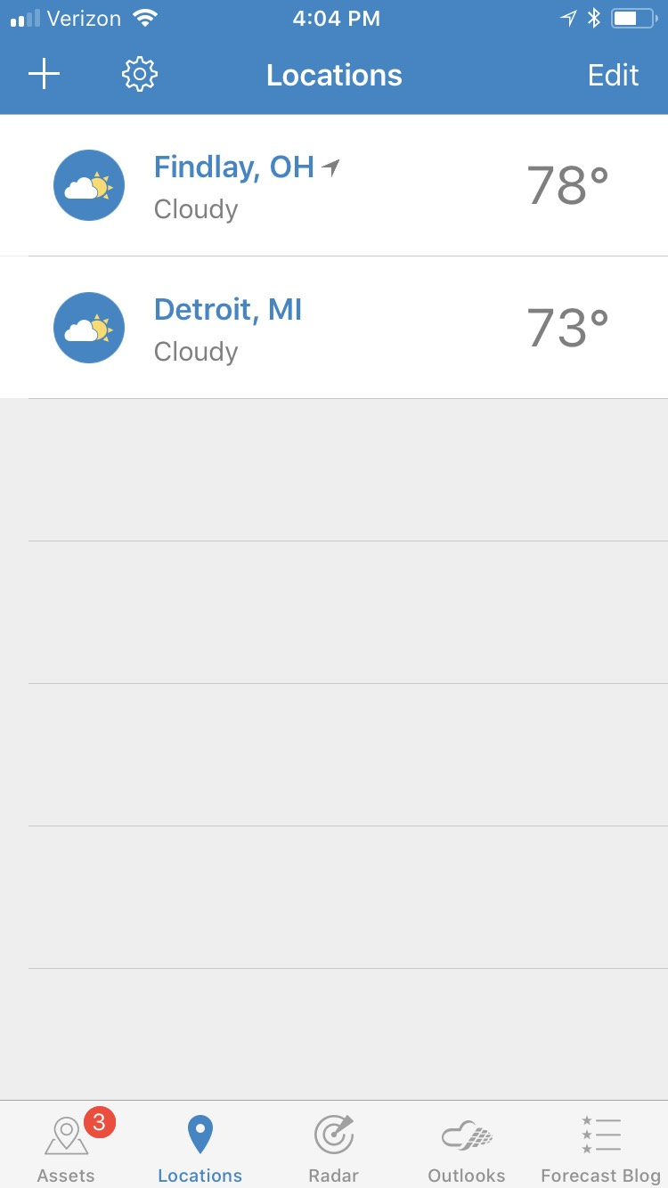
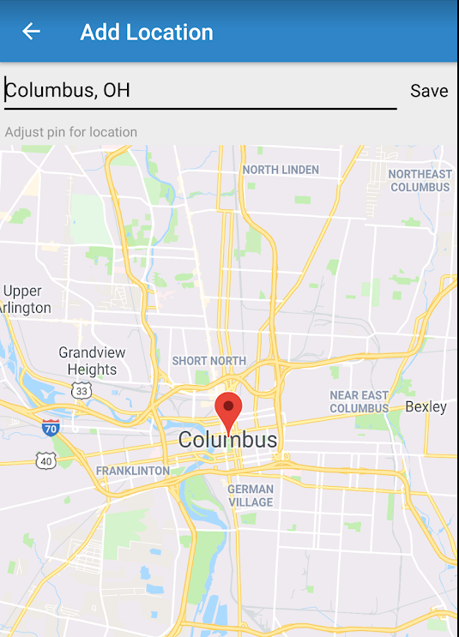
Locations
Adding Locations
Android
iPhone

Slide 24
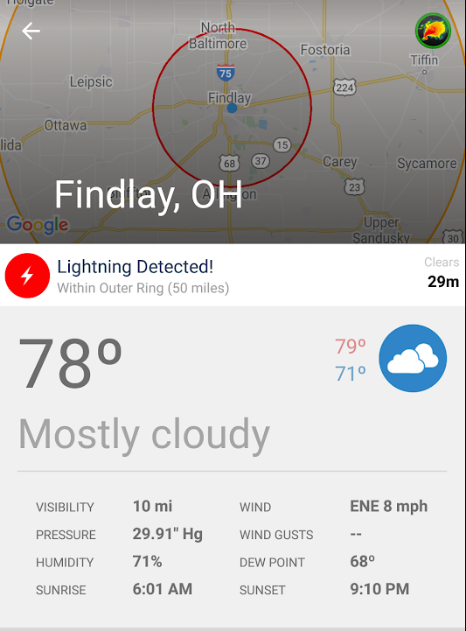
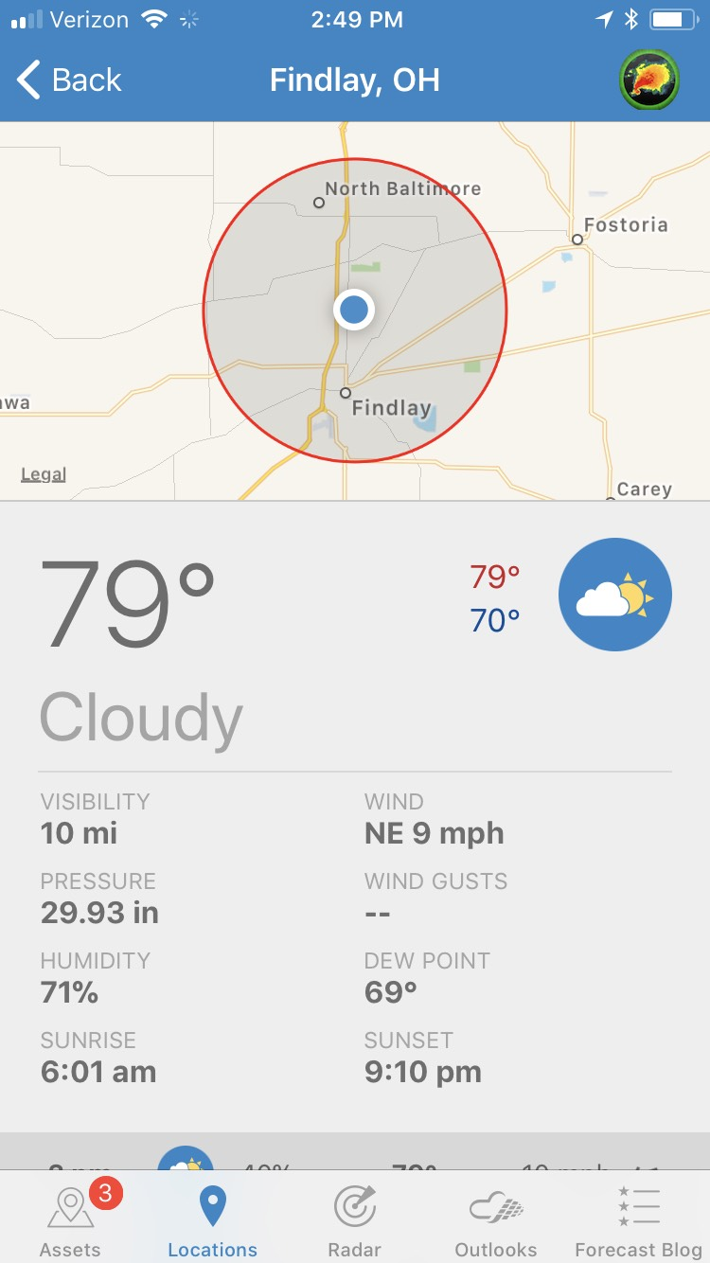
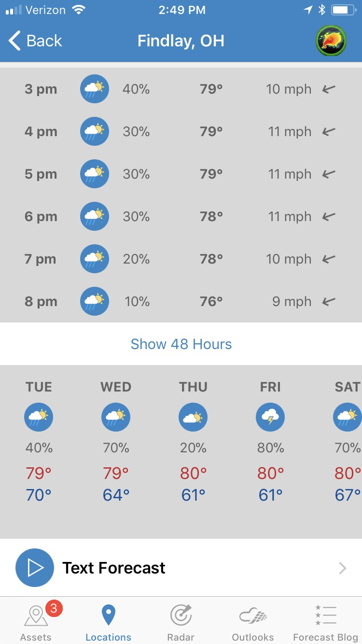
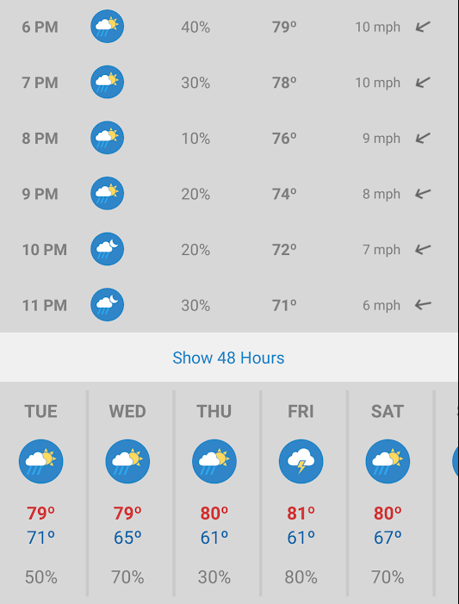
Locations
Locations Tab
Android
iPhone

Slide 25
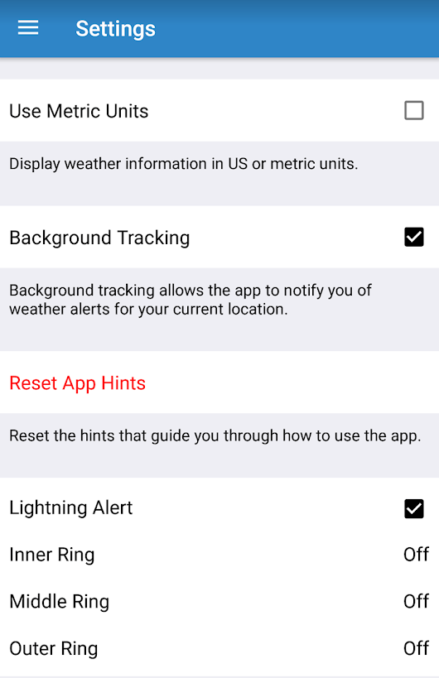
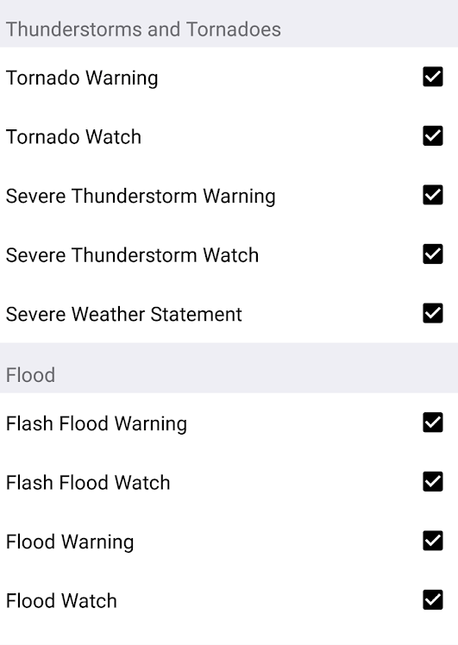
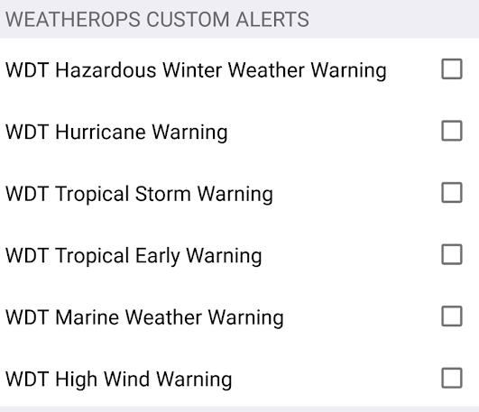
Locations
Personalize your Location Alerts

Slide 26
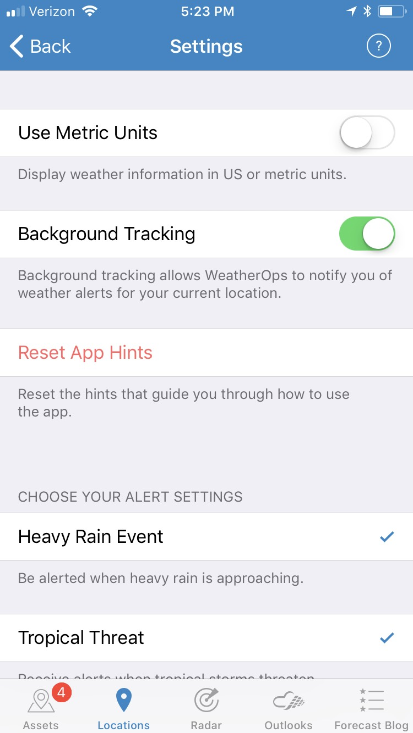
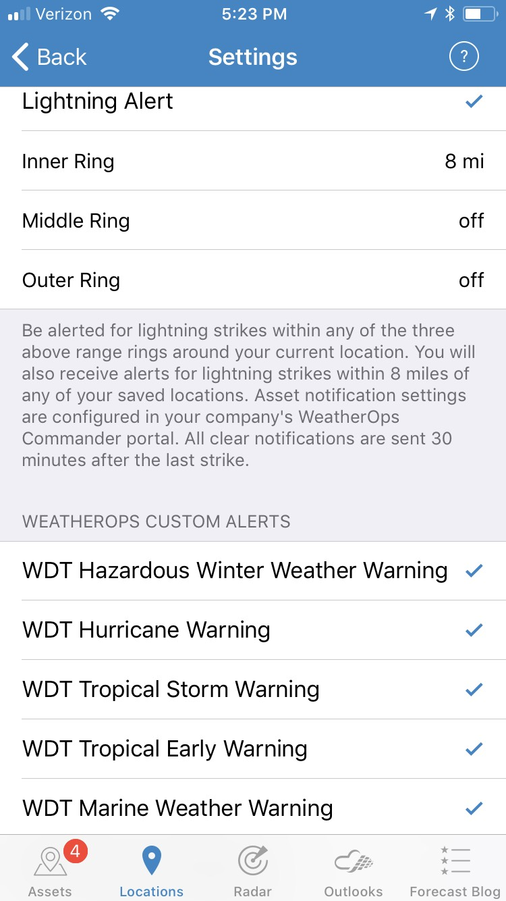
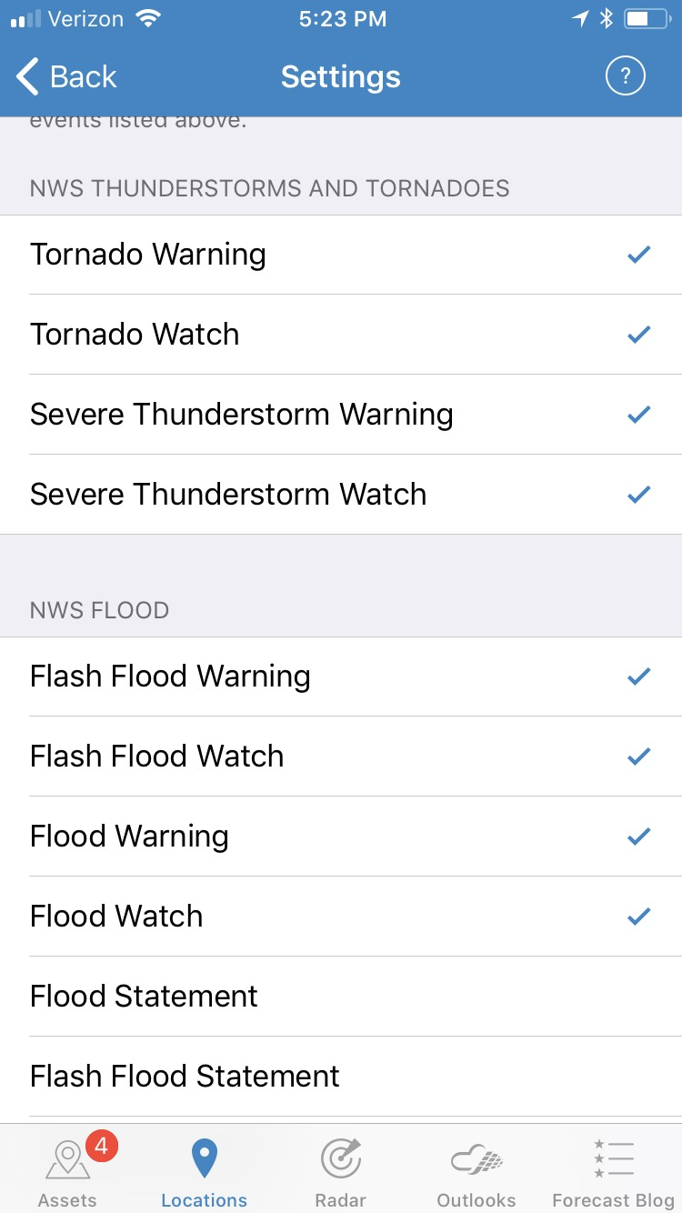
Locations
Personalize your Location Alerts

Slide 27
OE Policies with weatherops
FIELD
OFFICE
PMs has authority over what goes on out in the field
PMs are in contact with On-Call Mets during weather events and get their guidance from them as well as the app
This app is used as a tool, not a crutch
On-Call Mets have authority at NFWC

