Slide 1
Taskworld Rollout
January 3, 2018

Slide 2
What is it?
Taskworld is a collaboration platform that the entire company will use
We will use it to:
  Assign tasks
  Create our own To-Do Lists
  Keep updated on progress of projects
  Keep a log or record of each project we do
This will take the place of “Teamwork”
  Taskworld has a simpler format and will hopefully be less confusing

Slide 3
Outline
The basics
Creating a project and tasks
Assigning tasks to team members
Navigating your tasks in overview
Setting schedules and reoccurring tasks
Creating “templates”
Other features
Keep it going

Slide 4
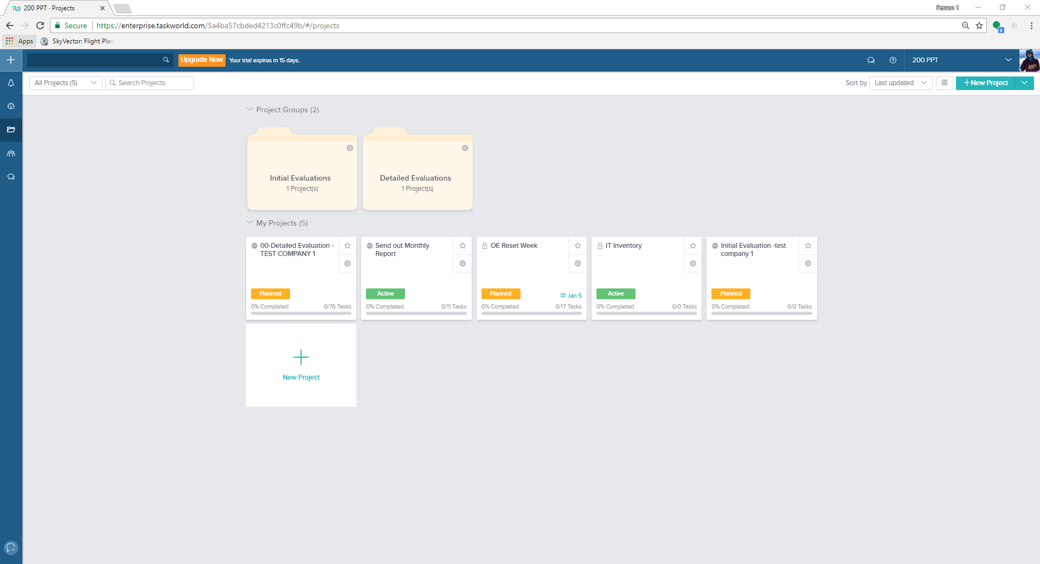
Taskworld
Start new task or project
Notifications
Overview of tasks in your workspace
Folder view of your projects and tasks
World means “public”
Lock means private (only you can see or who you chose to see it

Slide 5
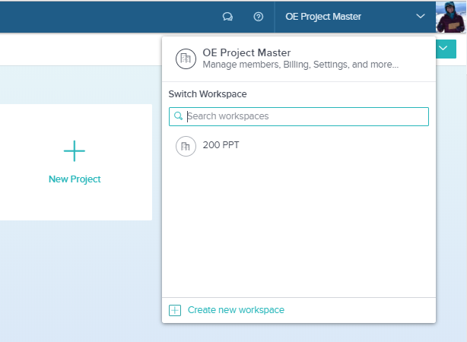
1. The Basics
Signing in
https://enterprise.taskworld.com/login
Sign in with your email being your username
Two “work spaces”
  Company wide
  Department specific

Slide 6
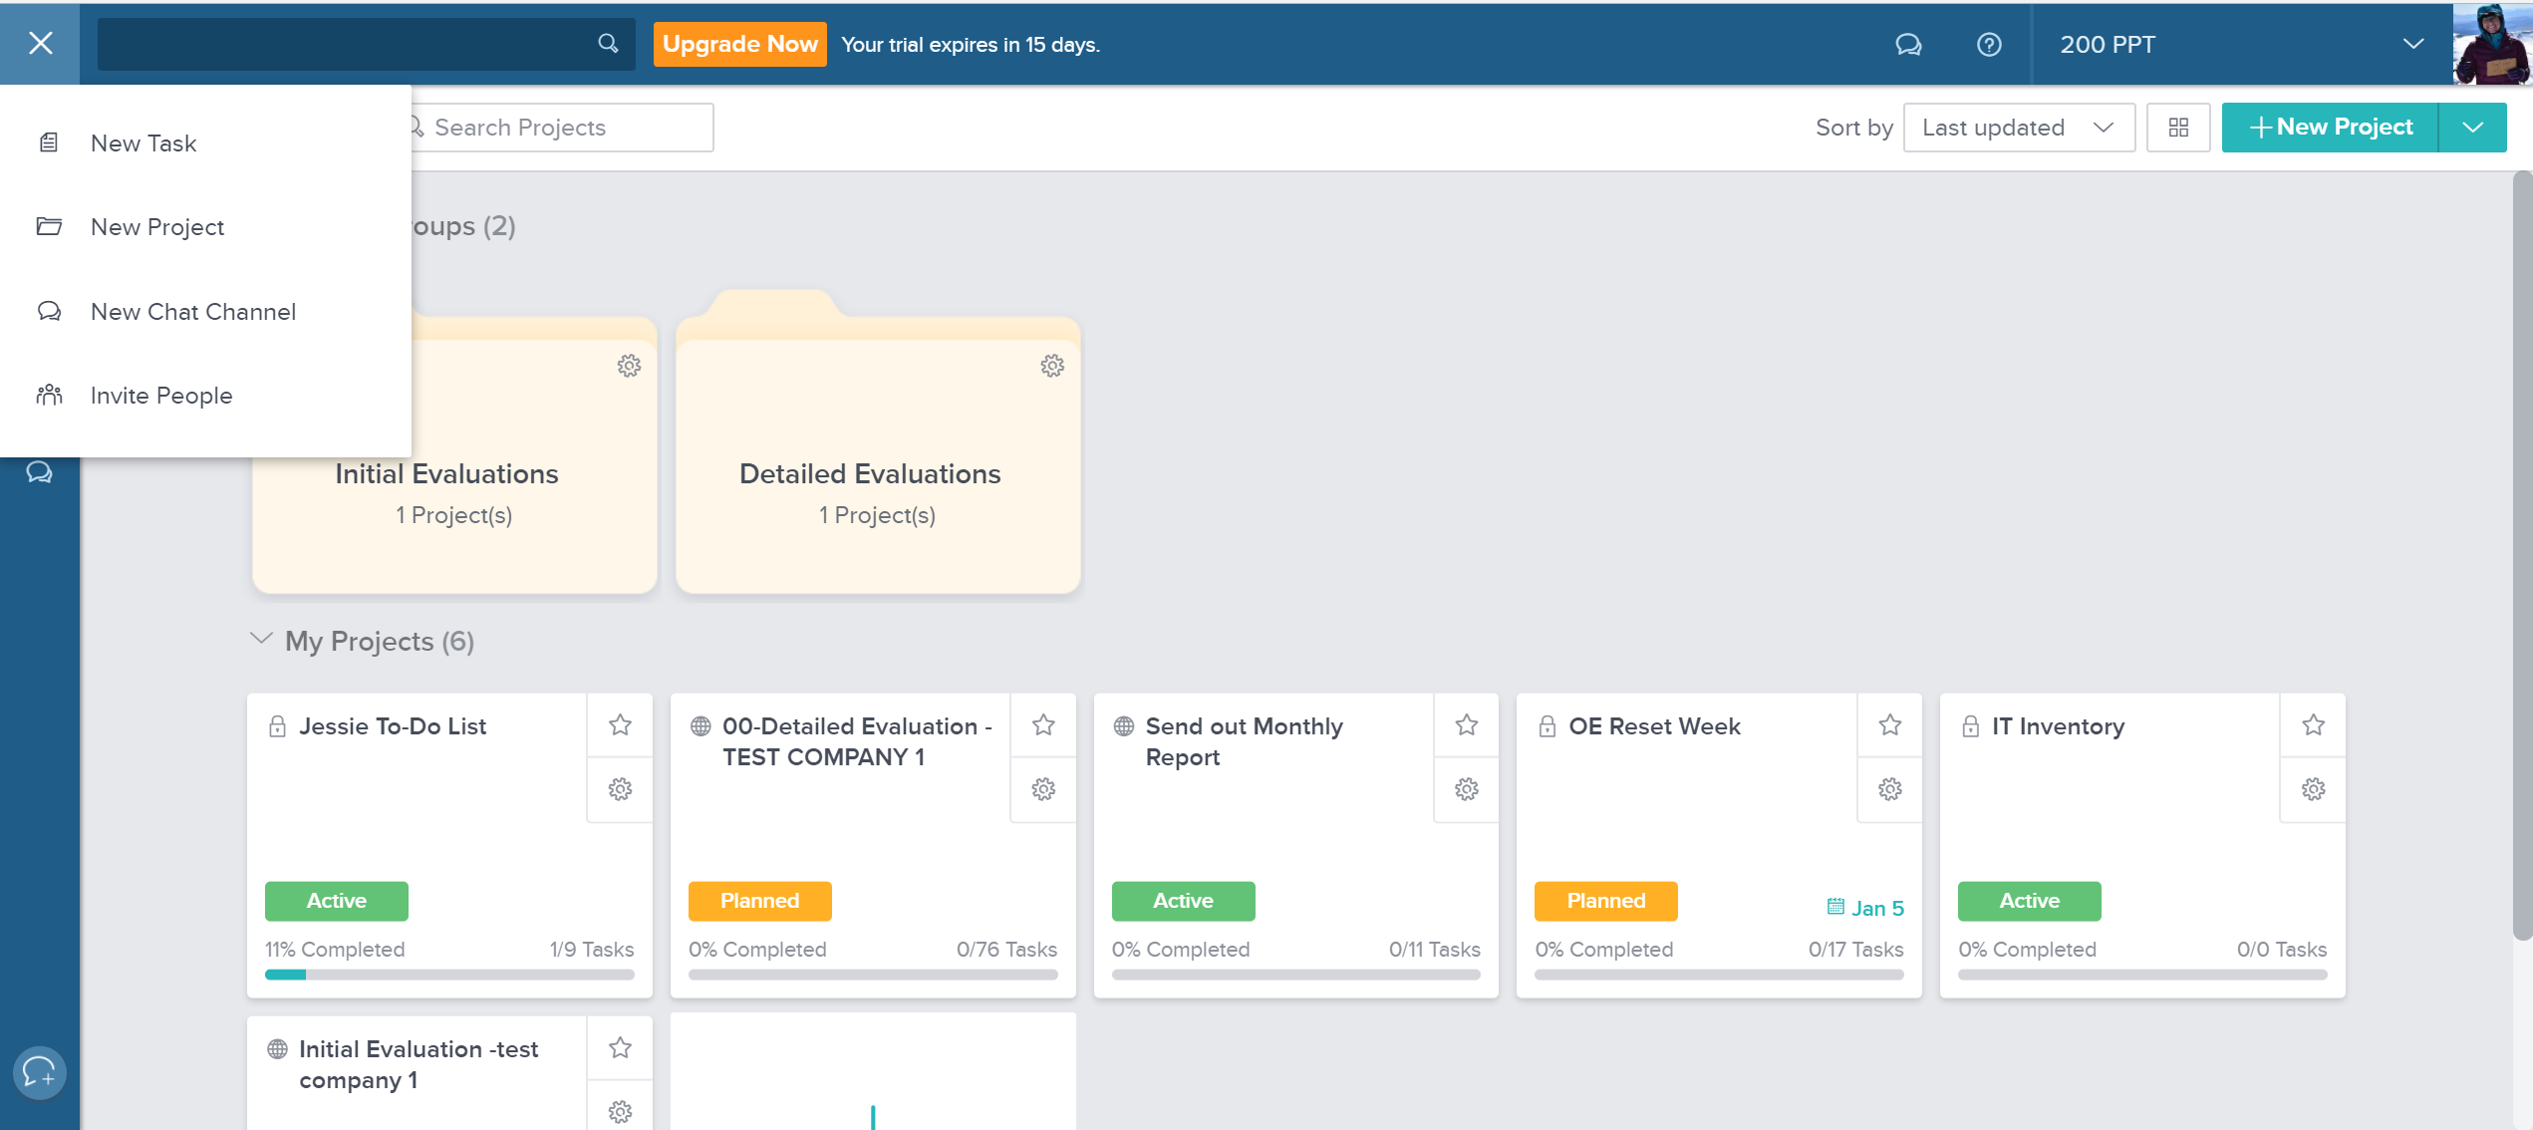
2. Creating Projects and Tasks
Create a project by selecting the “+” in the upper left corner

Slide 7
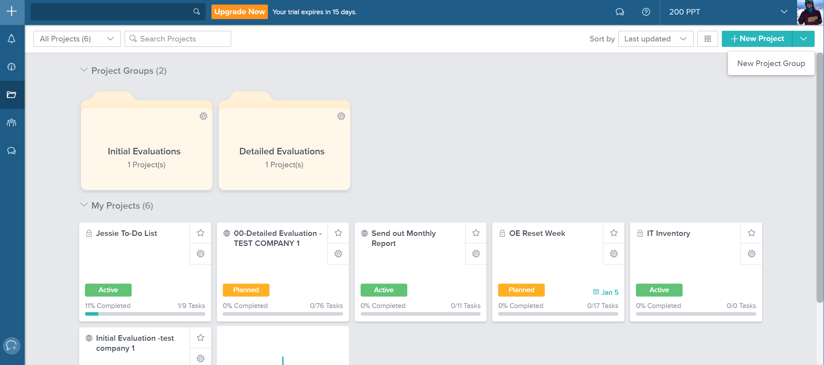
2. Creating Projects and Tasks
Create a “Project Group” as a way to organize your projects

Slide 8
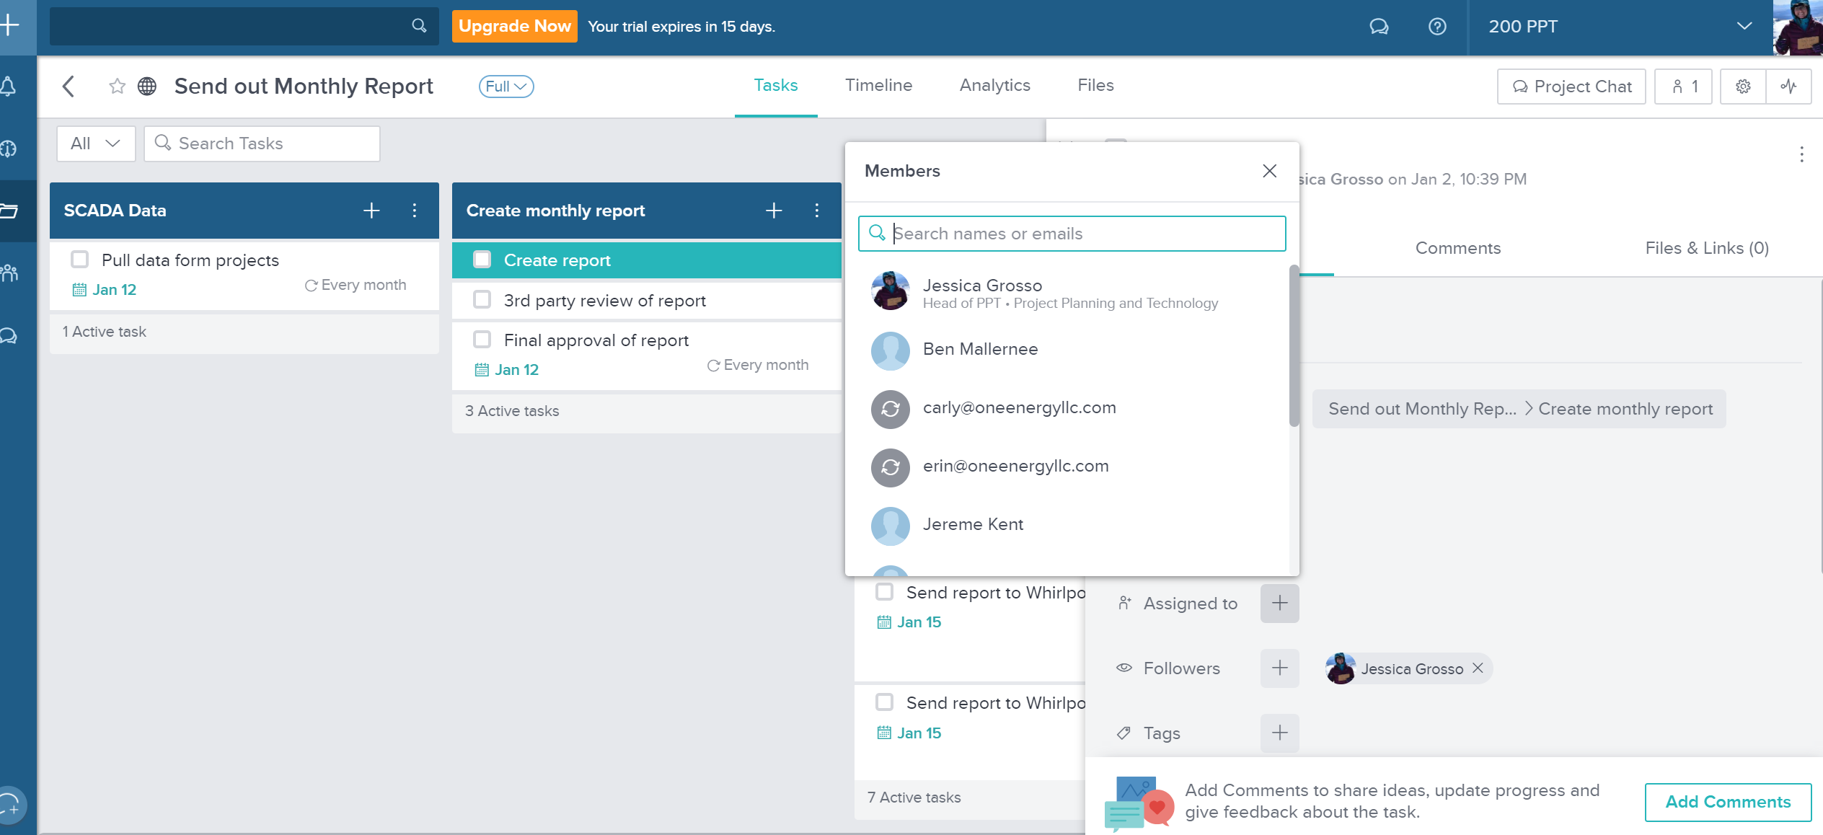
3. Assigning Tasks to Team Members
Assign members within your workspace to tasks

Slide 9
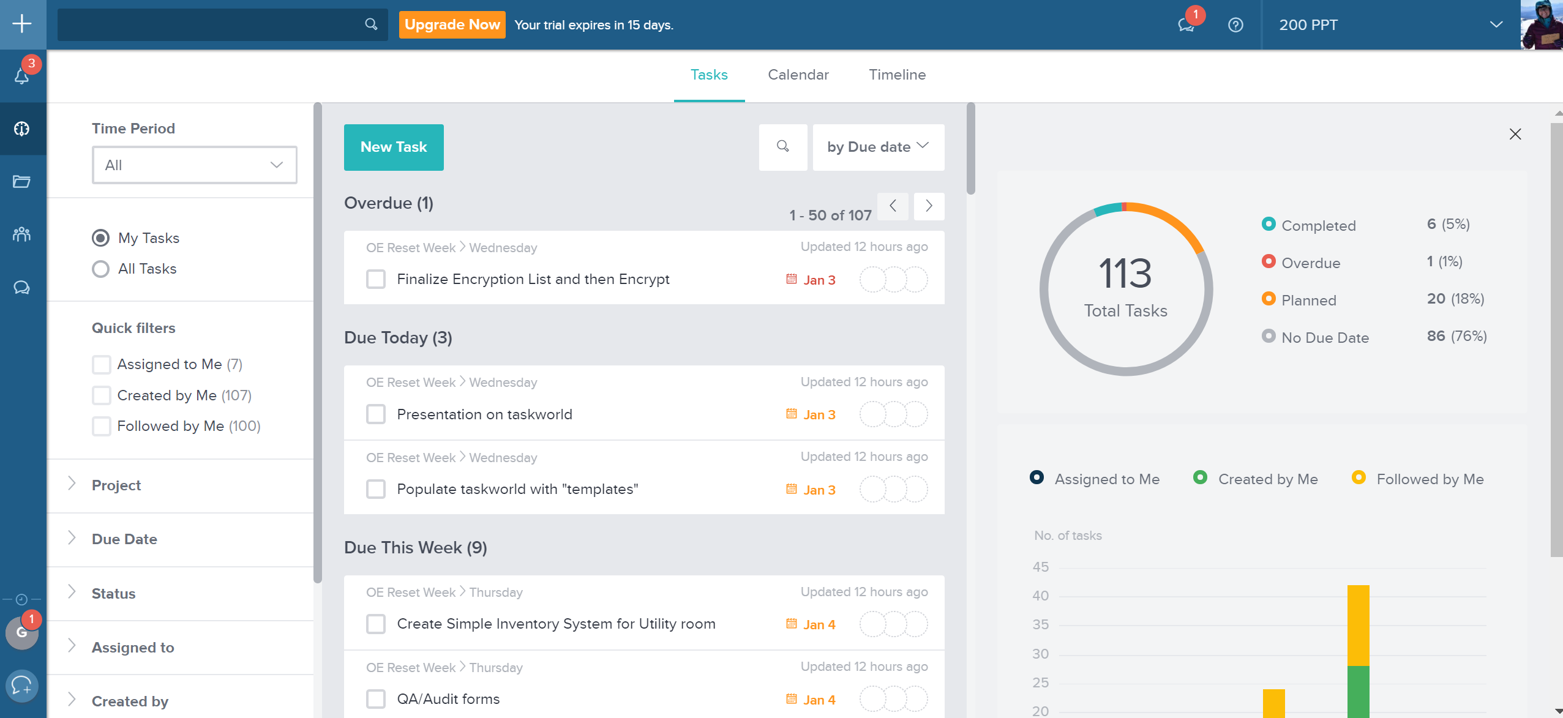
3. Assigning Tasks to Team Members
Utilize overview to see what tasks are assigned to you

Slide 10
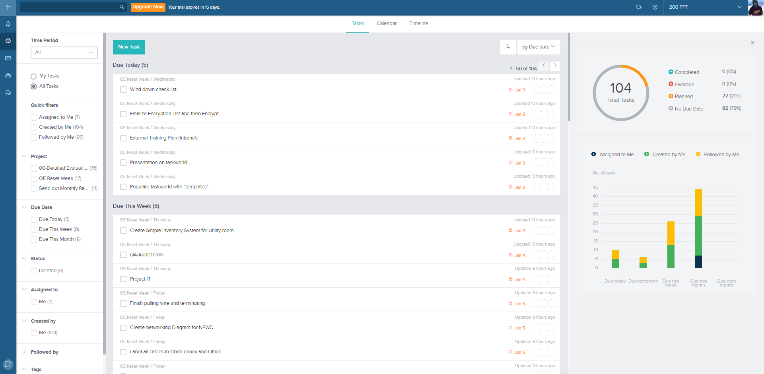
4. Navigating Your Tasks in Overview
How you filter your tasks
How you see your tasks

Slide 11
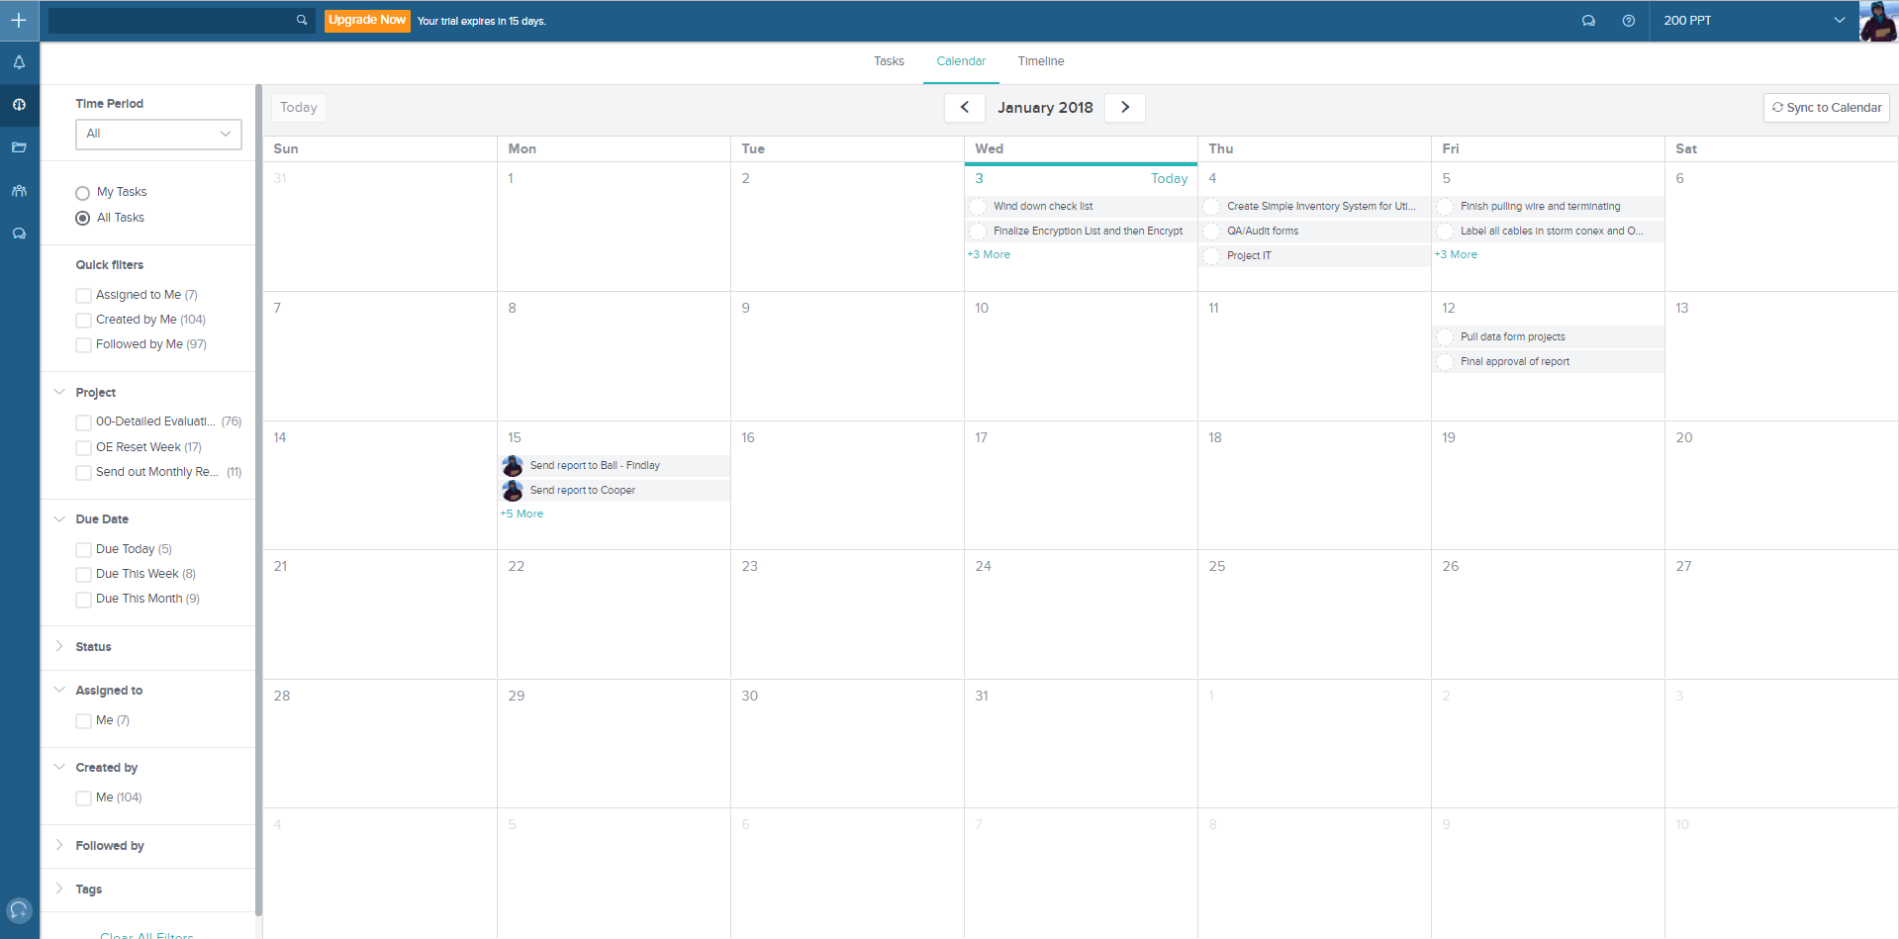
4. Navigating Your Tasks in Overview
Calendar View

Slide 12
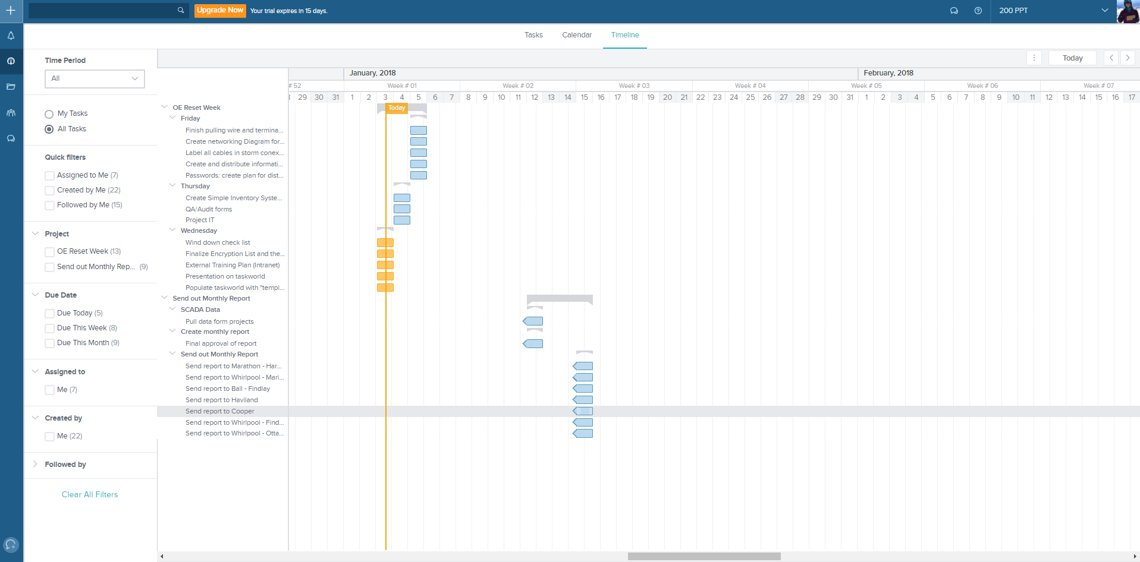
4. Navigating Your Tasks in Overview
Timeline/Gantt Chart View

Slide 13
5. Setting Schedules and Reoccurring Tasks
Due dates can be set for each task and also for a projects overall
“Actual completion date” option
Reoccurring tasks:
  Under due-date default is “do not repeat”
  Change this to how often you would like this task to repeat
  This way, that “project” is only listed once but allows you to add reoccurring tasks

Slide 14
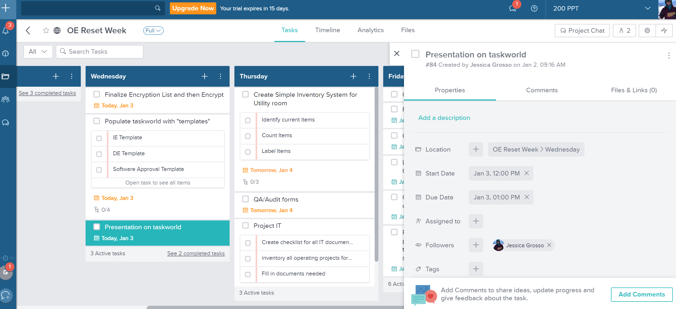
5. Setting Schedules and Reoccurring Tasks
Set start and end date/time for tasks by selecting a task

Slide 15
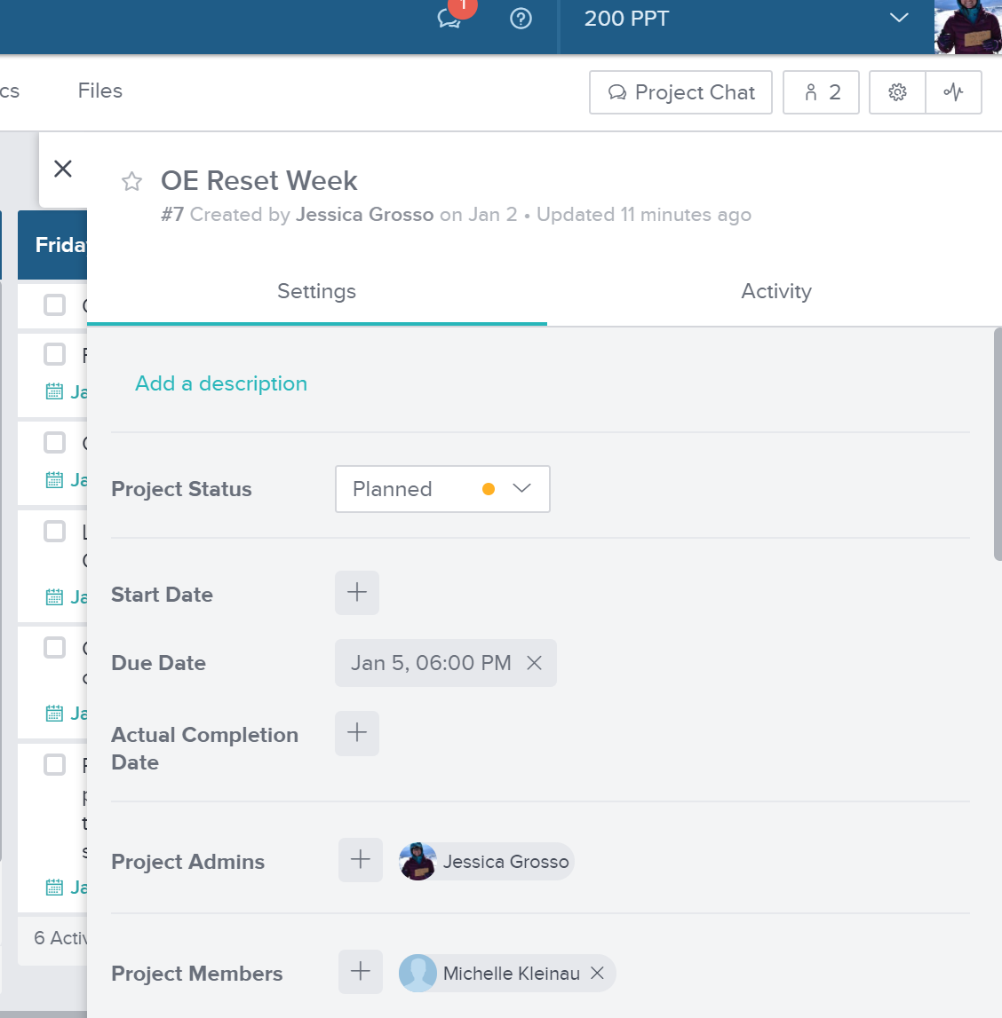
5. Setting Schedules and Reoccurring Tasks
Set start and end date/time for a project by selecting the settings button in the upper right corner

Slide 16
6. Creating Templates
You can create templates by creating “dummy” templates that you can duplicate
Set these as open ended (no due date) so they will always be available
Utilize “00-TEMPLATE” naming so it shows up first in alphabetical order or create a “Templates” folder

Slide 17
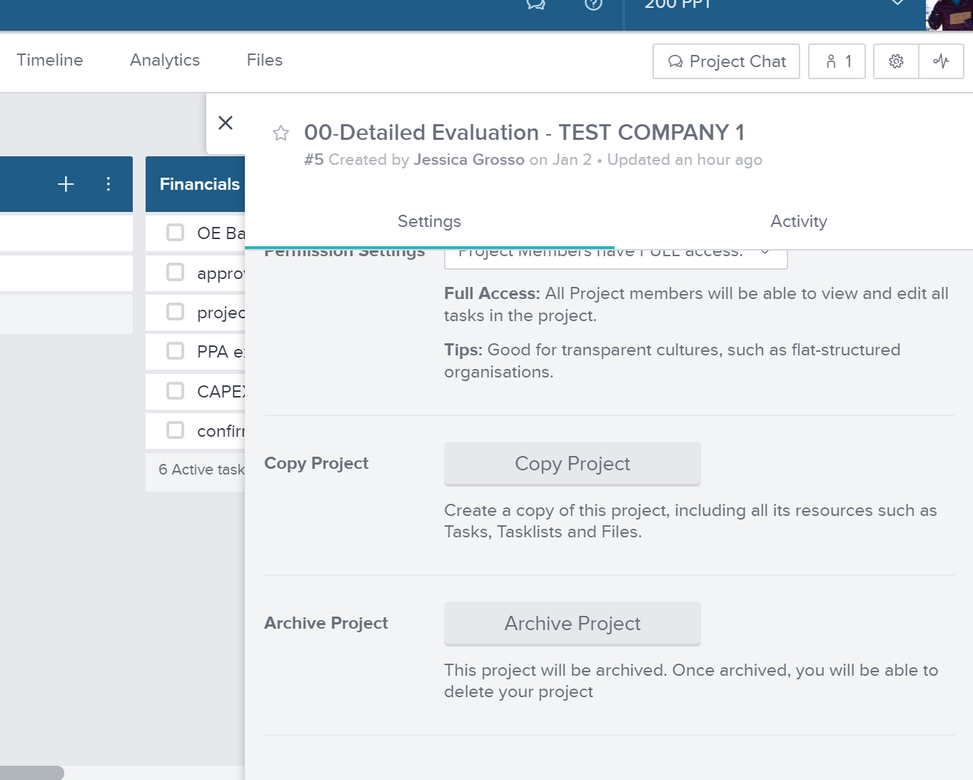
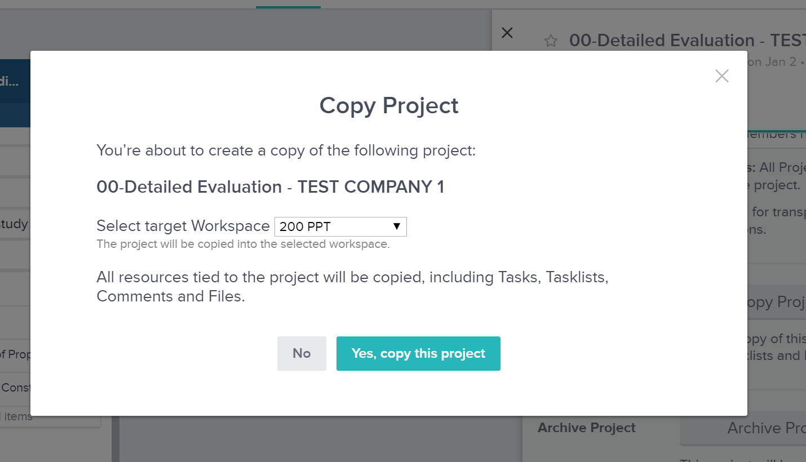
6. Creating Templates
Copy project, select workspace, rename project

Slide 18
7. Other Features
Project status:
  Planned
  Active
  Completed
  On Hold
  Cancelled
Tags
  Helps search for things faster
Time tracker
  You can start a timer to keep track of how long it takes you to complete that task
  You can input an expected time for each task
Notifications
  Set what you want to get notified for
Points system
  1-5 … can be used for anything you want

Slide 19
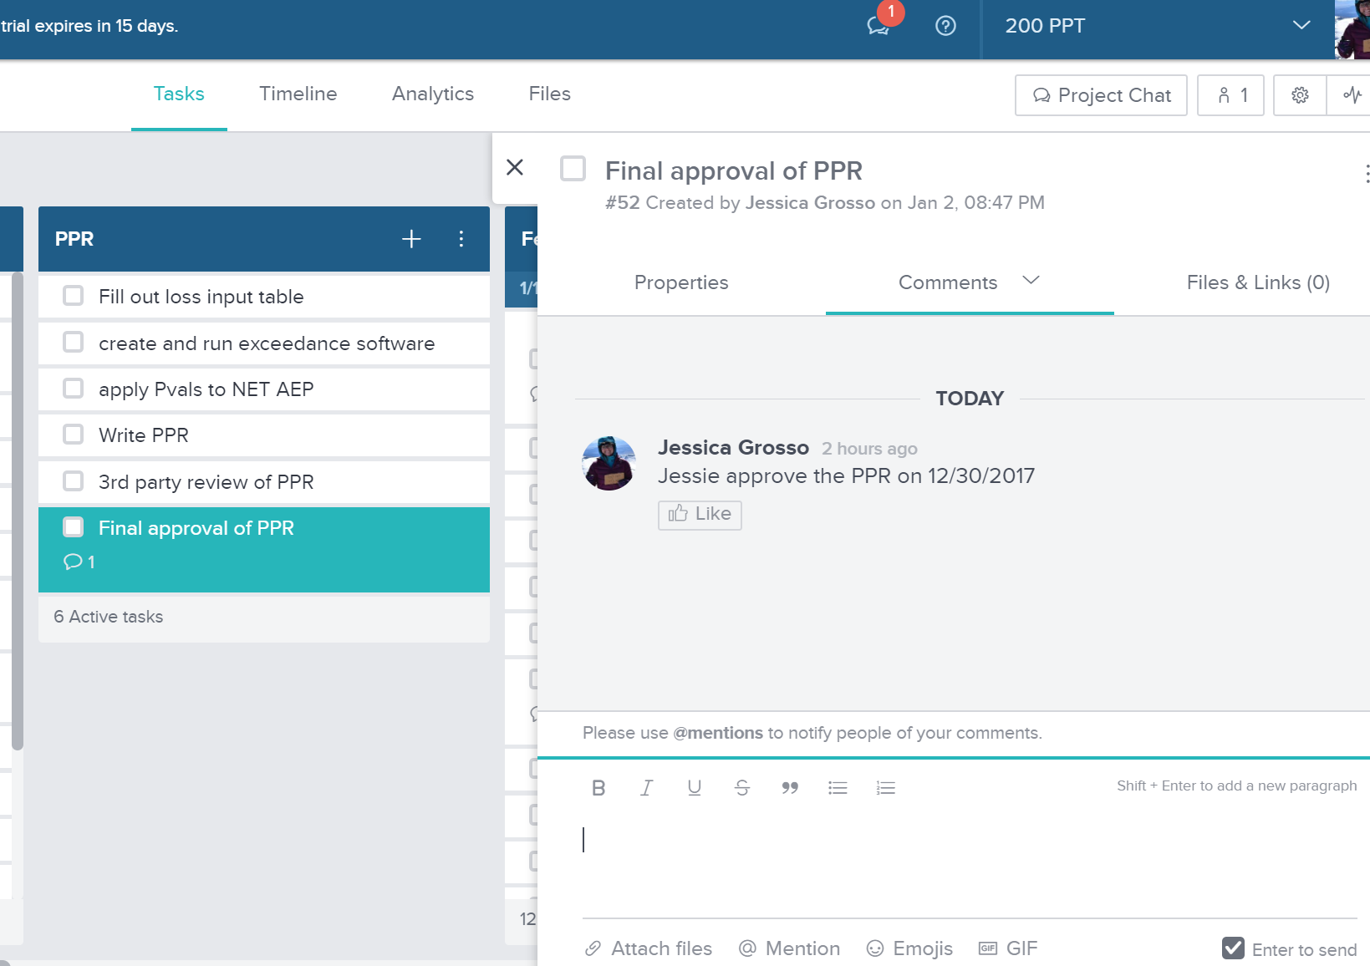
7. Other Features
Comments: select a task and choose “Comments” to add a comment to a task
Use this to make notes on anything special about a task or anything you would want to communicate to others in your group
PPT will use it to keep a record or log of each detailed evaluation to help with communication of past work

Slide 20
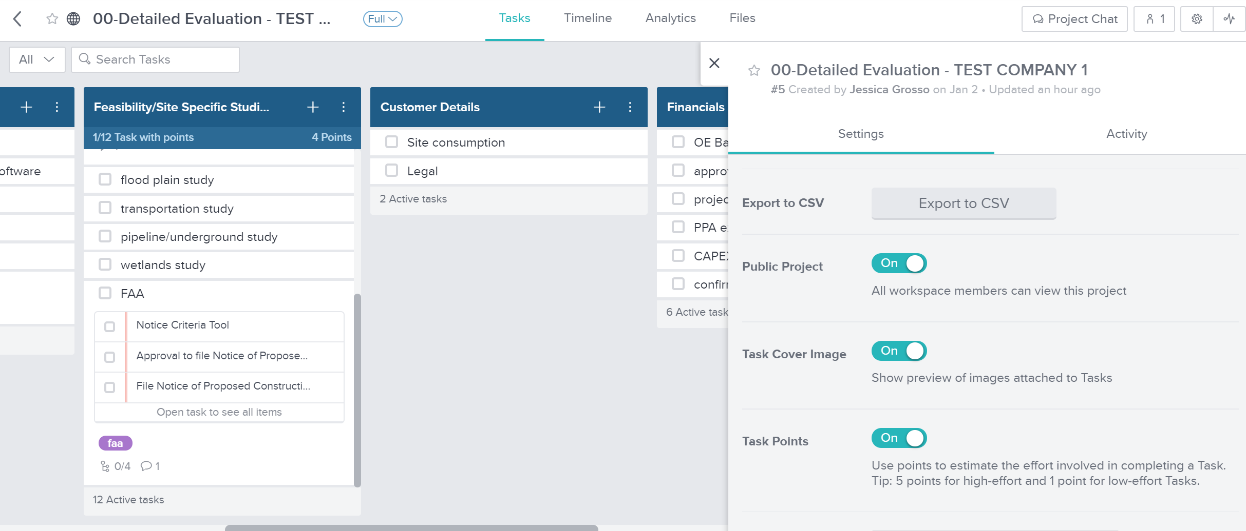
7. Other Features
Export to .CSV

Slide 21
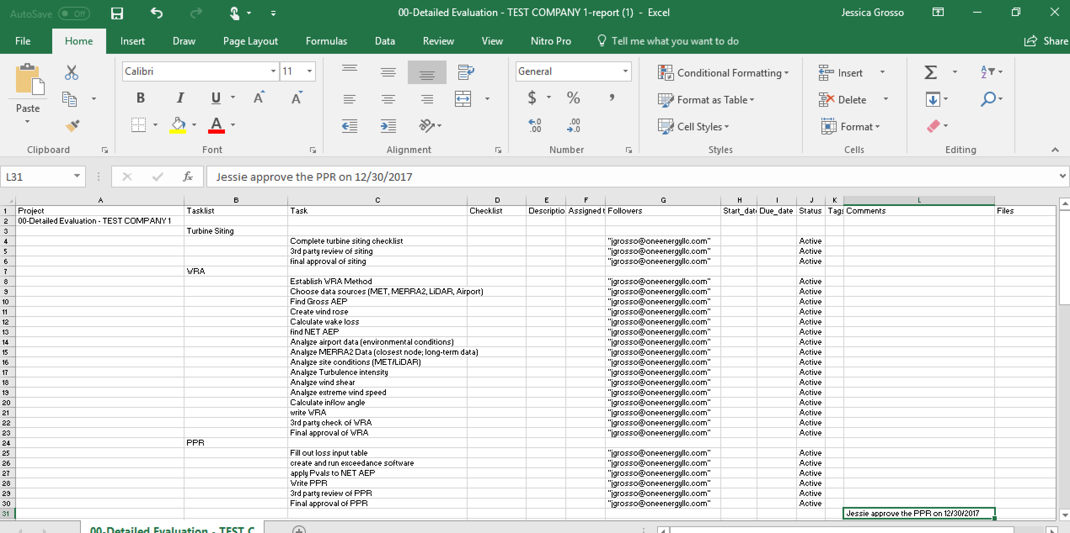
7. Other Features
If filled out well, it can be a permanent record of your project or task list.

Slide 22
Keep it going
This will only work if everyone commits to it
Determine how your team should use this and use it most efficiently…TODAY
If you have questions go to your manager
If you are a manager and have questions email IT@oneenergyllc.com

Slide 23
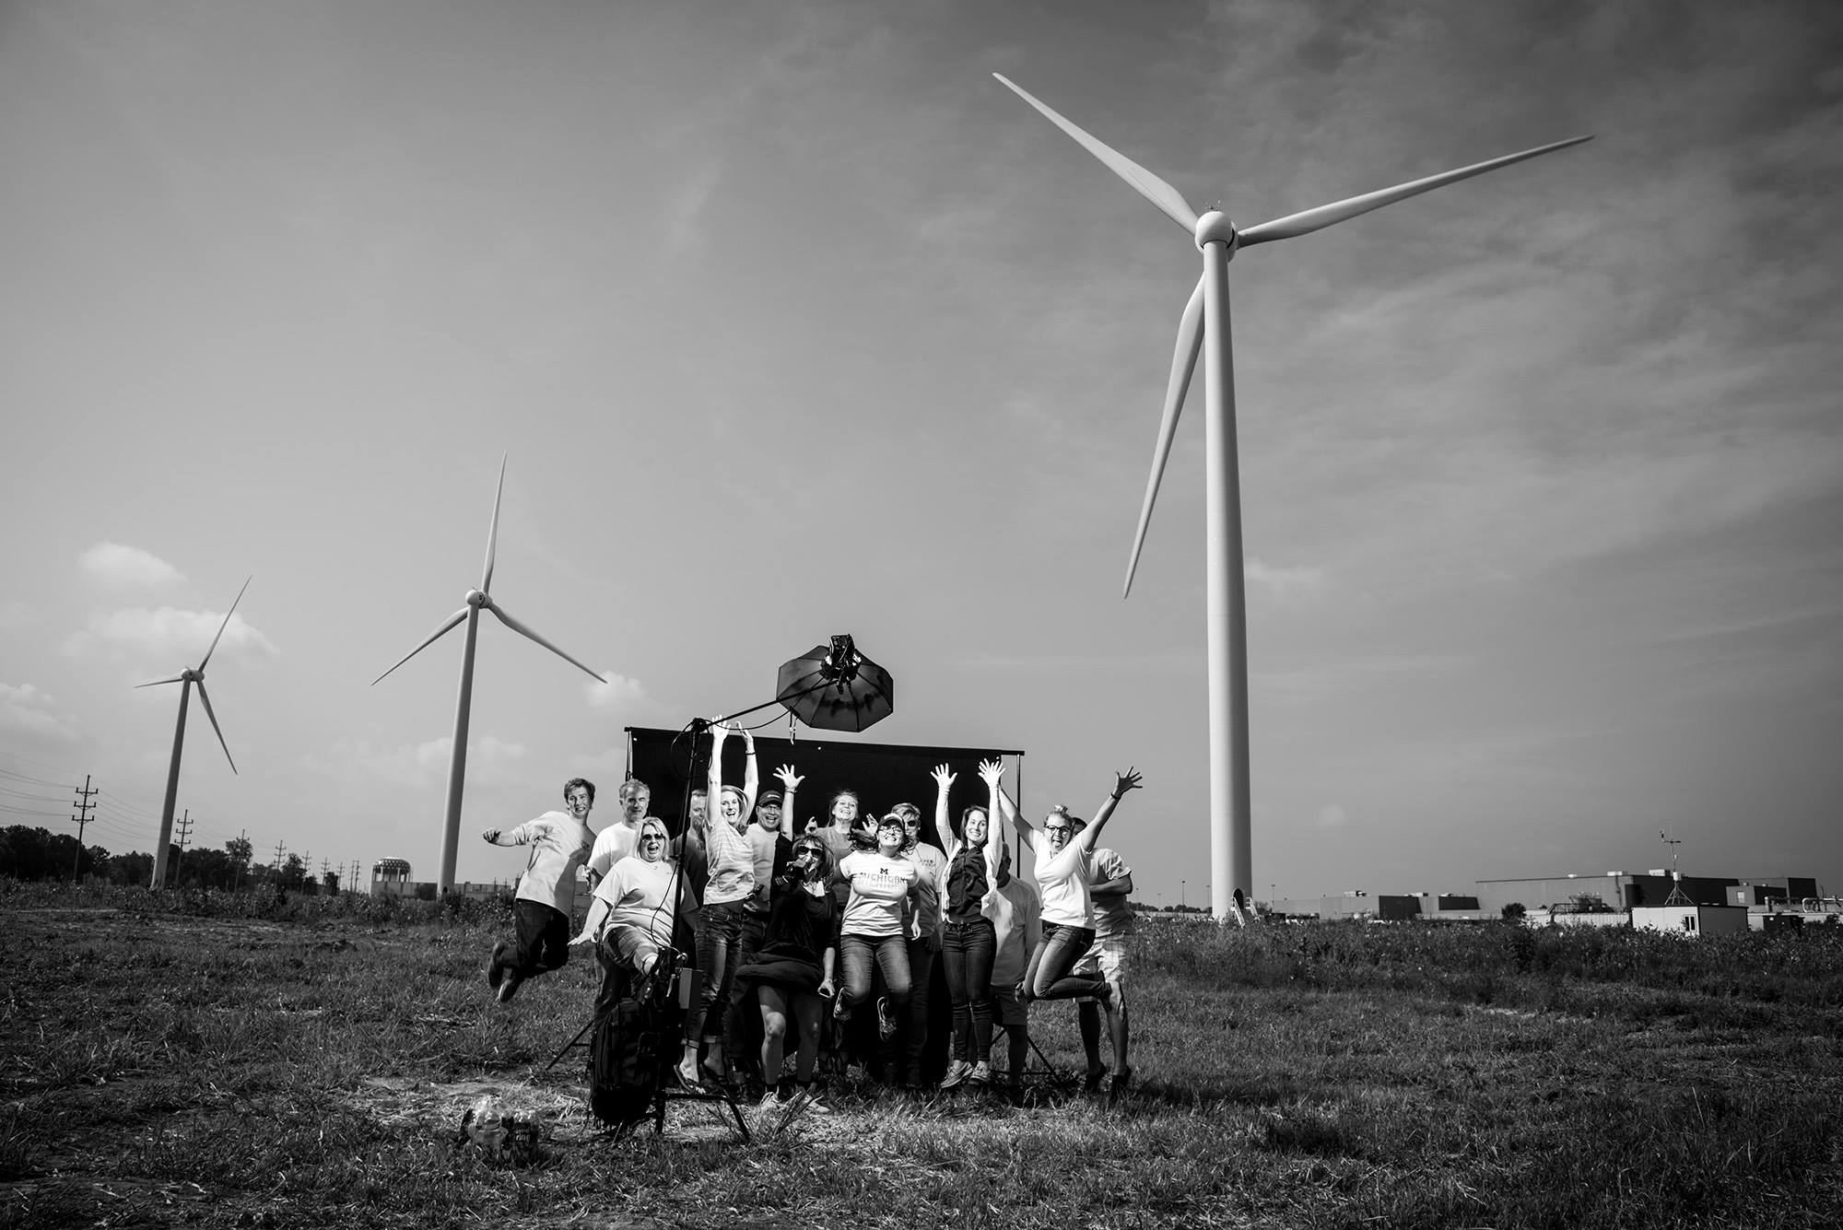
Questions?

