Slide 1
PPT Wind school (class 19) next steps part 2

Slide 2
outline
Introduction
MCC
  What is it?
  Process
File Structure
Construction Hand-off
Community Roll-out

Slide 3
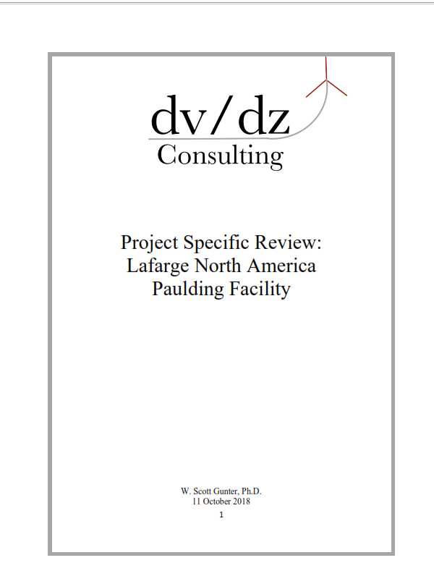
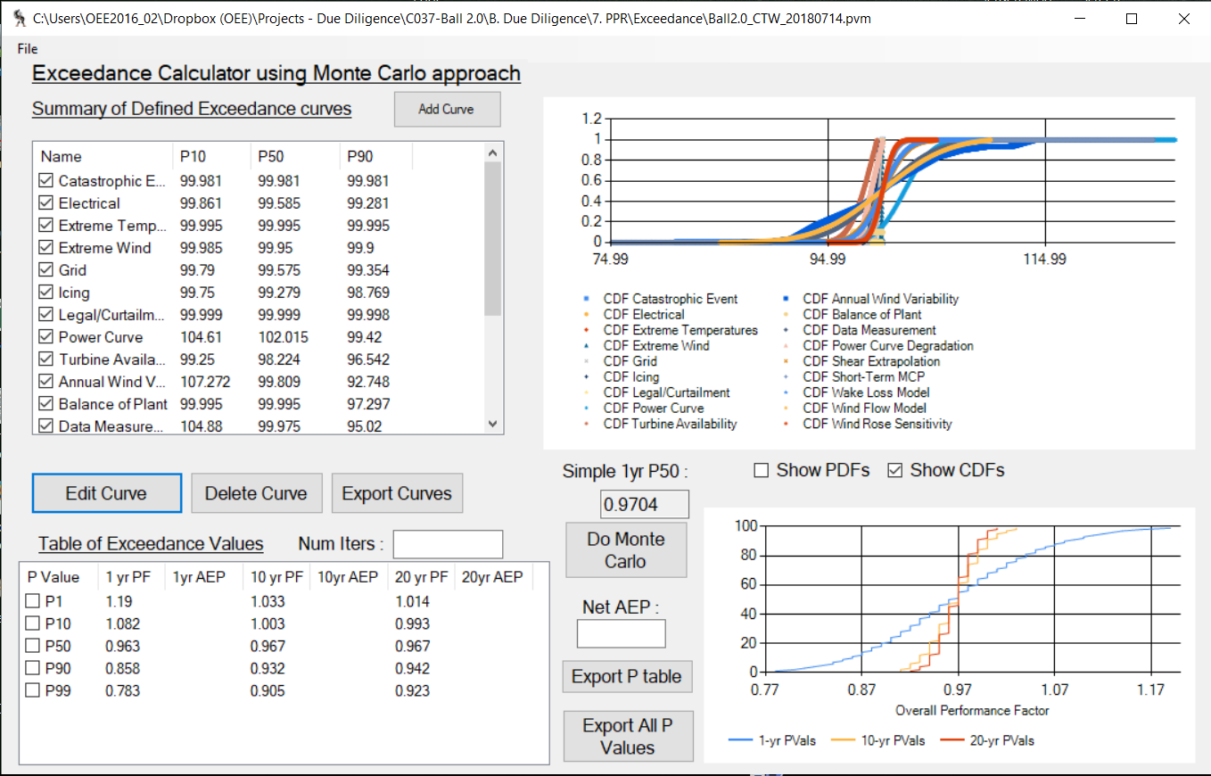
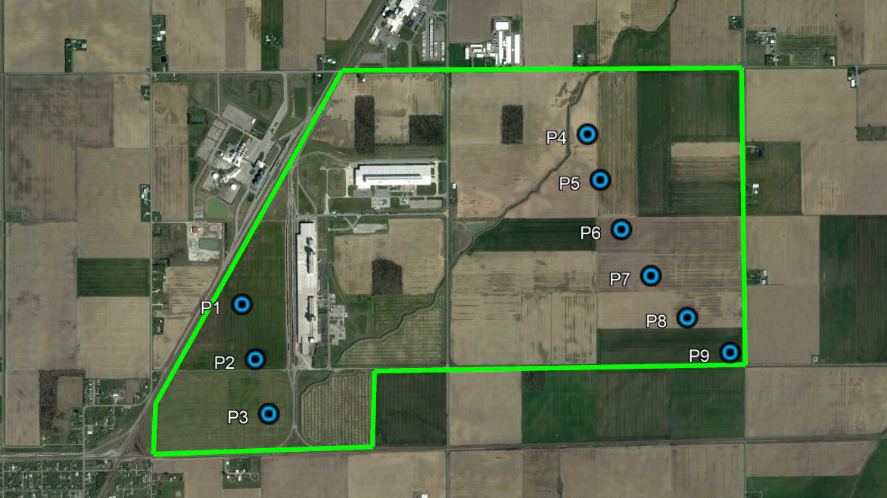


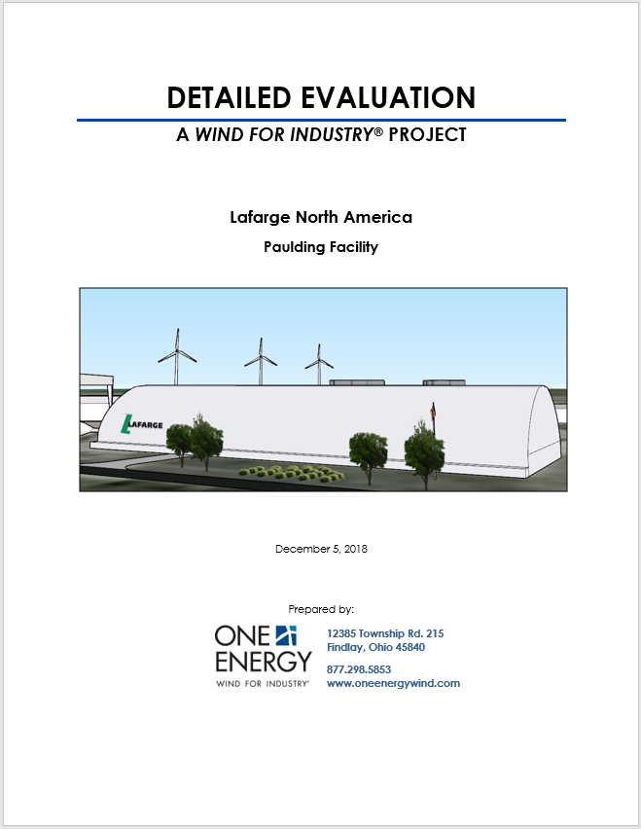


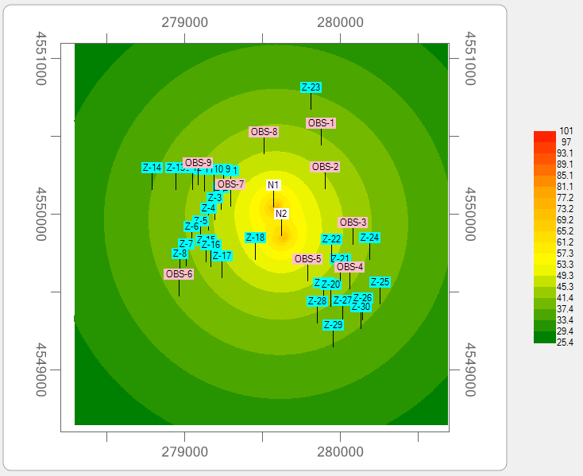
introduction
As we come to the end of PPT’s travels through the full Due Diligence of a project, we’ve got just a few more items to tie up and pass off the project to the appropriate groups within OE.

Slide 4
Material change of circumstance
What is it?
Material Change of Circumstance (MCC): an issued document indicating a change in the originally-predicted operating boundaries of a project due to an unforeseen circumstance. This can only be issued after a project has already been Placed-In-Service.
Examples of “expected operating boundaries”:
New wind project installed nearby that will affect wake loss
New wind project installed nearby that will drastically affect feasibility studies
Safety of operation
Significant Methodology error
Curtailment needs via Goldwind affecting production

Slide 5

Material change of circumstance
What is it?
Material Change of Circumstance (MCC): an issued document indicating a change in the expected operating boundaries of a project due to unforeseen circumstance.
We all know that one turbine will affect the energy production of a second turbine. When new wind turbines are installed near existing projects, wake effects will affect the energy production we tell the customer.
We have to take these new turbines into consideration and re-calculate the energy production on the existing projects to inform the customer on the changes expected.
vs
What does this mean for PPT?
Rerun wake losses incorporating all turbines and get new P50 values; documenting along the way
Create MCC
Update Monthly Production Reports

Slide 6
Material change of circumstance
Process
Rerun models to show impacts of change
Issue MCC to customer and update affected issued documents
Identify expected change
Create MCC

Slide 7

Material change of circumstance
Process
If rerunning due to addition of nearby turbines (most common scenario we’ll come across):
Rerun models to show impacts of change
Rerun wake loss for nearby projects with the new turbines
Apply wake loss to Gross AEP (no need to rerun)
Rerun Wind Variability Performance Factor
Rerun PPR software with updated wind variability PF
Take PPR software output and put into the ApplyingPVals spreadsheet to get new P50

Slide 8
Material change of circumstance
Process
Create MCC
Create document explaining the impact on the project.
List modified numbers (production, feasibility, etc.) and compare to previously issued numbers
Go through editing process and get approved by manager
Document should be clear and concise. Previous examples are only 1-page in length.

Slide 9

Material change of circumstance
Process
Issue MCC to customer and update affected issued documents
Head of Power Production will send the final customer-specific MCC to customer(s) affected
Update Monthly Production reports right after the MCC is issued to customer(s) so it is ready for the next months reports.
Erica thanks you for doing that.
Have an Associate re-print the full DE with the MCC included before – add Bates numbers in upper left hand corner and <date issued> MCC + ALL in upper right hand corner; update cover page to indicate this includes MCC

Slide 10
Material change of circumstance
A Brief History & a Surprising Future
Brief History
Surprising Future
Material Change of Circumstances were issued in October, 2018 to two operating projects: Ball – Findlay and Whirlpool – Findlay
Issued to account for wake loss from newly erected project at Valfilm Findlay.
Valfilm Findlay became operational late September, 2018.
Upon the start of operation of currently under-construction Ball 2.0:
  Three new Material Change of Circumstances will be issued to each of the Findlay based projects.
  Includes: Ball – Findlay, WP – Findlay, & Valfilm – Findlay

Slide 11
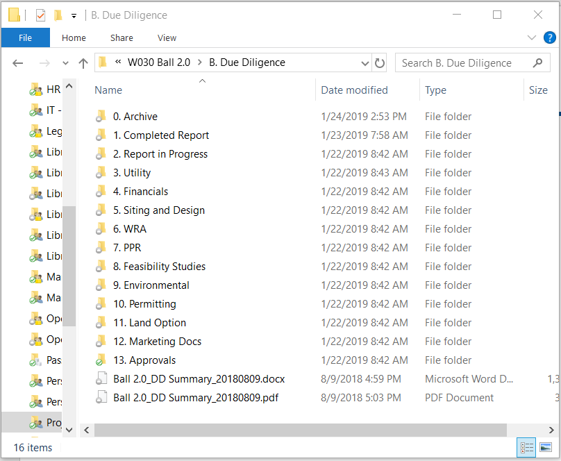
File structure
Internally-approved PDFs; pre-Dr Gunter; DataRoom folder with applicable wind data to send Gunter; folder with individual exhibit PDFs
Any additional utility rate analysis; any updated bills received
Property cards that we’re planning on getting an option on; figures needed for option
Externally-reviewed PDFs; post-Dr Gunter; FAA DNHs; final GW forms

Slide 12
File structure
While you are working on the report and before it goes through all final rounds of edits, keep .docx files in here
Copy of the most recent Project Master spreadsheet
Information regarding easements; EPA; FAA; zoning
Document creation for PR Packets (we’ll get to that in a bit)

Slide 13
File structure
Siting; 1-line diagrams; exhibit siting/land ownership layouts; sketchup model
Aviation (consult reports from Capital Airspace); ice; microwave (internal + external); pipeline; shadow; sound; transportation; TAILS models; zone list and official .kmz with everything in it
Flood; Phase 1 ESA reports; topo maps; wetland maps

Slide 14
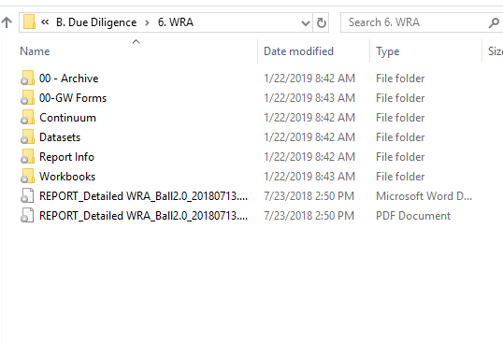
File structure
Input/output + model database
Figures needed for WRA report
Data that has only been cleaned – no analysis
Spreadsheets used for analysis

Slide 15
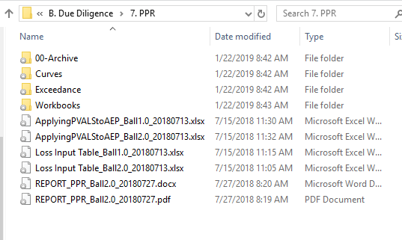
File structure
Spreadsheets used for curve creation
.csv files for real dstn curves
PPR software database (.pvm), output, curve figures

Slide 16
Construction hand-off
The period from the completion of the DE to the start of Construction (ground-breaking)
The Process
  Site Layout
  Phase I
  Geotech
  FAA Permitting
  Zoning Permitting
  SWPP Permitting (Storm Water Pollution Prevention)
  Transportation
  1-Line and Interconnection Application
  Special-Case Easements
  Comms/SCADA Order

Slide 17
Construction hand-off

Slide 18
Community roll-out
After the PPA is signed, a community rollout is organized and executed
The primary purpose of this process is to ensure a smooth introduction of One Energy into the local community
We do this by educating “key stakeholders” in the community
PPT creates resources using information from the Detailed Evaluation to support this process

Slide 19
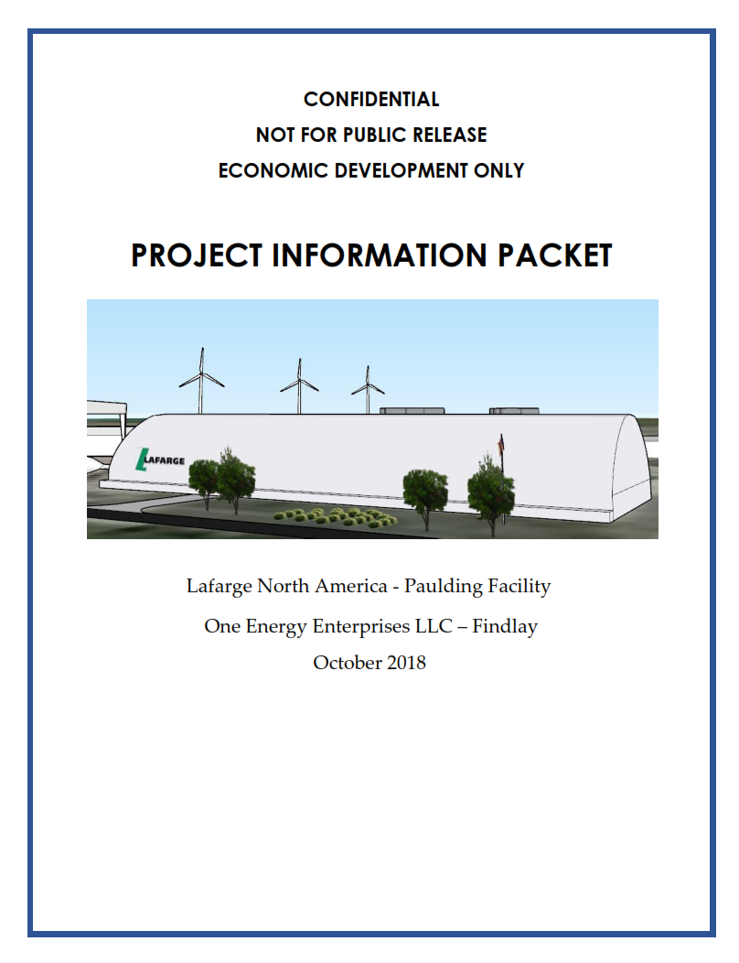
Community roll-out
A packet is created for the rollout and consists of:
  Project fact sheet
  Turbine fact sheet
  Feasibility Study information
  MW Scholarship information
  Site Layout

Slide 20
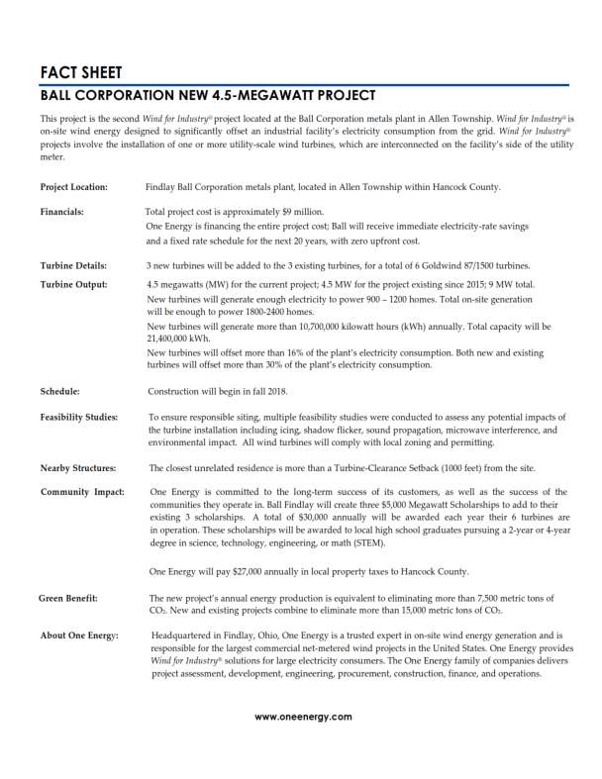
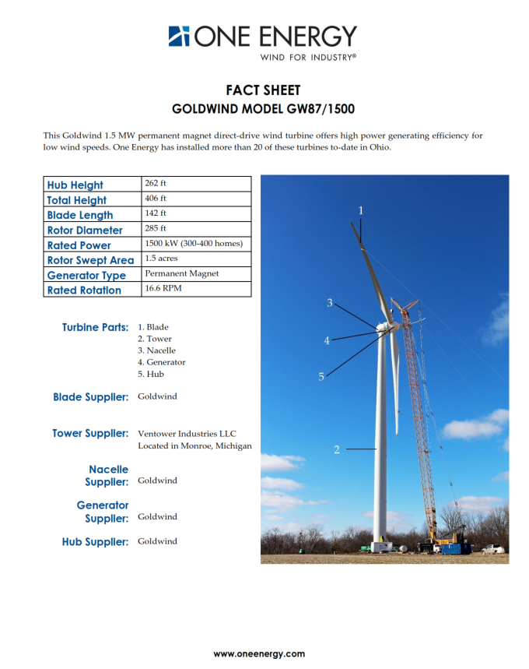

Slide 21
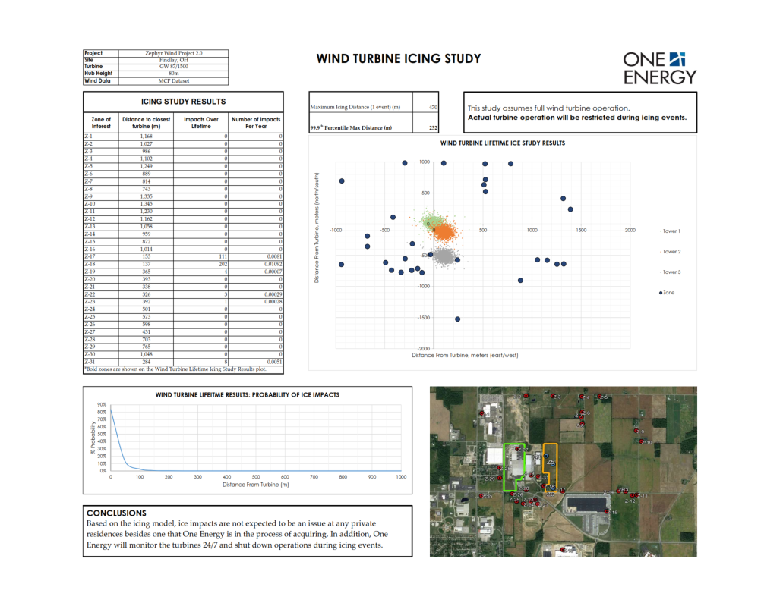
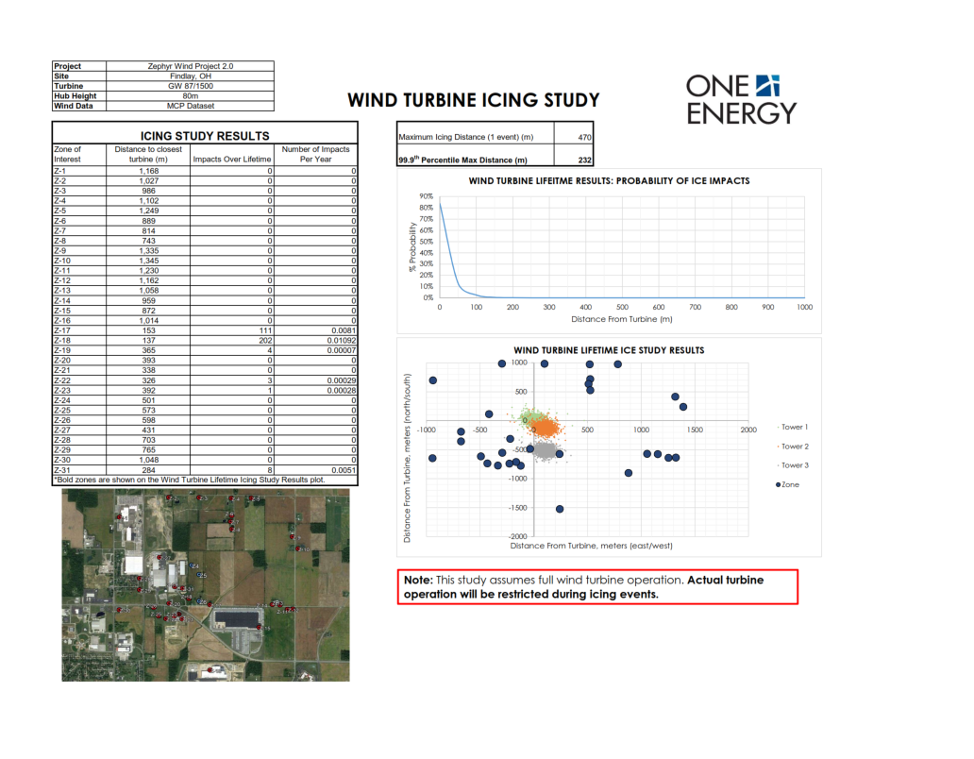
Exhibits – Icing Study
PR Packet – Icing Study

Slide 22
Community roll-out
The Community Rollout is often led through the local Economic Development team
  May also be led by customer
A key stakeholder list is identified
  Usually work alongside customer and local ED team to identify
  Key stakeholders often include: Mayor, City Council, Community Leaders, County Planning, City Engineers, Economic Development team, Auditor, etc.
Actual event is held at a chosen location (sometimes ED building)
  Key stakeholders are invited and One Energy is represented by JK, Project Manager, Angela, and their Point of Contact

Slide 23
Community roll-out
Community Rollout Event
  Short, ~1 hour
  Jereme normally leads this event with a presentation
  A representative from the customer’s team speaks
  Q&A
Groundbreaking Ceremony
  Follows Community Rollout
  Similar attendance as Community Rollout with addition of Media
    Often can be better attended by key stakeholders and customer’s corporate and local plant management
  Lasts ~1 hour and involved refreshments
  Located at customer’s site and includes OE prepared exhibits

Slide 24


















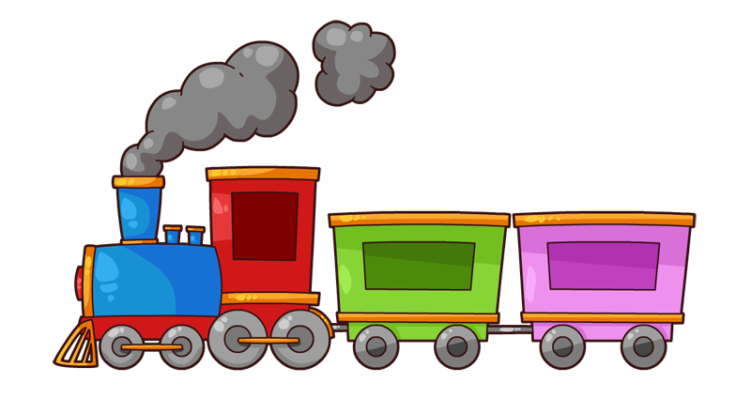




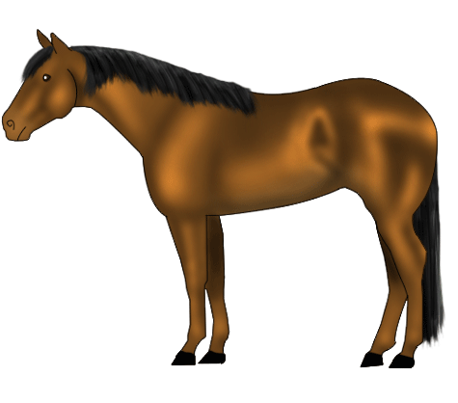


Questions?
Questions? Comments? Concerns?

