Slide 1
PPT Wind school (class 18) next steps part 1

Slide 2
outline
Introduction
Micrositing
  What is it?
  Process
Land Acquisition
  Why?
  Timeline & Process
PPT Additional Close-Out Items

Slide 3
introduction
Where are we in the full project development process?
DE has been internally approved
DE has been reviewed by Due Diligence Independent Engineer
Contract has been signed with the customer
PPT isn’t done yet with this project. We still have work to do.

Slide 4
micrositing
What is it?
Micrositing: any turbine siting change that does not exceed 1 arc-second from the original siting location. This term is adopted from the FAA.
Why would we need this step?
The civil layout may need to dictate slight adjustments for roadways, crane pads, laydown yards, etc.
Might need to adjust based on late customer-preferences for turbine siting
A surprise wetland may have popped up
The possibilities are endless as to why we would need to microsite

Slide 5
micrositing
Process
Micrositing Team gets together for a meeting
Discuss things that may affect turbine siting. Confirm final turbine siting.
If needed, rerun feasibility studies & production numbers
Housekeeping

Slide 6








micrositing
Process
Micrositing Team gets together for a meeting
Micrositing Team
When
Head of PPT
After PPA is signed
Before project begins construction
Project Manager
Drafter
Jereme

Slide 7
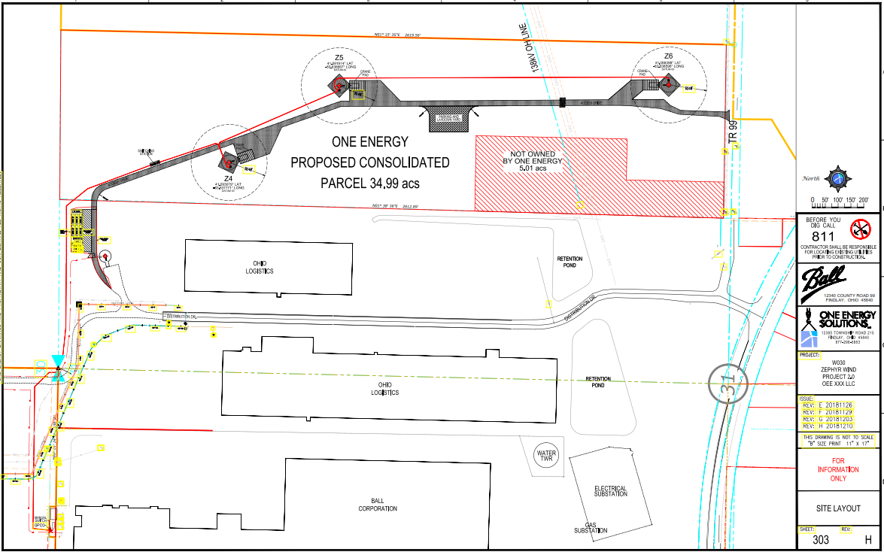
micrositing
Process
Discuss things that may affect turbine siting
It’s going to make more sense to move the Z5 west by 500 feet to not affect the crane pad
That’ll affect the road layout then. Do we adjust that too?
Doing that will also increase wake loss a whole bunch. Is it worth losing production?
Let’s only move the turbine 75 feet west. Final siting is…

Slide 8


micrositing
Process
Did the turbine move since the DE was review by the DD IE?
If needed, rerun feasibility studies & production numbers
You need an addendum
Was the move more than 1 arc-second?
Just rerun the feasibility studies
Rerun the feasibility studies and energy production
Are the results drastically different than before?
Sent to DD IE for review
Just the addendum for internal records & PR packets will suffice
Sent to DD IE for review

Slide 9
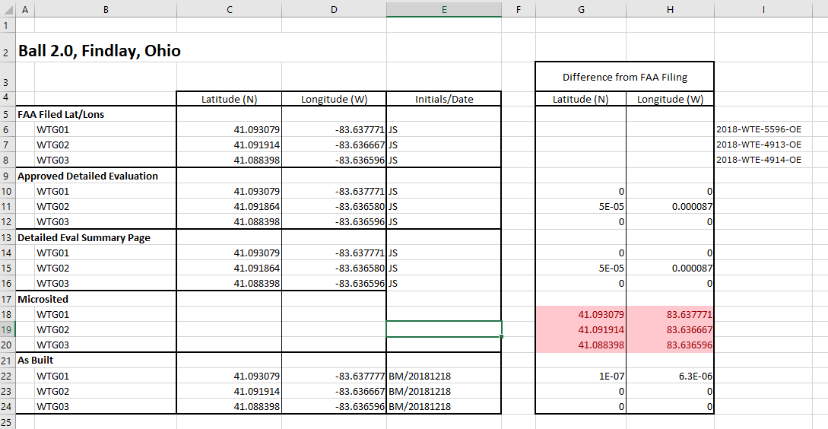
micrositing
Process
Housekeeping
Update Turbine Siting Log
Re-file with the FAA if any turbine locations moved more than 1 arc-second
If red – need to re-file
If not – do not need to re-file

Slide 10
Land acquisition
Why?
If the customer does not have enough land to safely site the project, additional land must be purchased.
  Legally, for net-metering, the project must be on “customer-generator’s premises” (ORC 4928.01)
  Our interpretation is that ownership of the land is necessary to be considered premises, cannot lease the land
One Energy buys the land and incorporates the costs associated with it into the offered PPA rate.

Slide 11
Land acquisition
Timeline & Process
1 month
3 months
1 week
1-3 months
12 months
Gather necessary information
Contact landowner; negotiate terms
Write a land option
Execute land option

Slide 12
Land acquisition
Timeline & Process
Gather necessary information
PPT works to obtain certain information about the land that is being considered for turbine siting
  Property cards
  Comparable sales in the area
    Find property type and size then use the advanced search on the auditors website for recent sales.
  Appraisal
    This does not occur until after communication with the land owner
    Professional Appraisal Services

Slide 13
Land acquisition
Timeline & Process
Contact landowner; negotiate terms
PPT and/or Jereme makes contact with the landowner
  PPT or Jereme explains who we are, what we are doing, and what we want
Typically choose land option instead of purchase agreement in case we do not end up needing/wanting the land
  This allows One Energy to secure land for a period of time in the event it wants to purchase it for a project
Basic terms discussed with the landowner include:
  Purchase price (typically 1.5 times the appraisal price)
  Option price (a small payment given upon signing)
  Length of time of option
  Any other details special to the land

Slide 14
Land acquisition
Timeline & Process
Write land option
The land option is a binding contract between One Energy and the landowner that gives One Energy the right to buy the described land during a specific period of time
Legal prepares the contract
The land option contains provisions regarding:
  Purchase price
  One Energy may enter the property (perform soil sampling, surveys, Phase I, etc.)
  Term (length) of the land option
  Landowner may not give any other person or company an option for the same land during the option period
  Anything that needs to happen in order for One Energy to buy the land (for example, One Energy must be granted a Variance)
  Miscellaneous provisions (One Energy may assign the option to any One Energy affiliate, all parties have the authority to sign the option, etc.)

Slide 15
Land acquisition
Timeline & Process
Execute land option
PPT sends a draft of the land option to the landowner for review
  The landowner may have an attorney review the option
Once the land option has been negotiated and both sides have agreed to its terms, the land option is signed by One Energy and the landowner
If and when One Energy wants to purchase the land, One Energy “exercises” the option
  Provides notice to the landowner that it wishes to exercise its option
    Option may contain how notice is to be provided
    Option usually provides short time period after exercise that land transfer must be completed
After exercise, legal works with title company to conduct a closing
  Legal will obtain title insurance for the property
  At the closing, landowner signs a deed transferring the property to One Energy
  At the closing, One Energy transfers money to the landowner

Slide 16

Ppt additional close-out items
DE Summary Page
Save PDF in correct folder
Print a copy and put into DE binder
Update Project-Master spreadsheet
Have Associates print&bind final copy with addendum (& addendum review if applicable) for the Library
Confirm HoPPT has put the final & approved documents into Athena
From APPROVED folder
Report & Exhibits & Review
Site Wind Report
Addendum (& Addendum Review if applicable)
Update Taskworld
Checkmark all tasks completed
Add in completion date

Slide 17

Questions?
Questions? Comments? Concerns?
Next class:
Next Steps Part 2

