Slide 1
PPT Wind school (class 17)
Turbine suitability

Slide 2
outline
Introduction
Goldwind forms overview
How to fill out
Sending to Goldwind

Slide 3
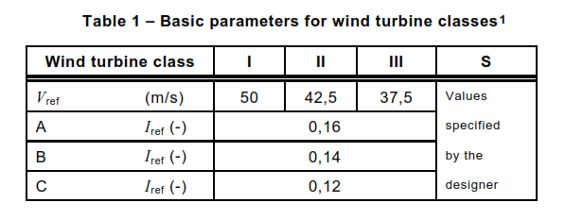
introduction
Turbines are not one-size fits all
IEC 61400-1
Designed for specific conditions, including average wind speed and turbulence
Roman numeral is for average wind speed
  I is the highest wind speed class, III is the lowest wind speed
Letter is for turbulence
  A is highest turbulence intensity, C is the lowest turbulence intensity
Need the right turbine for the wind regime

Slide 4
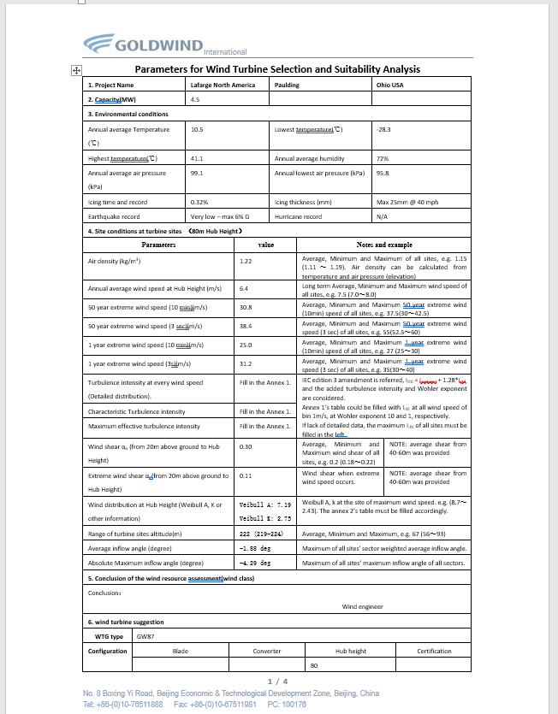
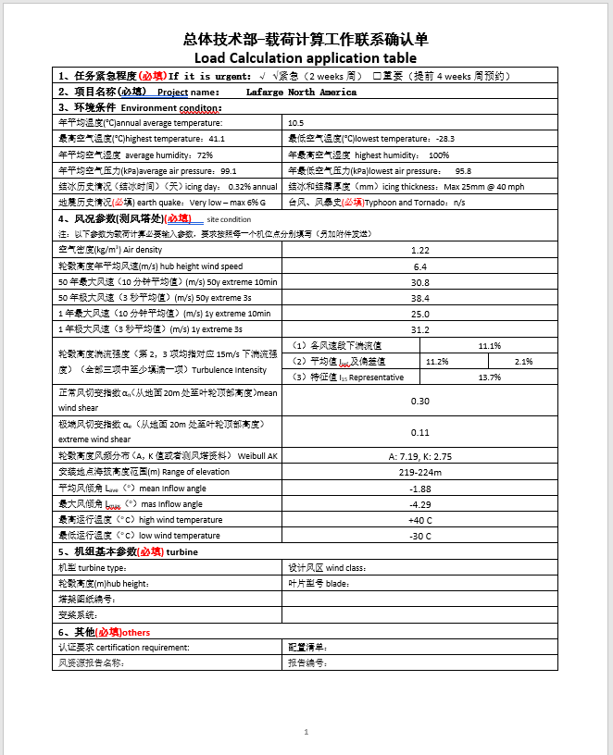
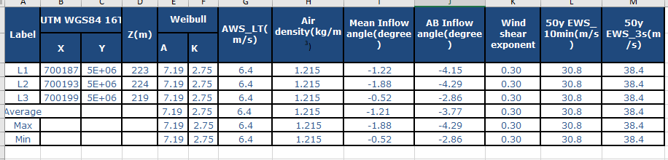
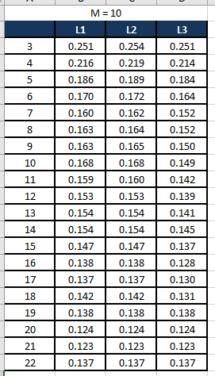
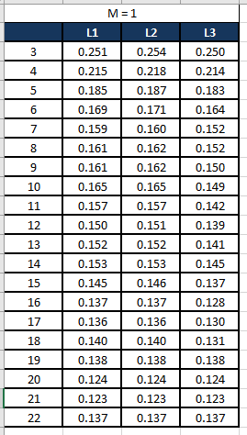
Goldwind forms overview
Templates:
Due Diligence - Working\Templates\GW Forms
Form for Turbine Selection
Load Calc App
Site Conditions

Slide 5
Goldwind forms overview
Form for Turbine Selection
Load Calc App
Site Conditions
All these forms contain variants of the same information that are necessary for Goldwind to run their internal models and determine which class of turbine should be used for the project.

Slide 6
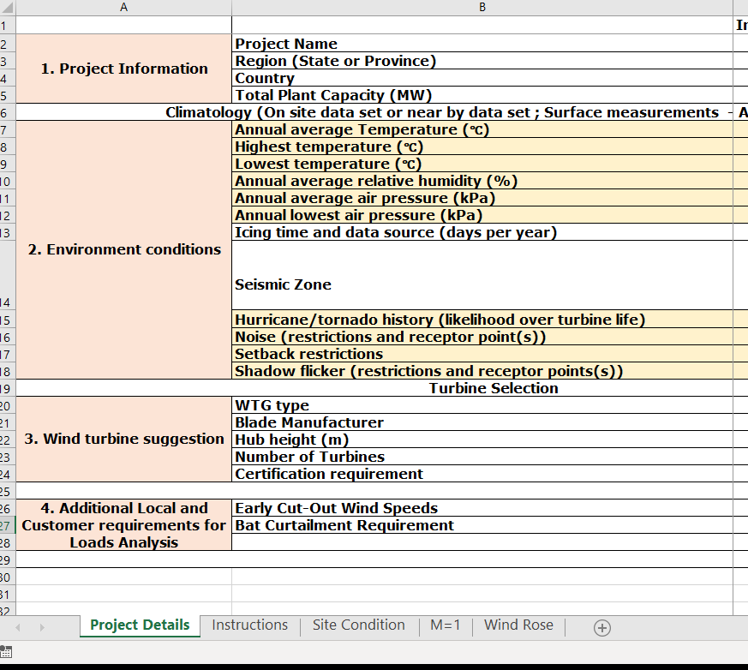
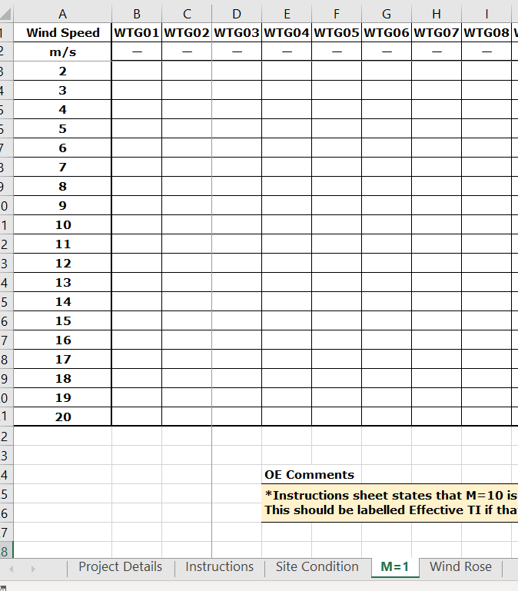
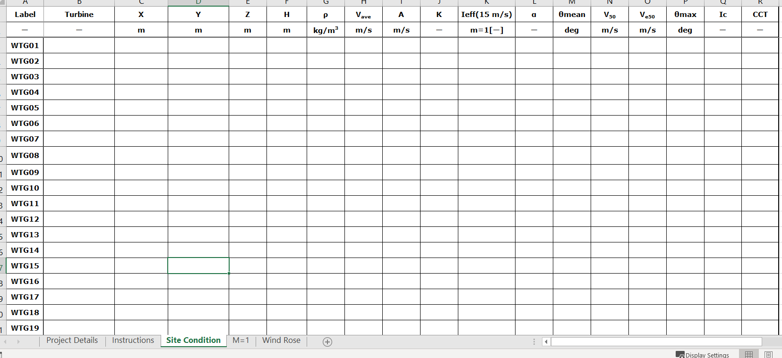
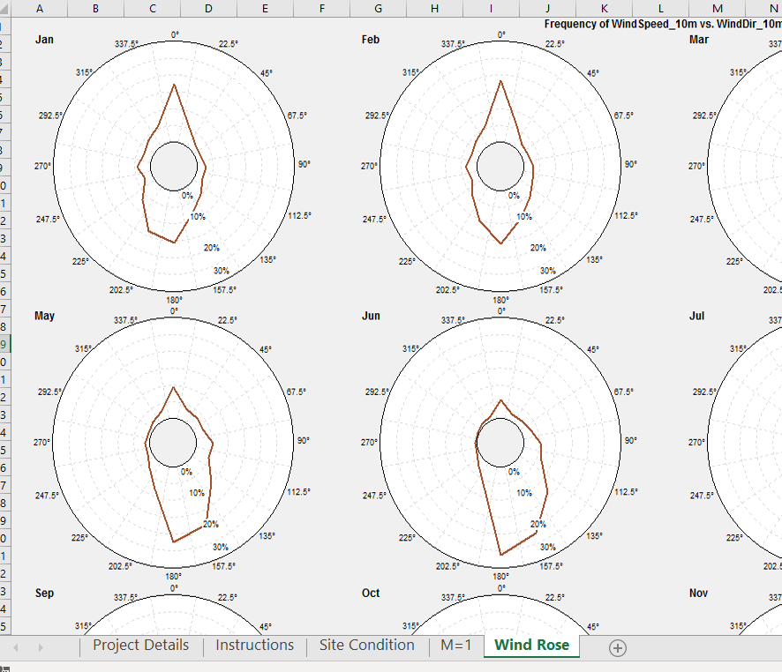
Goldwind forms overview
Proposed Suitability Form
We’ve been going back and forth with GW on what information is necessary to provide for turbine suitability. We sent comments to GW on their proposed
It’s likely that the rest of this presentation will be null shortly and we will move towards this form.
In the meantime…

Slide 7
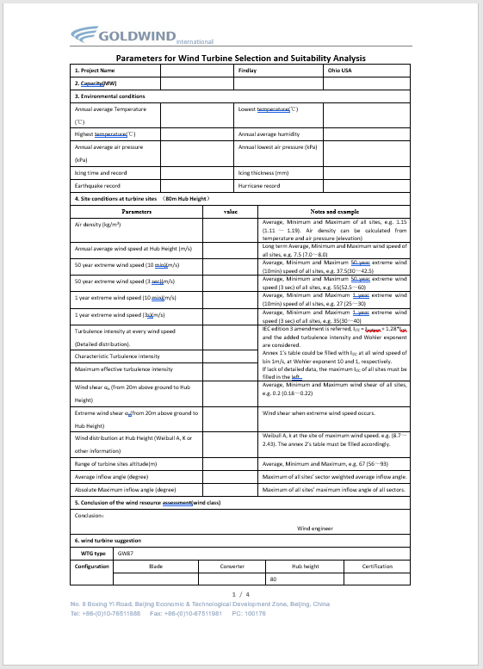
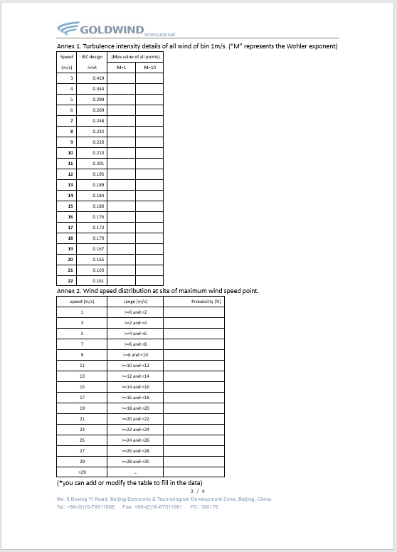
Goldwind forms overview
Form for Turbine Selection
Project Info
TI by ws and Wohler exponent
Environmental Conditions
Site Conditions
WS distribution
GW-portion to fill out

Slide 8
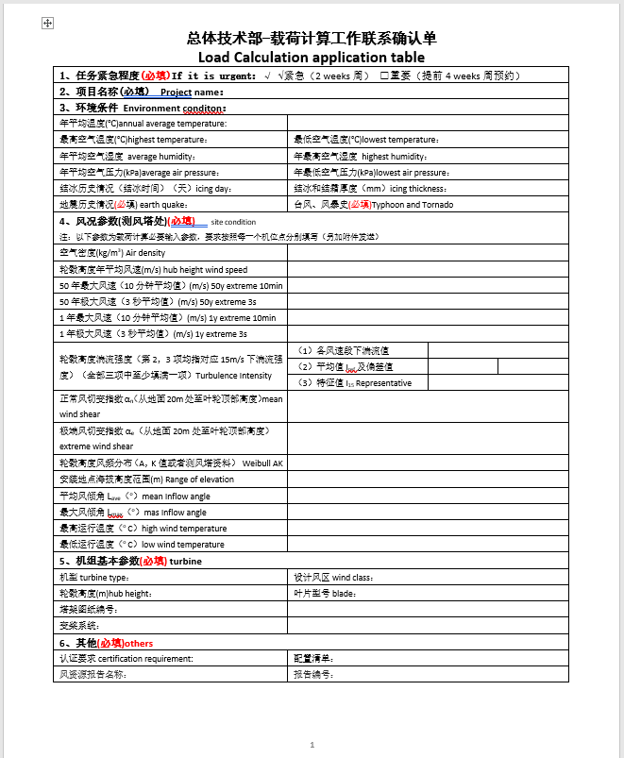
Goldwind forms overview
Load Calc App
Project Info
Environmental Conditions
Yes, it’s in Chinese.
Site Conditions
But we also have some translations in it to make it easier to know what they are asking for.
GW-portion to fill out

Slide 9
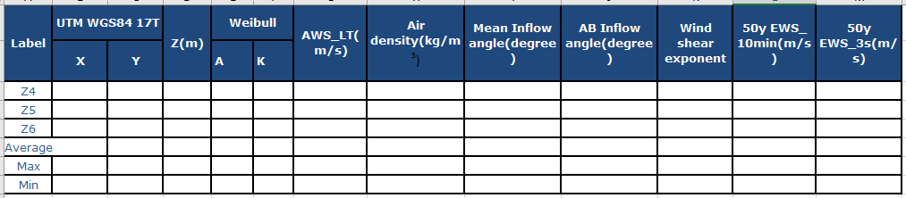
Goldwind forms overview
Site Conditions
Turbine Locations
Average WS
Inflow angles
Winds
Weibull parameters
Site air density

Slide 10
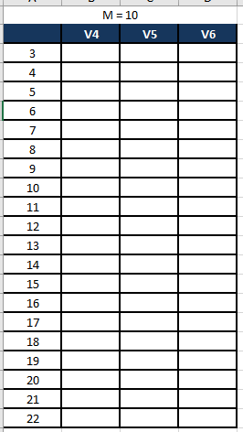
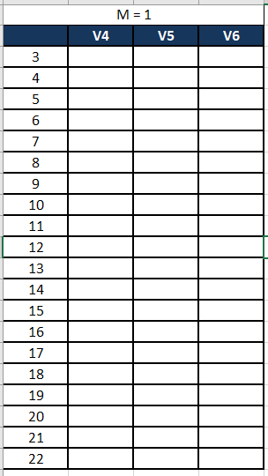
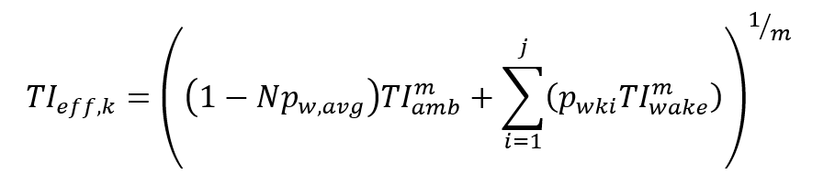
Goldwind forms overview
Site Conditions
Effective TI by wind speed with varying Wohler exponents, for all directions.
Effective TI is the turbulence intensity that takes the wakes of neighboring turbines into consideration and accounts for the added turbulence intensity.
TIamb is Ambient TI
Pw,avg is average probability of wake for all turbines
Pwki is the probability of wake at turbine i in directional sector k
N is number of neighboring turbines
m is Wohler exponent
j is number of turbines
k is directional sector
TIwake is wake-induced TI

Slide 11
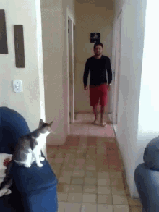
How to fill out
Intro
OH WAIT. WE DID!
And we even formatted the WRA to be in line with the GW form.
If only we had crunched these numbers beforehand during the WRA since we were working with all that data anyways…
Thanks Past-PPT team. You really thought about Future-PPT team.
All information in these forms must be exact to the WRA.
At this point in the DE process, the WRA is likely already reviewed and signed by IE so we MUST USE THE VALUES FROM IT

Slide 12
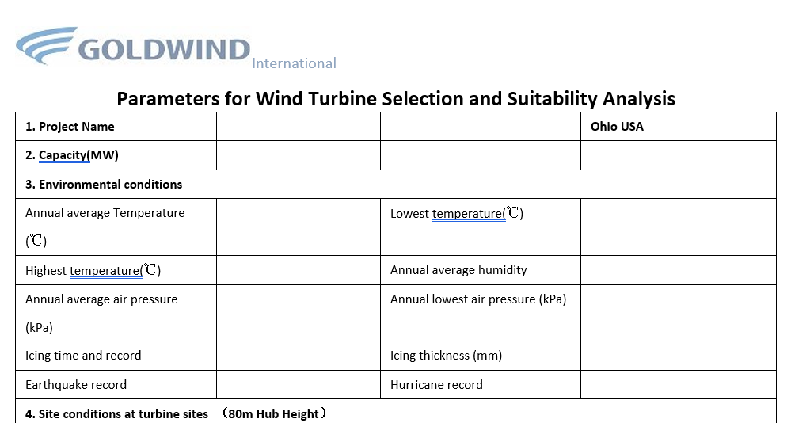
How to fill out
Form for Turbine Selection
Basic project information
A
A
A
B
C
C
E
WRA:
Section 6. Environmental Conditions
Subparts A-C, E-G
E
G
F

Slide 13
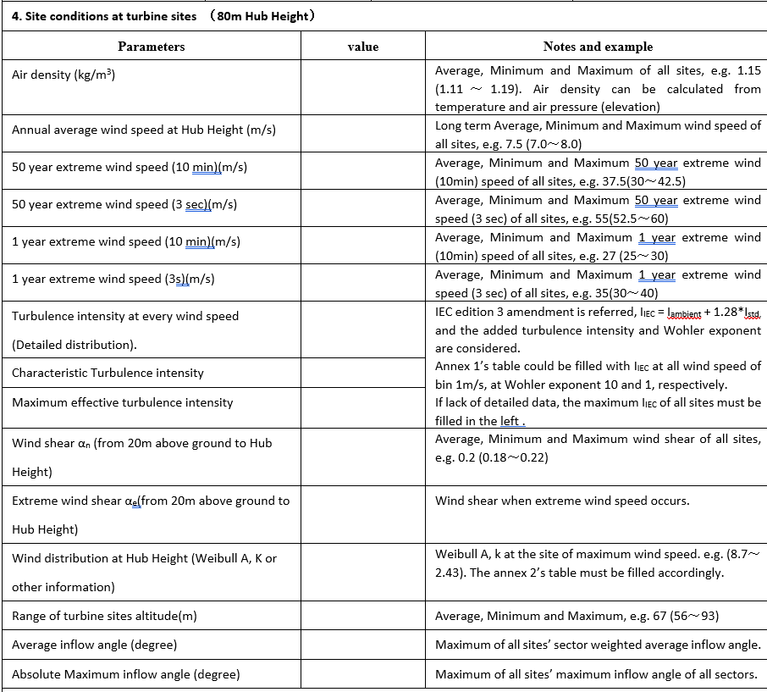
How to fill out
Form for Turbine Selection
6D
7A
7B
7B
7B
WRA:
Section 6. Environmental Conditions
Subpart D
Section 7. Site Conditions
Subparts A, B, D, E, G
Section 2. Project and Site Info
Subpart A
7B
7E
7E
7E
7D
7A
Always 0.11
2A
7G
7G

Slide 14
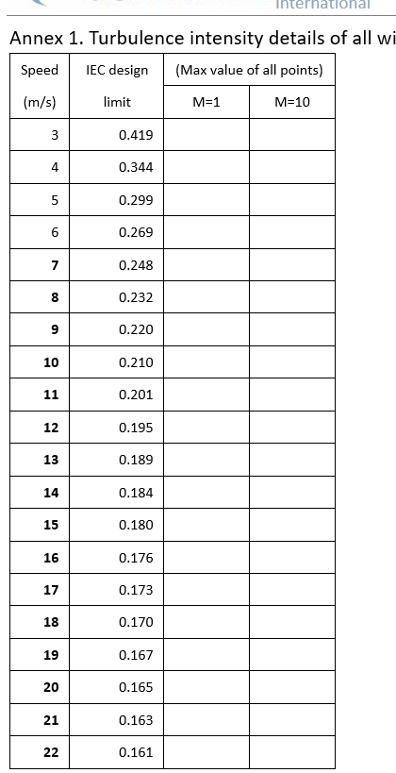
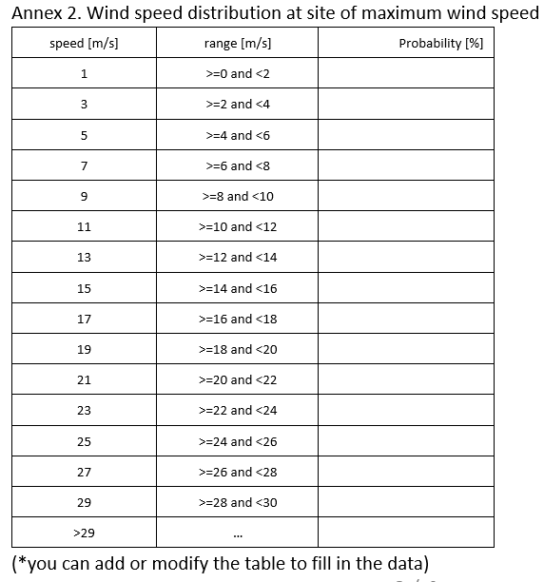
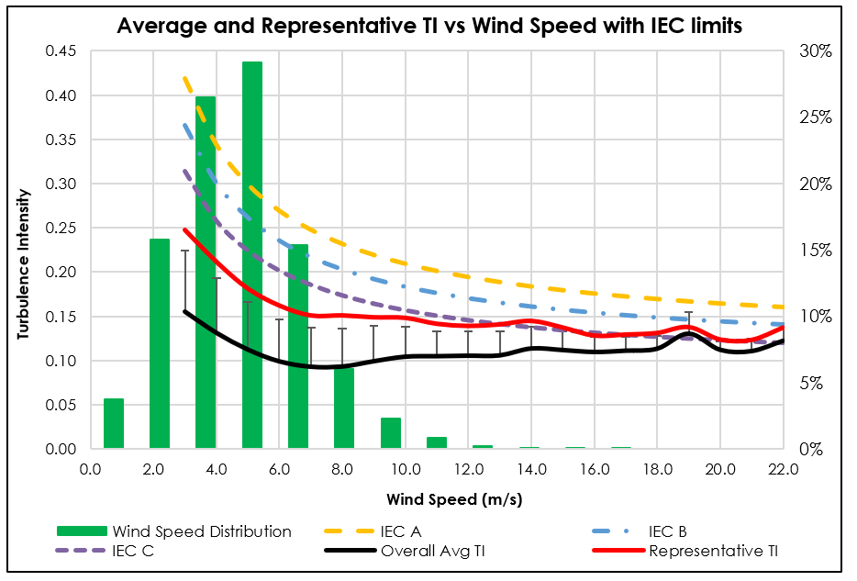
How to fill out
Form for Turbine Selection
WRA:
Section 7. Site Conditions
Subpart E
Need to create distribution based on MCP’d dataset used for Weibull calcs
7E
Need to make figure for each report

Slide 15
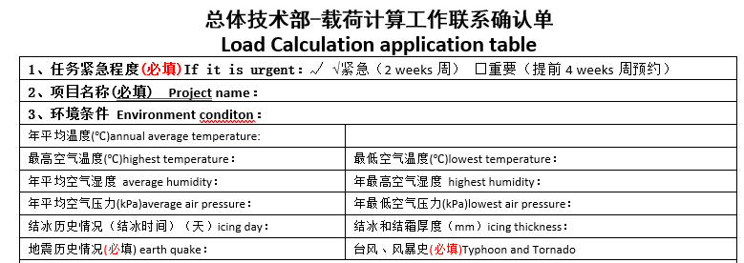
How to fill out
Load Calc App
Project name. Confirm it’s the same as the Form for Turbine Selection
WRA:
Section 6. Environmental Conditions
Subparts A-C, E-G
Make sure you’re answering the right questions. Look at previous GW forms if you are unsure what exactly is being asked.

Slide 16
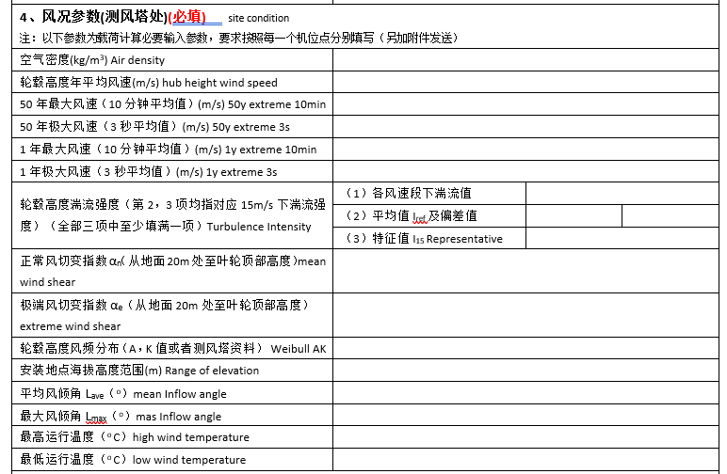
How to fill out
Load Calc App
WRA:
Section 6. Environmental Conditions
Subpart D
Section 7. Site Conditions
Subparts A, B, D, E, G
Section 2. Project and Site Info
Subpart A
(1) Average, all direction TI in %
(2) TI at 15 m/s in %; Standard dev of TI at 15 m/s in %
(3) Rep-TI at 15 m/s in %
P50 wind shear α all WS > cut-in
Always 0.11

Slide 17
How to fill out
Site Conditions
WRA:
Section 7. Site Conditions
Subpart B; 50 yr extremes
*all values are the same
WRA:
Section 7. Site Conditions
Subpart D; P50 all ws > cut-in
*all values are the same
Need to put turbine lat/lons into Universal Transverse Mercator (UTM) coordinates
WRA:
Section 7. Environ’l Conditions
Subpart D
*all turbines use same values
WRA:
Section 7. Environ’l Conditions
Subpart D
*each turbine is different value, then max/min is of all the turbines
*AB is max inflow angle
WRA:
Section 6. Site Conditions
Subpart A
*all turbines use same values

Slide 18
How to fill out
Site Conditions
WRA:
Section 7. Environ’l Conditions
Subpart E
*Effective TI by turbine and by Wohler exponent

Slide 19
sending to goldwind
Process
Complete all three files and PDF
Signed off by another person
GW-C uses all the information to run loads modeling
HoPPT will send forms to GW-US
GW-US will send to GW-C
Let Head of PPT know GW files are complete
Discussions with GW-C/GW-US regarding results of loads report
Approval for type of turbine for project
HoPPT sends loads report to Construction
GW-US sends HoPPT loads report
GW-C sends loads report back to GW-US
Construction then sends to Nester for tower analysis

Slide 20
sending to goldwind
Process
Complete all three files and PDF
Signed off by another person
We do NOT use GW as an editor.
Let Head of PPT know GW files are complete
We need to triple check each form sent to them for correct numbers and typos.
Things to do:
Confirm all values with the WRA
Confirm spelling of project names, project location, lat/lons
Have a second person confirm and approve all values/words as well
If GW form was already sent for a nearby project, compare values for current project with the other project. Make sure they are comparable and not drastically different.
CHECK TO SEE IF GW WAS SENT A FORM ALREADY FOR A NEARBY PROJECT

Slide 21




sending to goldwind
Process
HoPPT will send forms to GW-US

Slide 22

sending to goldwind
Process
HoPPT will send forms to GW-US
GW-US sends to GW-C

Slide 23

sending to goldwind
Process
HoPPT will send forms to GW-US
GW-C uses information to run loads models
GW-US sends to GW-C

Slide 24
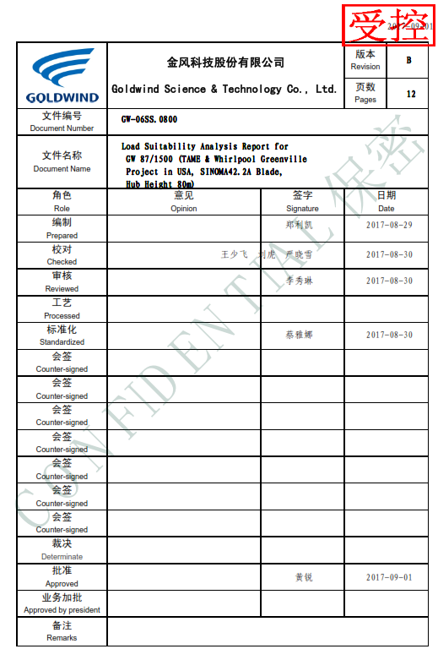
sending to goldwind
Process
HoPPT will send forms to GW-US
GW-C uses information to run loads models. Creates loads report
GW-US sends to GW-C

Slide 25
sending to goldwind
Process
HoPPT will send forms to GW-US
GW-C uses information to run loads models. Creates loads report
GW-C sends loads report to GW-US
GW-US sends to GW-C

Slide 26
sending to goldwind
Process
HoPPT will send forms to GW-US
GW-C uses information to run loads models. Creates loads report
GW-C sends loads report to GW-US
GW-US sends loads report to HoPPT
GW-US sends to GW-C
All of these steps combined are contractually supposed to take 21 days.

Slide 27
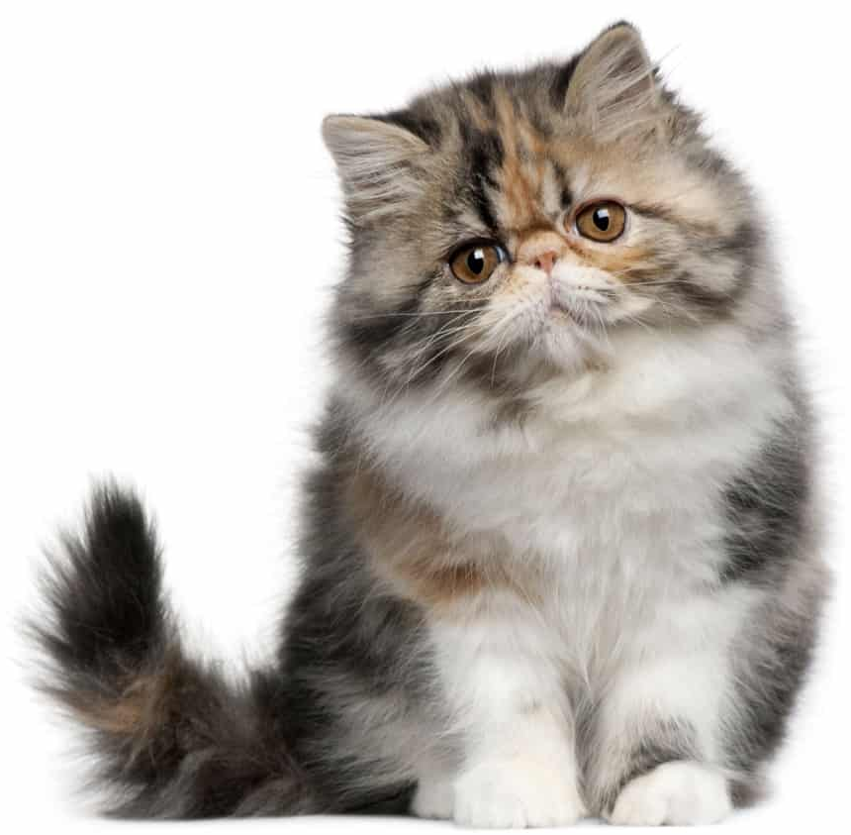
sending to goldwind
Process
Discussions with GW-C/GW-US regarding results of loads report
Approval for type of turbine for project
Sorry, but according to these values you provided, the turbine you want failed at 23 m/s for TI and loading.
We can mitigate that! We will turn the turbines off at 20 m/s regardless so it will not be affected.
Sounds good to me!
You may have a turbine.

Slide 28


sending to goldwind
Process
HoPPT sends loads report to Construction
Construction then sends to Nester for tower analysis

Slide 29
sending to goldwind
Process
HoPPT sends loads report to Construction
Construction then sends to Nester for tower analysis

Slide 30
sending to goldwind
Process
HoPPT sends loads report to Construction
Construction then sends to Nester for tower analysis
PPT’s work here is done.

Slide 31
homework
Read Chapter 6 (External Conditions) of IEC 61400-1
Due next class

Slide 32

Questions?
Questions? Comments? Concerns?
Next class:
Next Steps Part 1

