Slide 1
PPT WIND SCHOOL (CLASS 14b)
Engineering

Slide 2
outline
Introduction
Engineering
  Site Layout
  Interconnection
    One Line
  Impact on Siting
  Consideration during Development

Slide 3
introduction
Engineering is the backbone of any project
Includes the following:
  Safety Planning
  Optimization
  Client’s Goals
All engineering flows through OE
  In-house staff
  Close partners
Engineering for success before the project begins

Slide 4
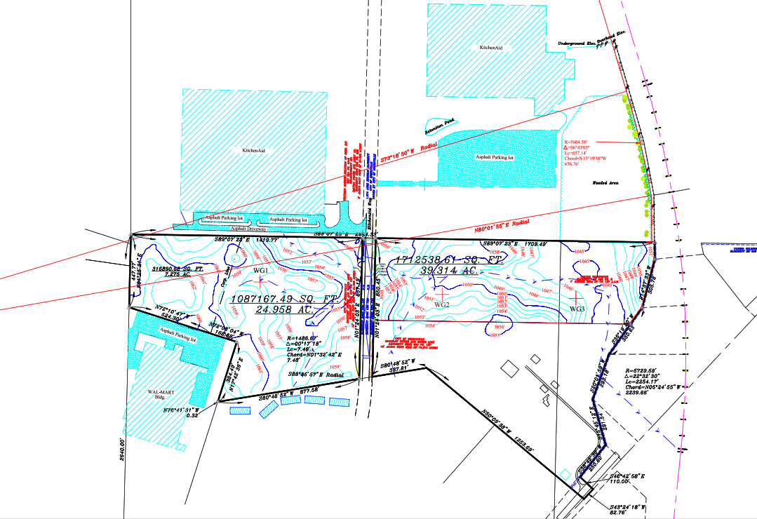
Engineering
Existing Conditions

Slide 5
Engineering
Impact on Siting
Goal is to optimize production but save construction costs
Have to consider construction costs
  Labor
  Materials
    Rock
    Collection Line
    Trees
  Equipment needed
Utilizing/Avoiding terrain and existing infrastructure

Slide 6
Engineering
Considerations During Development
Roads
  Boring or overhead implications = $$$
Steam/River
  Boring or overhead implications = $$$
Forest
  Removal of trees = Time
Elevation changes
  Resulting in flooding
  Implications on drainage

Slide 7
Engineering
Site Layout
What is needed
  Access Drives
  Crane Pads
  Parking and Laydown Yard
  Collection Lines
  Communication Lines
  Crane Staging Area
  Turbine Components Staging Area
  Drainage

Slide 8
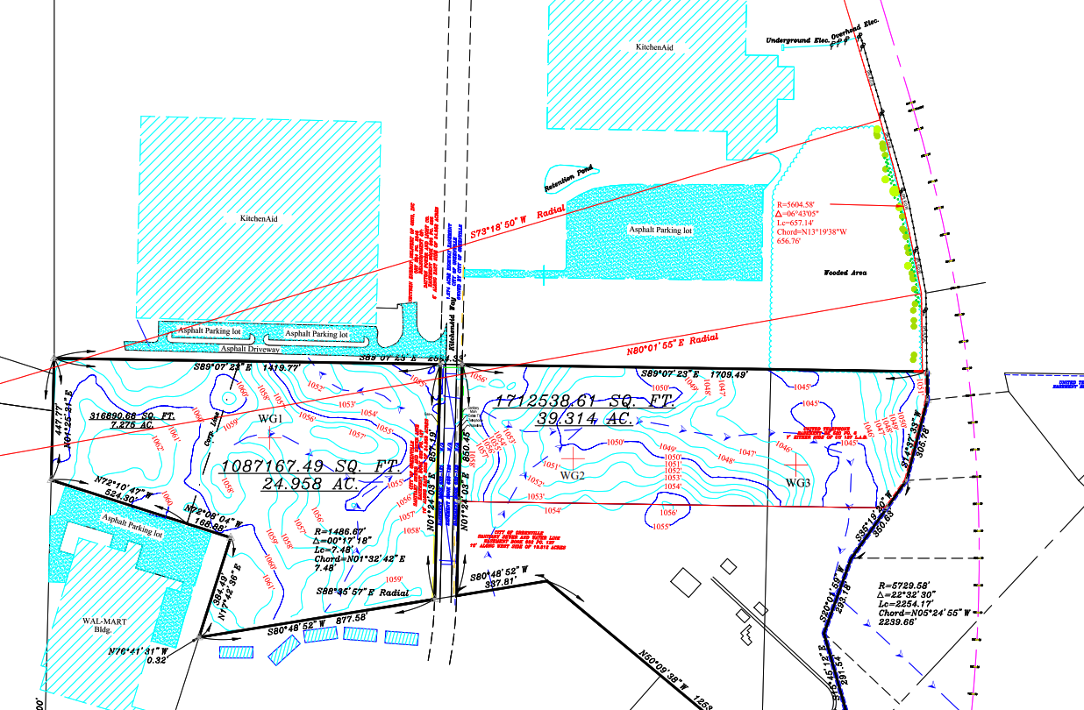
Where would you place collection lines and access roads?

Slide 9
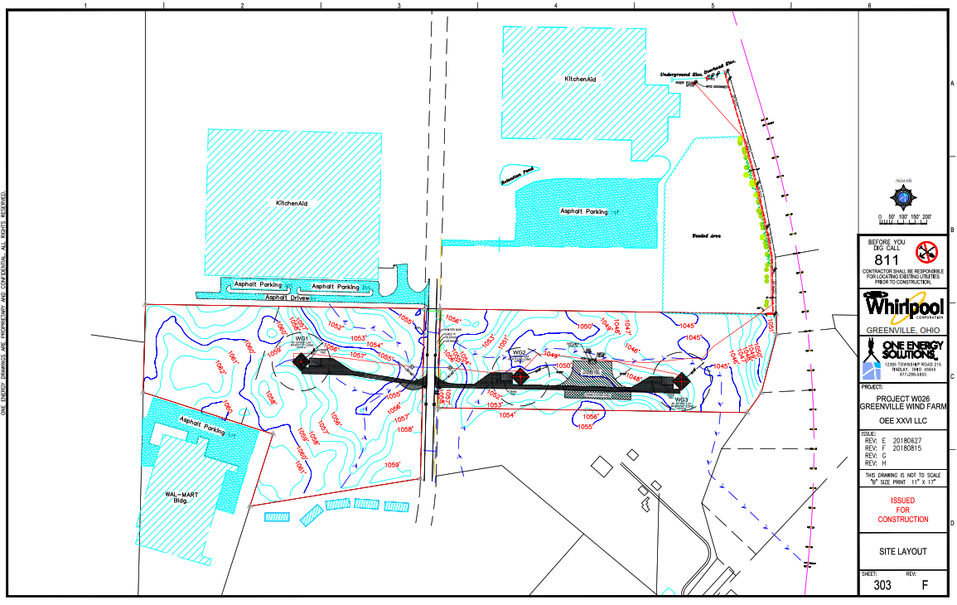
Engineering
Site Layout

Slide 10
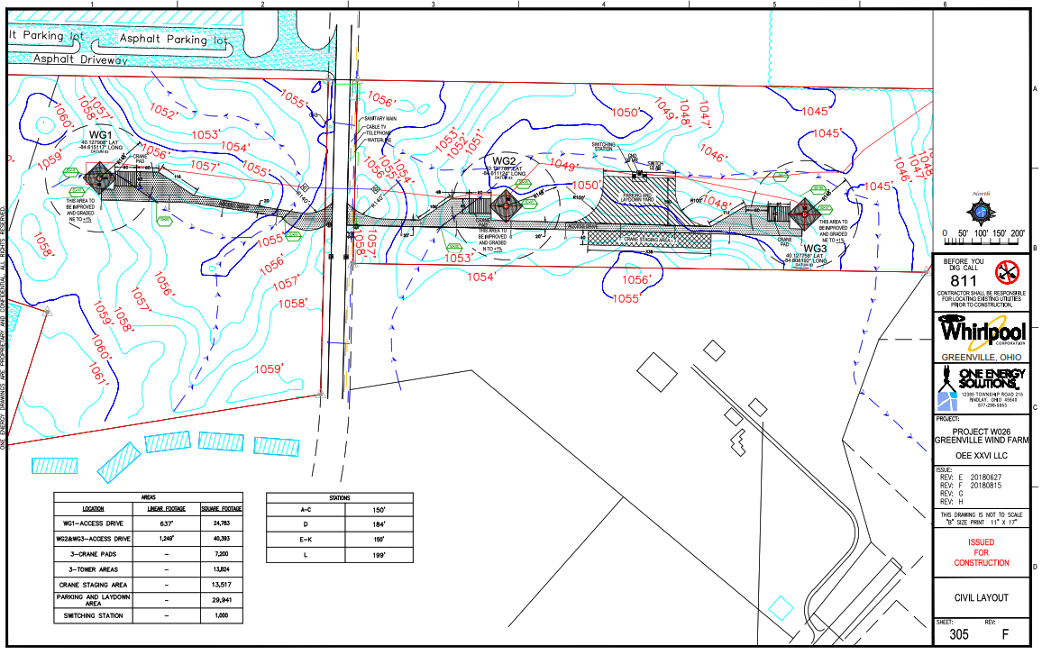
Engineering
Site Layout

Slide 11
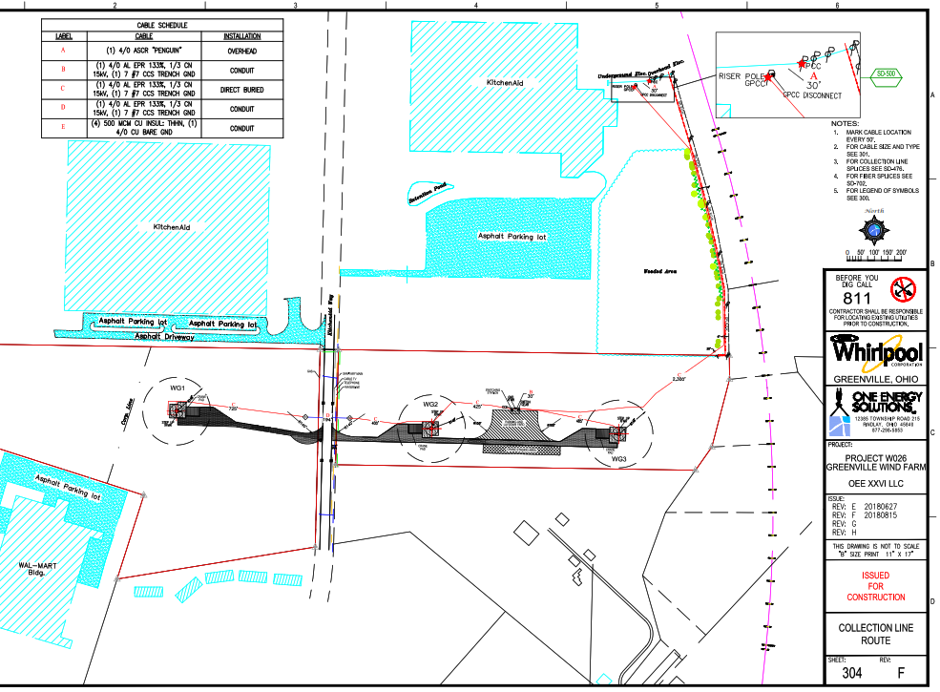
Engineering
Collection Line

Slide 12
Engineering
Collection Line
How will the collection line cross the road?
Bore
Overhead

Slide 13
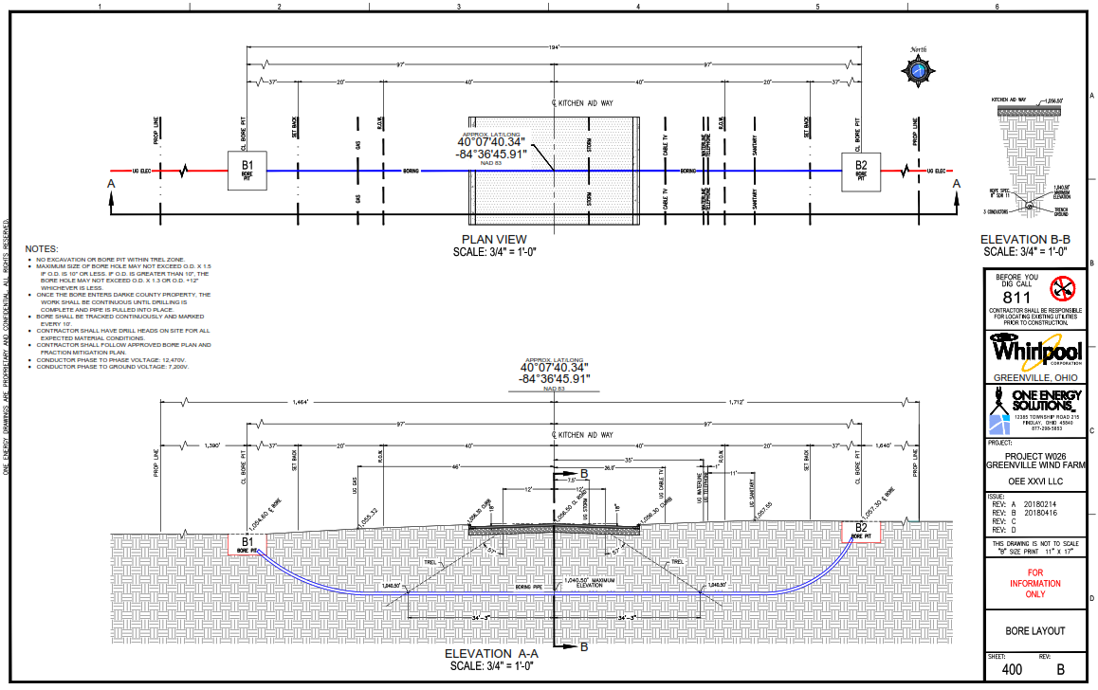
Bore Layout

Slide 14
Engineering
One-Line
Representation of complicated electrical distribution system into a simplified description.
Main components are indicated by standard graphical symbol
Provides information how the components connect and how the power flows through the system.
  Flow of electricity from turbines to customer

Slide 15
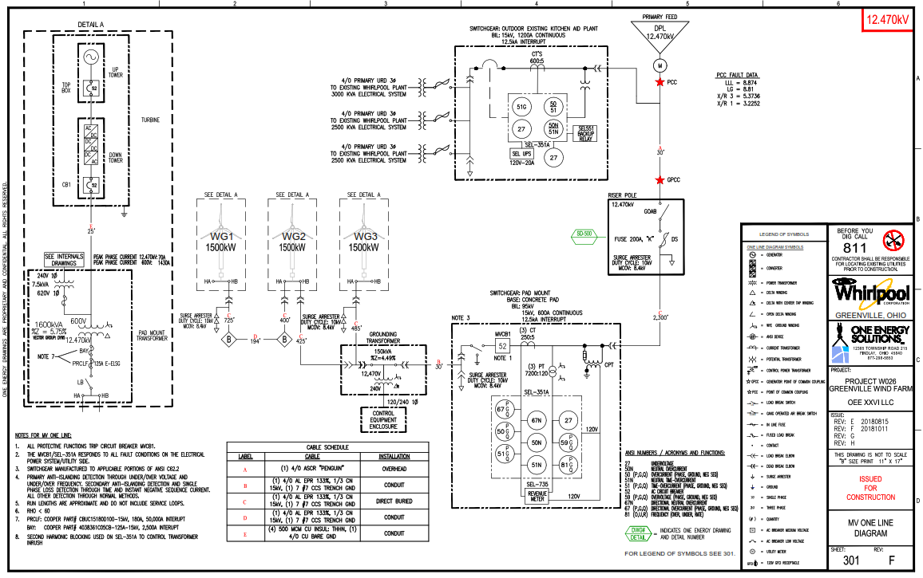
Engineering
One-Line

Slide 16
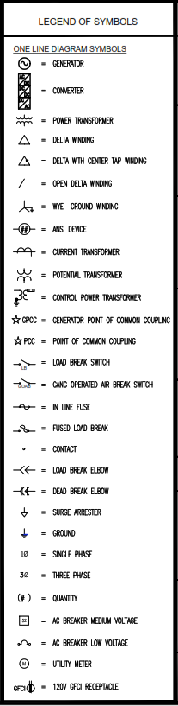
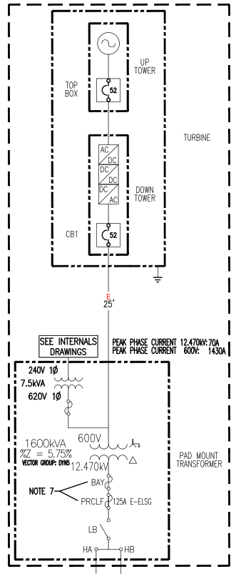
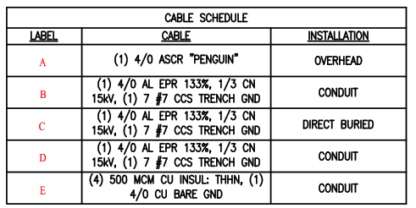
Engineering
One-Line: Turbine and Transformer

Slide 17
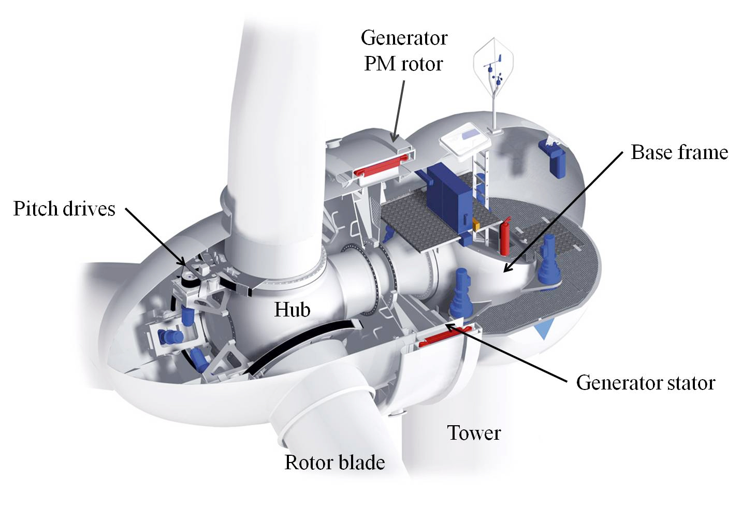
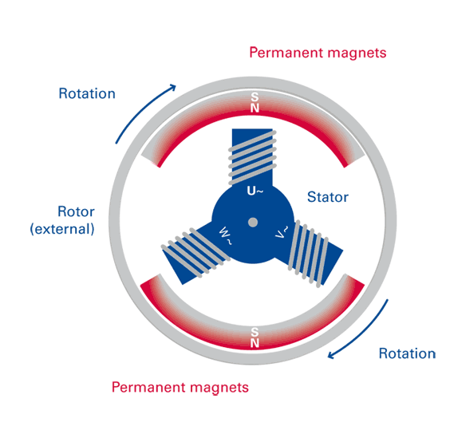
Engineering
Permanent Magnet Direct Drive Generator

Slide 18
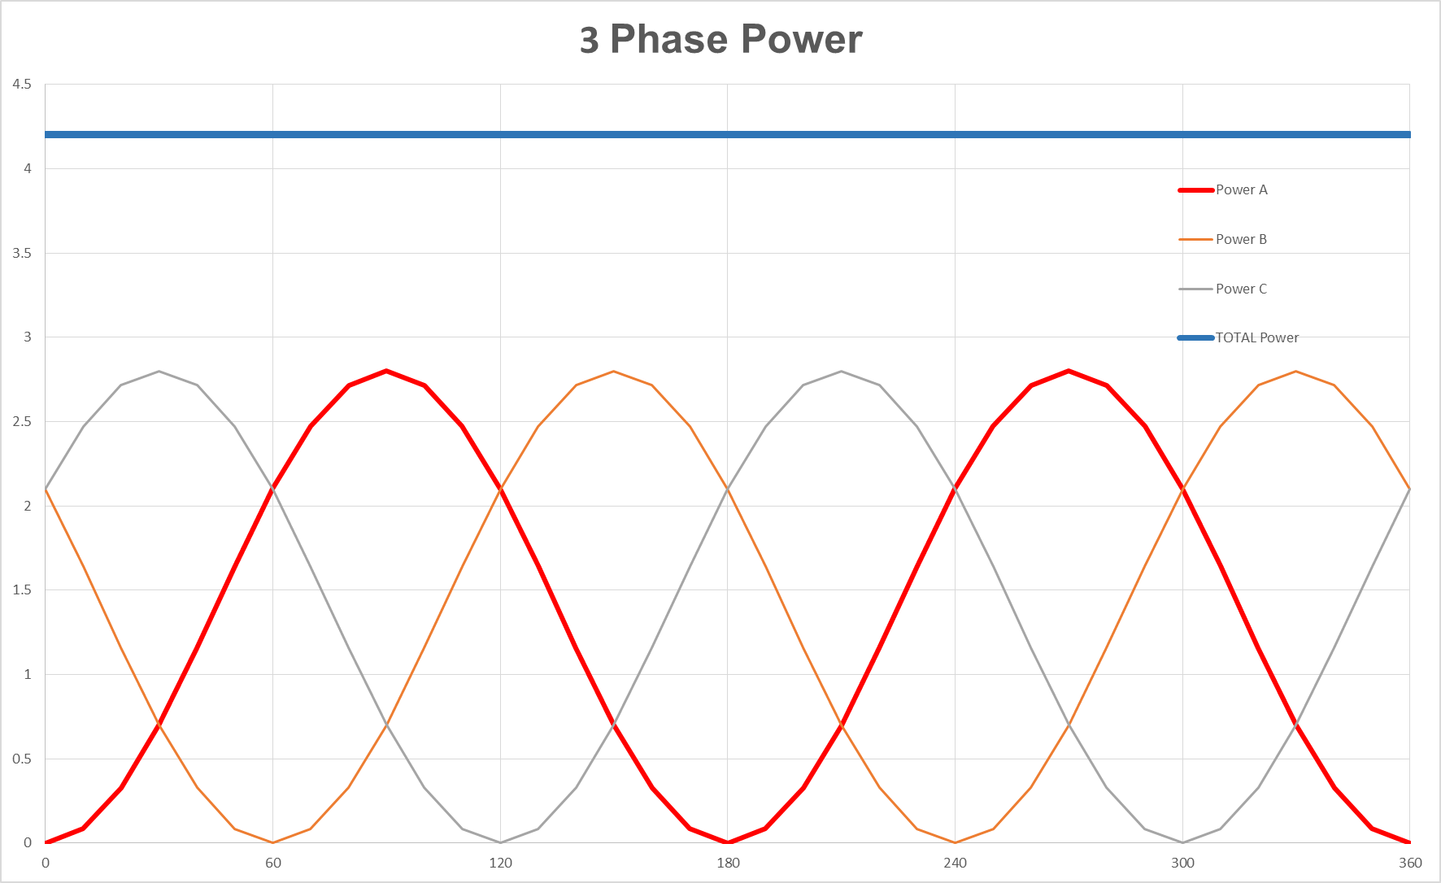
Engineering
AC Three Phase (3Φ) - Power (Watts) = Volts x Amps

Slide 19
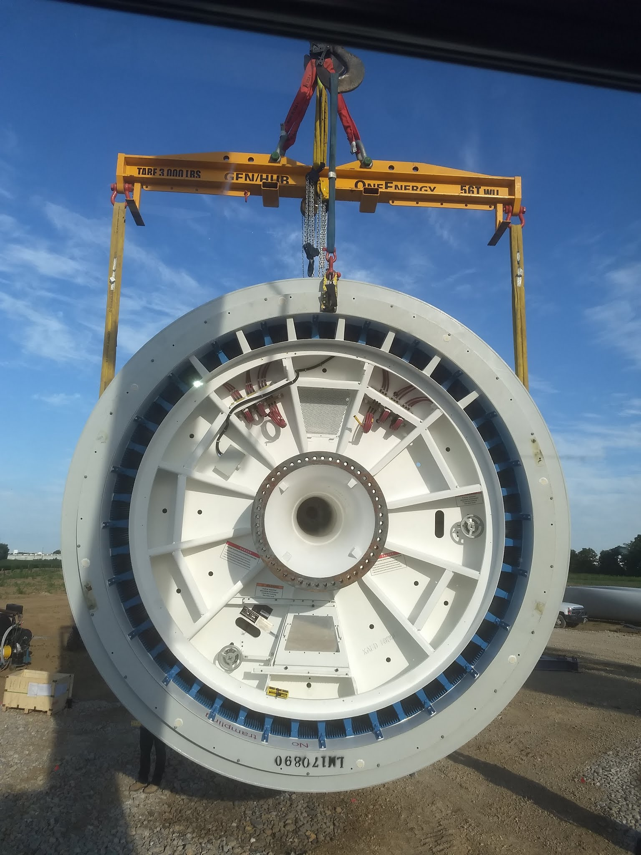
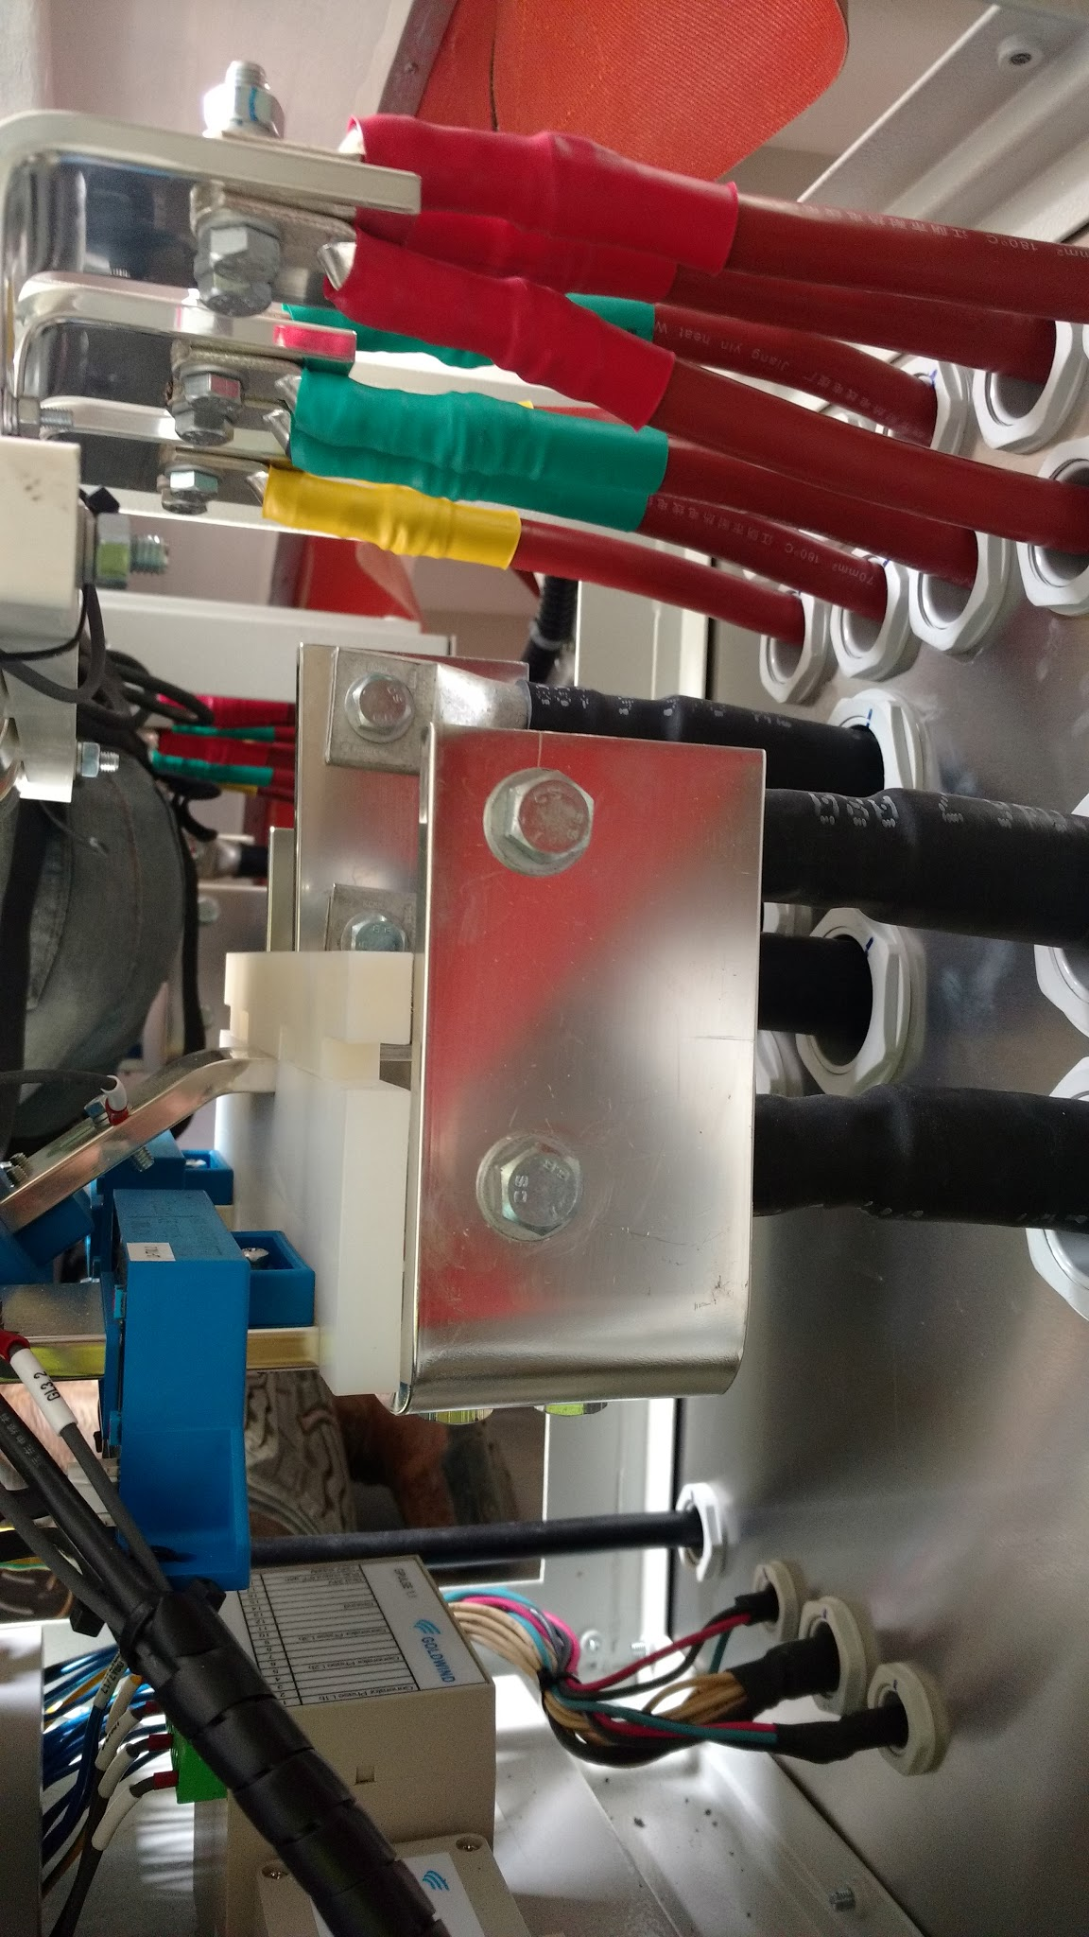
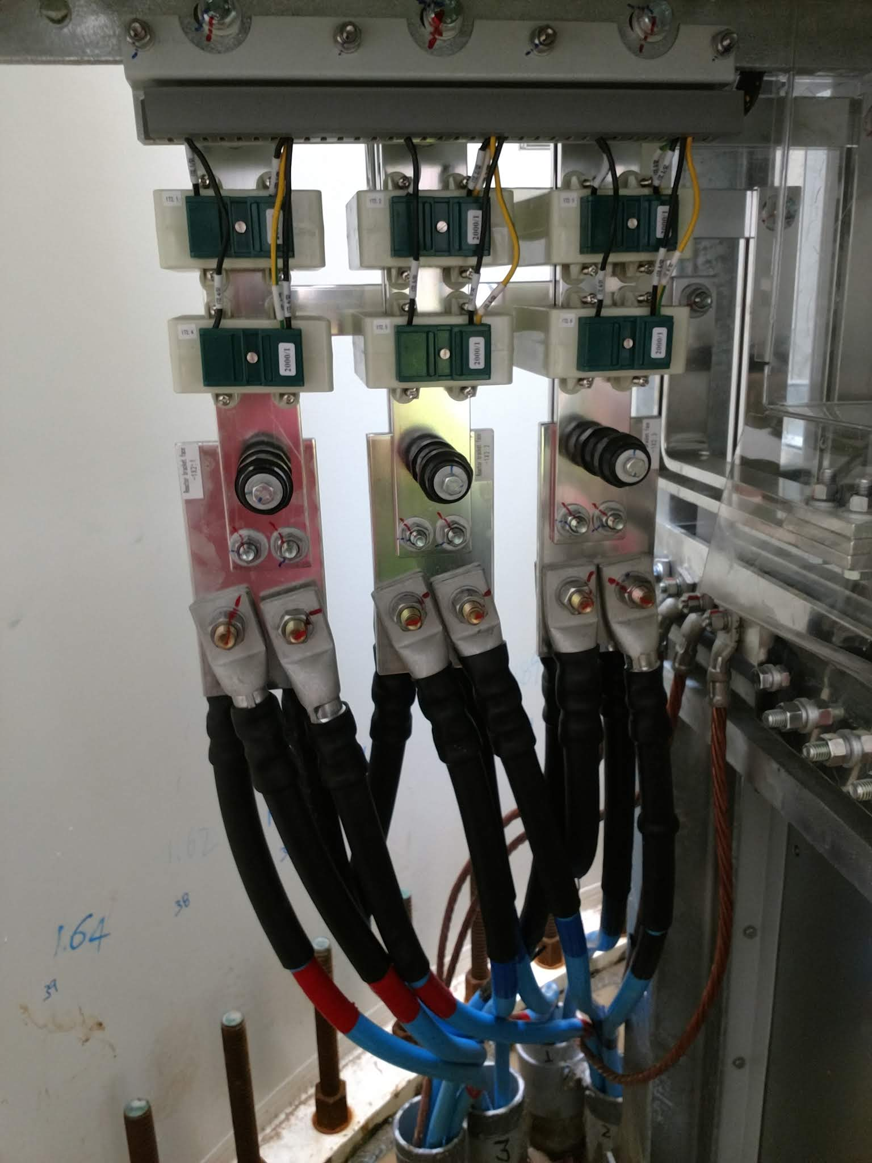
Engineering
One-Line: Generator to Basement
Generator
Gen to Nacelle
To Transformer

Slide 20
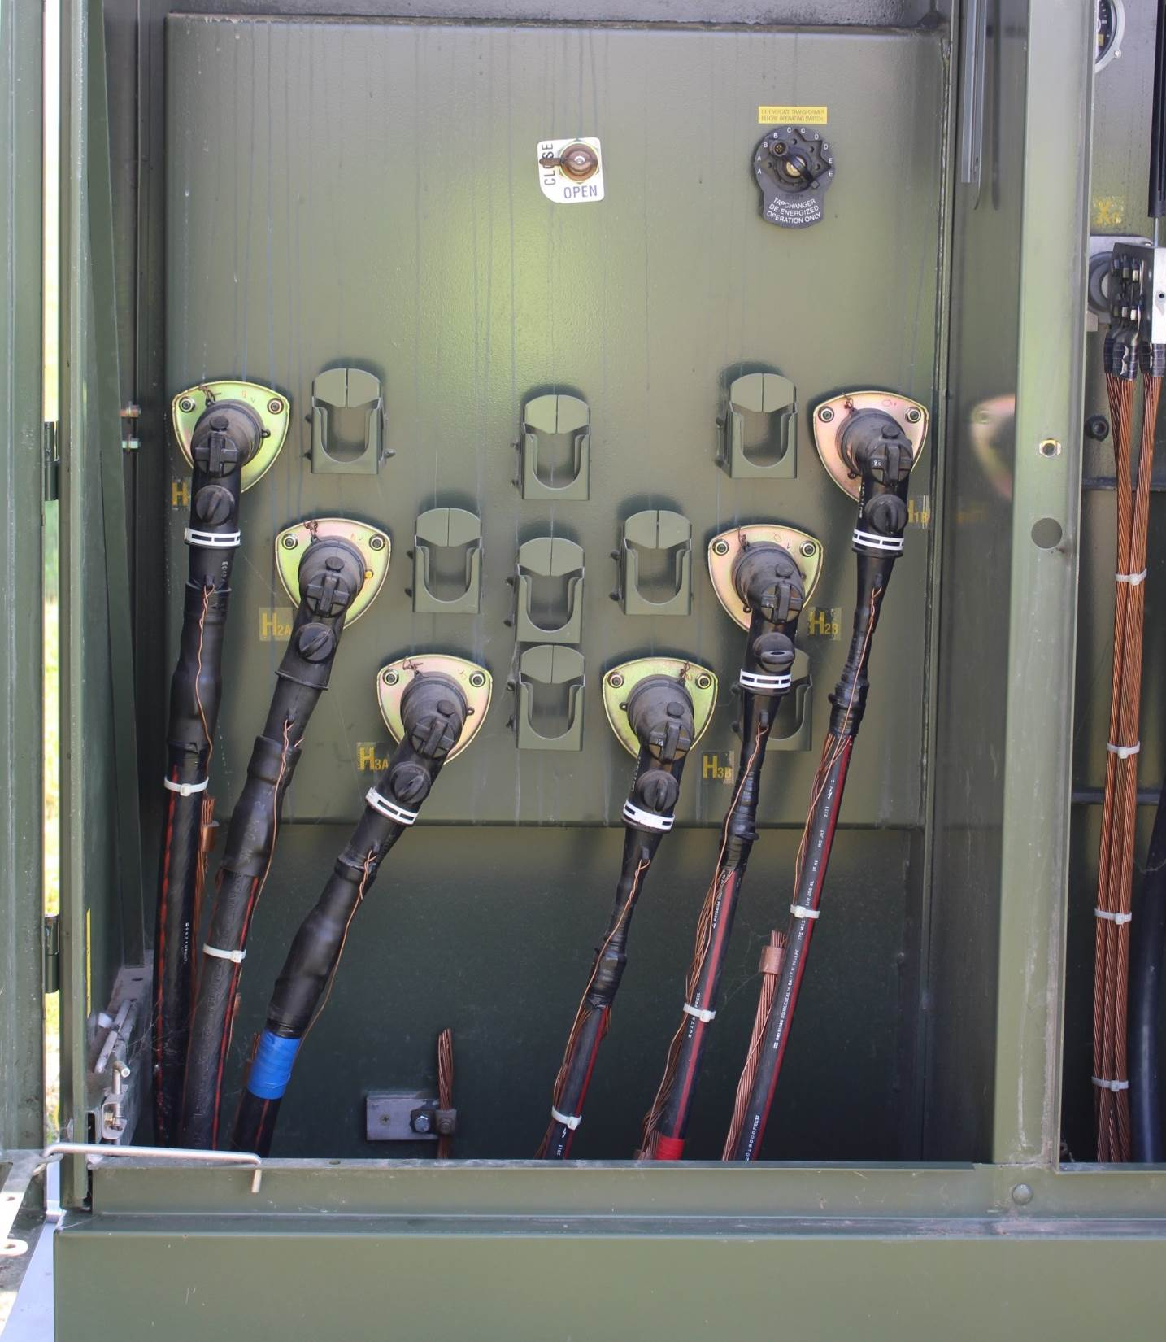
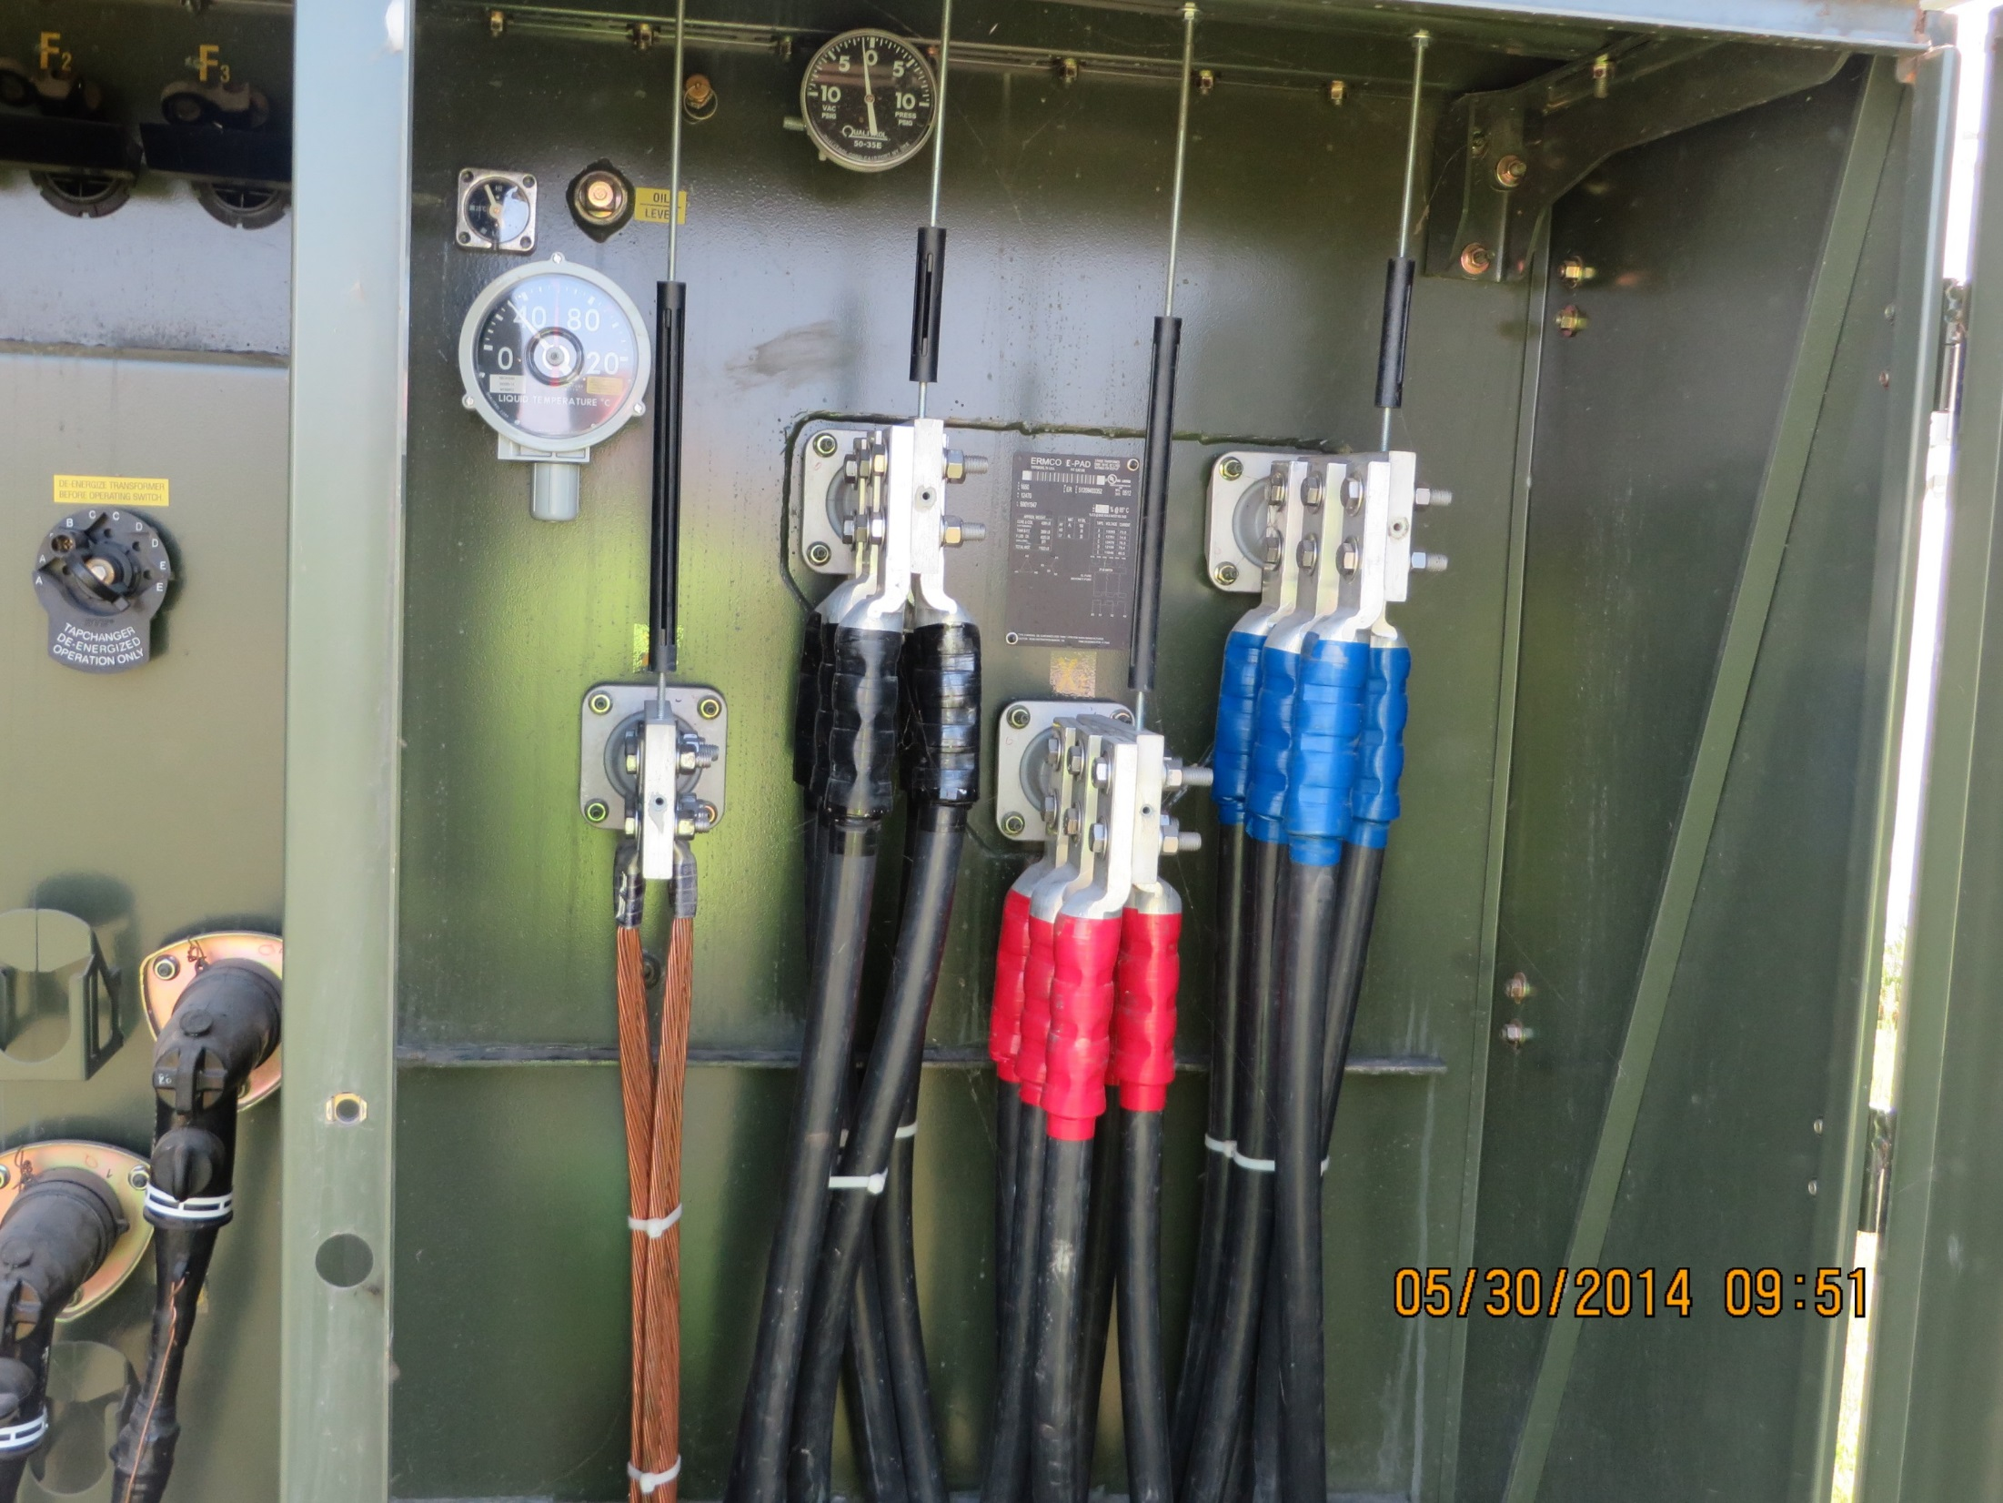
Engineering
One-Line: Step-Up Transformer
High Side - Grid
Low Side - Turbine

Slide 21
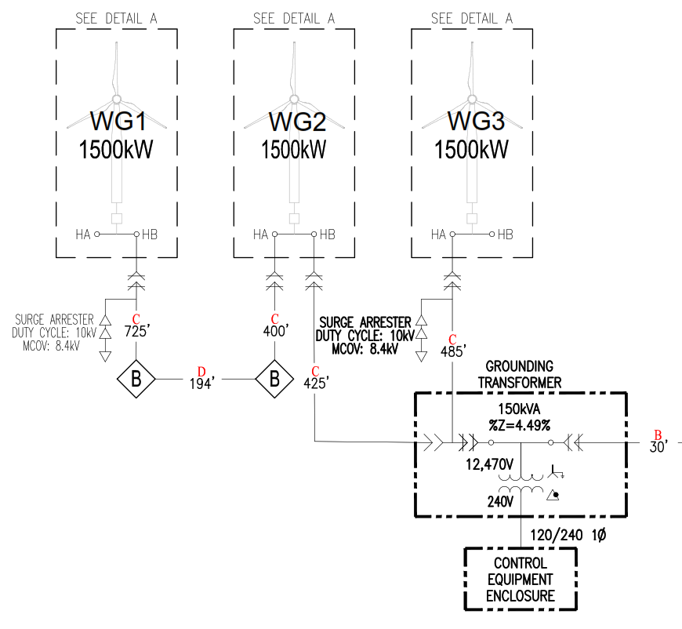
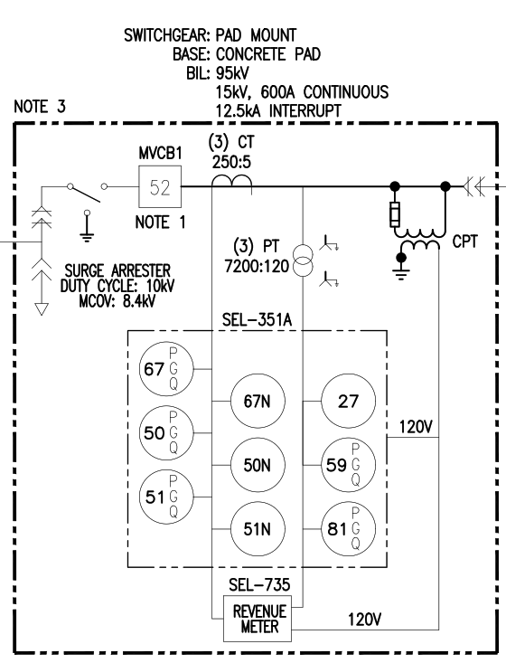
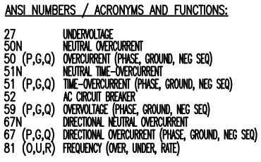
Engineering
One-Line: Ground Transformer & Switchgear

Slide 22
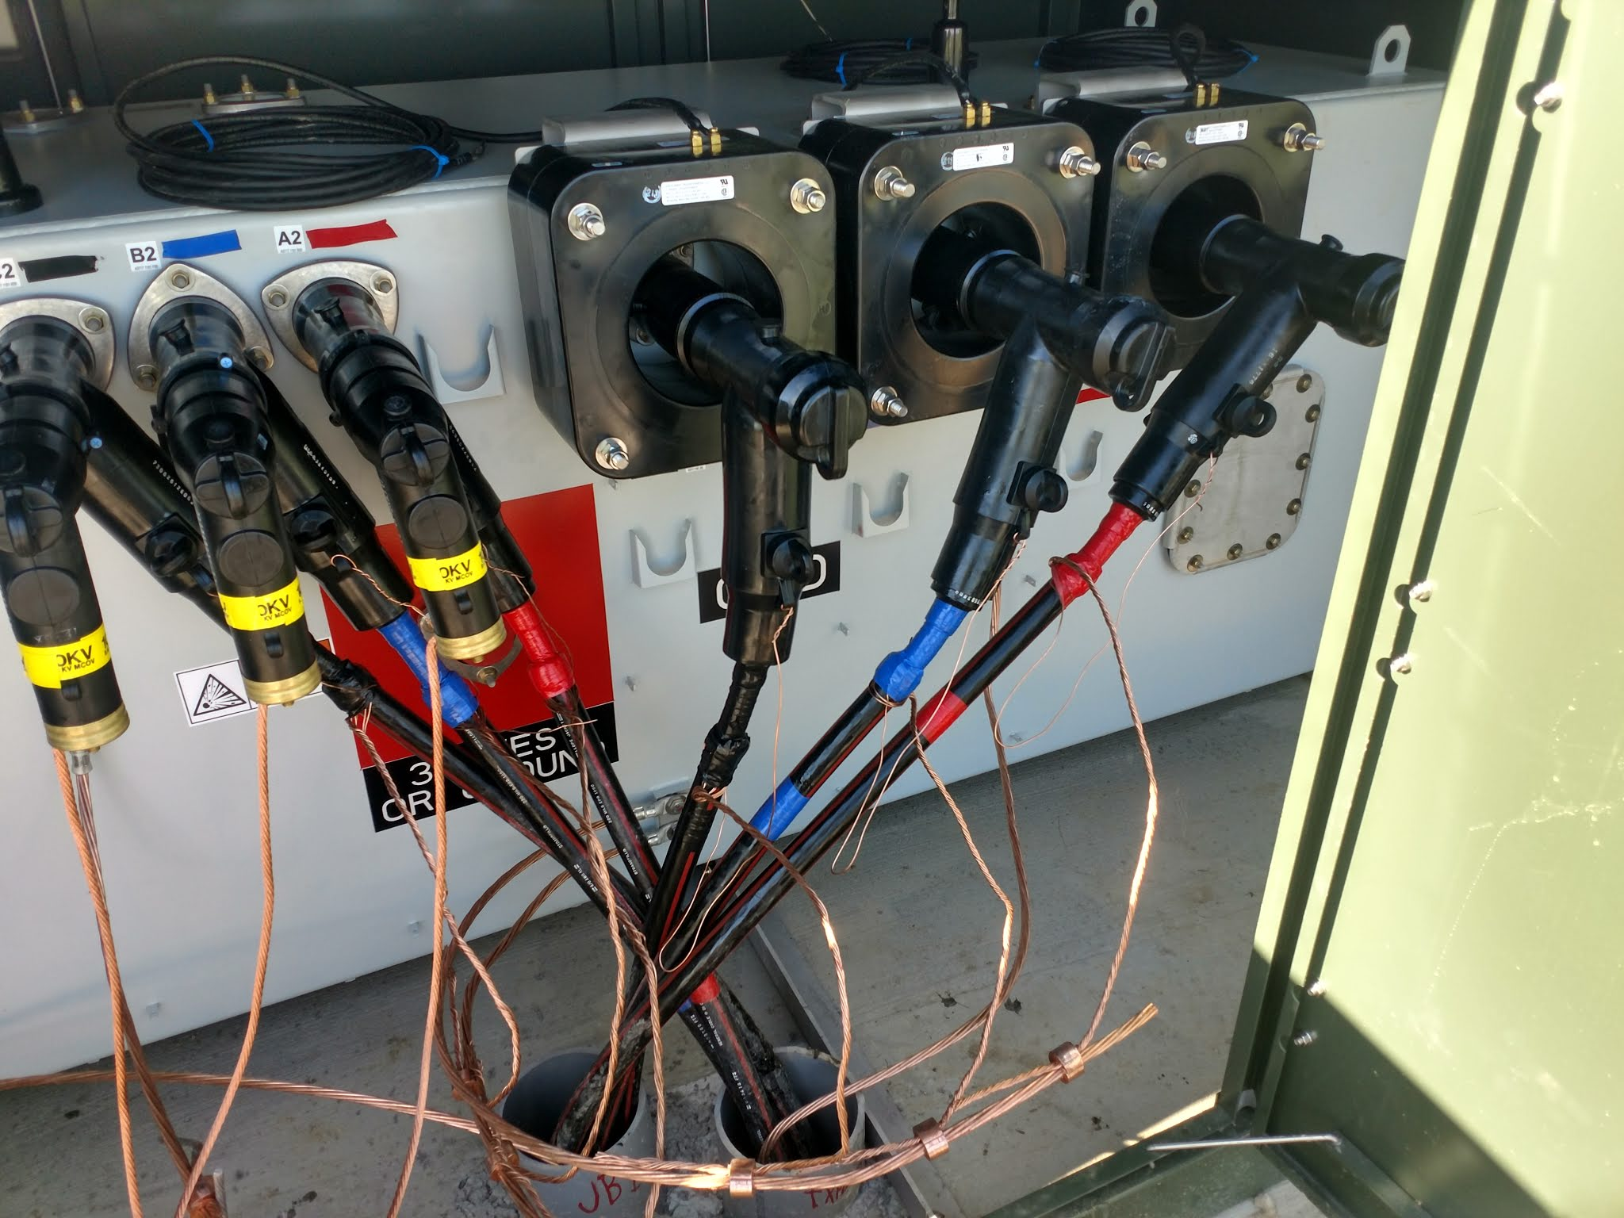
Engineering
One-Line: Switchgear

Slide 23
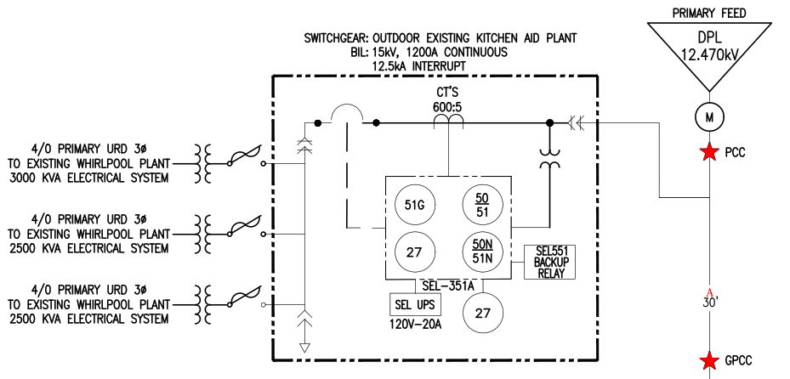
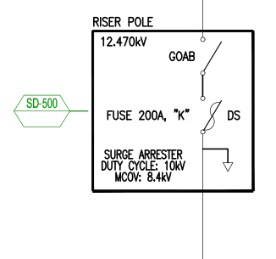

Engineering
One-Line: Point of Common Coupling

Slide 24
Engineering
Geotech
Completed after a project has been signed and land/easement is obtained
To explore and evaluate the subsurface conditions at the proposed WTG sites, develop geotechnical design and construction recommendations for the project
Implications on foundation design, grounding grid, and existing conditions. Used to calculate ground bearing pressure for crane pad and for backfilling foundation.

Slide 25
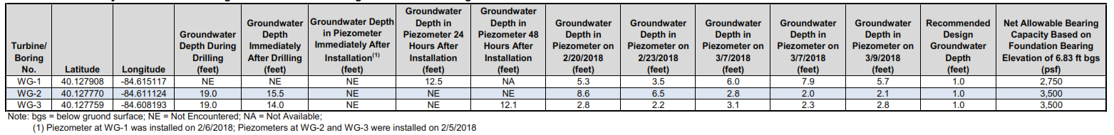
Engineering
Geotech
Analyzes allowable bearing pressure and water table

Slide 26
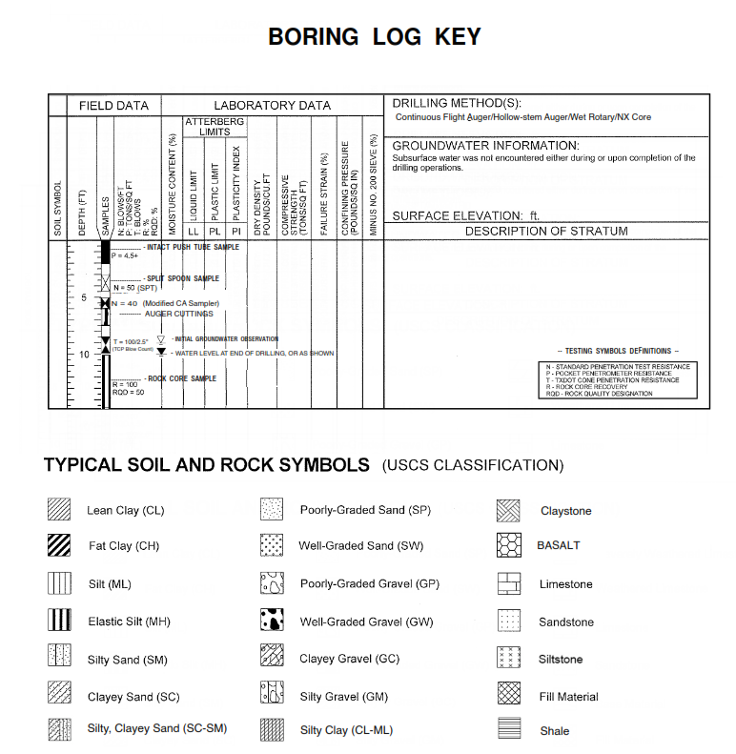
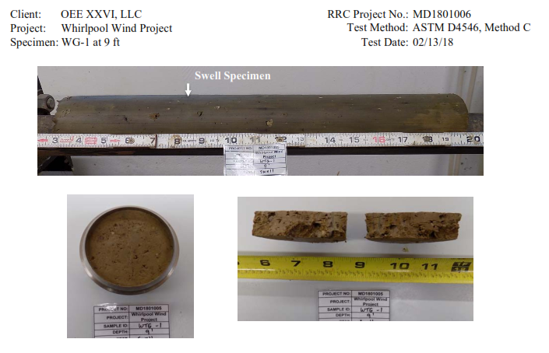
Engineering
Geotech

Slide 27
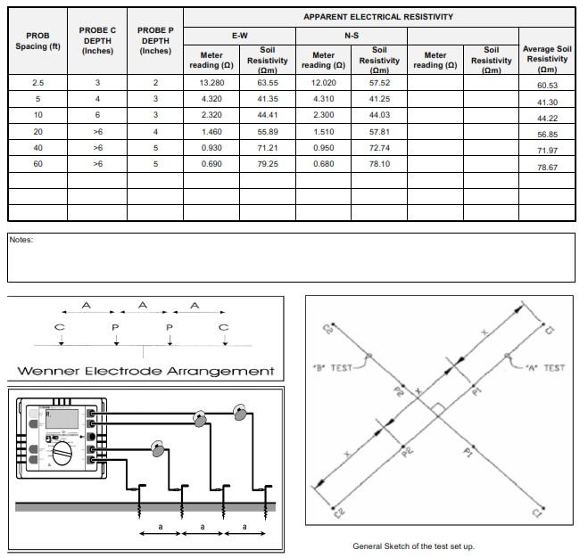
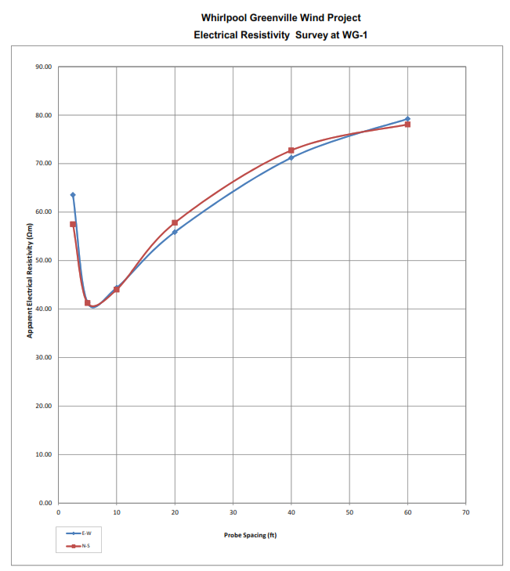
Engineering
Geotech
Analyzes minimum soil resistivity – structure & grounding

Slide 28
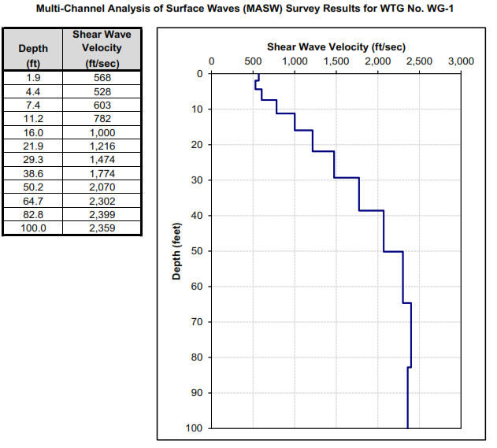
Engineering
Geotech
Multi-Channel Analysis of Surface Waves
  Evaluate engineering and Geotech properties (stiffness) of subsurface

Slide 29
Engineering
Why is it so Important?
Wind Energy engineering encompasses many fields
  Aerospace Engineer
    Creating turbine blades and rotors
  Civil
    Design support structures for turbines and related infrastructure
  Electrical
    Create and test electronic components of turbines involved in creating electricity
  Electronics
    Work on systems that use electricity to operate the turbine
  Environmental
    Assess and minimize potential environmental impacts
  Industrial
    Plan and supervise manufacture of wind turbines
  Materials
    Research, create, and test materials involved in operating turbines
  Mechanical
    Design, develop, and test machines involving in operating turbines.
  Network
    Communication and security involving operating turbines.

Slide 30
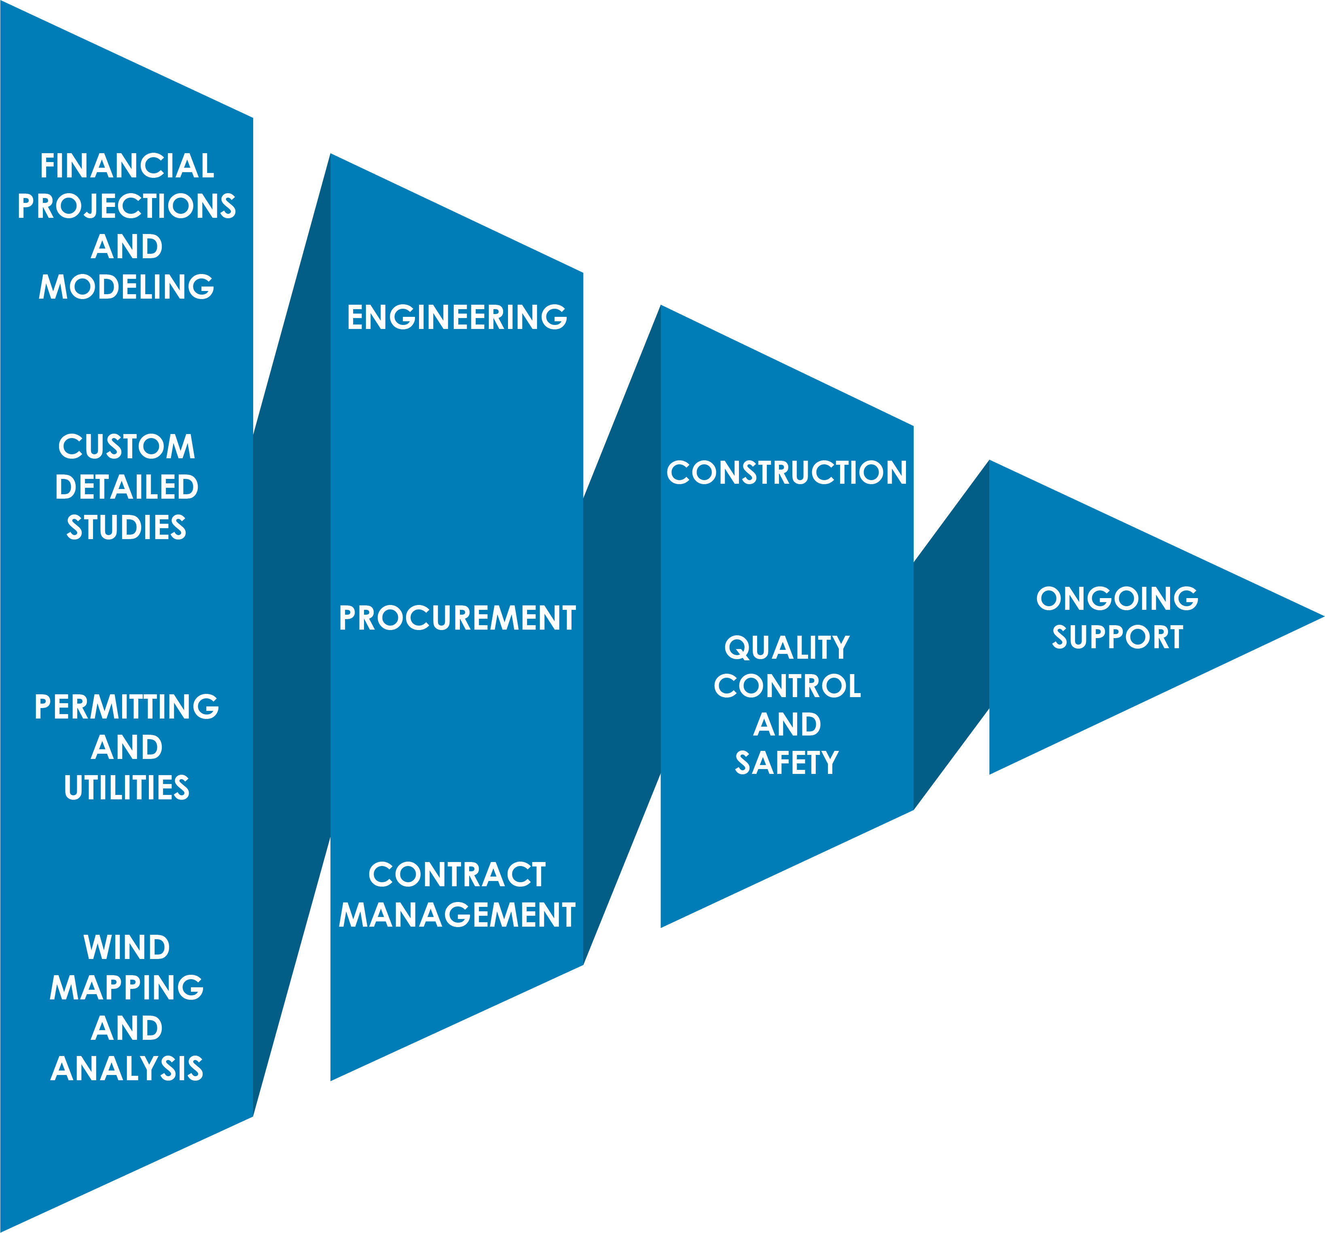
Engineering
Why is it so Important?
Vertical Integration
  Wind Energy is complicated but a project with One Energy is not.

Slide 31
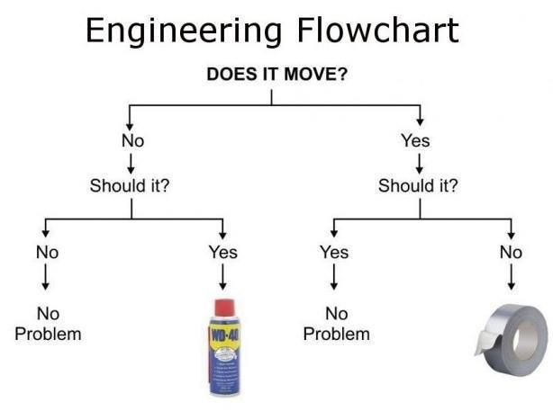

Questions?
Questions? Comments? Concerns?
Next class:
Report Writing

Slide 32
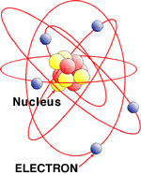
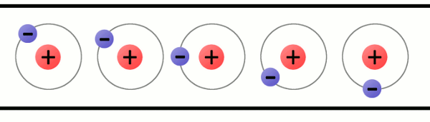
Engineering
Electricity
Electrons Move From Atom To Atom
Current: Flow of electrons
  Units: Amperes or Amps
Voltage: Electrical “pressure” or “potential” [“Potential difference”]
  Units: Volts

Slide 33
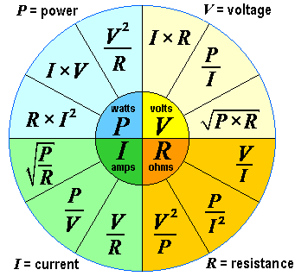
Engineering
“Power Wheel”

Slide 34

Engineering
War of Currents – Late 1800s
Direct Current (DC)
  Thomas Edison
  Low voltage (~100 volts) systems
  Distributed generation
Alternating Current (AC)
  Nikola Tesla and George Westinghouse
  Allows high voltage generation
  Easy conversion higher-to-lower or lower-to-higher voltage with transformer
  Transmission much more efficient

Slide 35
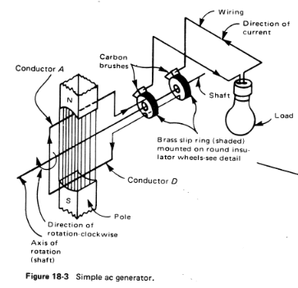
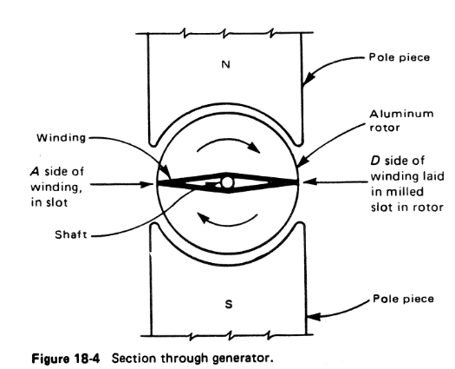
Engineering
Electricity

Slide 36
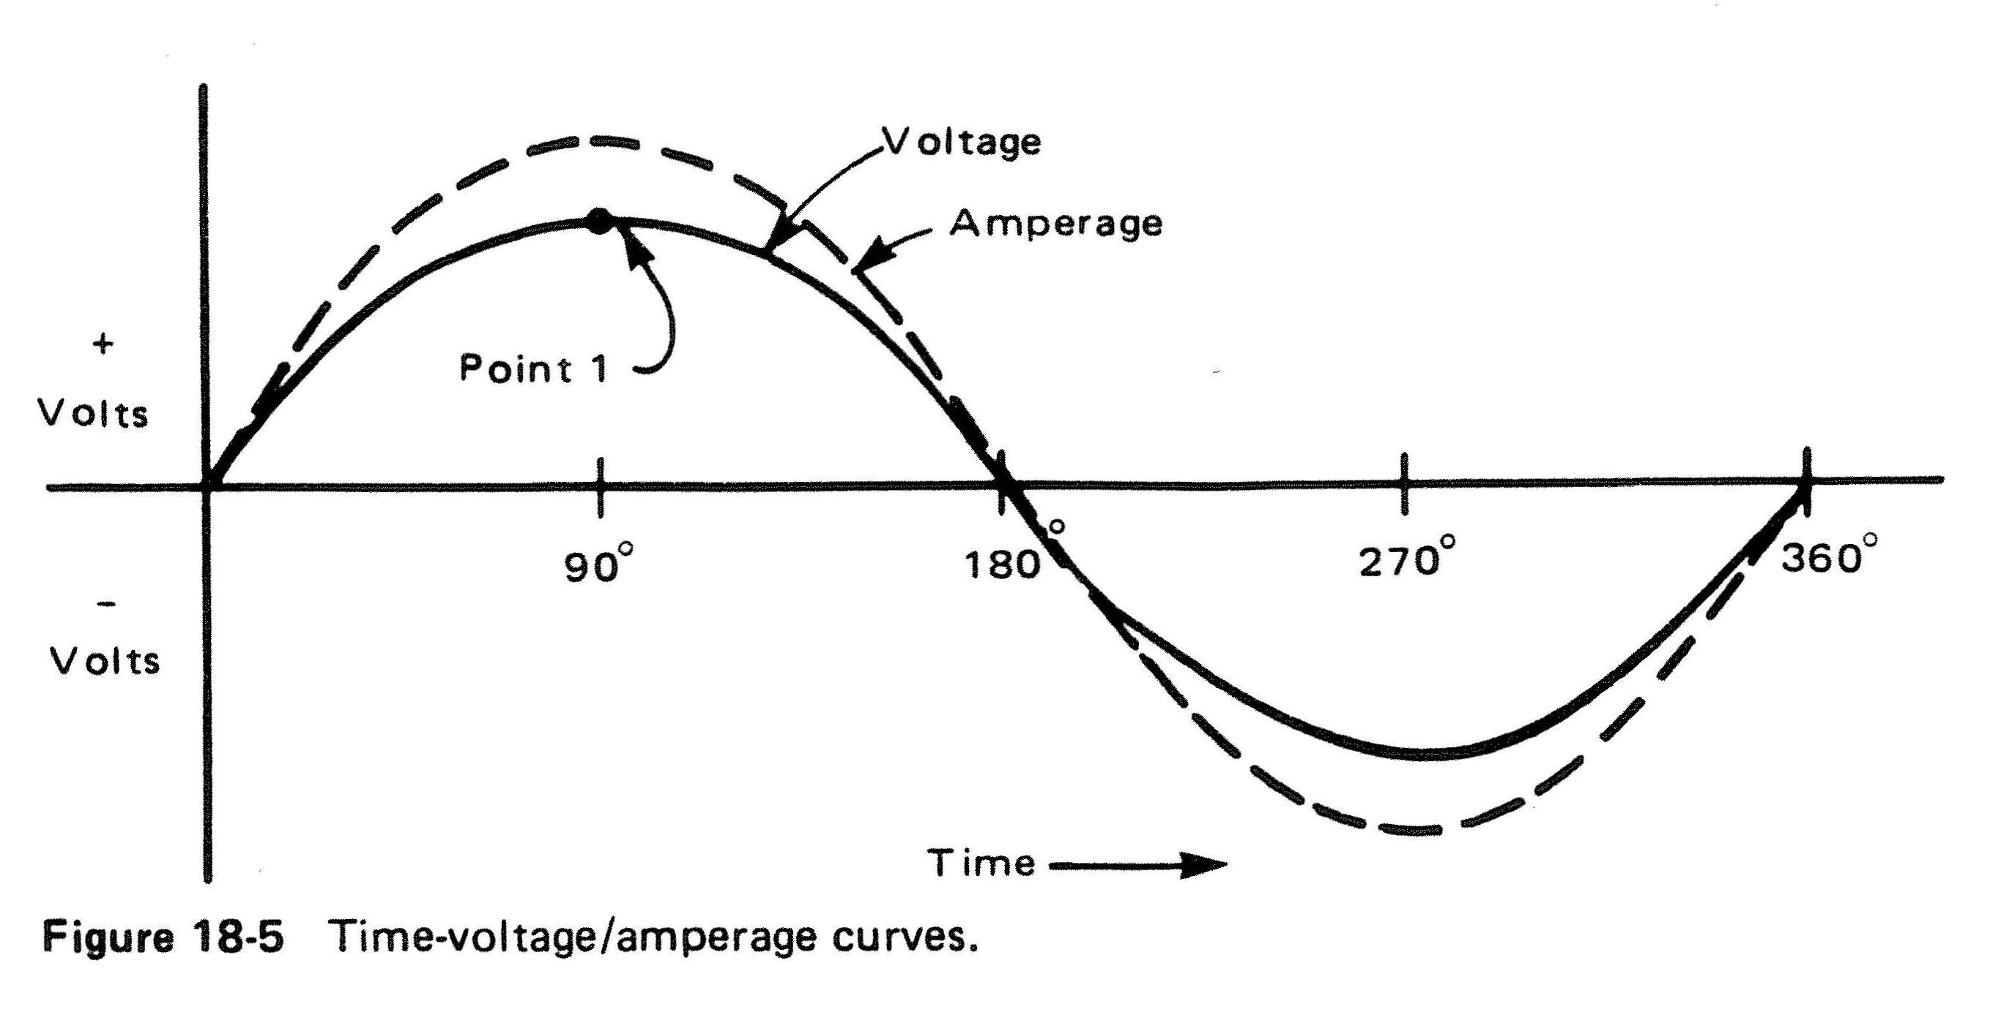
Engineering
AC Single Phase (1Φ)
60 Hertz = 60 Cycles per Second

Slide 37
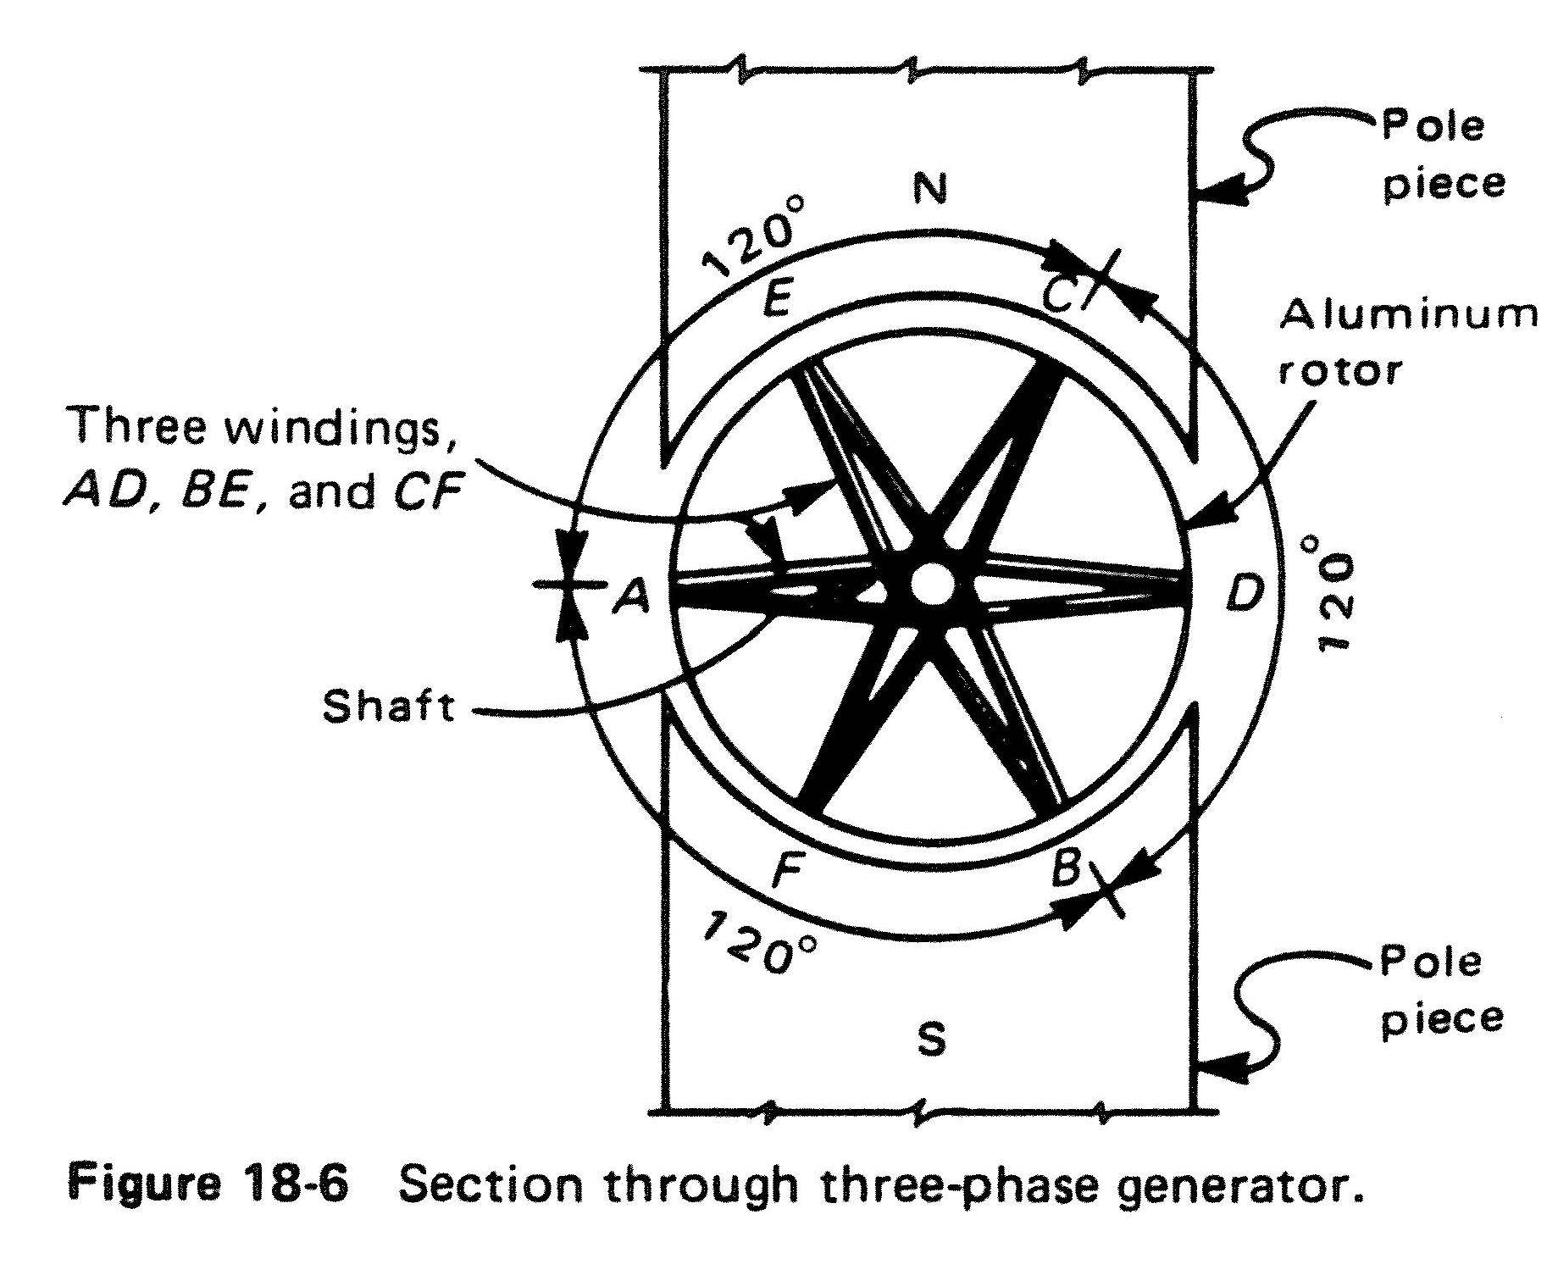
Engineering
AC Three Phase (3Φ)

Slide 38
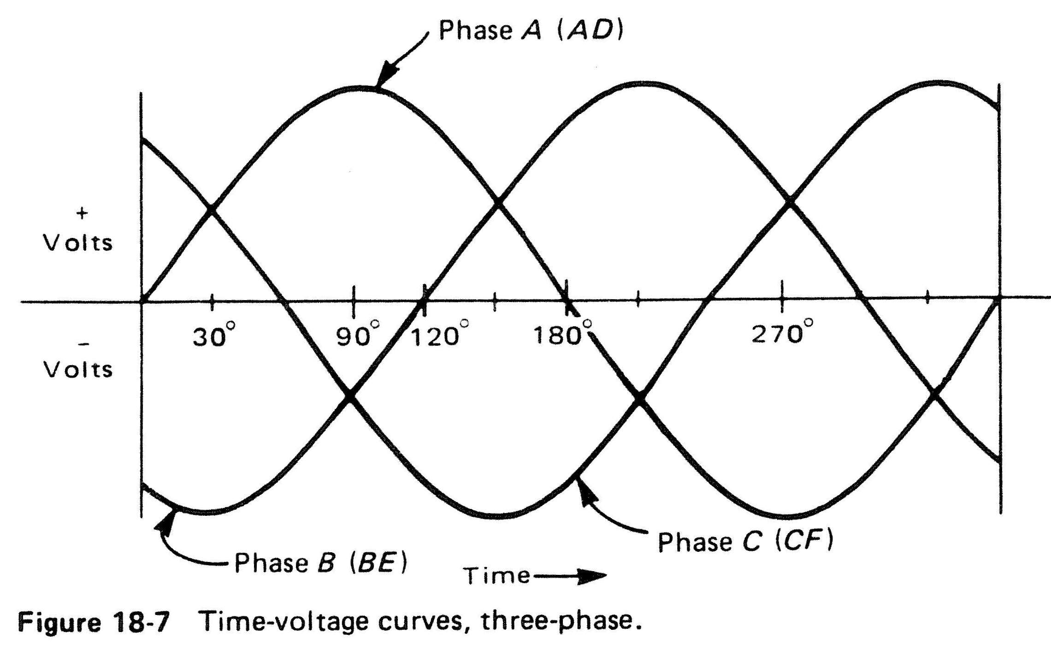
Engineering
AC Three Phase (3Φ)

Slide 39
Engineering
AC Three Phase (3Φ)
Line-to-Line (Phase-to-Phase) = √3 x Line-to-Ground
(√3 = 1.732)
 | Line-to-Line | Line-to-Ground
Harpster | 4160 | 2400
Whirlpool, Haviland, Cooper Farms | 12470 | 7200
Ball | 34500 | 20000

Slide 40
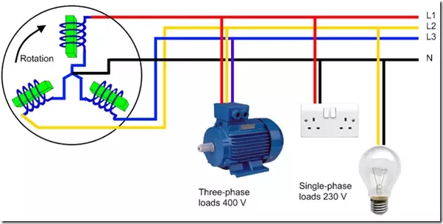
Engineering
AC Single Phase (1Φ) or AC Three Phase (3Φ)

Slide 41
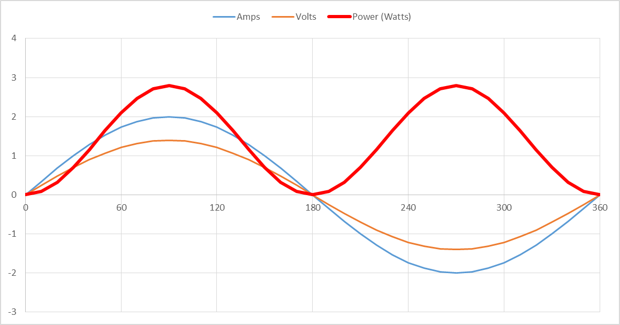
Engineering
AC Single Phase (1Φ) - Power (Watts) = Volts x Amps

Slide 42
Engineering
AC Three Phase (3Φ) - Power (Watts) = Volts x Amps

Slide 43
Engineering
Permanent Magnet Direct Drive Generator

Slide 44
Engineering
AC Three Phase (3Φ) Summary
Three Phase AC Power
Three separate conductors, each with Voltage and Current shifted by 120° relative to each other
Voltage
  Line-to-Ground
  Line-to-line (phase-to-phase) = √3 x Line-to-Ground
Current
  Current in each phase = total current / √3
Power = V x A
  Power in each phase varies
  Total power is constant

Slide 45
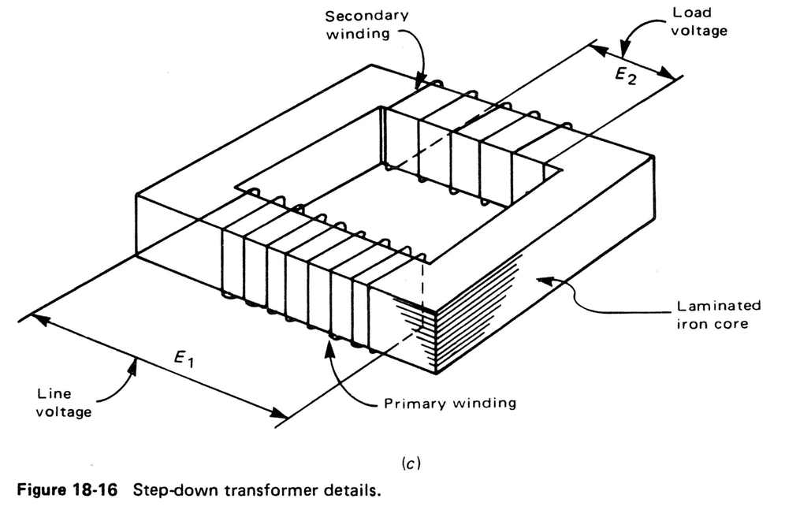
Engineering
Transformers

Slide 46

Engineering
Transformers
E₂ / E₁ = N₂ / N₁
_{OR}
E₂ = E₁*N₂ / N₁
If E₁=4160V; N₂=100; N₁=1733; I₁=15A
Find E₂: E₂ = 4160V*100/1733 = 240V

Slide 47
Engineering
Transformers
I₂ / I₁ = N₂ / N₁
_{OR}
I₂ = I₁*N₂ / N₁
Find I₂:
I₂ = 15A*1733/100 = 260A

Slide 48
Engineering
Transformers
Find Power = V x A = Watts
P₁ = 4160V x 15A = 62,400 Watts
P₂ = 240V x 260° = 62,400 Watts

