Slide 1
PPT WIND SCHOOL (CLASS 14A)
Third-Party studies

Slide 2
outline
Introduction
Third-Party Studies
  Microwave Study
  Phase I
  Geotech
  Transportation
  Land Appraisals
  Wetlands
  FAA
  Goldwind
  Independent Engineer
  Legal

Slide 3
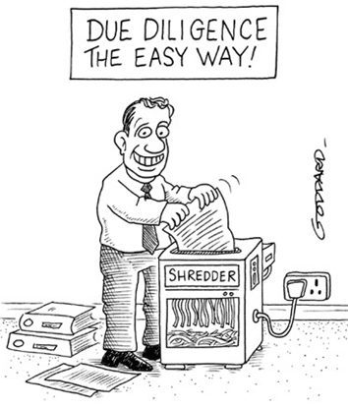


Introduction
One Energy is not an expert in all things, so we utilize external sources to ensure full due diligence in our projects
Don’t do this!

Slide 4

Third-Party Studies
Microwave
Why:
To confirm that our internal microwave search found all nearby microwave paths. Our internal search is good, but this gives us evidence that we actively sought out locations of microwave paths
How:
Third-party typically used: ADTI
Contact them and ask for their initial search quote for single lat/lon (variable to change)
Write out a PO for accounting and get approved
Use a lat/lon of one turbine for the search – preferably the turbine closest to any microwave path that was found during the internal search
Will receive study back within a week to either confirm or indicate microwave paths were found and turbine siting may need to be adjusted

Slide 5
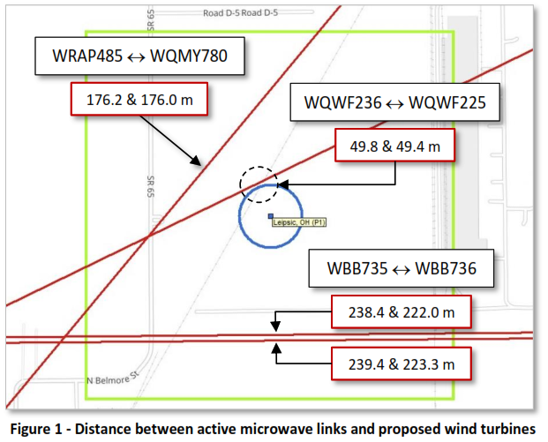
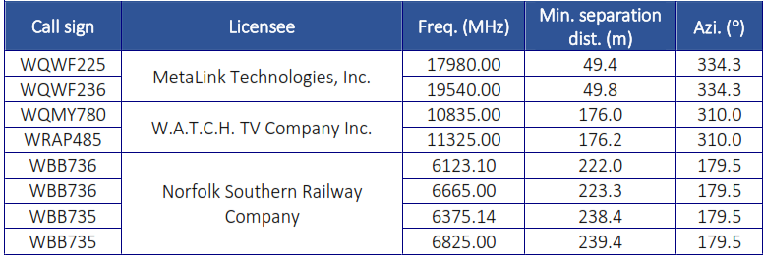
Third-Party Studies
Microwave Study Example Report

Slide 6
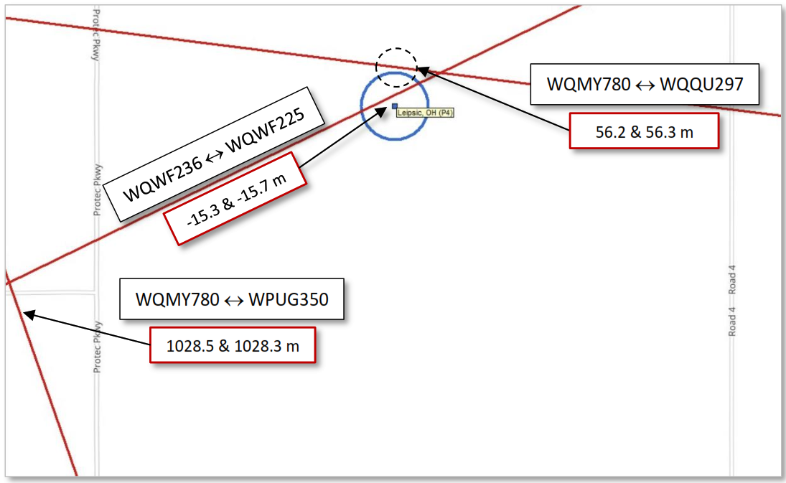
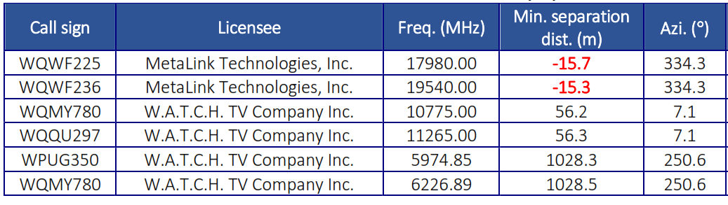
Third-Party Studies
Microwave Study Example Report

Slide 7
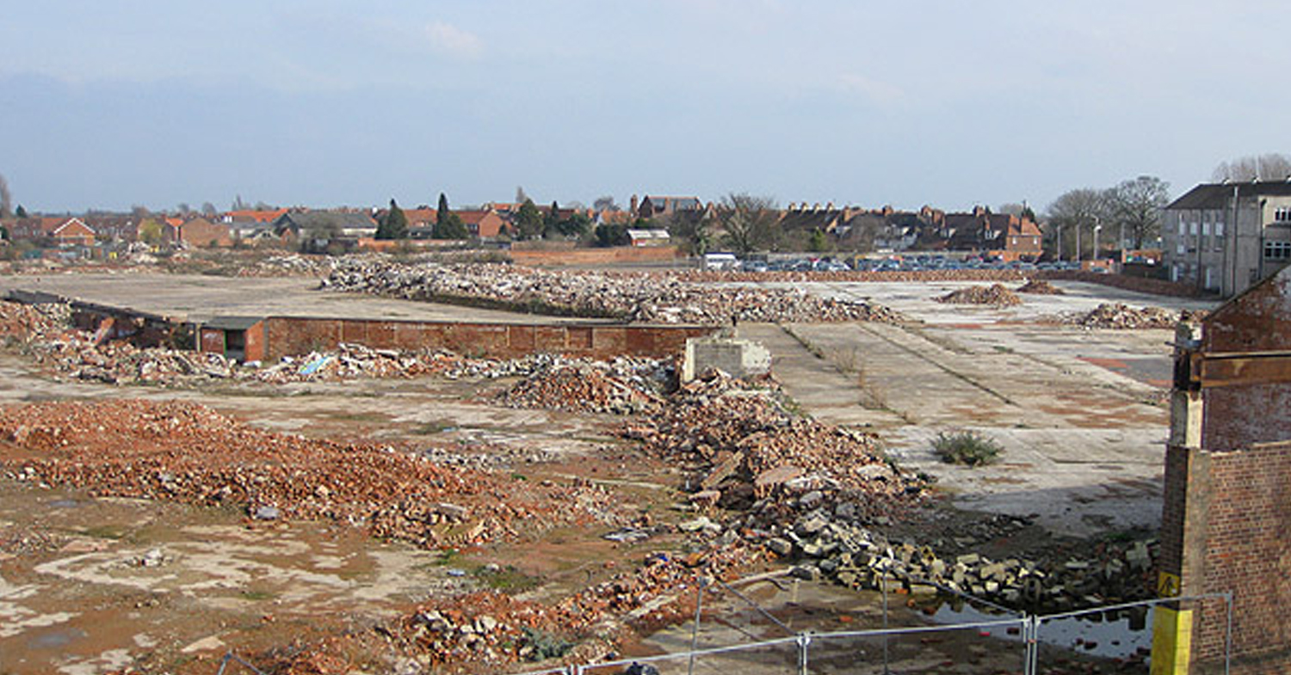

Third-Party Studies
Phase 1 ESA
Why:
If we’re going to purchase the land, we need to know if there’s any weird environmental stuff going on with it. Phase 1 ESA’s are considered the first step in environmental due diligence. The report will indicate if the land is contaminated, has recognized environmental condition (REC), among other things.
How:
Third-party typically used: PM Environmental, Inc
Contact Renee McFarlan to request a Phase 1 quote and include Property Cards and Google Earth Image of proposed site. As for Phase 1 ESA and NWI screening for all parcels.
Complete PO and get it approved
Coordinate a day/time for the assessor to go to the land in question where you will be available to go as well
Hang out with the assessor during the evaluation
Will receive report back within 2 weeks typically which will indicate if a Phase 2 study is necessary

Slide 8
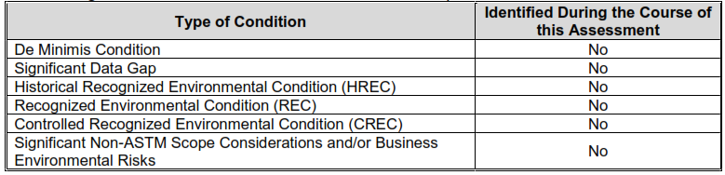
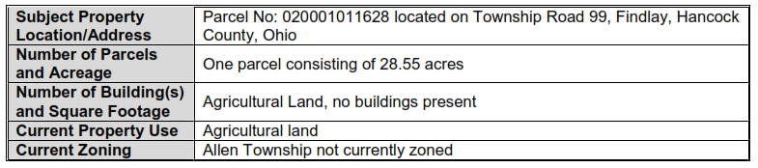
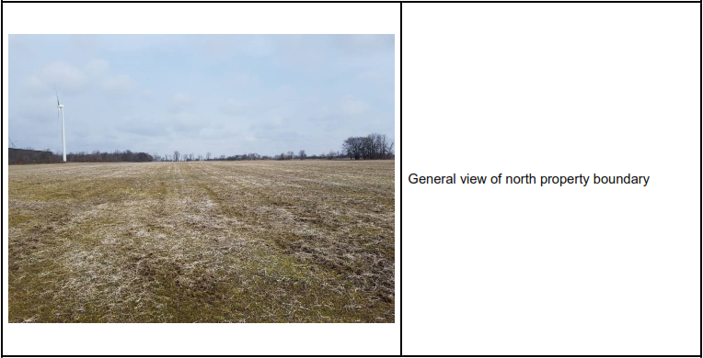
Third-Party Studies
Phase I ESA Example Report
Site overview
Site photographs

Slide 9
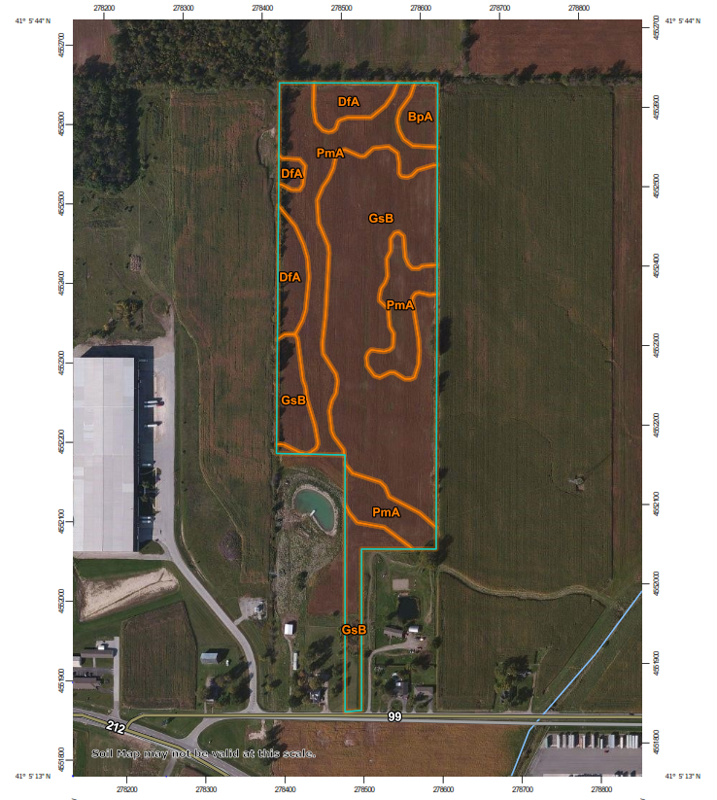
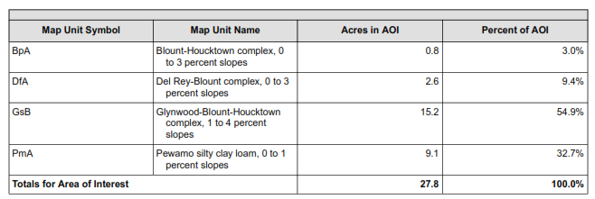
Third-Party Studies
Phase I ESA Example Report
Soil Survey
  US Department of Agriculture

Slide 10
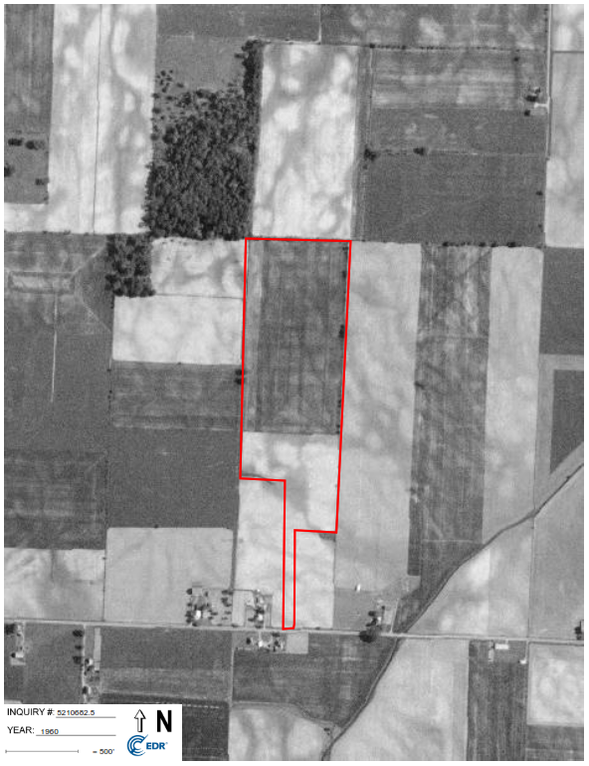
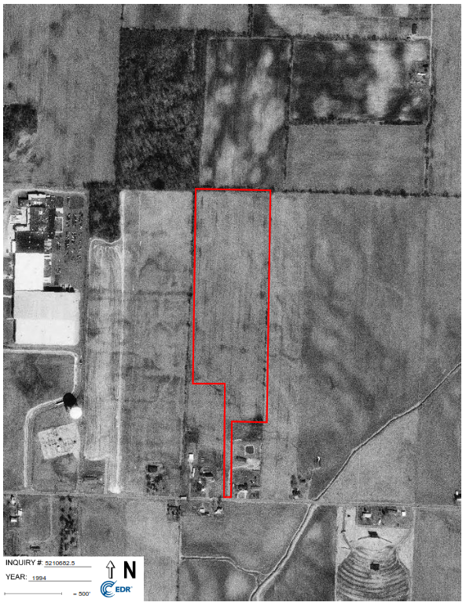
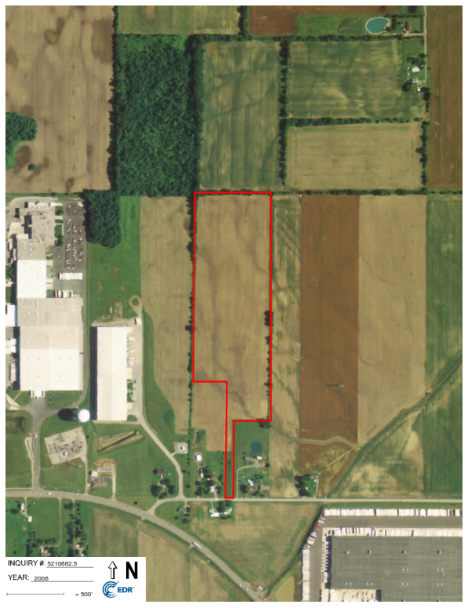
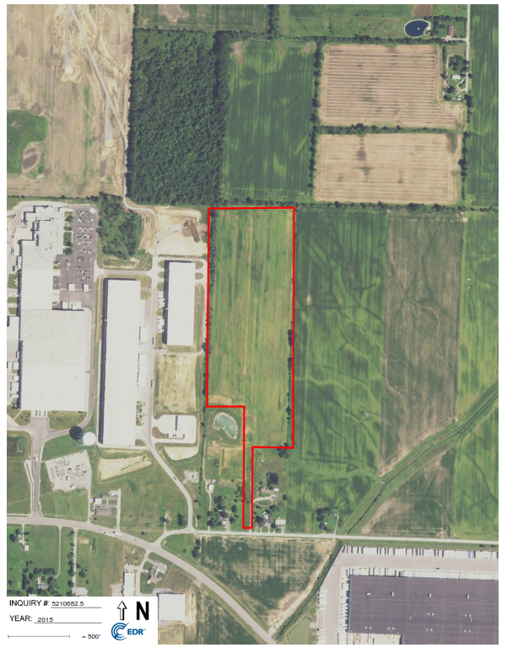
Third-Party Studies
Phase I ESA Example Report
Aerial Photos
  Show timeline of land use

Slide 11
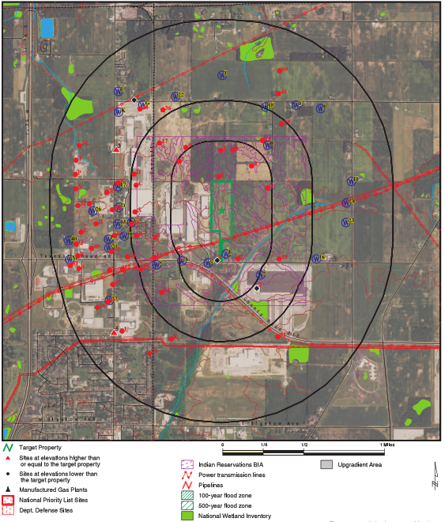
Third-Party Studies
Phase I ESA Example Report
Environmental Database Search by EDR
  Environmental Data Resources
Review of the following:
  Industry in the area
  Records of Emergency Reports
  Local Land Records
  Local Brownfield sites
  Local Landfill/Solid waste sites
  Local Hazardous Waste/Contaminated sites

Slide 12
Third-Party Studies
Geotech
Why:
To explore and evaluate the subsurface conditions at the proposed WTG sites, develop geotechnical design and construction recommendations for the project. Has implications on foundation design and electrical distribution.
How:
Third-party typically used: RRC: Power and Energy
Contact RRC to request a Geotech quote
Complete PO and get it approved
RRC will coordinate a drill rig and send a representative to the site. Coordinate a day/time to go to the land in question where you will be available to go as well
Hang out with the assessor during the evaluation
OE will receive report back within 2 weeks typically which will indicate if a further engineering is necessary
RRC Geotech division will send to foundation division and ensure foundation design is still compliant
Structural Engineer approves foundation design for project
12

Slide 13
Third-Party Studies
Transportation
Why:
Components are considered oversized/overweight loads and have a transportation requirements. Completed to ensure that transporting turbine components is feasible.
How:
Third-party used: Regionally – Ohio Department of Transportation
Contact ODOT to request a regional transportation route to the site
ODOT will determine best regional route and get to nearest highway or interstate
OE will complete route from regional route to proposed site – local study. Route must account for turning radii, powerlines, railroad crossings, overpass heights, bridge crossings, and construction zones
OE component suppliers determine final transportation route.
  Suppliers obtain permits for regional transportation
  OE obtains permitting necessary for local transportation
No county officials or engineers are contacted during this study to maintain project confidentiality
13

Slide 14
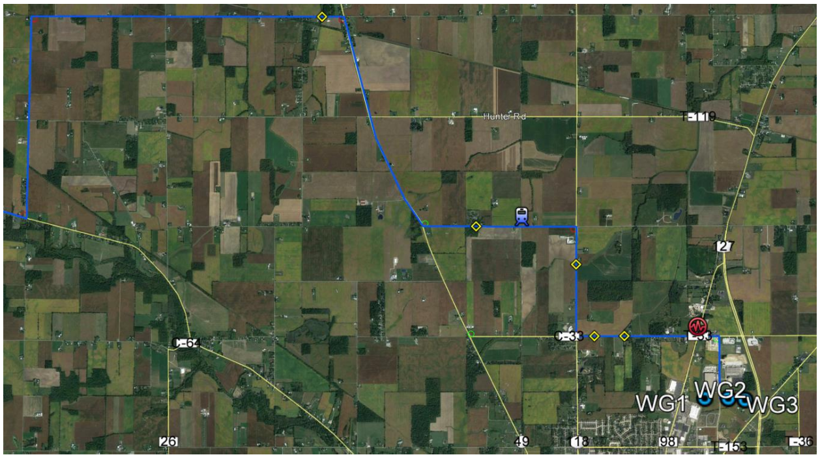
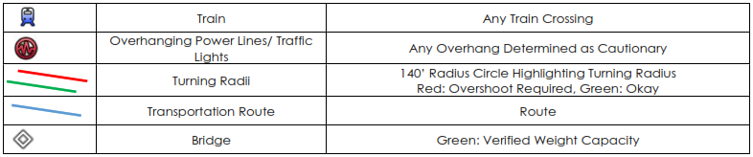
Third-Party Studies
Transportation

Slide 15
Third-Party Studies
Land Appraisals
Why:
To get an unbiased opinion of the market value of what the land, and potentially home, are worth. Property values on the property card are used for tax purposes only and aren’t the market value. Internal searches of comparable properties is usually completed before an appraisal is requested but an official appraisal gives us confirmation. We have used the number from the appraisal to determine the purchase price (i.e. 1.5 x appraisal value).
How:
Third-party typically used: Professional Appraisal Services
Contact and request appraisal at the property. Be prepared with address and parcel number.
Coordinate a day/time for the appraiser to go to the land in question at an agreed upon with the current land owner. If there is a building the land owner will need to be there to let them in.
One Energy does not have to be there unless requested by the land owner.
Once appraisal happens it usually takes about a week to receive the report. At that time an invoice is generated.
Once the invoice is paid you can see the results of the appraisal value.

Slide 16
Third-Party Studies
Wetlands
Why:
To confirm that our wetlands search. Our internal search is good, but this gives us evidence that we actively sought out locations of all wetlands.
How:
Third-party typically used: Big Ben
Contact him to solve all problems
Put your feet up because everything will be taken care of

Slide 17
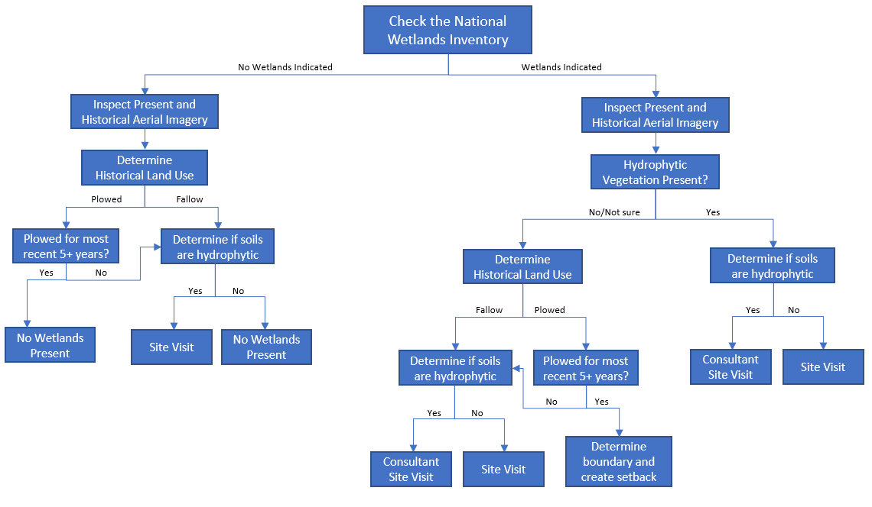

Slide 18
Third-Party Studies
FAA
Why:
To provide a clear snapshot of the aviation constraints that could limit a Wind for Industry project. To help identify areas of issue within a desired project area.
Who:
Capital Airspace – Contact through Jessie Grosso
What:
Obstruction Evaluation for a specific airport including: imaginary surface and traffic pattern
Coordinate with FAA Obstruction Evaluation Group on our behalf (we do this sometimes if there are potential issues because Capitol Airspace has a great relationship with them)
Answer simple questions about the FAA process, aviation procedures, and airspace

Slide 19

Questions?
Questions? Comments? Concerns?
Next Up:
Engineering

