Slide 1
PPT Wind school (class 13A) financials

Slide 2
outline
Introduction
Project Master
Pricing Meeting
Incentives
Report Deliverables
Example

Slide 3
introduction
OE offers two financial options for our projects
PPA
CAPEX
We front all the costs associated with the project, and the customer pays per kWh delivered to the facility.
One Energy owns the project.
We develop, engineer, procure, and construct the project for the customer. Customer pays for entirety of project upfront and only has operating costs associated throughout lifetime of project.
Customer owns the project.
With either option, we want to make a profit.
But how do we determine what CAPEX cost or PPA rate we can offer while hitting our returns and trying to save the customer money?

Slide 4


introduction
Main factors that affect OE project financing
Project Capacity Factor
Construction & Legal Costs
Land Costs
ITC
It’s all one big balancing act.
But with money.
Notes:
Construction costs include: longer collection lines, sited in mined areas, necessary to rebuild a bridge to get components to site, etc
Legal costs include: additional resources needed with municipalities/cooperatives, any potential FAA issues, zoning steps

Slide 5
Project master
Background
Many different uses
  Big-picture record keeping throughout life of project from development to operations
    Each stage gets a new spreadsheet, do not save over
  Used by CFO for projections that are given to investors
  Plays into the Tax Equity Model
  Plays into the Fleet Roll Up Model
Many different users
  Internal
  Customer
  OECC investors
  OE investors
  Fleet investors

Slide 6
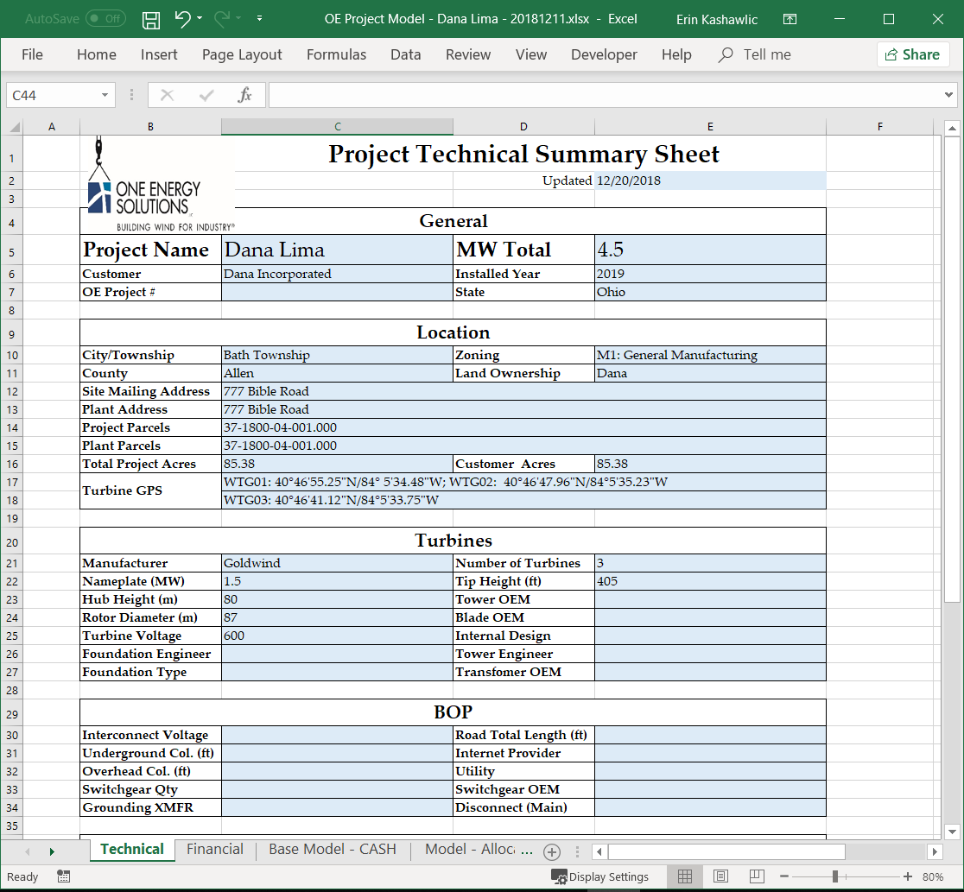
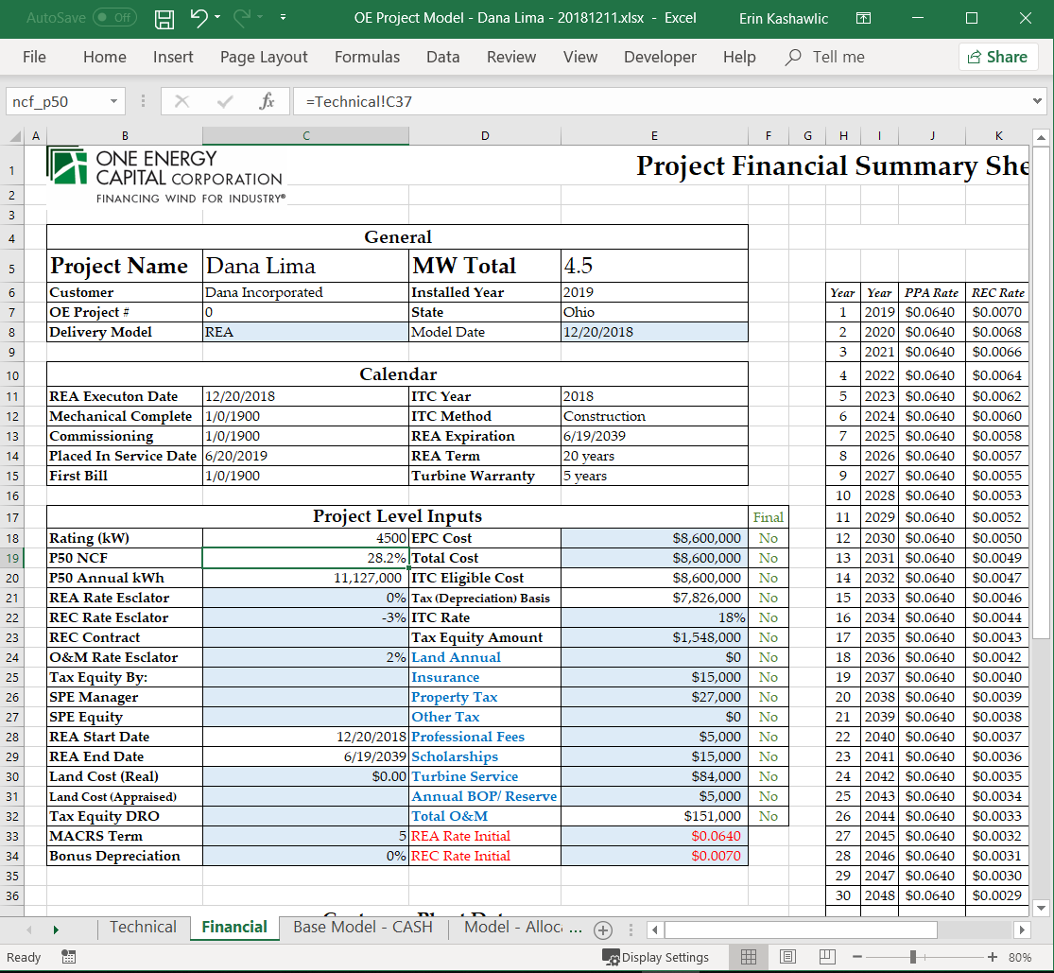
Project master
Background
Template:
Dropbox (OEE)\Projects – Master\00- OE Project Model - Template – LATEST DATE.xlsx
Two tabs to edit (Technical & Financial)
Edit known information in BLUE cells
Each sheet should get progressively filled in as project moves throughout stages
Only fill in information that is known during that stage
  IE should be fairly bare
  DE should have more of the information completed
Other tabs are the models as well as the customer deliverables
Financial
Technical

Slide 7
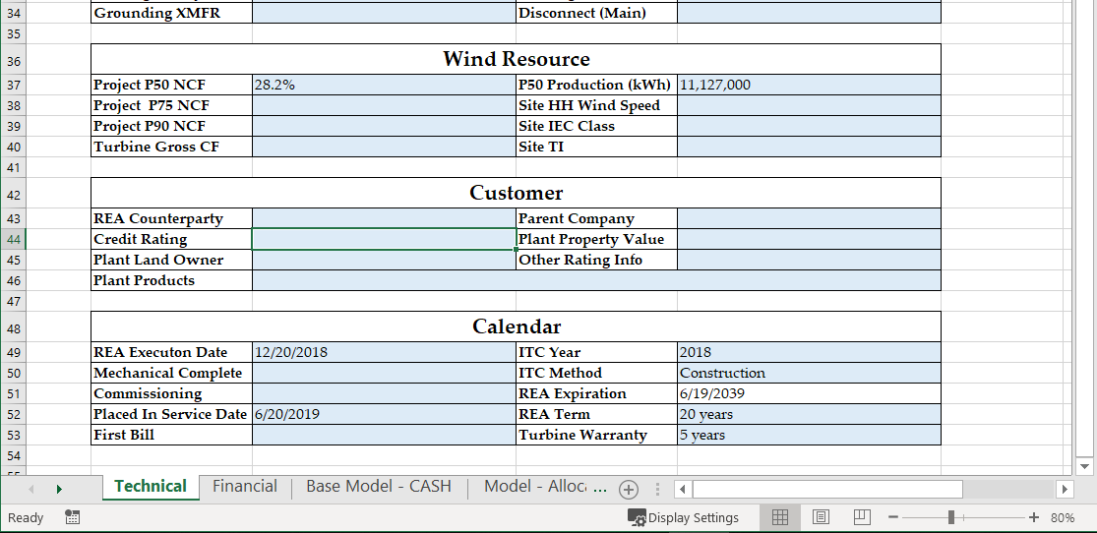
Project master
Technical Sheet
Project Name
MW Total
Customer
Installed Year
State
Project Parcel Acres
Project P50 NCF
Notes:
During IE stage: Project P50 NCF is the Anticipated Capacity Factor. Do not change the P50 production value cell during this stage.
During DE stage: Project P50 NCF is the P50 Capacity Factor found from the PPR; P50 production value cell can be updated to the P50 AEP

Slide 8
Project master
Financial Sheet
EPC Costs
1 WTG: $3.2 mil
2 WTG: $6.0 mil
3 WTG: $8.6 mil
ITC Rate
Adjust O&M costs accordingly relative to project size (Professional Fees and BOP do not change)
Land Costs
PPA Rate Initial – take a first guess!
REC Rate
$0.007 in OH

Slide 9
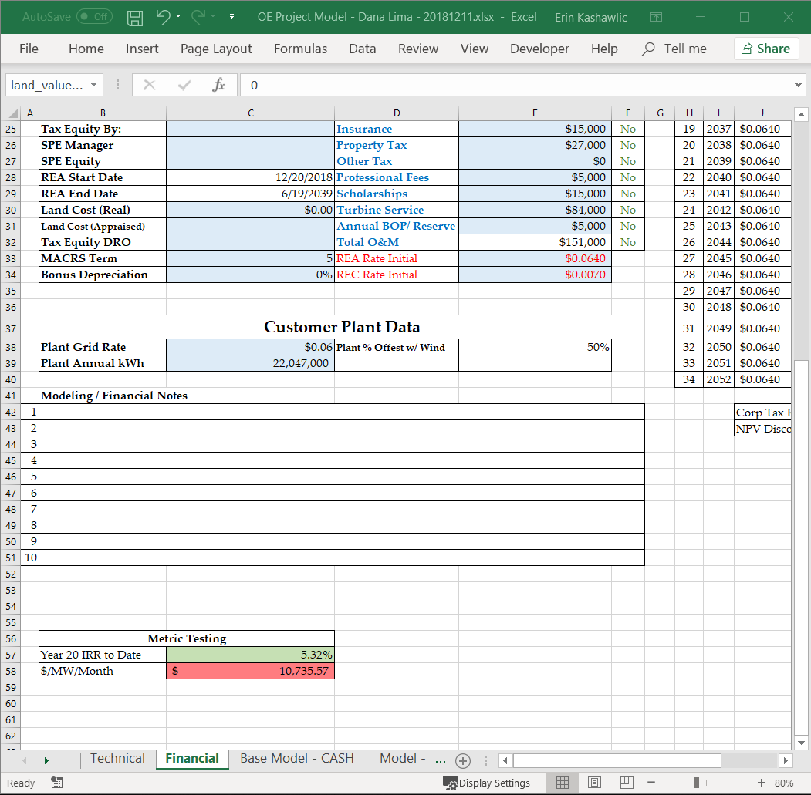
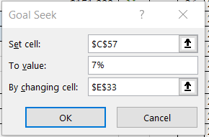
Project master
Financial Sheet
How do we know we’ve got the right PPA rate to offer?
Use Goal Seek to find the PPA rate that hits our internal IRR of 7%
Make sure to include % sign!

Slide 10
Project master
Financial Sheet
Adjusting the PPA rate will change the model and then spit out what the Yr 20 IRR is here

Slide 11
Pricing Meeting
Who: Pricing Committee and Analyst-lead on IE in question
What: Meeting to indicate any abnormalities in project that may affect quoted pricing; adjust different levers within model to ensure returns are met
When: During Harpooning – In Progress stage (IE); meetings occur every Friday at 9:30a
Why: To confirm and finalize offered PPA rate and CAPEX costs that are used within financial modeling and given to customer. PPA rate decided on in this meeting is the official rate moving forward.
Notes:
So we’ve got a really good estimate of what we think the PPA rate we can offer should be. Now what? We head off to the pricing meeting! woooooooo

Slide 12
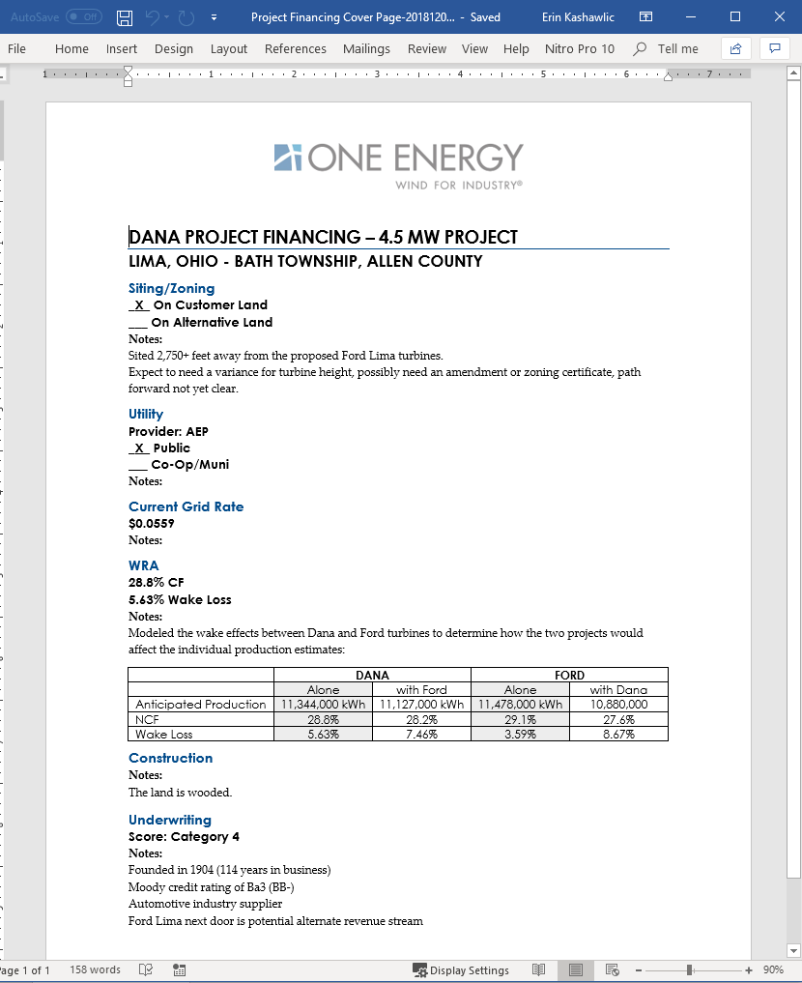
Pricing meeting
Materials Needed
Project Master Spreadsheet saved in ./Financials folder
Financial Cover Sheet, hardcopy
\Financials

Slide 13
Financial incentives
ITC/PTC
Federal tax credit claimed against the lax liability of the project.
Dollar-for-dollar reduction in the income taxes that financier claiming the credit would otherwise pay federal government, being phased out.
Investment Tax Credit
Large wind projects have opportunity to claim either of these tax incentives
Inflation-adjusted per-kWh tax credit for electricity generated by qualified renewable source and sold to an unrelated entity during the taxable year.
Credit lasts 10 years, being phased out.
Production Tax Credit

Slide 14
Financial incentives
ITC/PTC
Federal tax credit claimed against the lax liability of the project.
Dollar-for-dollar reduction in the income taxes that financier claiming the credit would otherwise pay federal government, being phased out.
Investment Tax Credit
But what is considered “in construction”?
The energy-generating property must begin construction or placed in service in the year in which the credit is first taken.
Notice 2018-59 gives guidance
Start physical work of a significant nature
Meet the “5% Safe Harbor test” by incurring 5+% of total cost of the facility in the year credit is to be received
Year | ITC
2016 | 30%
2017 | 24%
2018 | 18%
2019 | 12%
2020 | N/A

Slide 15
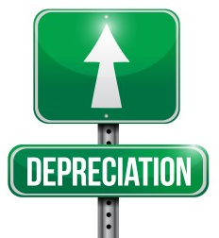
Financial incentives
MACRS
MACRS: Modified Accelerated Cost Recovery System
Most tangible (and some intangible) assets are depreciable.
Depreciation is an income tax deduction that allows one to recover the cost basis of certain assets. Thought-process behind it is that this is an annual allowance for the wear and tear, deterioration, or obsolescence of the asset.
Year | MACRS Depreciation (of depreciable basis)
Year 1 | 20.00%
Year 2 | 32.00%
Year 3 | 19.20%
Year 4 | 11.52%
Year 5 | 11.52%
Year 6 | 5.76%
MACRS is one guideline to depreciate assets, dependent on class of asset.
Renewable energy is a 5-yr property.
Depreciation:
A reduction in value of an asset over time
Notes:
Discuss bonus depreciation here: what it is, why we don’t use it, etc

Slide 16
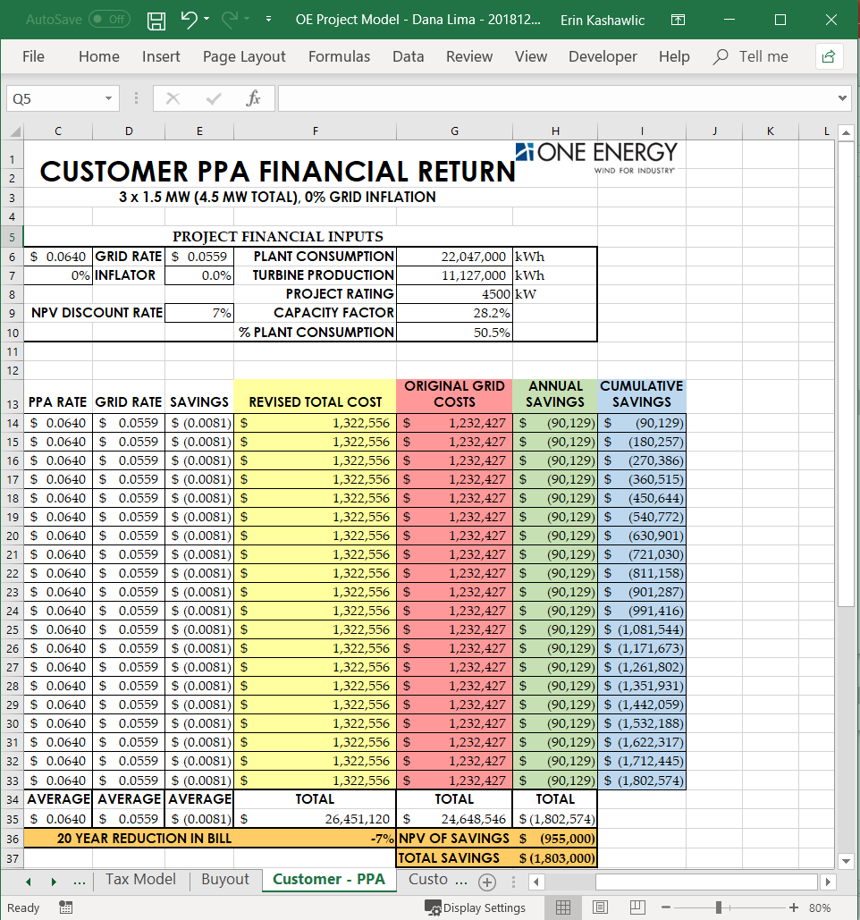
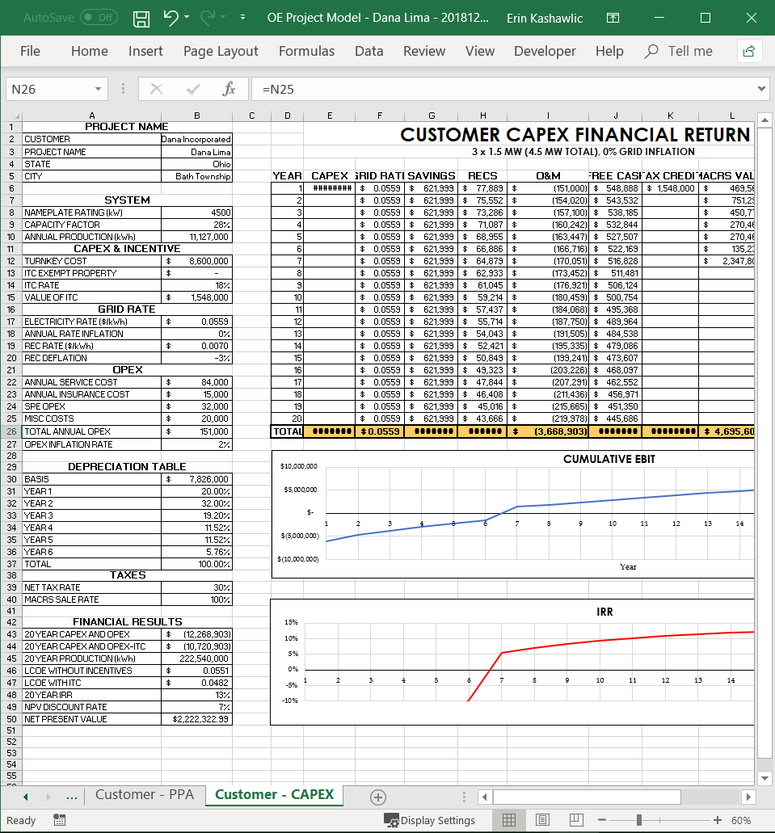
Report deliverables
Project Master Spreadsheet saved in ./Financials folder
PPA
CAPEX
Run at both 0% and 2.2% (if in OH) grid inflation scenarios
Change within each Customer Deliverable tab
Grid rate (customer’s current MCOE) must be input, along with facility consumption
Change within the Financial tab
Only PDF the pages, do not save a new workbook each time
Four PDF’s total
Customer - PPA
Customer - CAPEX
Notes:
Explain why 2.2% grid inflation number

Slide 17
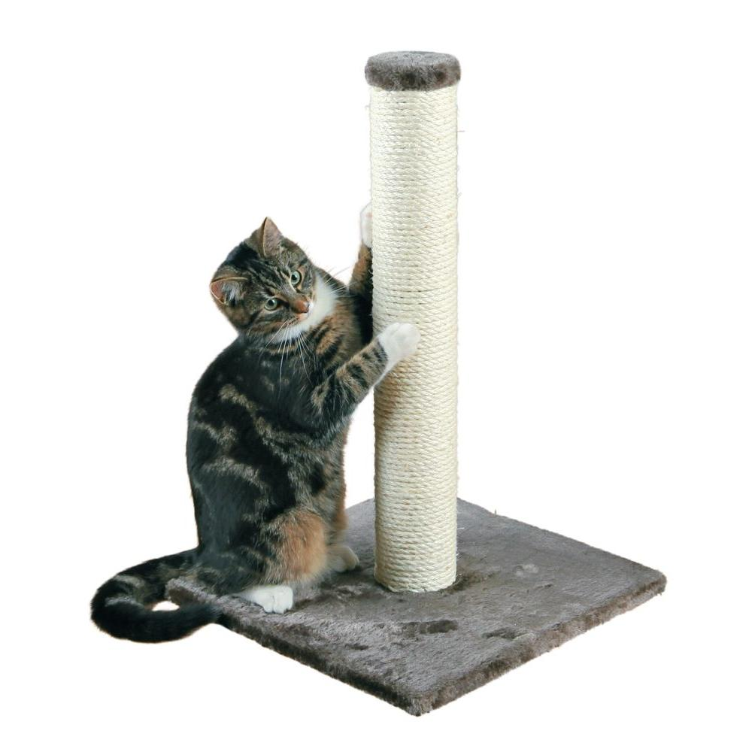
Example
Scenario: The hot, new company ‘CATSRULE’ inquired with One Energy about installing a Wind for Industry project at their scratching-post manufacturing facility. They provided three months of utility bills from AEP, so we were able to determine their MCOE and annual consumption. They have enough land that they own to safely site two turbines. The wind resource in that area is very good. What PPA rate are we going to be able to offer them with hitting an IRR of 7%? All details that we’ve already discovered are listed below:
Location: Paulding, OH
MCOE: $0.0750
Annual consumption: 12,000,000 kWh
Anticipated Capacity Factor: 33.4%
Install date 2019
Parcel # 37-1800-04-001.000
Unzoned
We have no stocked turbines and have to order the turbines in 2019
Cats are super cute
Approx. $0.0675

Slide 18
Example
Scenario (cont’d): CATSRULE wants to see what our financial models say for both the PPA and CAPEX scenarios.
What is the Total Savings and 20 Year Reduction in Bill for both 0% and 2.2% grid inflation for the PPA scenario?
What’s the 20 Year IRR and Breakeven Year for both 0% and 2.2% grid inflation for the CAPEX scenario?
PPA
CAPEX
Grid Inflation | Total Savings | 20-Yr Reduction
0%
2.2%
Grid Inflation | 20-Yr IRR | Breakeven Year
0%
2.2%
$1,317,000
7%
20.26%
6
$4,468,000
20%
22.50%
5.75
Notes:
Have them think together as a group about how to get the breakeven year for CAPEX. Have someone explain what IRR is and what the difference between positive and negative IRR means in laymans terms. Then ask so what does it mean when the IRR is equal to 0% (leading them to think about why/how we can use the graphs to get the breakeven year etc)

Slide 19

Questions?
Questions? Comments? Concerns?
Next Up:
Zoning

