Slide 1
PPT Wind school (class 13B) zoning

Slide 2
outline
Introduction to Zoning
One Energy Zoning Needs
The Zoning Memo
  Background/Process
  PPT Inputs
  Analysis
  PPT Uses

Slide 3
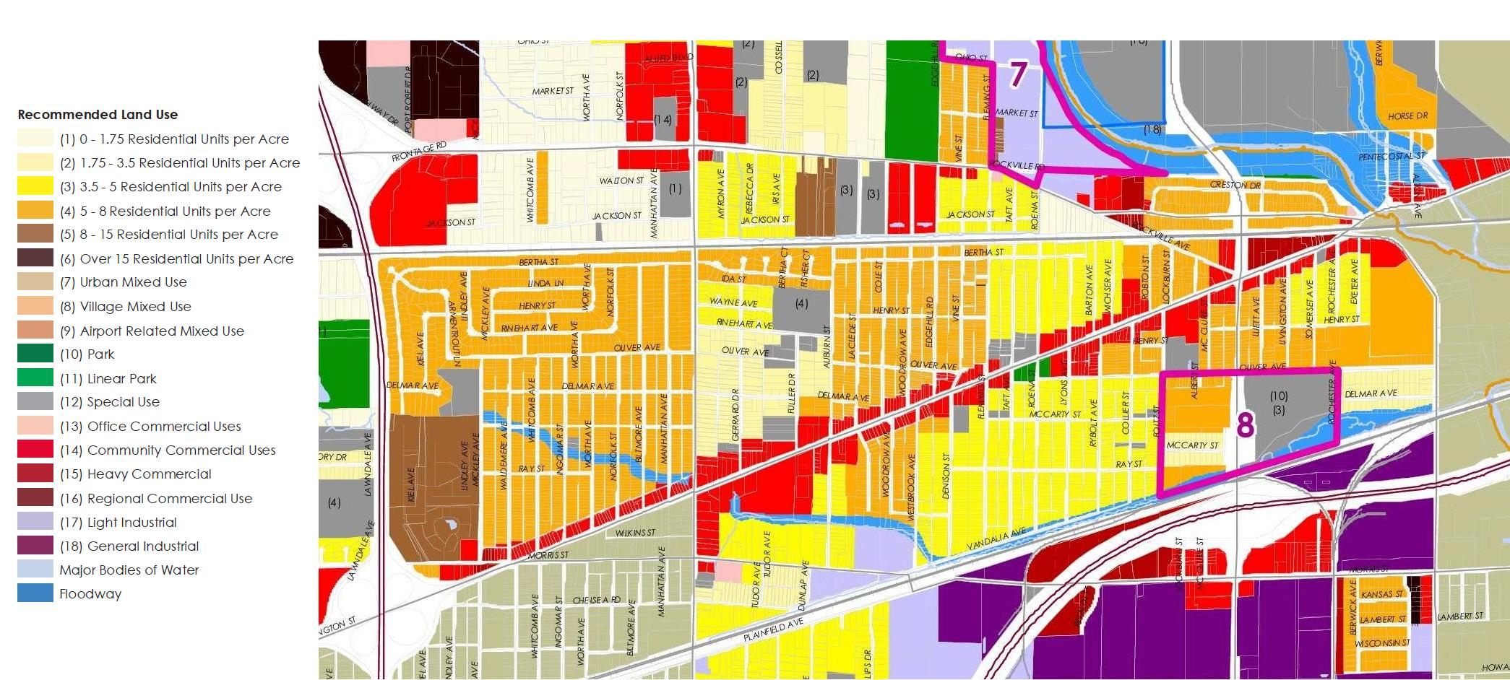
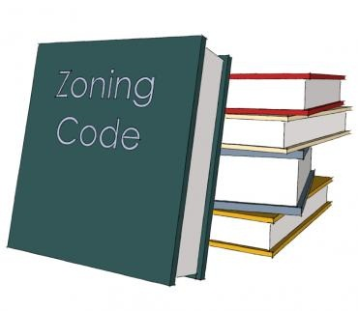
introduction
Zoning: the process of dividing land in a municipality into zones (like residential, industrial, etc) in which certain land uses are permitted or prohibited; also, the set of ordinances by which such zones are established and regulated
In plain words.. how a city/village/township controls what is built and where
It’s a way of protecting the welfare of the community by
Preventing undesirable buildings in certain locations
Allows for similar types of buildings and structures in specific locations

Slide 4
One energy zoning needs
Why is this important for One Energy project development?
Has a section in both the IE and DE
May impact turbine siting
May determine the technical feasibility of a project
Is anything a show-stopper and what steps do we need to take to adhere to local zoning?
What can zoning tell us as we develop a project?
Where, in any given area, a turbine may be sited
Setbacks from various objects
Potential height restrictions
Any specific requirements that are for wind turbines

Slide 5
The zoning memo
Background
Legal puts together a zoning memo for PPT that answers a few main questions
  Are there any ordinances that will prohibit this project from moving forward?
  Are there any ordinances that will affect turbine siting?
  Are there any wind turbine-specific ordinances that we have to pay extra attention to?
  What does this municipality consider a wind turbines?
  What possible paths forward do we have to making this project work?

Slide 6

The zoning memo
Process
PPT collects necessary information and gives to Legal
Legal conducts analysis, completes zoning memo, and gives to PPT
PPT reads zoning memo and applies findings to turbine siting

Slide 7
The zoning memo
PPT Inputs
PPT collects necessary information and gives to Legal
1. Land used for project siting
  Specify if either customer-owned or we have to purchase
2. What county is the land in?
  What municipality is the land within?
    City Limits?
    Township?
    Village?
    Unincorporated area?
3. What is the parcel zoned as?
4. Is there a zoning ordinance/regulation?
5. Is there a wind-specific ordinance?
Notes:
Examples:
City limits: Autoliv/Veoneer (sort of?)
Township: Greenville; NFWC
Village: Ottawa
Unincorporated Area: ??

Slide 8
The zoning memo
PPT Inputs
PPT collects necessary information and gives to Legal
Input for Legal | How to Obtain
Land used to project siting | Google Earth, County Auditor websites (for property ownership)
County/Municipality | Utilize online resources, plat maps
Parcel Zoning | Specific Municipality zoning map; typically on the municipality website
Ordinance/Regulation? | Municipality website will typically have a copy for use
Wind-Specific Ordinance? | Skim through entire resolution to see if wind turbine appears as a heading (a quick ctrl-f ‘wind’ within a searchable document should help)

Slide 9
The zoning memo
PPT Inputs
PPT collects necessary information and gives to Legal
But what happens if the zoning ordinance or zoning map isn’t anywhere to be found on the interwebs?
First step, ask Legal
  They’ve been collecting ordinances from all over the state and may have already gotten it
If Legal doesn’t have a copy, call the Zoning Inspector (if one exists) or a County Official to see if they have one
Super important to not reveal who you are and why you are asking for zoning information
Someone related to OE (an intern, or an ED contact, etc) will pick up the zoning information from the Zoning Inspector or County Official if only hard-copies

Slide 10
The zoning memo
PPT Inputs
PPT collects necessary information and gives to Legal

Slide 11
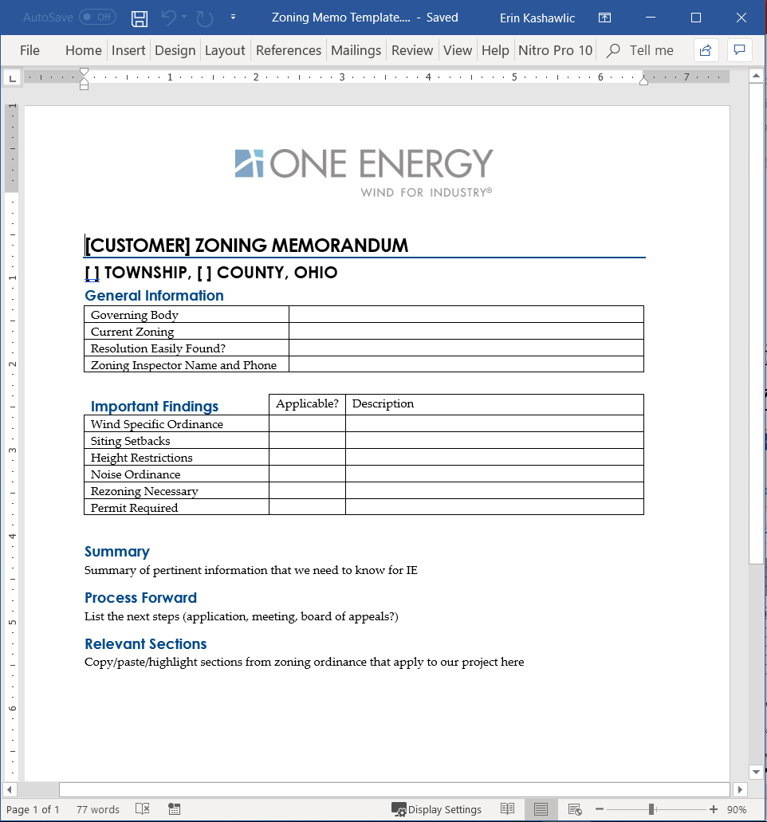
The zoning memo
Analysis
Legal conducts analysis, completes zoning memo, and gives to PPT
Things specifically looked for:
What does the wind-specific ordinance say? Does it apply to turbines of our size? Is it considered a “Conditional Use”?
Is a turbine permitted? What about large structures?
Is a turbine permitted only in specific zoning districts?
Are there any other important items, like noise, landscaping/buffering, etc?
Is there an applicable setback from structures or property lines?

Slide 12
The zoning memo
Analysis
Legal conducts analysis, completes zoning memo, and gives to PPT
Main goal of the Zoning Memo: to determine how to legally build a wind turbine
Can we obtain a Conditional Use permits if needed?
Are certain permits necessary?
Reasonable to rezone the land?
Do we need a height variance?
Does the ordinance have to be amended to allow for wind turbines?
Notes:
Submit variance application
The Supreme Court of Ohio has set forth elements that must be met to be granted a variance – basis is that literal interpretation of the ordinance would deprive a property owner of his right to use the land, creating substantial injustice
Usually places have their own variance applications
Area variance – height, setbacks
Use variance
Allows a use to be permitted on land

Slide 13
The zoning memo
Analysis
Legal conducts analysis, completes zoning memo, and gives to PPT
Includes path forward for compliance, though most times there are multiple answers
Why choose one path to compliance over another?
Deciding bodies; likelihood of success
Sometimes we have to go through multiple bodies before obtaining ultimate approval
Timeline
Totally dependent on how many hoops need to be gone through and how many applications to process
Notes:
Ex: variances are decided by Board of Zoning Appeals
Ex: Rezone/amend ordinance decided by Board of Township Trustees or City Council typically, and other bodies

Slide 14
The zoning memo
PPT Uses
PPT reads zoning memo and applies findings to turbine siting
Read the Zoning Memo after Legal returns it
Main thing to look for is any applicable setbacks for the proposed zoning path forward
If there are setbacks, adjust turbine siting to adhere to indicated setbacks
Summarize main findings from the Zoning Memo in the IE or DE; do not include the proposed zoning path forward and only indicate that we have acknowledged that there is (or is not) a viable path forward

Slide 15


The zoning memo
Side Note
Fires happen and Legal gets busy AF and sometimes can’t get PPT a full Zoning Memo as fast as it’s needed.
If that’s the case, Legal will work to get a short paragraph summarizing the ordinance to be included within the IE

Slide 16

Questions?
Questions? Comments? Concerns?
Next class:
Third-Party Studies & Engineering

