Slide 1
PPT Wind school (class 15) report writing

Slide 2
outline
The OE format
Editing
You want this internally approved? Here’s how
Independent Engineer review process
Final close-out items

Slide 3
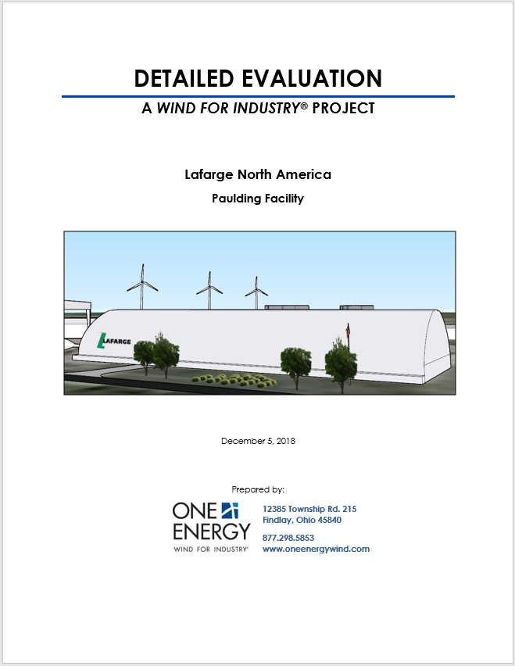
OE format
Exhibits
  Utility Rates
  Project Area and Maps
  Local Information
  Site Layout
  WRA
  PPR
  Turbine Icing Study
  Shadow Study
  Sound Propagation
  Other Site-Specific Studies
  FAA
  Engineering
  PPA Information
  DE Flowchart
  OE Company Profile
  Methodologies
Report
  Initial Assessments
  Project Siting
  Wind Resource Assessment
  Project Performance
  Feasibility and Site Specific Studies
  Engineering
  Financials
  Community Considerations
  Conclusions
Average DE length: 200 pages

Slide 4
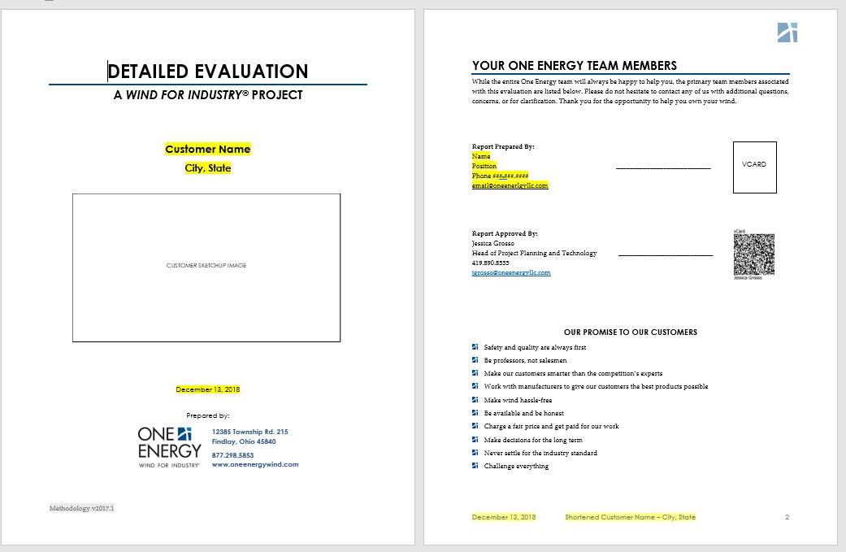
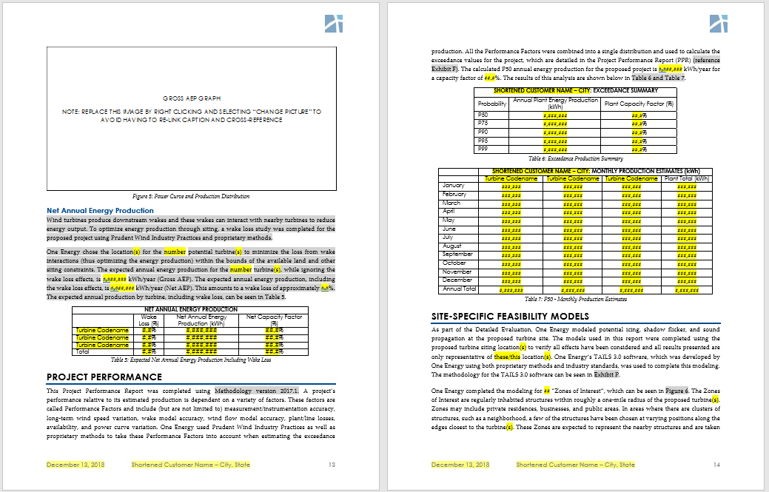
Oe format
Report
Template:
Due Diligence - Resources\OE Documentation\Templates\00 – DE Template_<most recent date>.docx
Yellow: change these sections
Gray: read these sections and see if they still apply the way it is currently written; these sections shouldn’t change much but confirm it’s still accurate

Slide 5
Oe format
Report
White boxes: graphics placeholder. The type of graphic is indicated within the box. May be plots, satellite images, SketchUp model, etc.
Right click > change picture

Slide 6
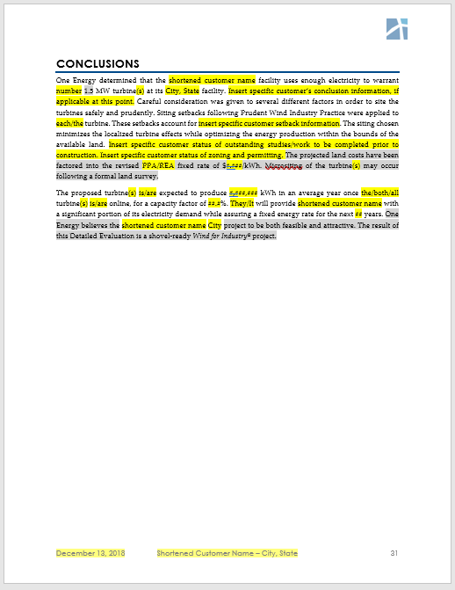
Oe format
Report
Within the conclusion, make sure that key areas of concern are included, along with P50 numbers, what studies still need to be completed, things that could effect the progress of the project, etc.
Needs final conclusion. Is this a shovel-ready project or not? Be direct.

Slide 7
Oe format
Exhibits
Exhibit cover pages are standard
Copy from Due Diligence – Working/Templates/Detailed Eval Report/Exhibit Cover Pages
Exhibits are created and then saved in:
Exhibit A: ./3. Utility/
Exhibit B: ./11. Land Option/
Exhibit C: ./10. Permitting/
Exhibit D: ./5. Siting and Design
Exhibit E: ./6. WRA/
Exhibit F: ./7. PPR/
Exhibit G: ./8. Feasibility Studies/
Exhibit H: ./8. Feasibility Studies/
Exhibit I: ./8. Feasibility Studies/
Exhibit J: ./8. Feasibility Studies/
Exhibit K: ./10. Permitting/
Exhibit L: ./5. Siting and Design/
Exhibit M:
Exhibit N:
Exhibit O:
Exhibit P:
All exhibits must be approved by manager before being put into ./1. Completed Report/Exhibits

Slide 8
Oe format
WRA Report
Template:
Due Diligence - Resources\OE Documentation\Templates\00 – WRA Template_<most recent date>.docx
Part 1
Part 2
Part 3
Update Gross and Net AEP values from the WRA
Update Methodology version
Update turbine locations in table
Right click on turbing siting image > change picture from file
Update Gross and Net AEP values
Confirm WTG information
Update dataset types and distances from project site
Right click on Loss Input Table > change picture from file
  Import the satellite image with the dataset locations

Slide 9
Oe format
WRA Report
Part 4
Part 5
Part 6
Update Reference Wind Turbines spreadsheet
  Create .png files of graphic and of table
Right click > change picture from file on the satellite image and table image
Update blurb
Update dataset information
Update dataset information table
Update environmental conditions tables with respective information from spreadsheets in ./6. WRA/Workbooks
Part 7
Part 8/9
Part 10
Update site conditions tables with respective spreadsheets
Update TI graphics
Update Gross and Net AEP values
Insert wake loss graphic
Update monthly Net values
Update production values in conclusion

Slide 10
Oe format
PPR Report
Template:
Due Diligence - Resources\OE Documentation\Templates\00 – PPR Template_<most recent date>.docx
Part 1
Part 2
Part 3
Update Gross and Net AEP values from the WRA
Update P50 values
Update Methodology version
Update turbine locations in table
Right click on turbing siting image > change picture from file
Update Gross and Net AEP values directly from WRA
Right click on Loss Input Table > change picture from file
  Import the project LIT graphic
Individual Performance Factors
  Update blurbs
  Update table contents
  Update PDF/CDF graphics directly from Exceedence software

Slide 11
Oe format
PPR Report
Part 4
Part 5
Part 6
Update blurb
Right click > change picture from file on the Composite Performance Distn image to the Composite Perf Distn from Exceedence software
Update each table with exceedance values from ApplyingPVALS spreadsheet as indicated within the spreadsheet
Update P50 values in blurb

Slide 12

Oe format
WRA/PPR Report Check
After everything is input, do you think you’re done with the WRA and PPR?
Have BM or JS check the reports as a second set of eyes.
Make sure all datasets and spreadsheets are in the correct folders before they check. They will check every single number to make sure that values were input into the report correctly.
BM or JS will confirm and complete a sign-off sheet.

Slide 13
Oe format
Compiling
Think about what you wrote
  Does it make sense?
  Is it technical? This is not written for the customer, it should be more technical than the IE.
  Would your reader have more questions at the end of it?
  Is it succinct?
  Did you clearly answer the question of “Is this a shovel-ready project?”
  Did you clearly address any risks?
Are all of the files in the correct folders for people who approve them to find easily?
Is it formatted correctly?
Did you think about what was written or what was already in the template? Does it work for your project or does the template phrasing need to change?

Slide 14
Oe format
Compiling
Graphics
  Black outline with 1pt width
  Figure caption without a space between the figure and caption
Font
  Standard OE font choices (text is Palatino Linotype; headings Century Gothic; tables Century Gothic)
Table of Contents
  Update
Tables are same font size/type

Slide 15
editing
Edit report yourself
Finish report writing
Copyeditor
Manager
Report
Audit Checklist

Slide 16

Internal approval
After manager approves last iteration of edits, the DE report is determined to be internally-approved
Each exhibit also has to be approved by a manager

Slide 17
Internal approval
Outputs
PDF the final internal-approved report + exhibits
  Filenames:
    REV0x_DetailedEval_<company>_ALL COMBINED.pdf
      Report + Exhibits
    REV0x_DetailedEval_<company>_EXHIBITS ONLY.pdf
      Exhibits combined into one file
    REV0x_DetailedEval_<company>_REPORT ONLY.pdf
      Only report
    REV0x_DetailedEval_<company>_SITE WIND REPORT.pdf
      WRA and PPR combined into one file
  Put these PDFs into /1. Completed Report folder
  Put all final individual internal-approved exhibit PDFs into /1. Completed Report/Exhibits

Slide 18
Independent engineer review
Before we send to the IE, gather all necessary data files into one location
  All data used for WRA should be copied into /1. Completed Report/DataRoom
    IE uses this to confirm our numbers
PDFs from /1. Completed Report and datafiles from /1. Completed Report/DataRoom are sent to IE via DataRoom
  Important to note that the files in these folders are specific – we need to keep track of what versions we have sent

Slide 19
Independent engineer review
Best Case Scenario
No concerns
No edits
Review completed
Typical Scenario
Few concerns
Some edits
1-3 iterations of the report sent back and forth
Multiple phone calls and email chains explaining ourselves; may have to redo some sections depending on feedback
Review completed
Worst Case Scenario
Major concerns
Thoroughly disagrees with our report
Does not approve
Review still completed

Slide 20
Independent engineer review
Outputs
After multiple iterations and adjustments, Independent Engineer will write his/her final review of the project
Signed review is sent to OE
  If you were DE lead, you had better read this review and know it inside-out

Slide 21
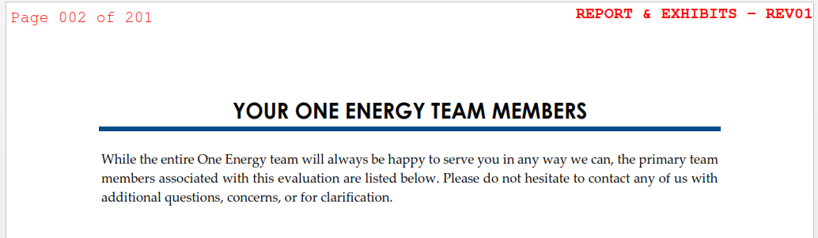
final close-out housekeeping
Copy the PDFs that were given to and approved by the IE into /13. Approvals
  Files:
    REV0x_DetailedEval_<company>_REPORT ONLY.pdf
      Report only
    REV0x_DetailedEval_<company>_REPORT w EXHIBITS.pdf
      Report + exhibits
    REV0x_DetailedEval_<company>_SITE WIND REPORT.pdf
      WRA and PPR combined into one file
    REV0x_DetailedEval_<company>_GUNTER REVIEW.pdf
      IE final signed review
    REV0x_DetailedEval_<company>_GUNTER REVIEW AND REPORT.pdf
      IE final signed review and report+exhibits into one file. Review first then report.
  Add Bates numbers on all files, all pages in upper left corner
  Add file and REV number on all files, all pages in upper right corner

Slide 22

close-out housekeeping
Create DE Summary page
  Save PDF in correct location
  Print and put into DE Summary binder
Update Turbine Siting Log
Update Term Sheet
Update Project Master Sheet
Finalize Goldwind forms (later class)
Clean folders
Update Whaleboard
Update Taskworld
Confirm it was put into Athena
Ask Associates to print/bind a copy for the library
We’ll go more in-depth on these at a later class

Slide 23
homework
Read Dr. Gunter’s review of Lafarge
Due next class

Slide 24

Questions?
Questions? Comments? Concerns?
Next class:
FAA Process

