Slide 1
From turbine to plant
Andrew rapin

Slide 2
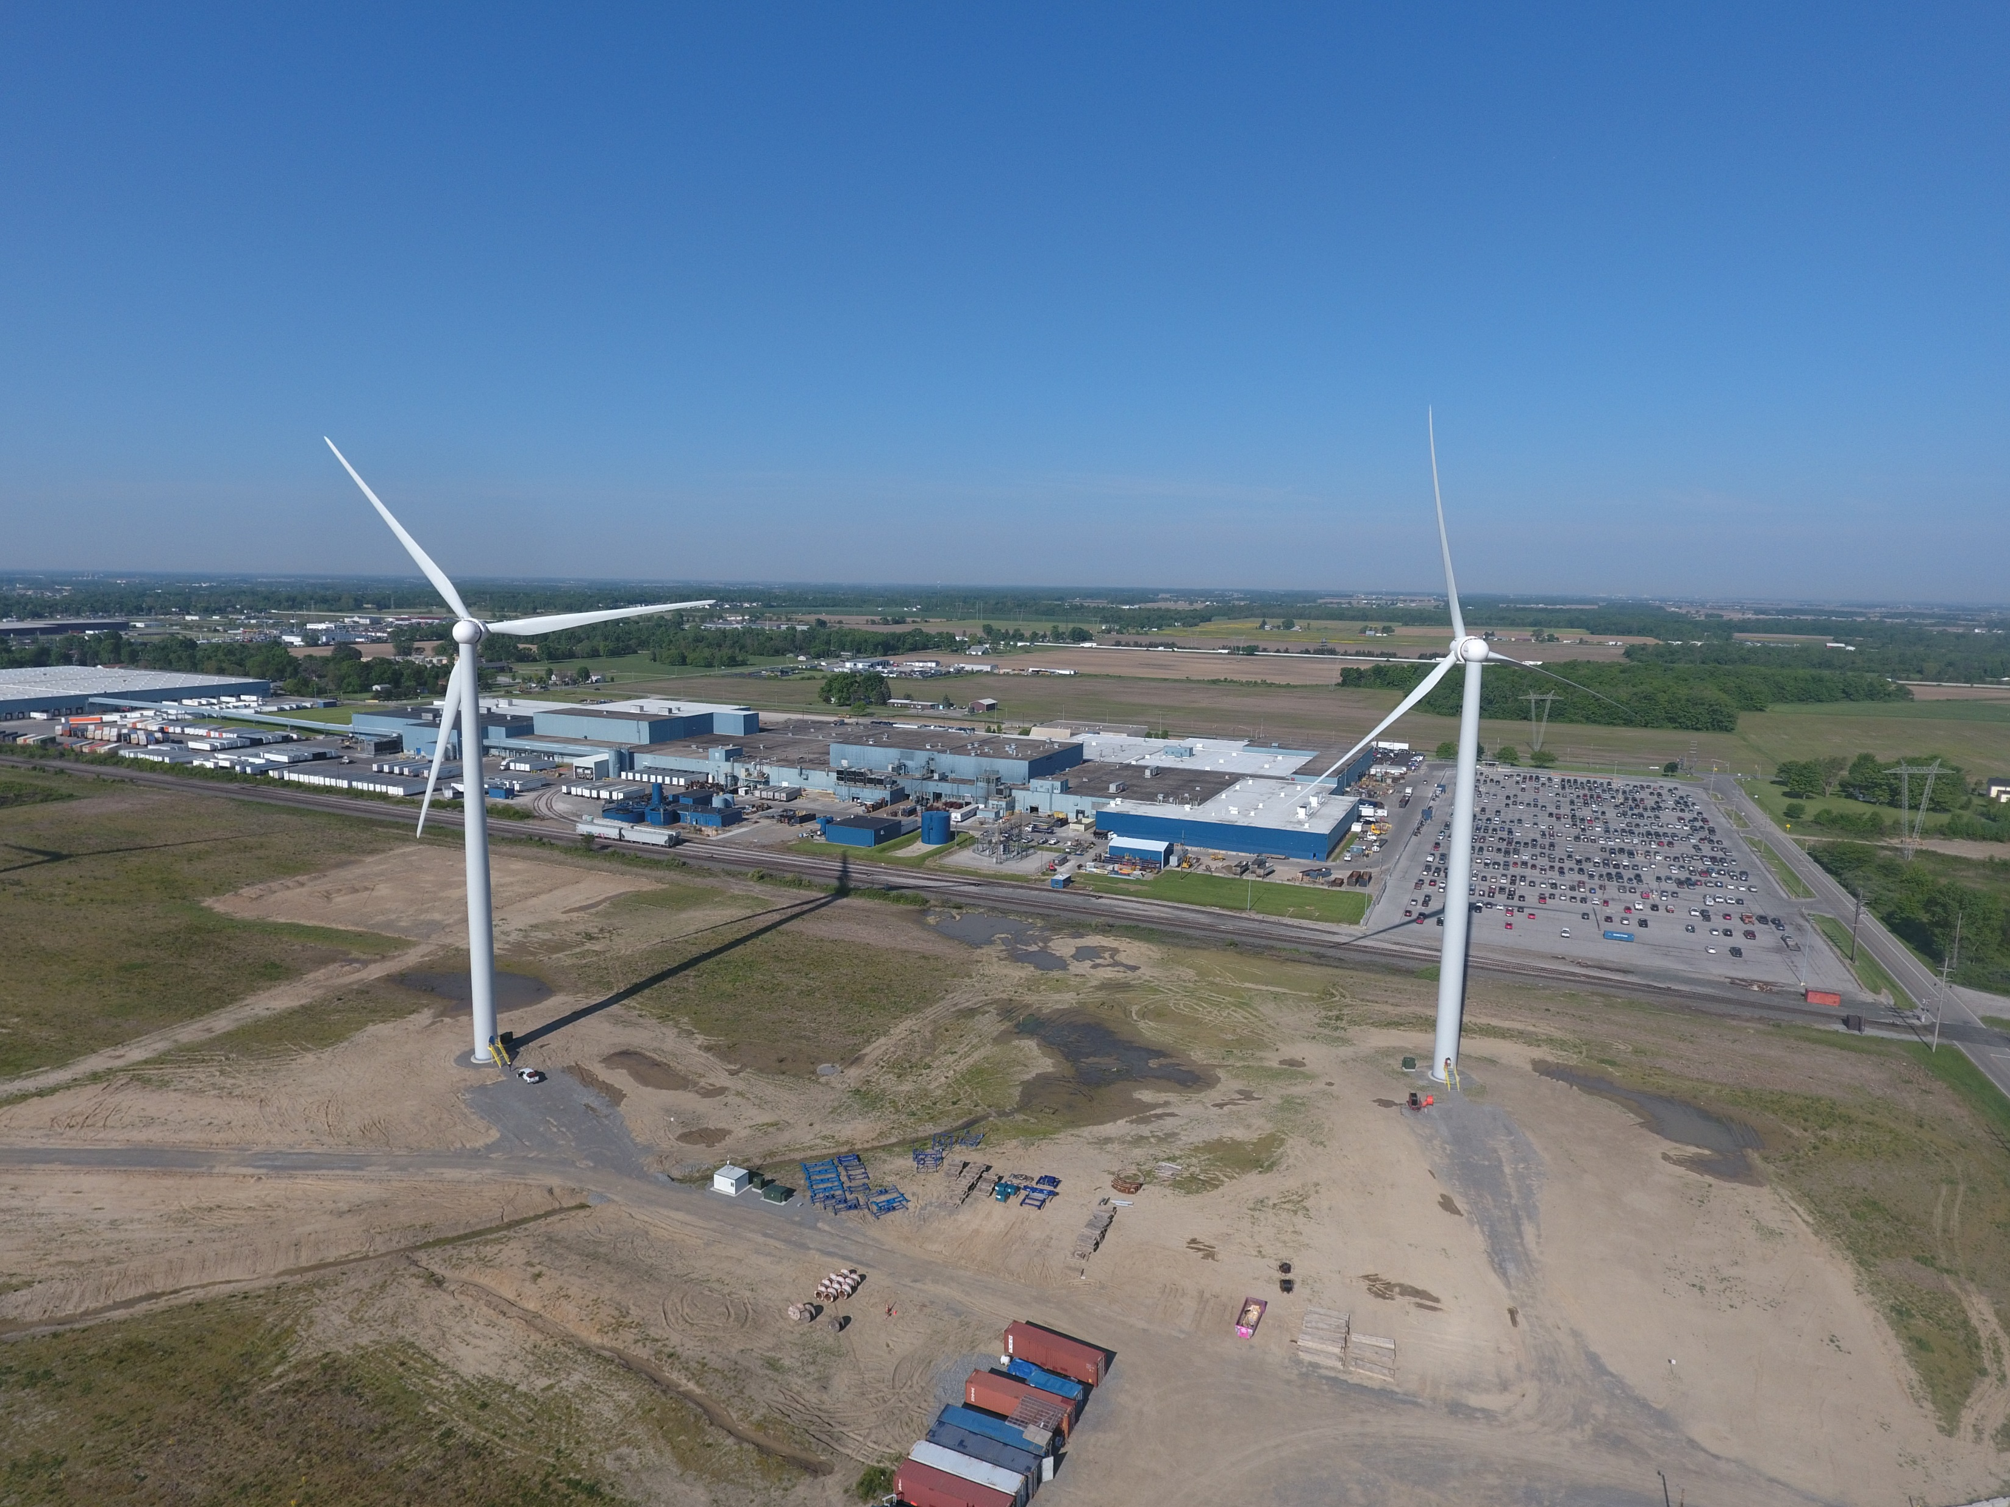
what we’re talking about
Flow of electricity from our turbines to our customer’s facilities
How to read a one-line drawing What it means when you hear [Project] tripped
OE responsibility vs GW responsibility
Reference Presentation: Electricity 101

Slide 3
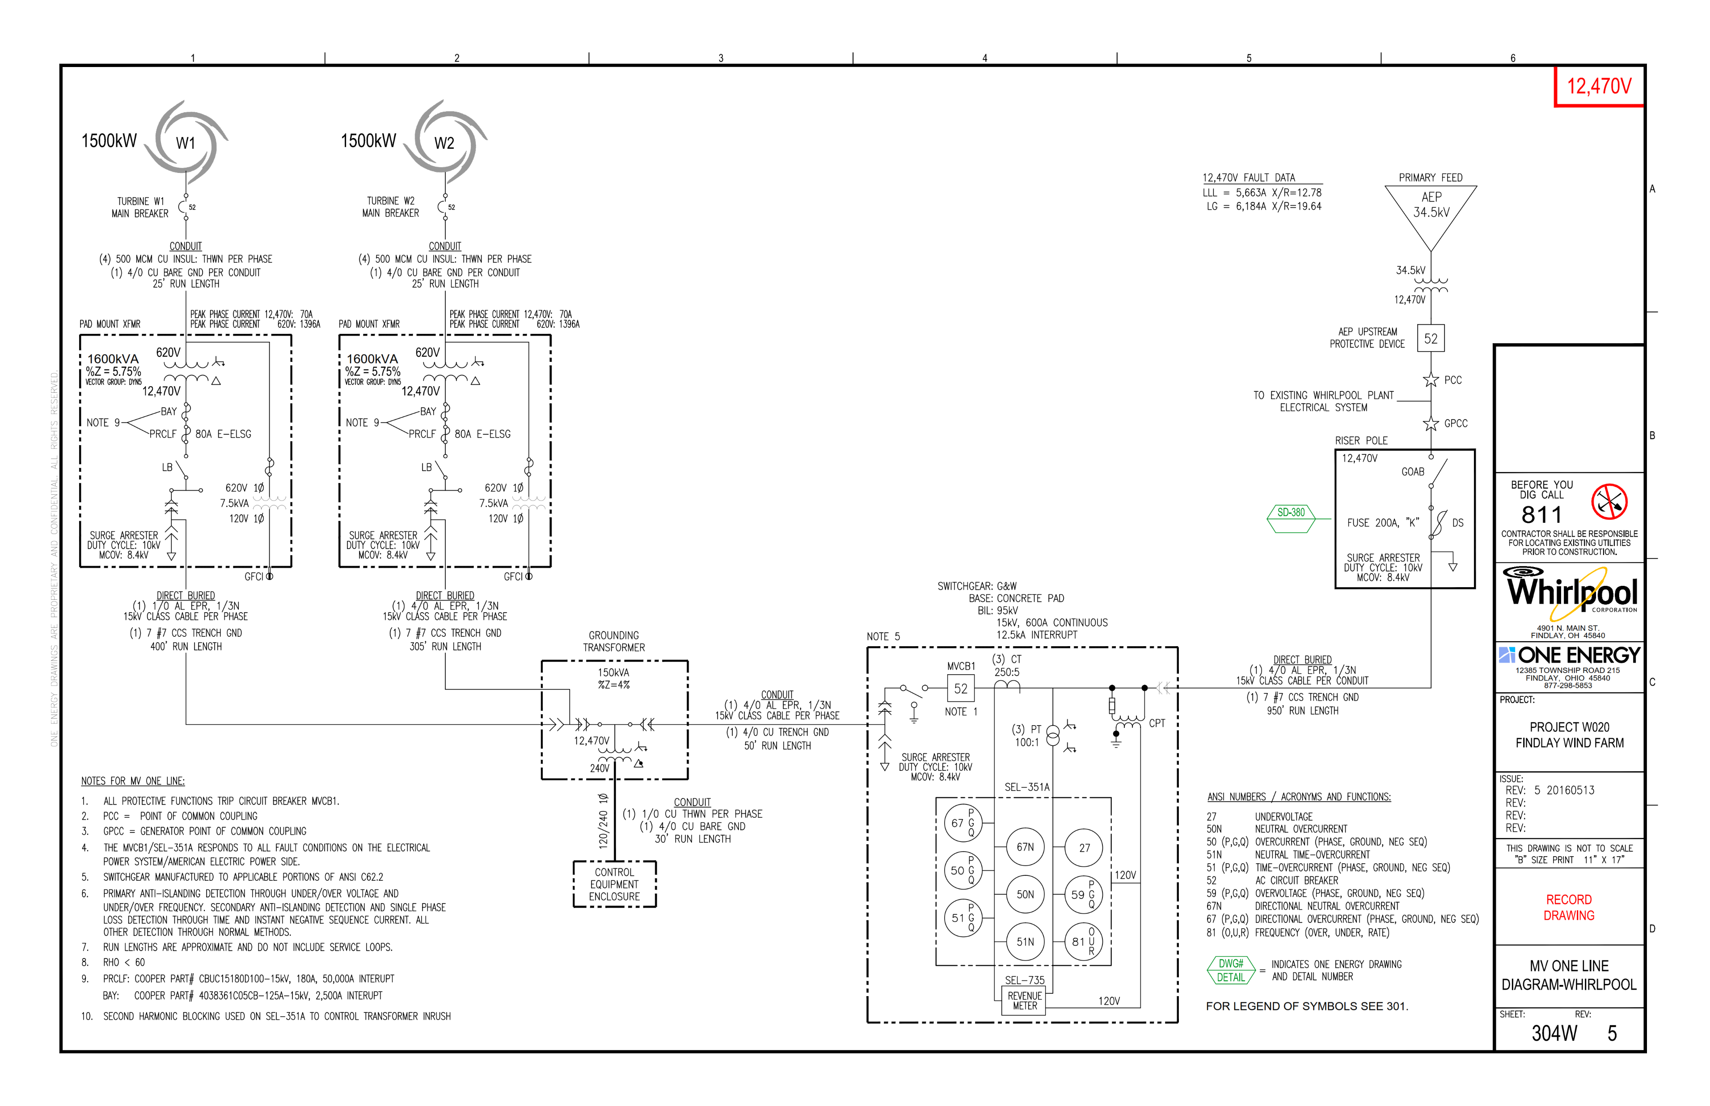
one-Line drawing

Slide 4
In operation
From Here
To Here

Slide 5
Starting with the turbine
Starting Here

Slide 6
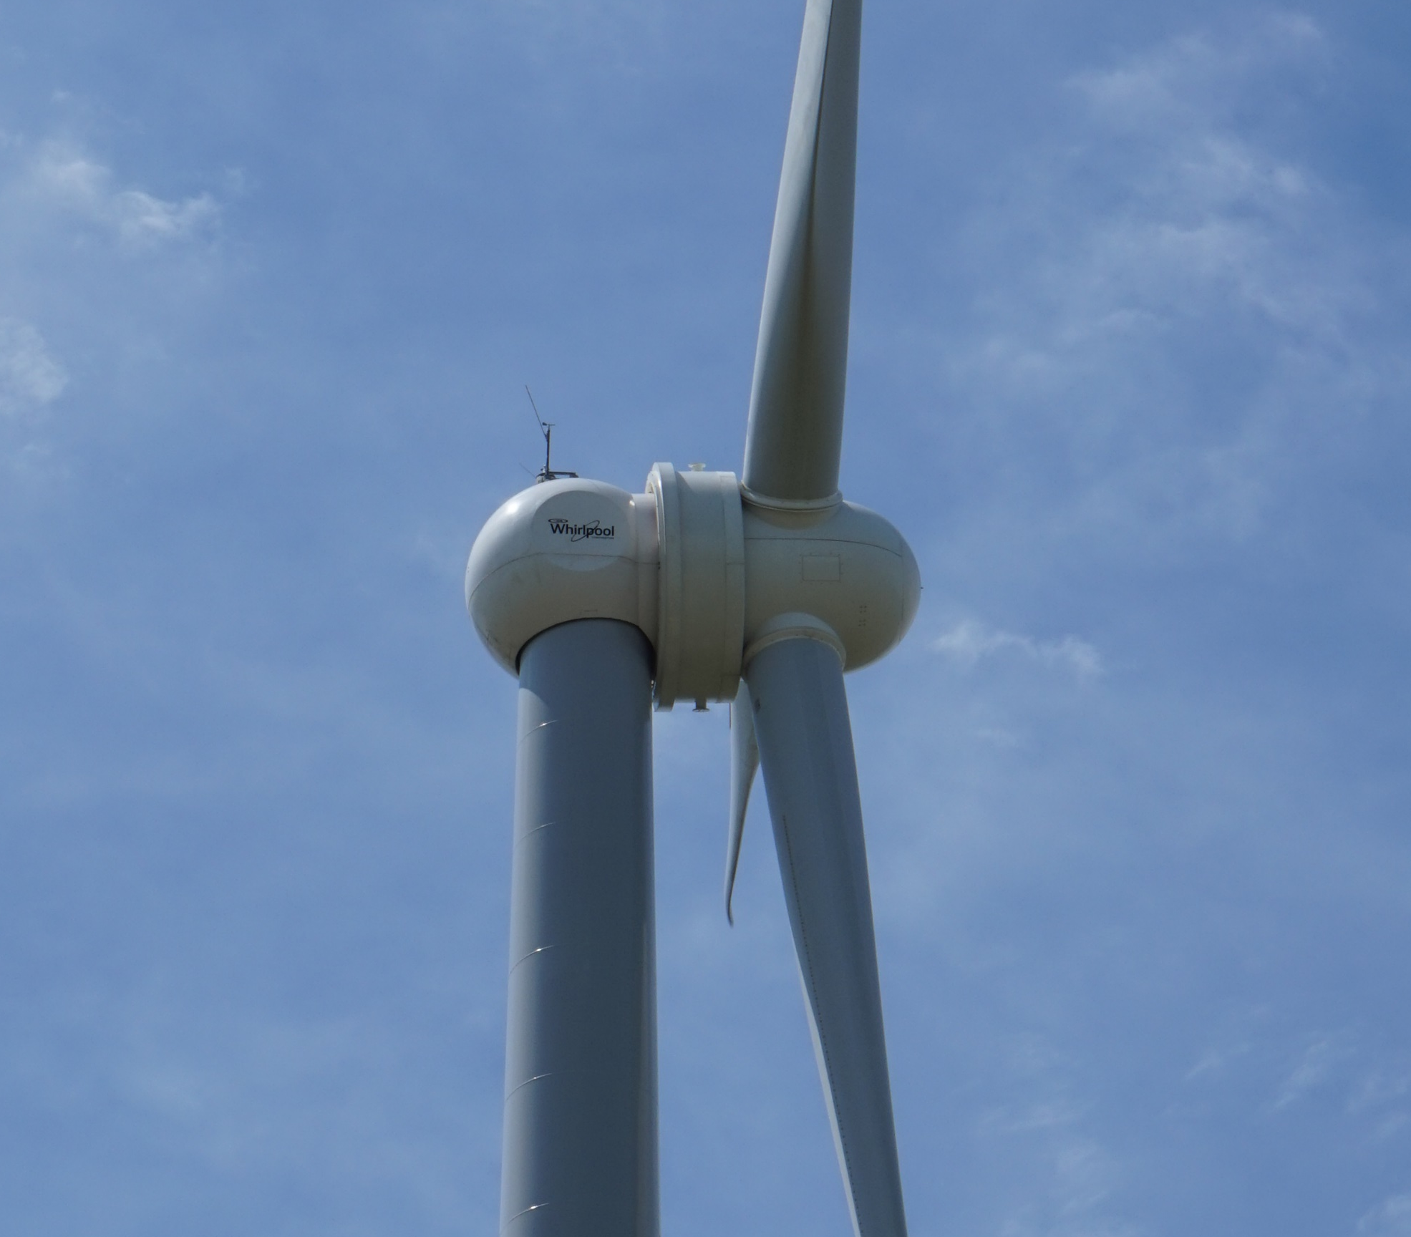
gw generator
Permanent Magnet Direct Drive (PMDD) Synchronous Generator
16.8 RPM Optimum
Generates wild three phase AC power
Full AC → DC → AC conversion
Clean grid synchronized power
Notes:
Permanent Magnet: Why we get from China.
Direct Drive: Driven by rotor
Synchronous: Waveform of the output voltage is a function of the generator
Draw diagram of wild AC, DC, AC

Slide 7
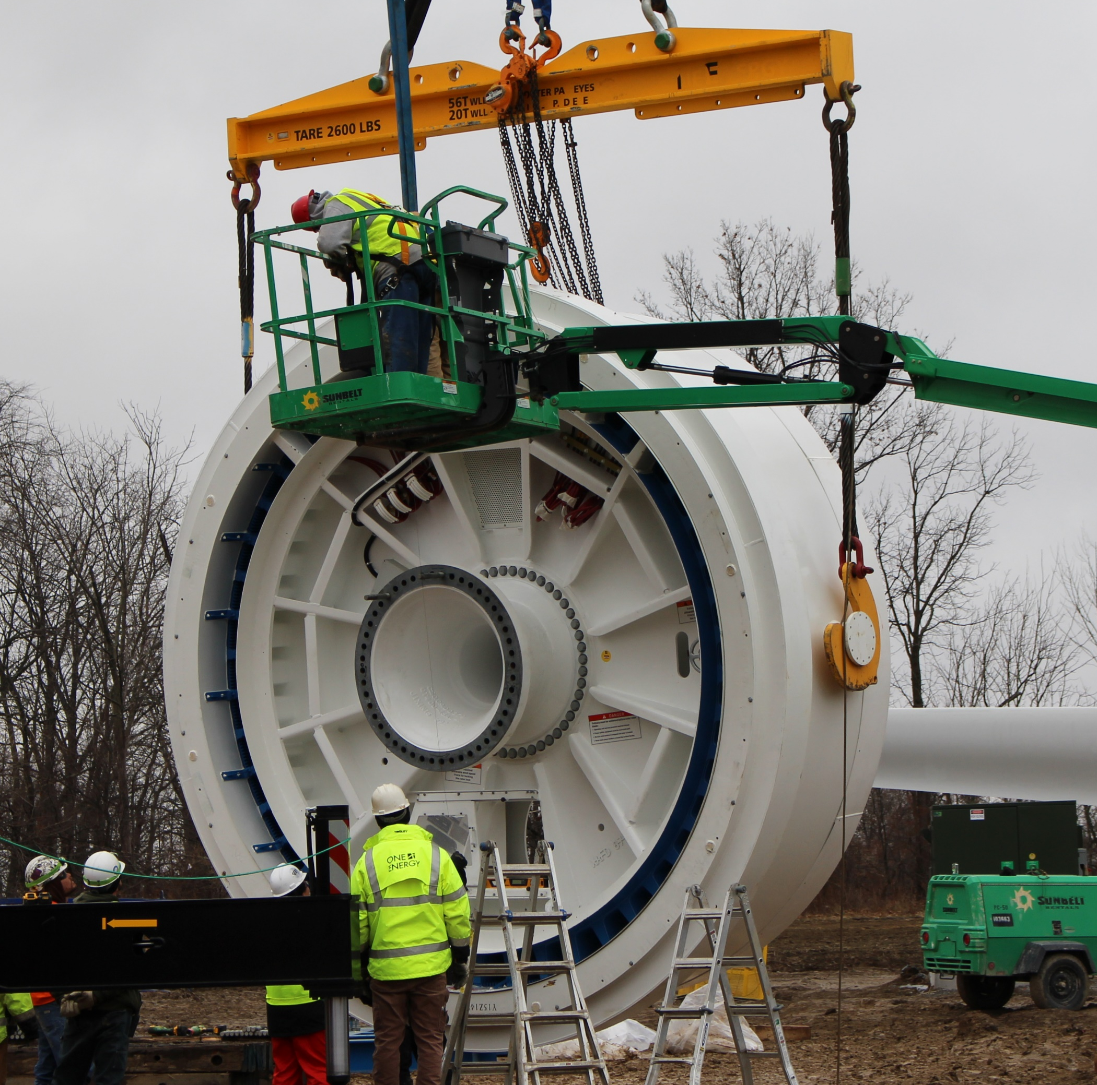
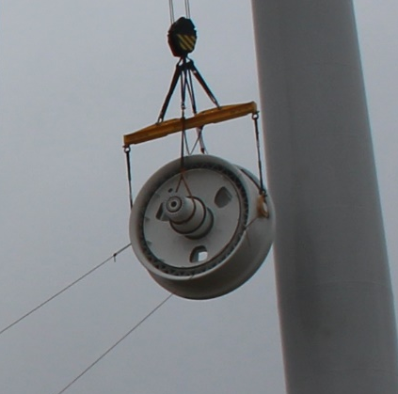
Gw generator

Slide 8
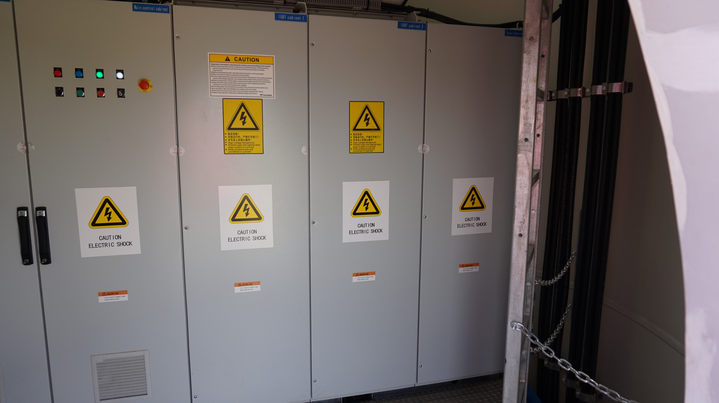
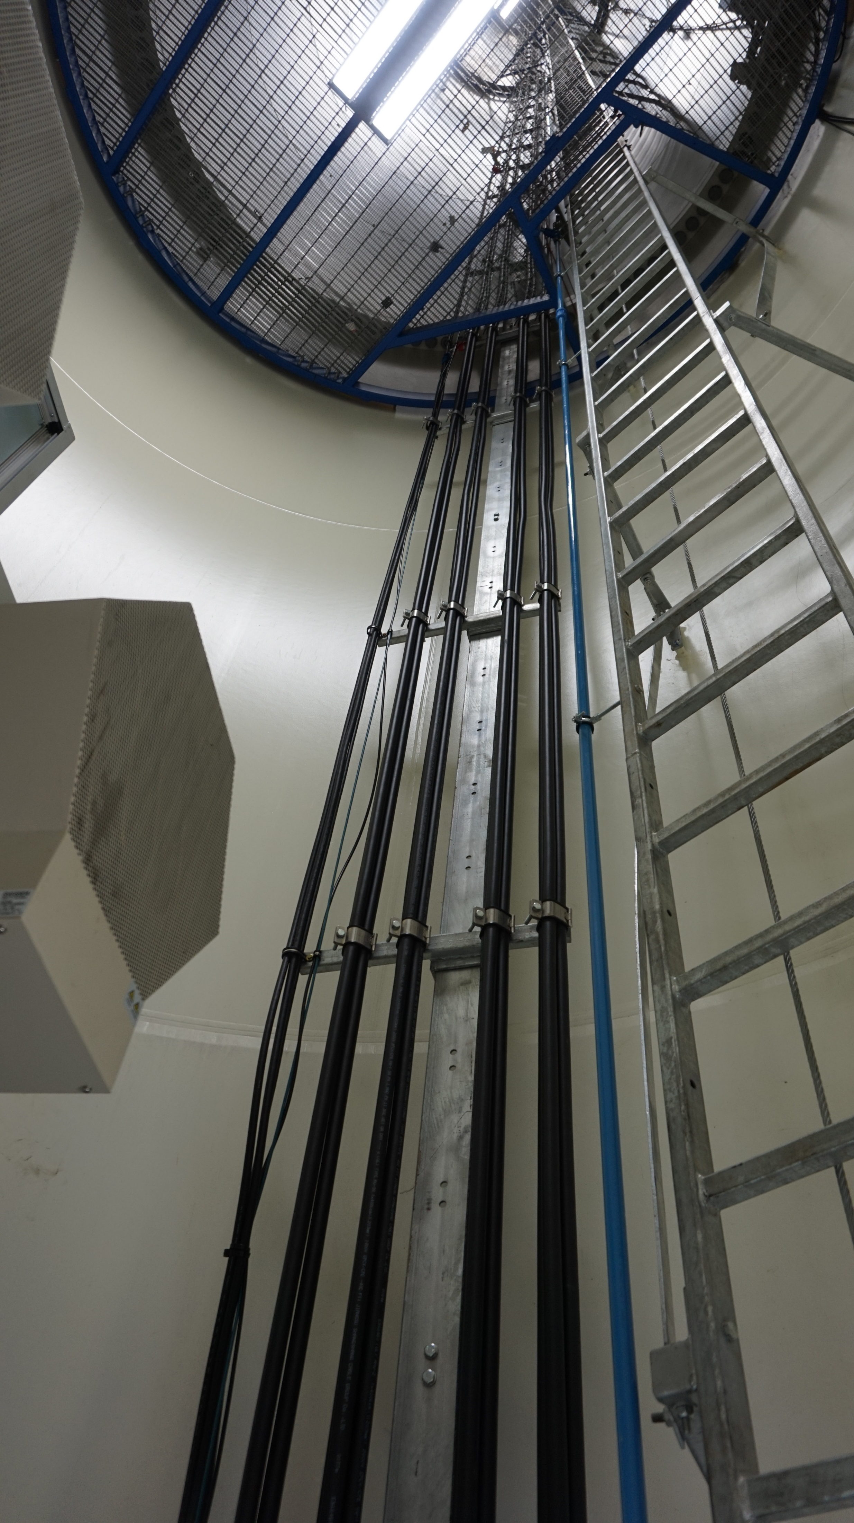
Tower base

Slide 9
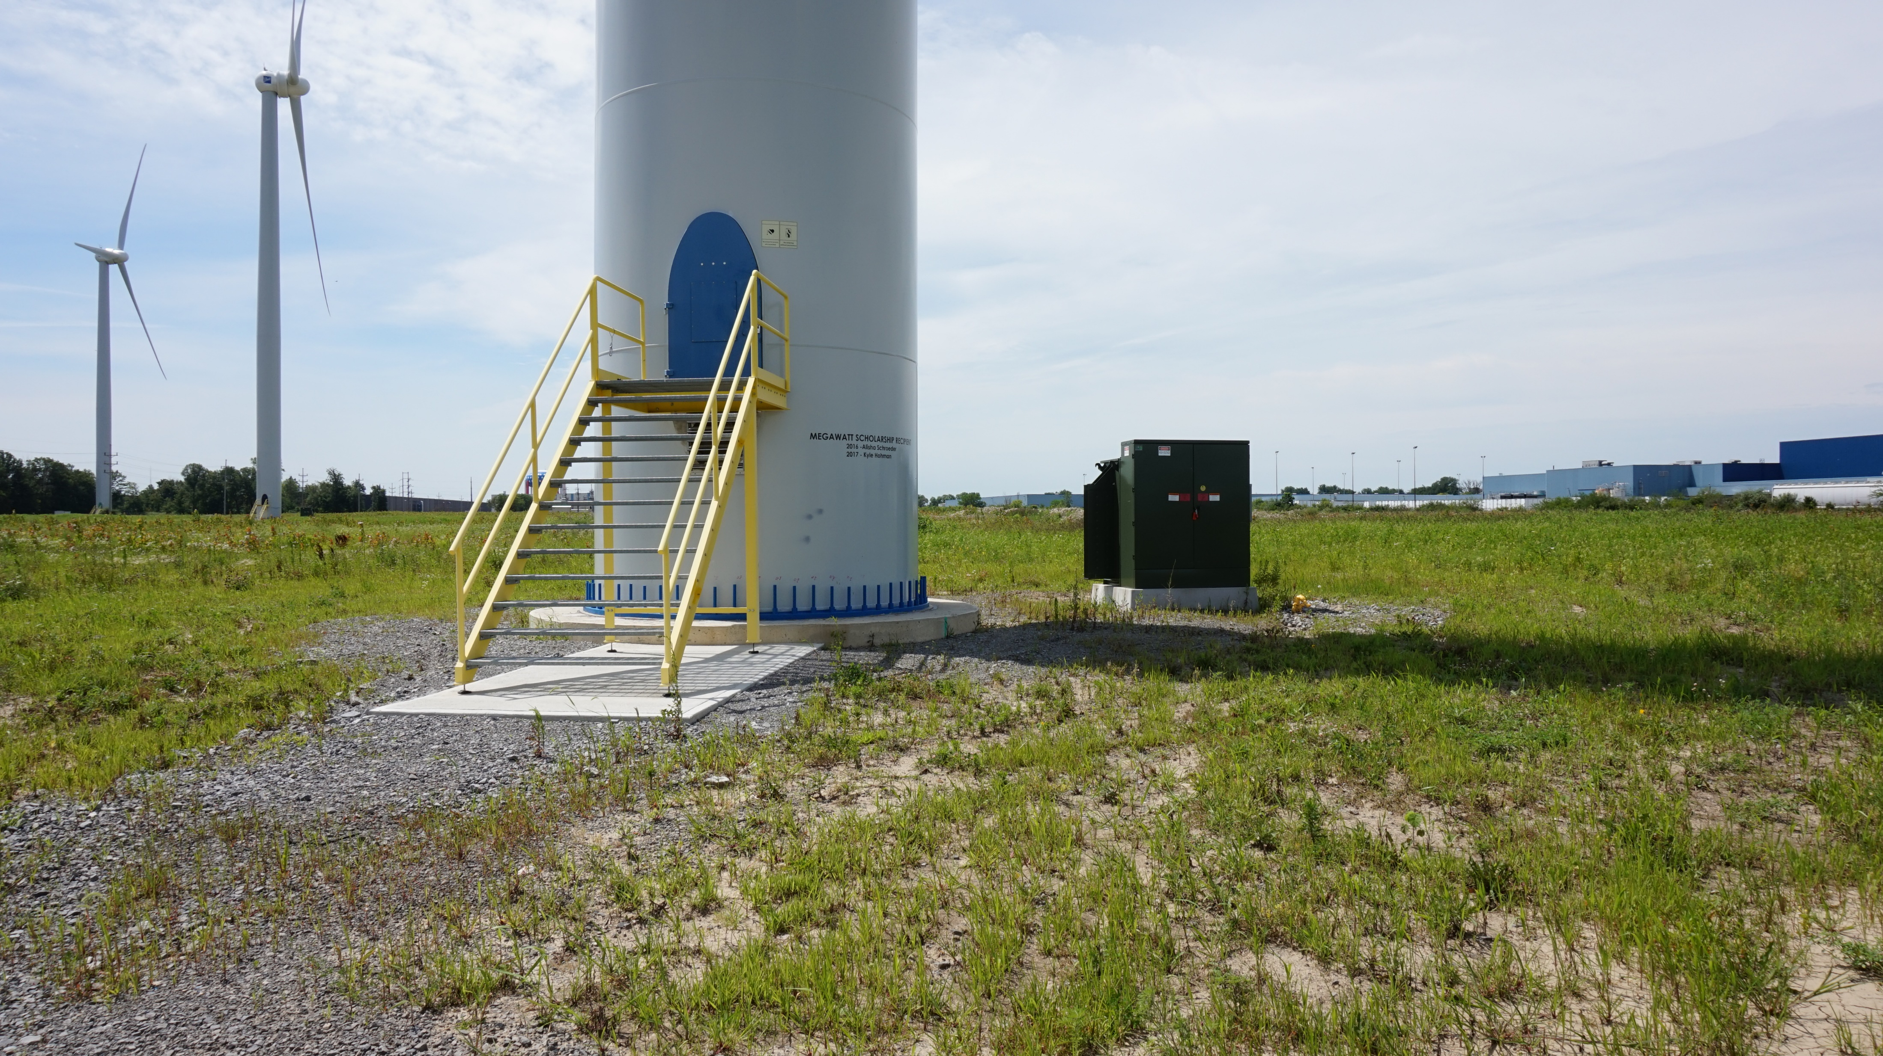
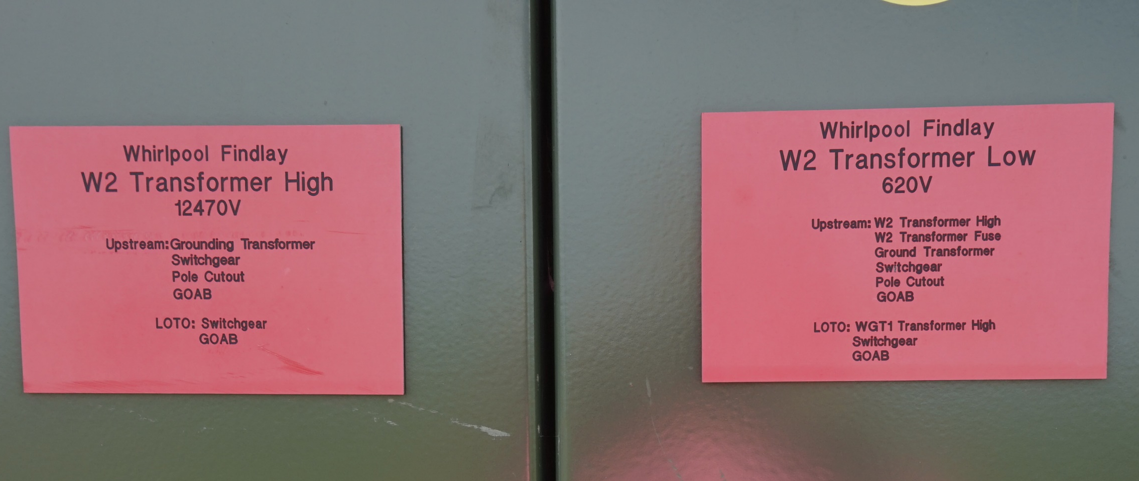
Once we’re out of the turbine
Underground conduit
To pad mount transformer
Used to match grid voltage
  Common voltages are 34.5kV, 12,470V, and 4,160V

Slide 10

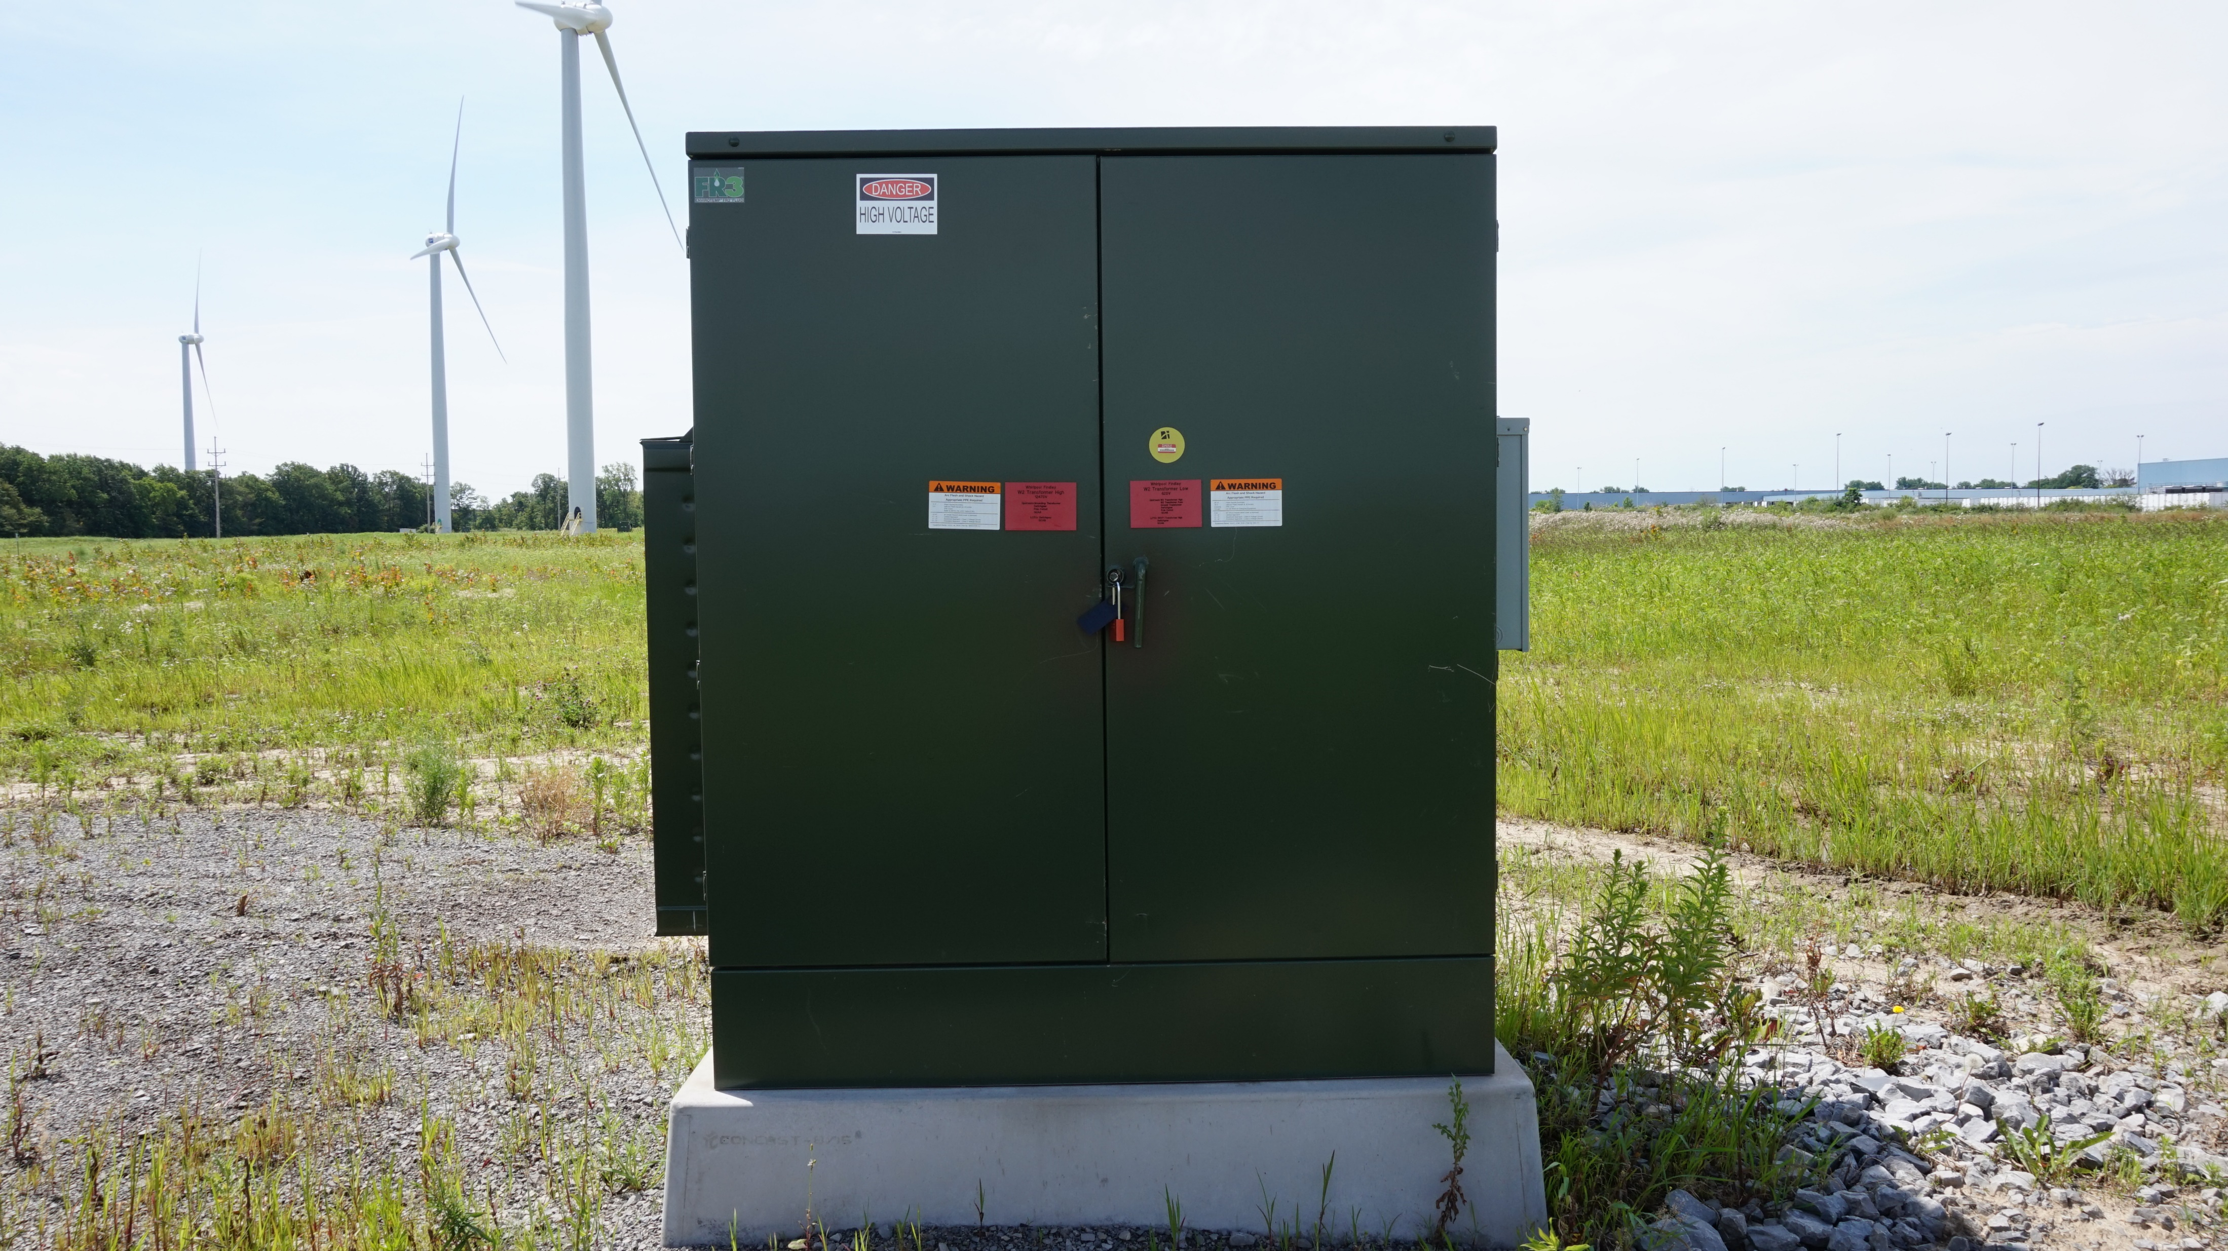
On the one line

Slide 11
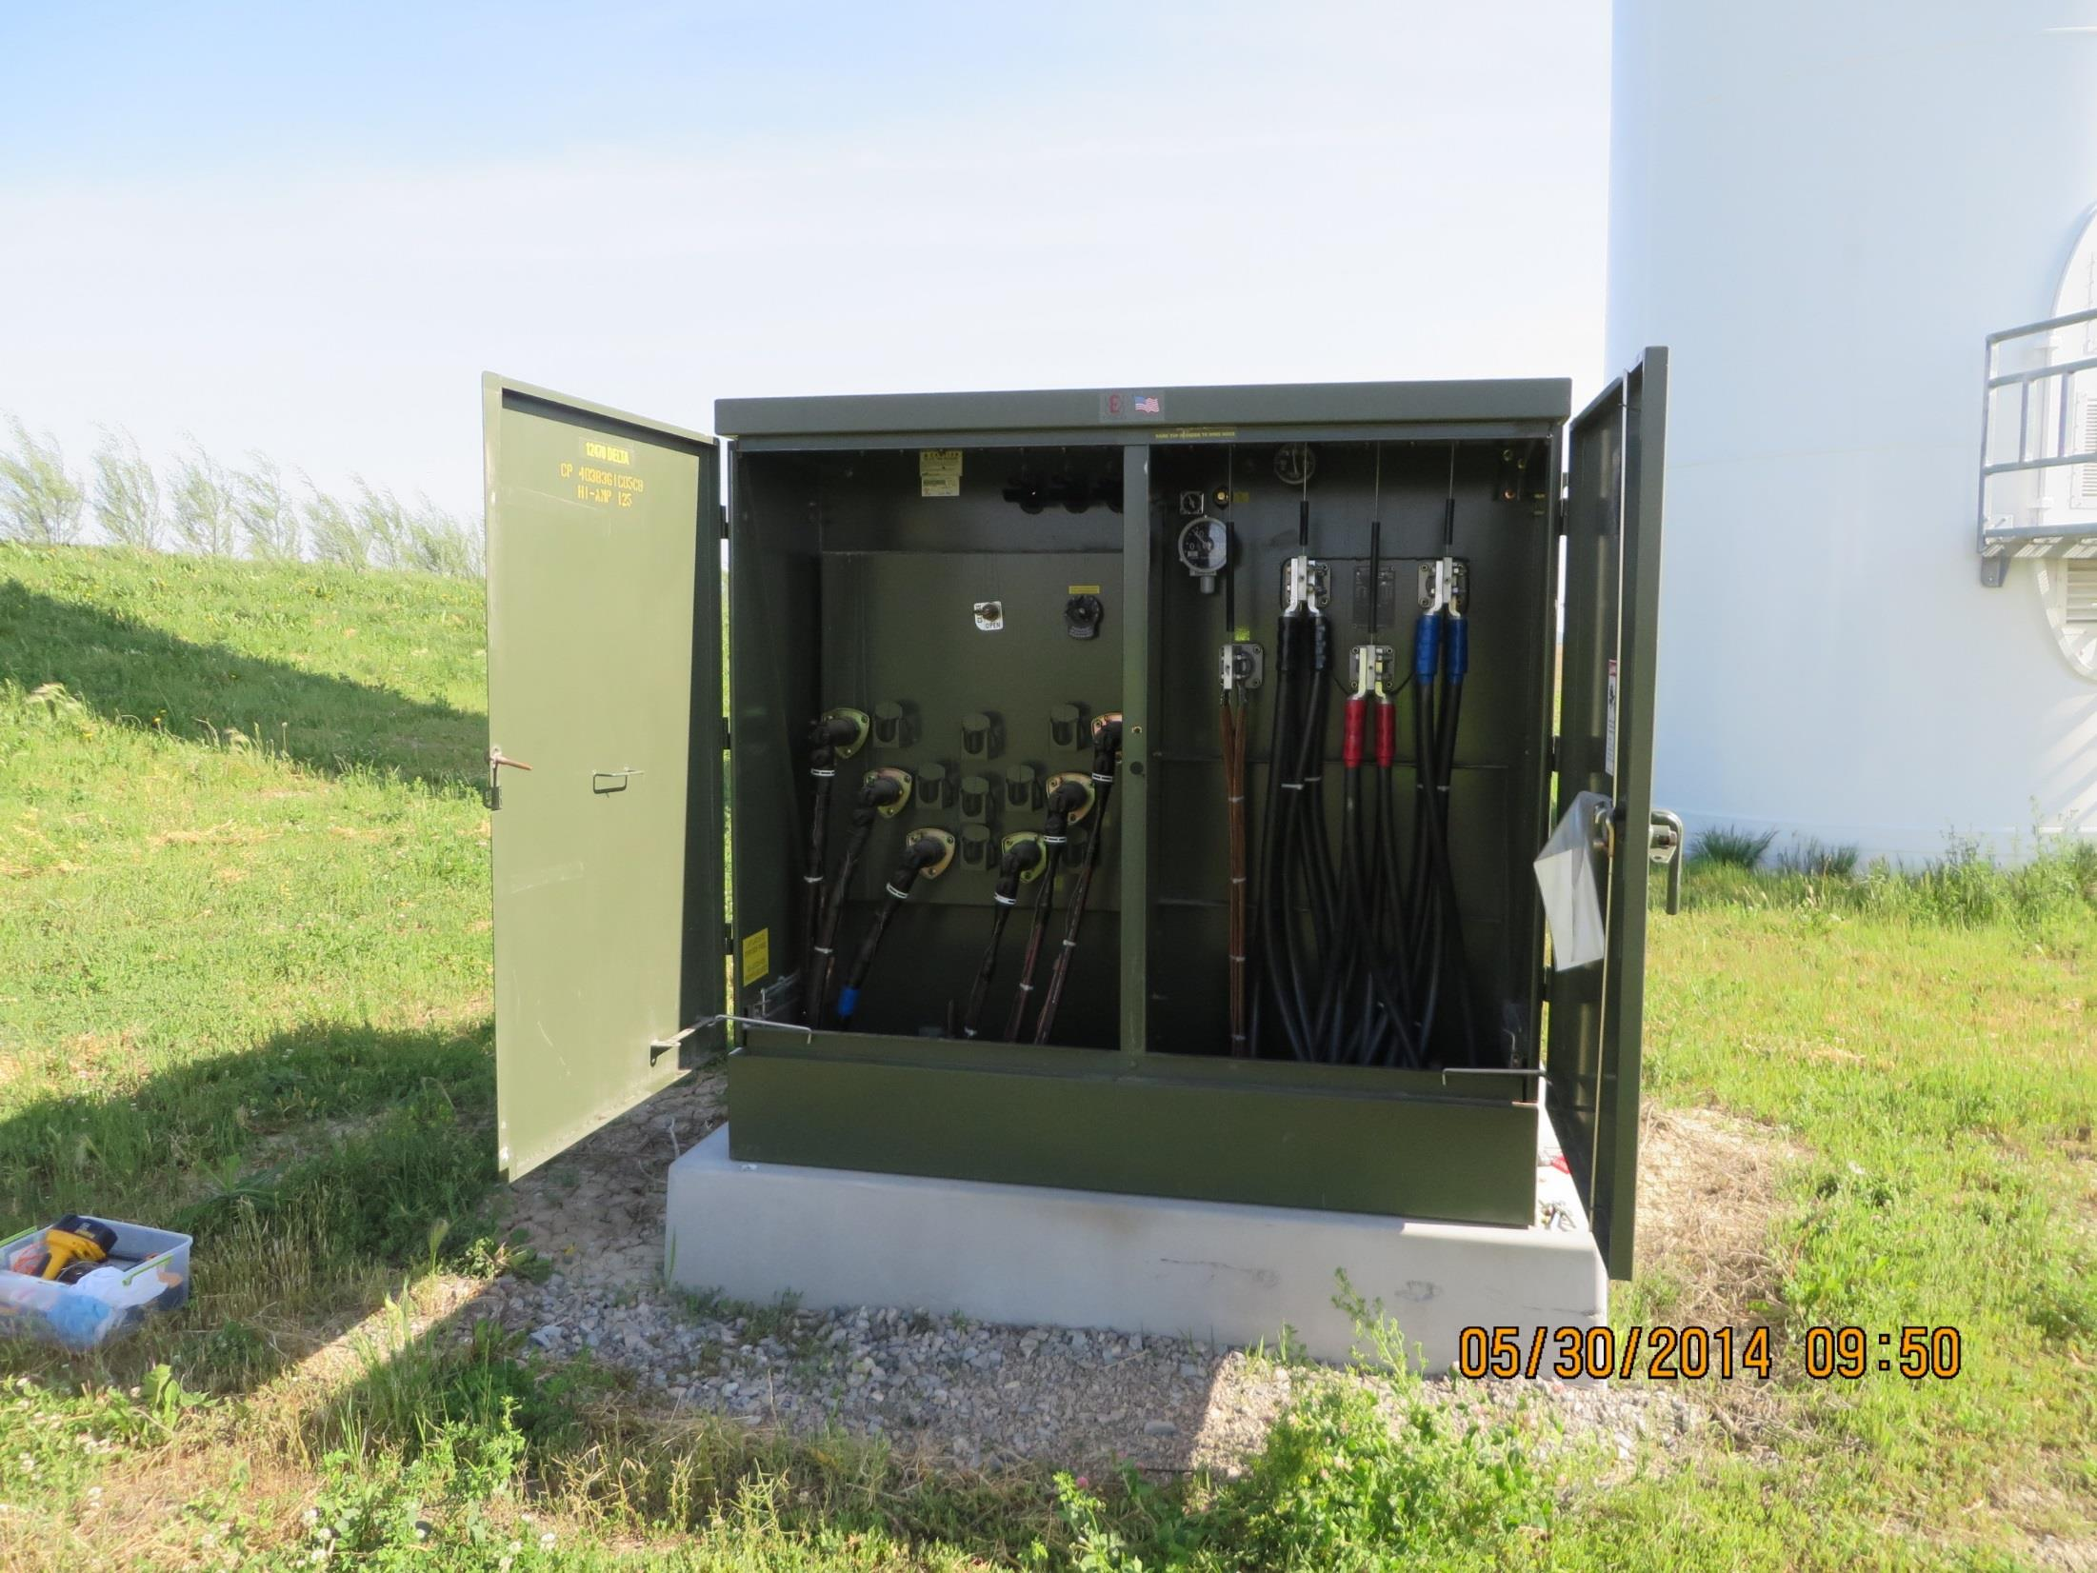
transformer

Slide 12
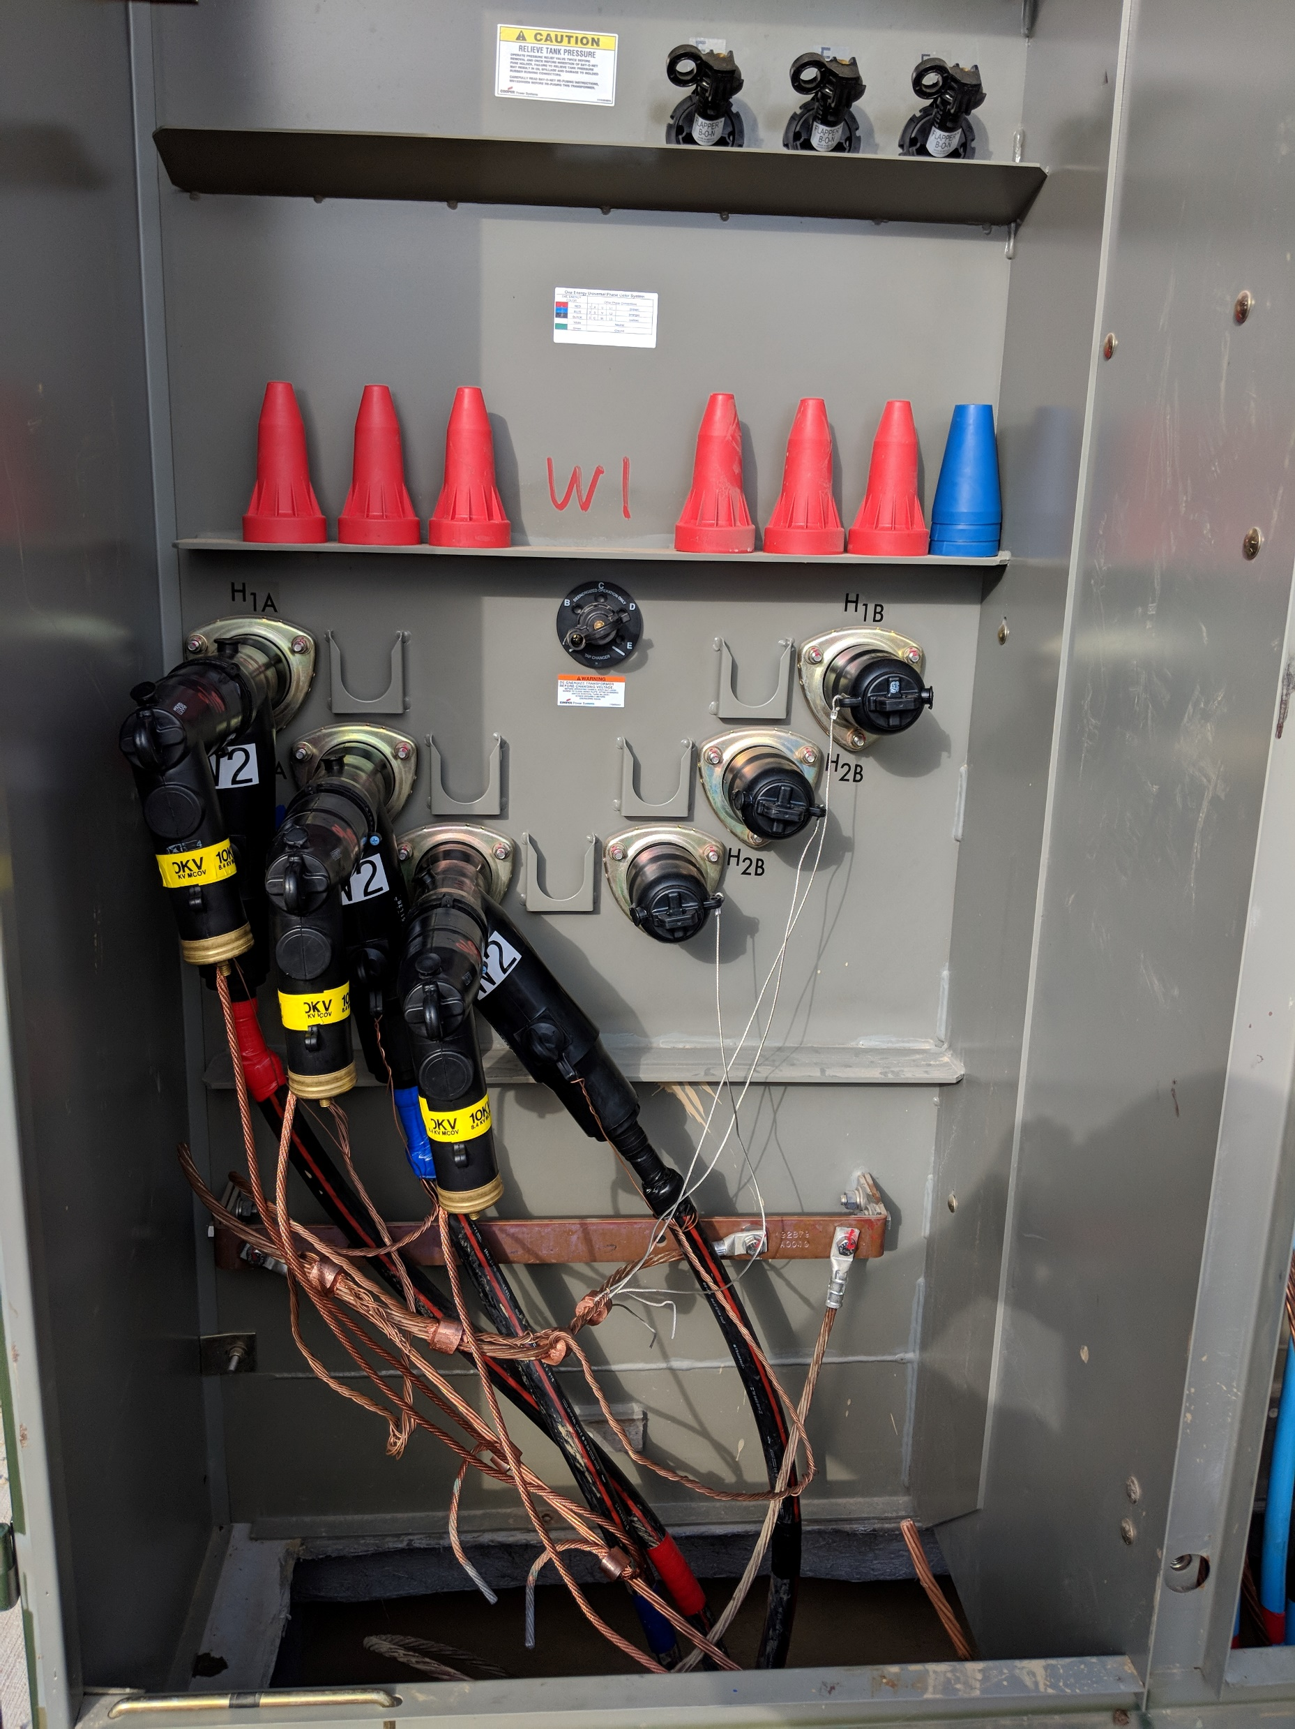
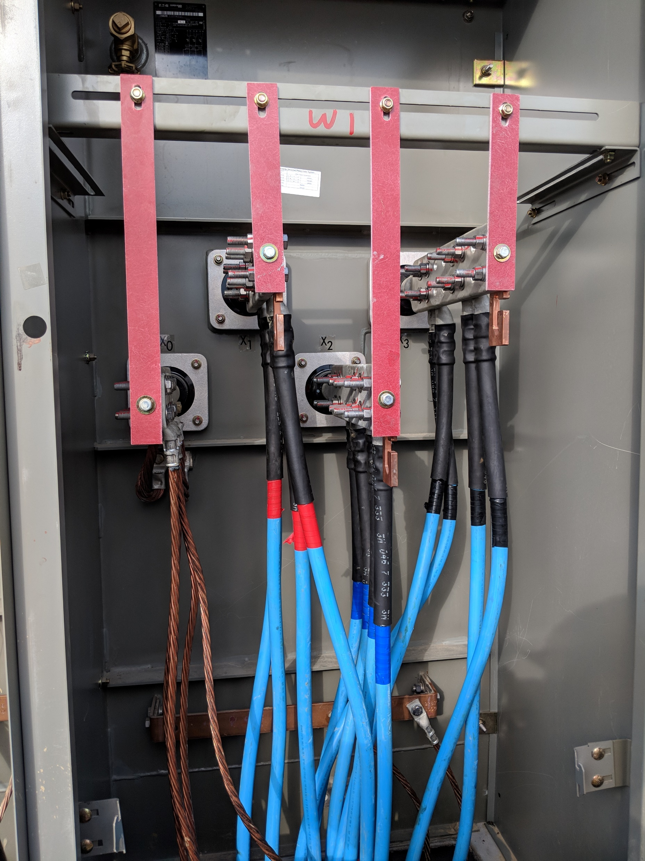
Transformer

Slide 13
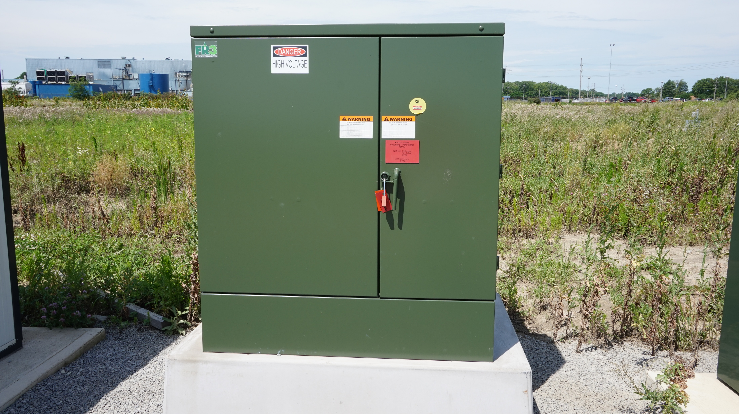
Grounding transformer

Slide 14

switchgear
Protects us from the grid and the grid from us
When you hear that a project has tripped, this is what tripped
Once tripped we are isolated from the grid and customer
Typically do switching remotely

Slide 15
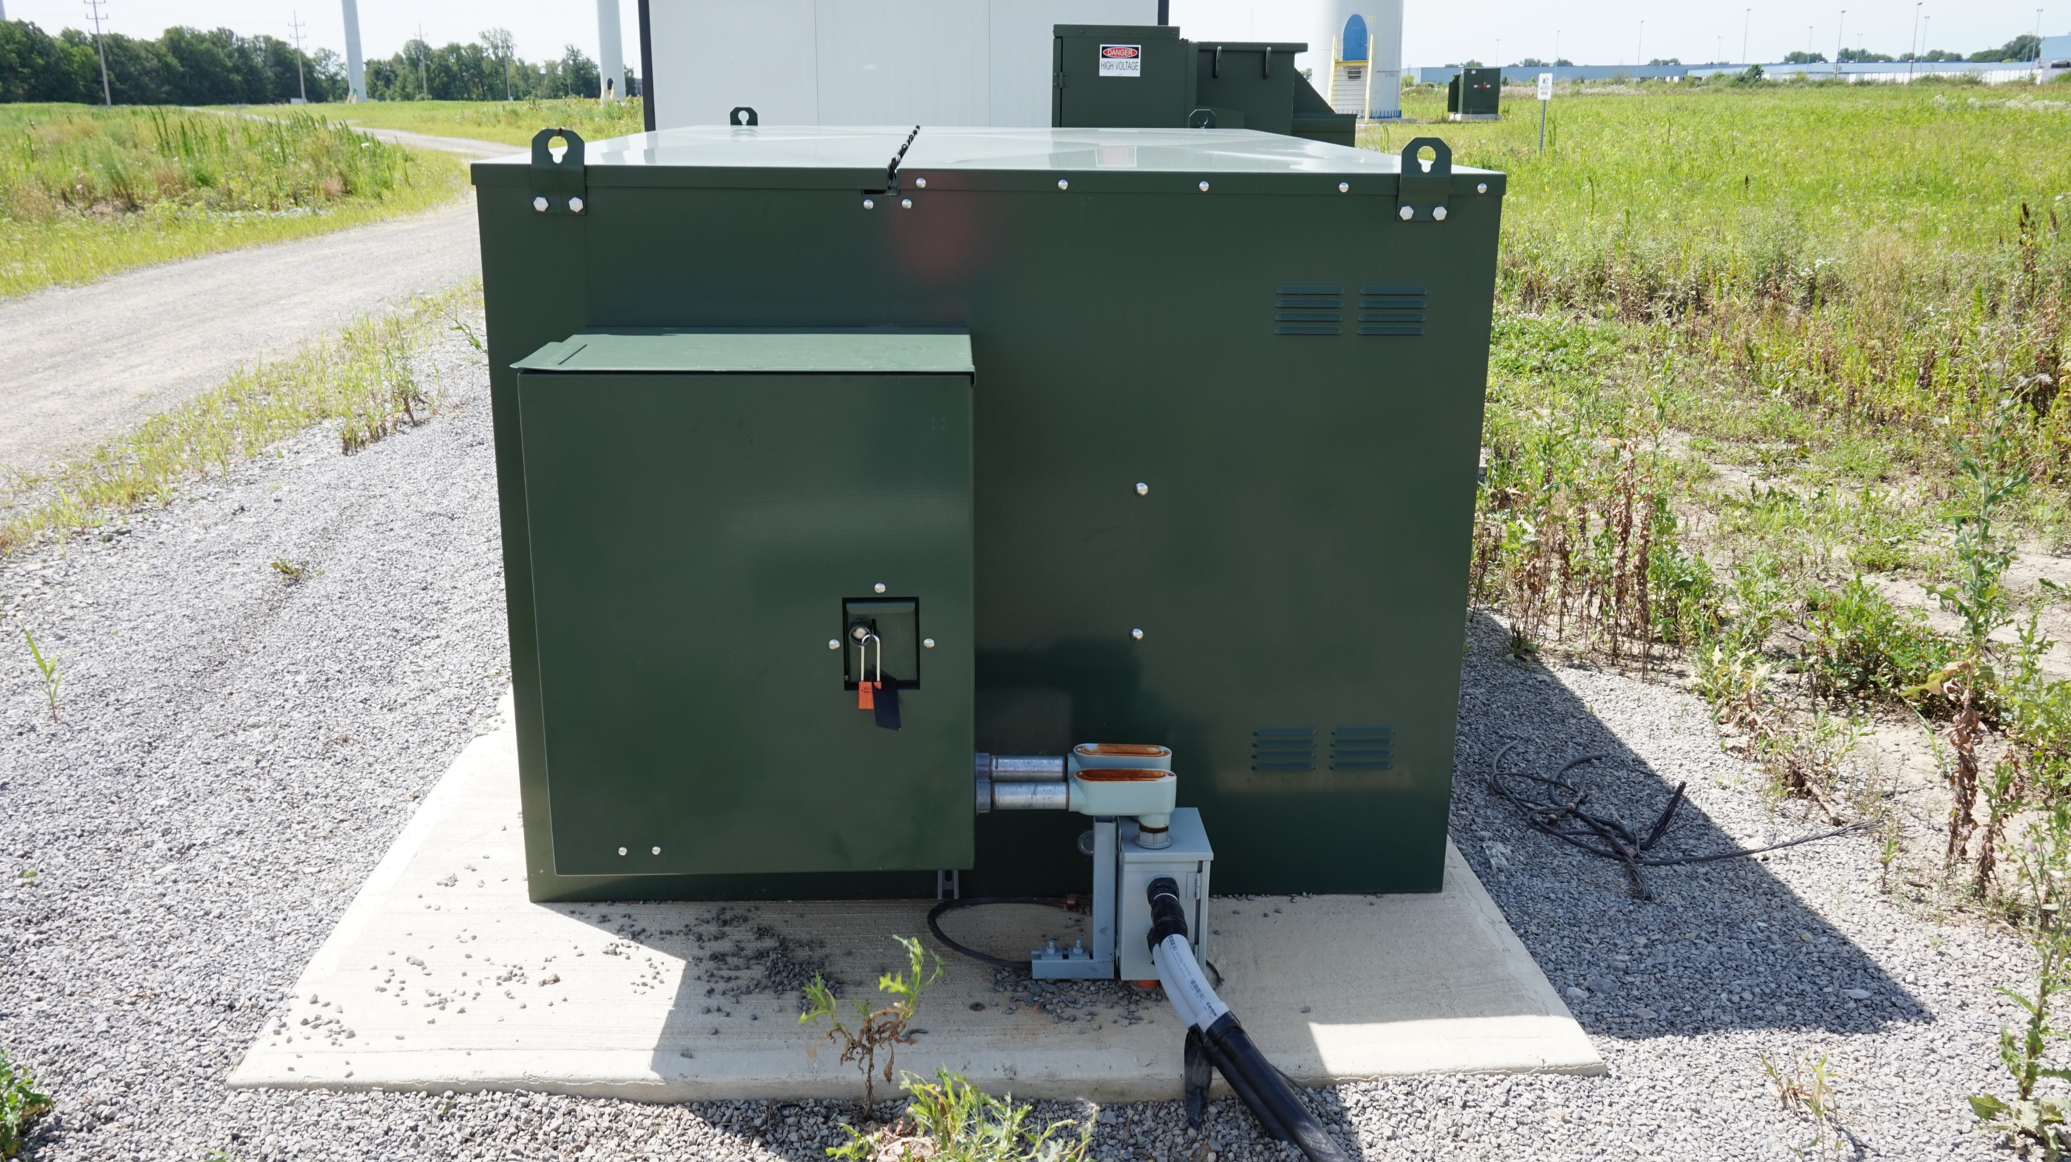
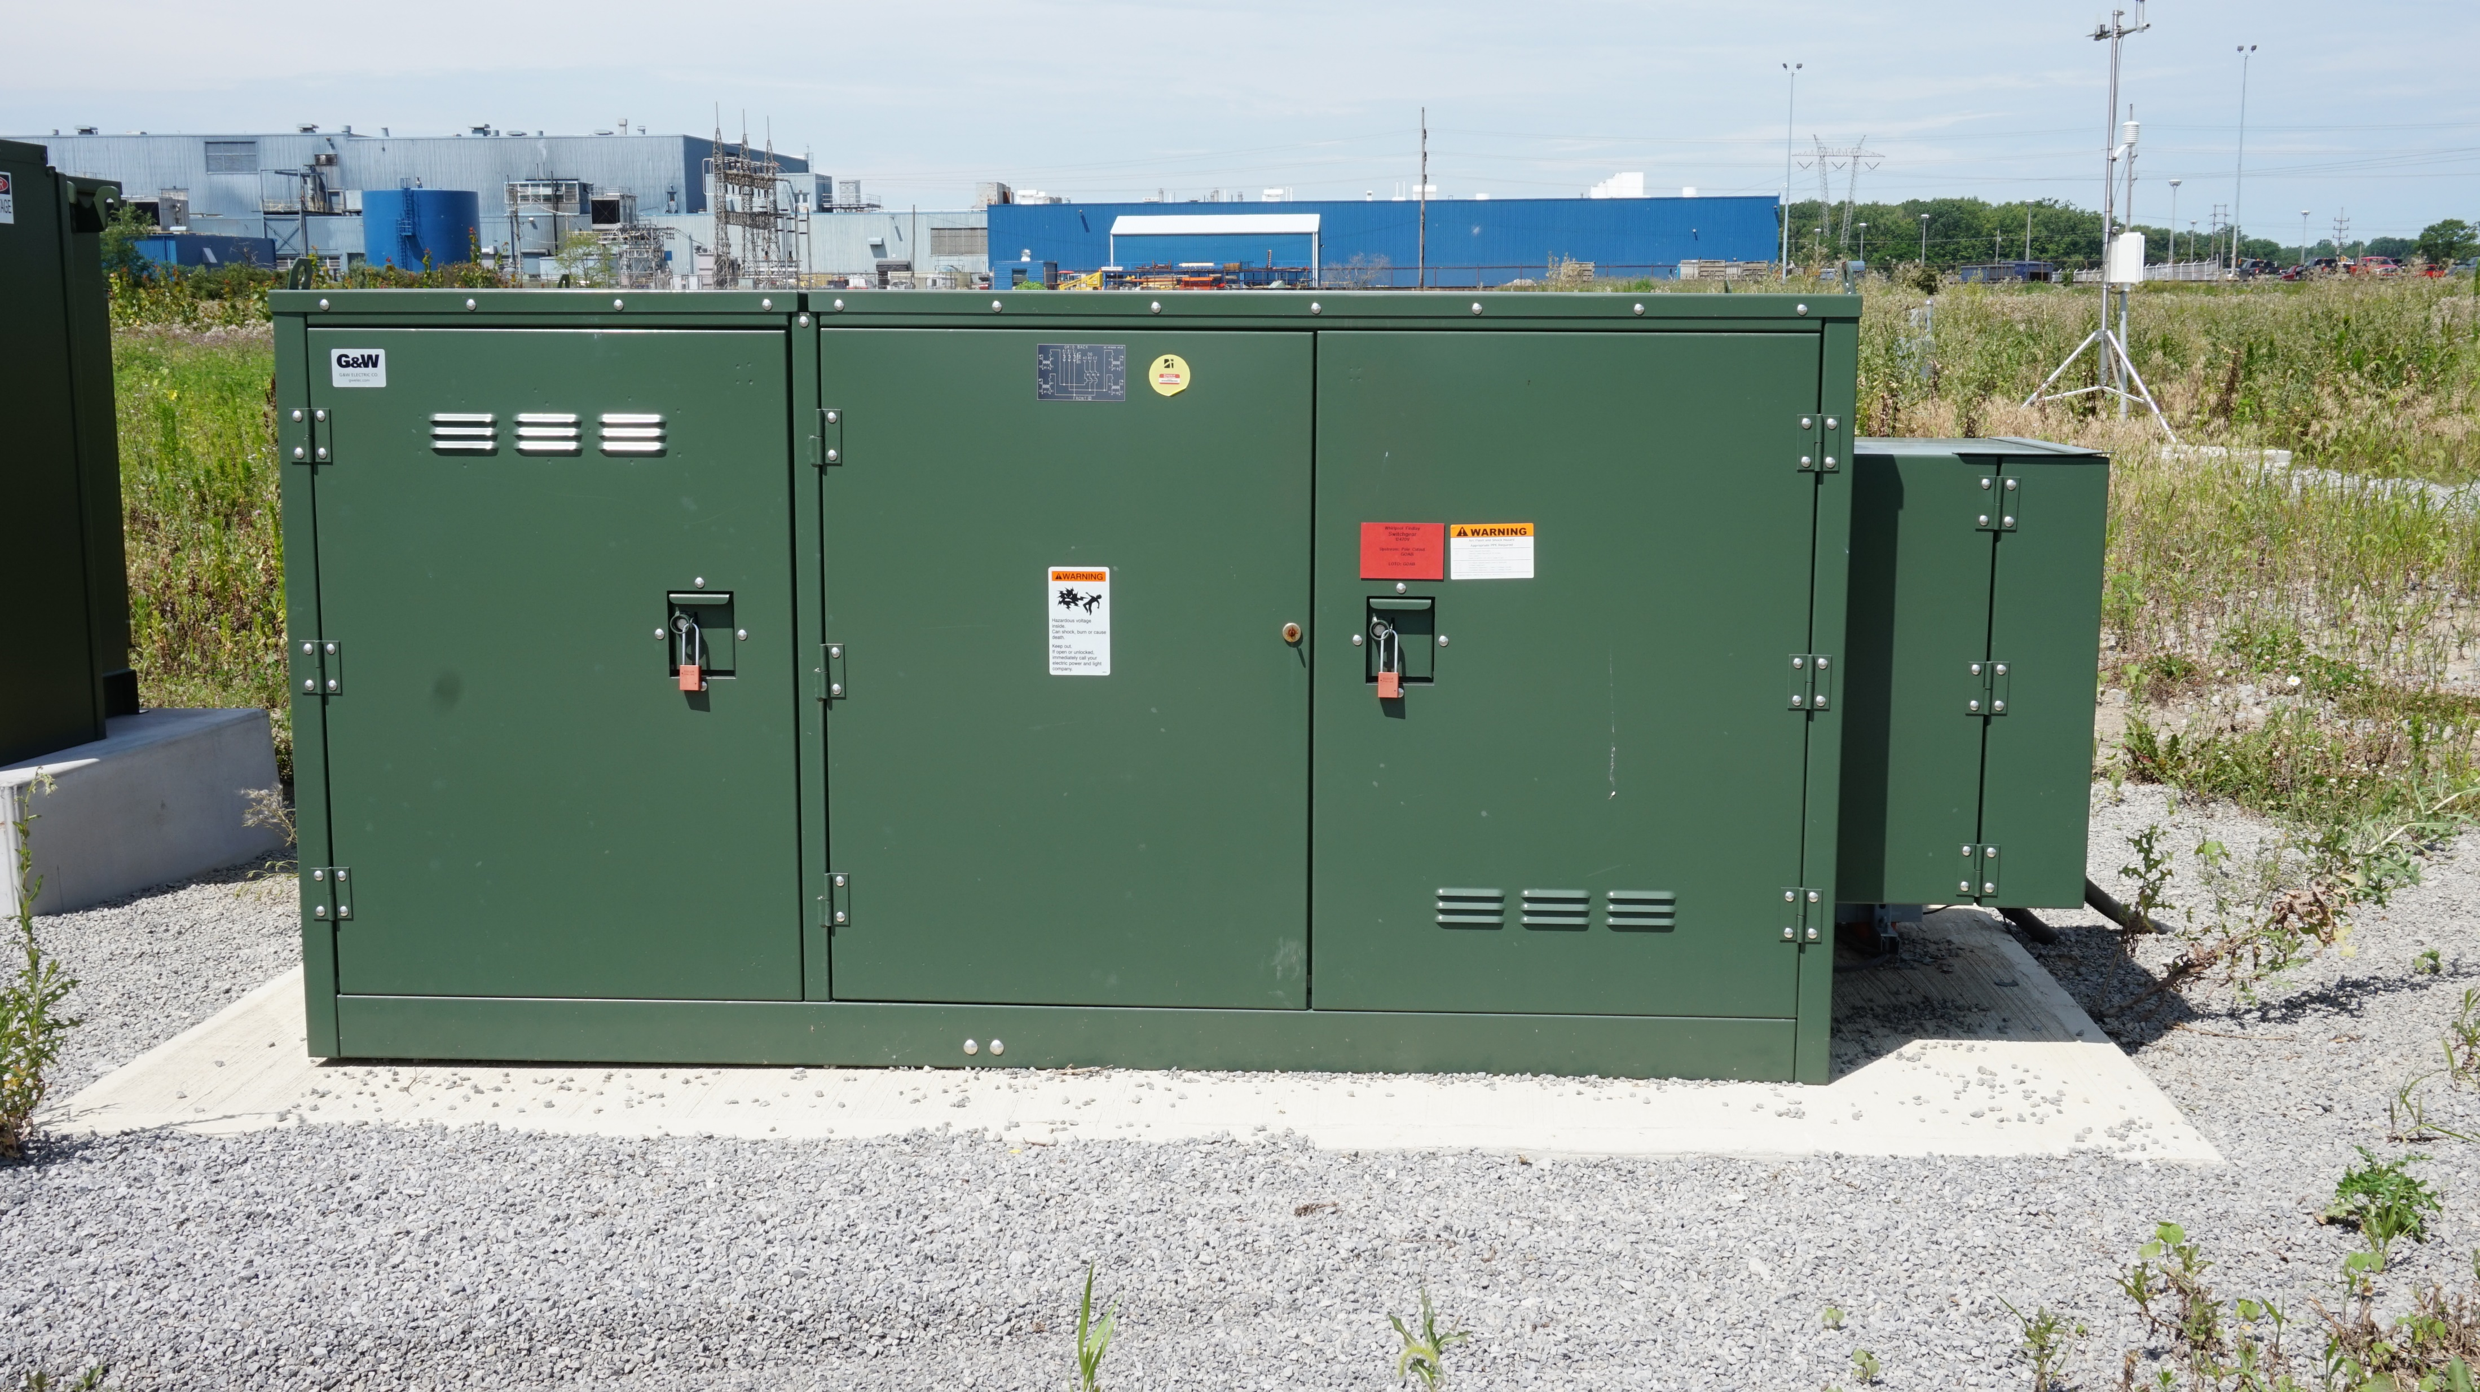
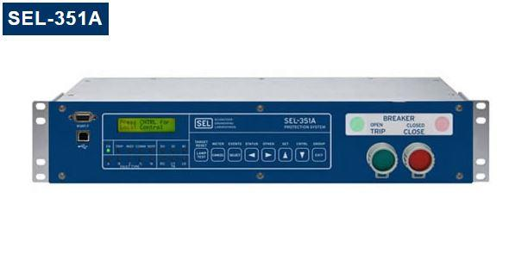
switchgear

Slide 16
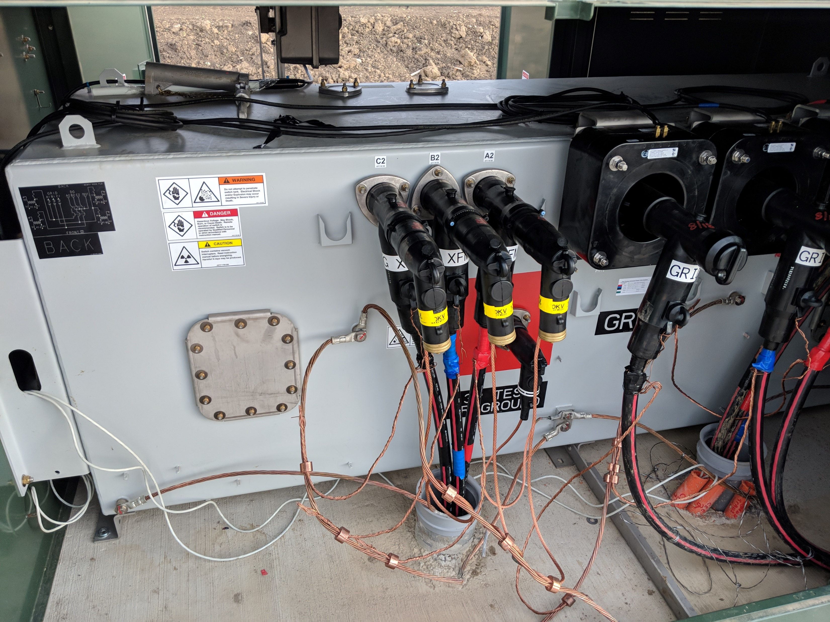
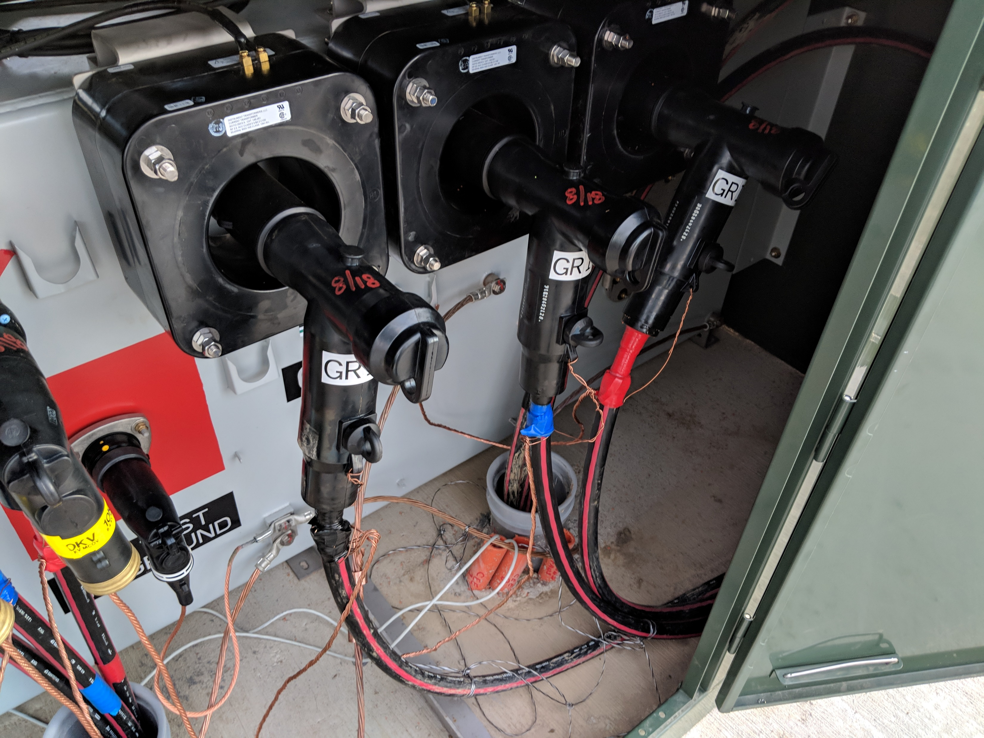
Switchgear

Slide 17
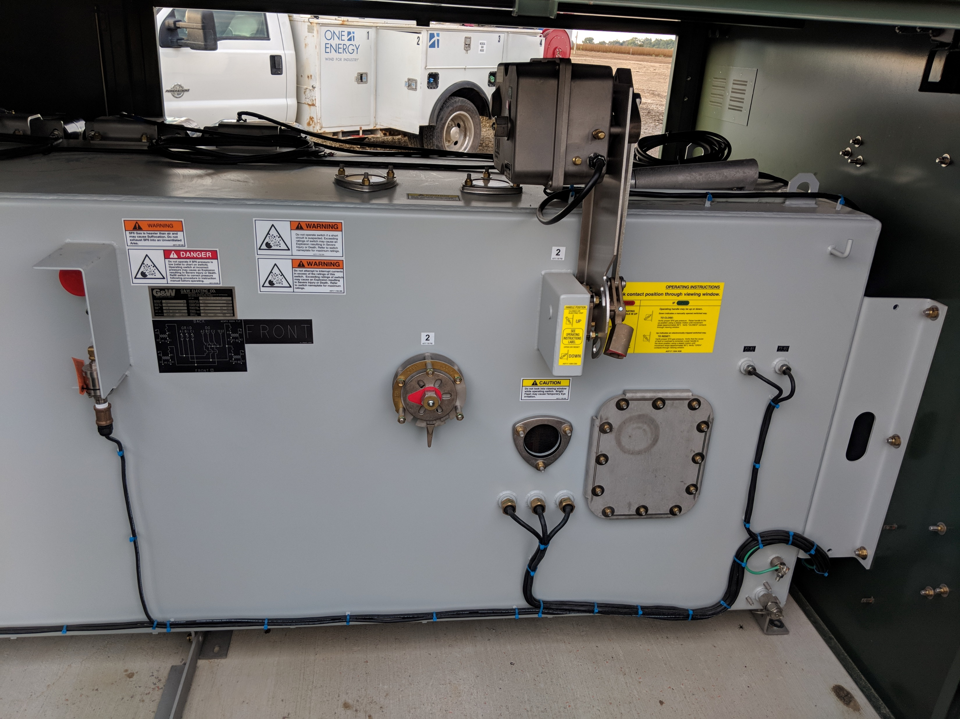
Switchgear

Slide 18
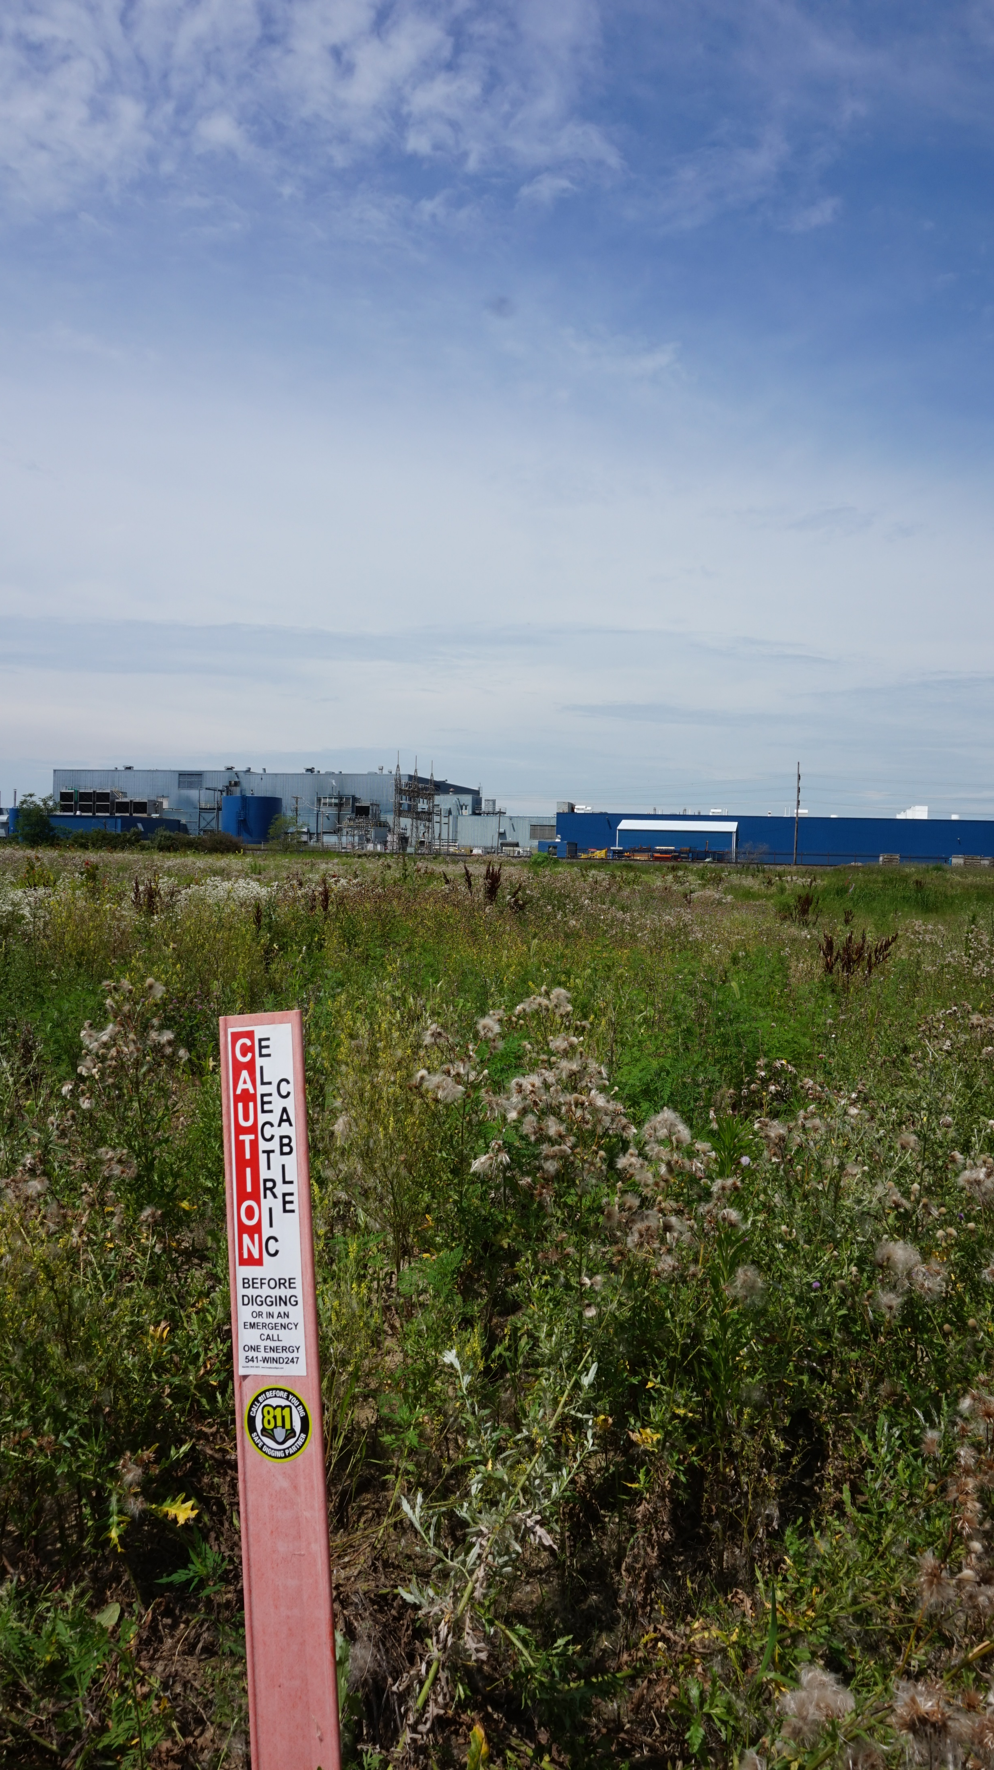
Run to plant
Entire run is referred to as “Collection Line”
Could be underground or overhead (like Marion)
Boring under rail lines

Slide 19
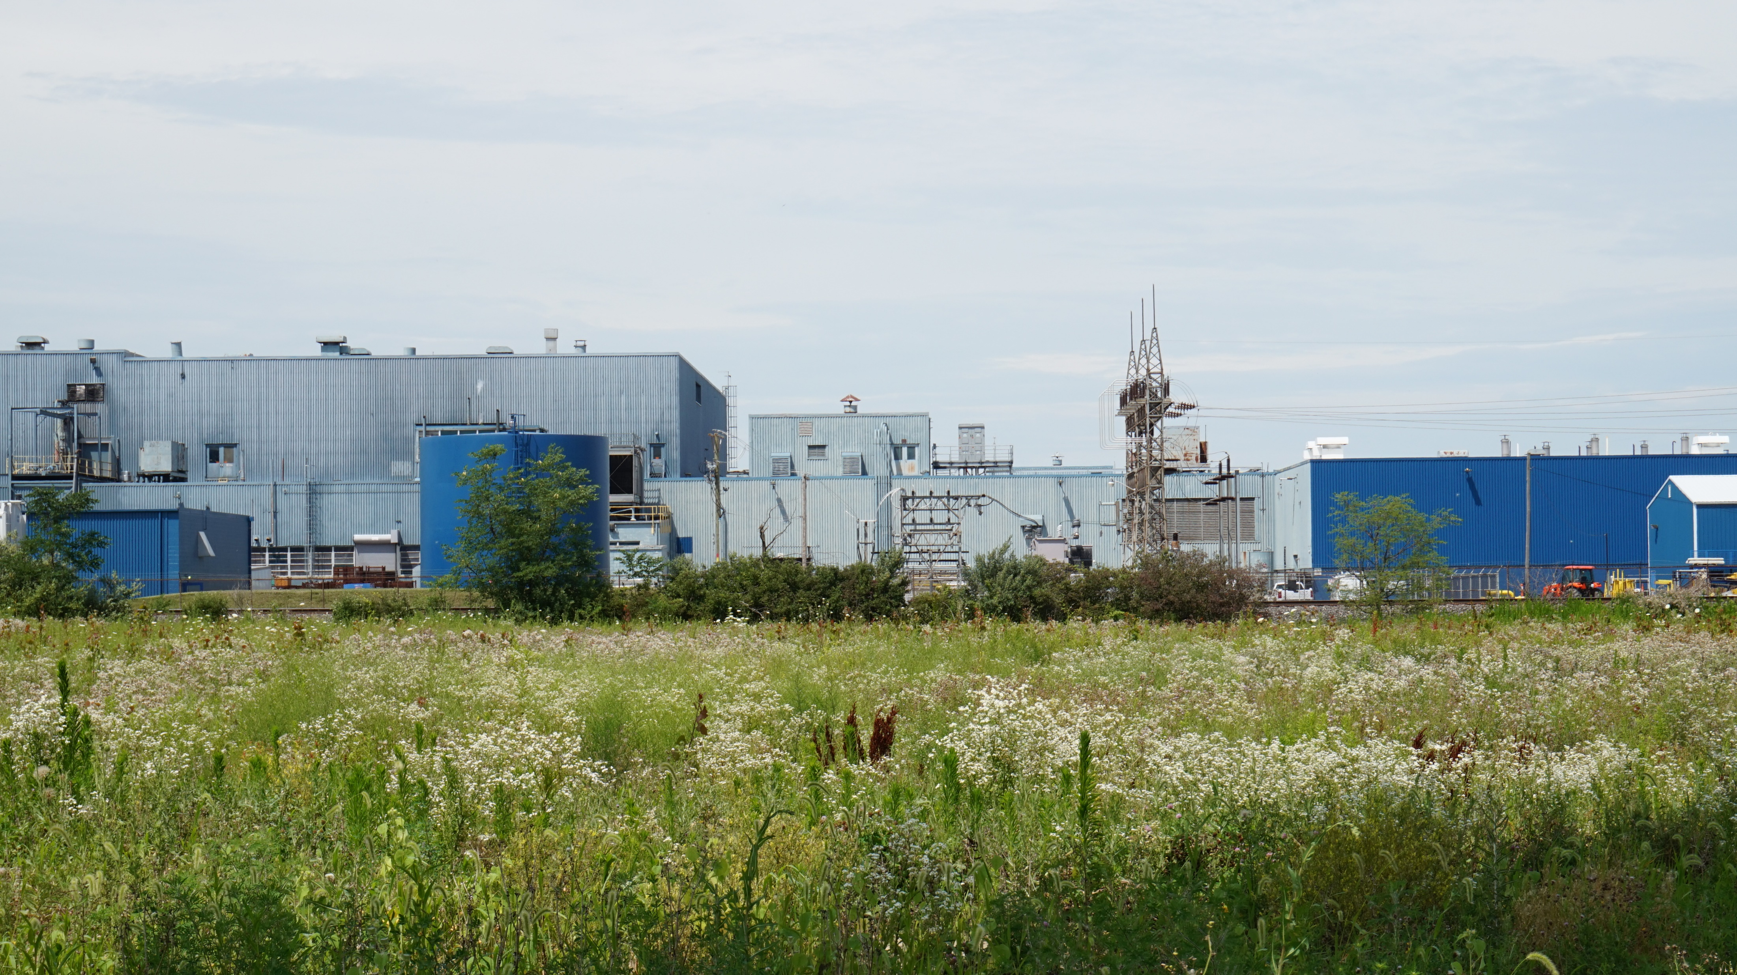
At the substation
Whirlpool
Grid
OE
Transformer

Slide 20
OE’s side
200A fuse on each phase
GOAB – Gang-Operated Air-Break
GPCC: Generator Point of Common Coupling
PCC: Point of Common Coupling

Slide 21
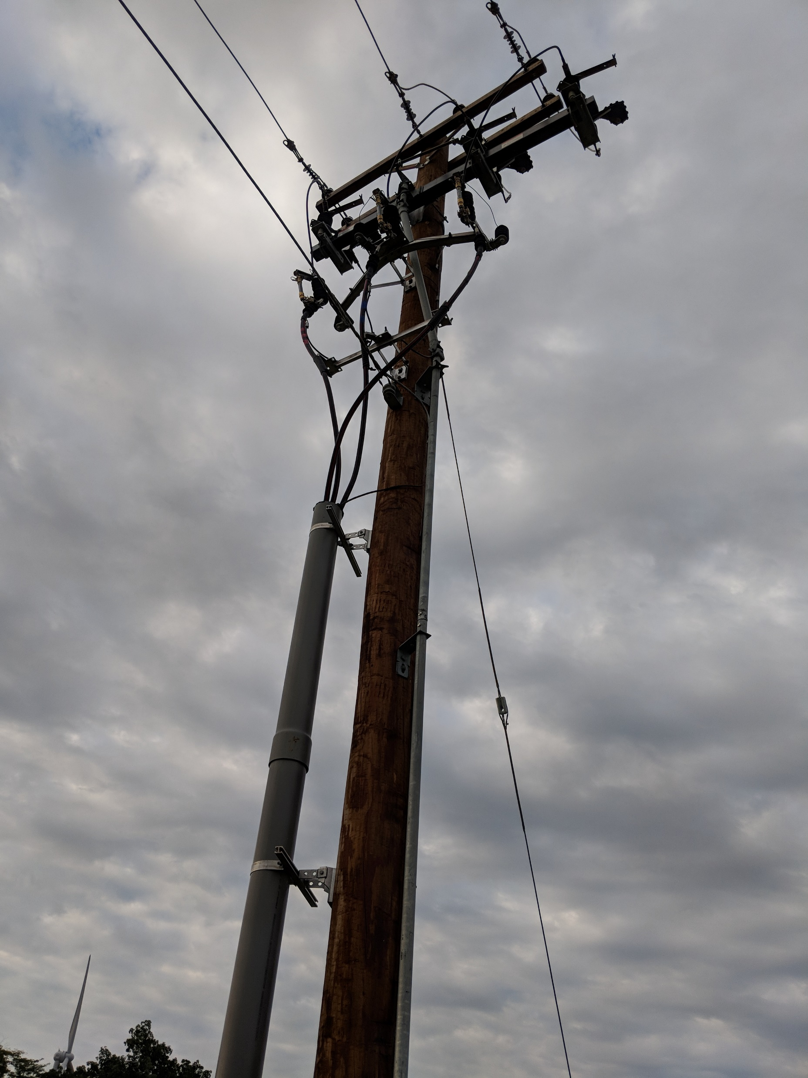
Pole

Slide 22
Responsibility
One Energy
Anything between the turbine and the plant connection
Transformer, Grounding Transformer, Switchgear, Riser Pole Fuses
Most switching can be done remotely
Goldwind
Semi-annual and annual maintenance
Any turbine issues
Remote Operations Center (ROC) and local team
Some automated turbine functions cause downtime

Slide 23
Thank you | questions?

