Slide 1
Pythagorean Theorem
&
Distance Formula

Slide 2

Pythagorean Theorem
$$a^{2}+b^{2}=c^{2}$$
proof

Slide 3




Pythagorean Theorem
$$a^{2}+b^{2}=c^{2}$$
c
a
b

Slide 4

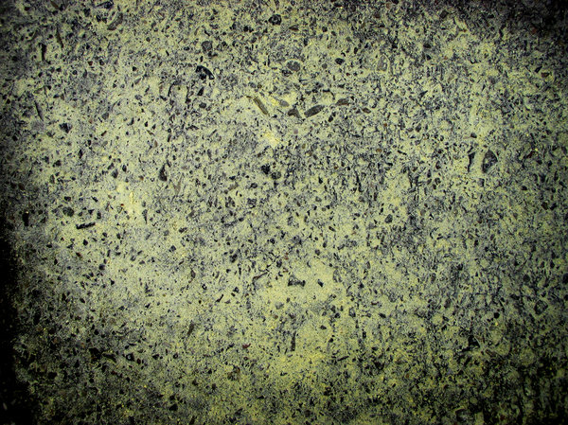





Special Triangles
45$\text{°}$
$$\text{x}\sqrt{\text{2}}$$
45$\text{°}\text{−45}\text{°}\text{−90}\text{°}$
x
45$\text{°}$
x

Slide 5




Special Triangles
3$\text{0}\text{°}\text{−60}\text{°}\text{−90}\text{°}$
6$\text{0}\text{°}$
2x
x
3$\text{0}\text{°}$
$$\text{x}\sqrt{\text{3}}$$

Slide 6


Pythagorean Theorem
C=$\text{10}\sqrt{\text{5}}$=22.361
10
20

Slide 7

Pythagorean Theorem
C=$\text{5}\sqrt{\text{34}}$=29.155
15
25

Slide 8

Pythagorean Theorem
a=$\text{24}$
51
45

Slide 9
Pythagorean Theorem
b=60
61
11

Slide 10

Pythagorean Triples
3-4-5
5-12-13
8-15-17
7-24-25
20-21-29
12-35-37
9-40-41
Scale up
3-4-5
6-8-10
9-12-15

Slide 11

Distance Formula
$$D=\sqrt{{\left(x_{2}−x_{1}\right)}^{2}+{\left(y_{2}−y_{1}\right)}^{2}}$$

Slide 12


Distance Formula
$$D=\sqrt{{\left(x_{2}−x_{1}\right)}^{2}+{\left(y_{2}−y_{1}\right)}^{2}}$$
10
9
8
7
6
5
4
3
2
1
 | 1 | 2 | 3 | 4 | 5 | 6 | 7 | 8 | 9 | 10
$$P_{1}=\left(x_{1},y_{1}\right)$$
$$P_{2}=(x_{2},y_{2})$$

Slide 13

Distance Formula
(3,5) (-2,-7)
D=13
(8,0) (2,-3)
D=3$\sqrt{\text{5}}$=6.708

