Slide 1
Systems of equations
Solving by addition/elimination
Jenn Stillings

Slide 2
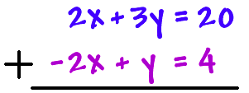

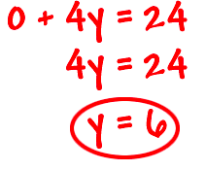
Solving by addition/elimination
Let’s do one and you’ll see how it works…
What are your thoughts on the problem as you look at it?
What happens when we add the two equations-–STRAIGHT DOWN?

Slide 3

Solving by addition/elimination
So now what??
What does x equal??

Slide 4
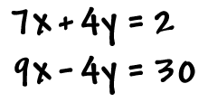
Your turn…
Solution
(2, -3)

Slide 5

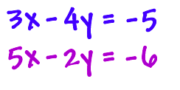

Slide 6

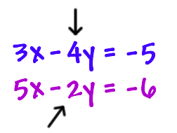
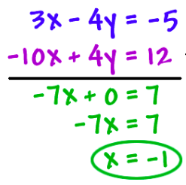



NOW WHAT???

Slide 7




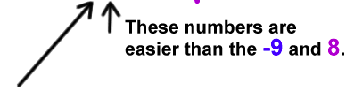
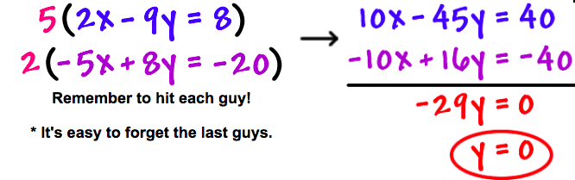

Slide 8
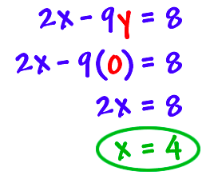


So now what??

Slide 9
