Slide 1
Starter
Calculate the area of the following shapes
6m
120mm
110mm
4m
9cm
100mm
50mm
4cm

Slide 2
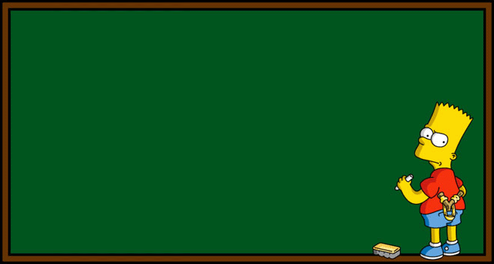
Surface Area
Learning Objectives:
Able to calculate the area of 2D shapes
Able to calculate the surface area of
a cuboid
Able to calculate the surface area of
other prisms

Slide 3
Prisms
A prism is a 3D shape that has a constant cross-section.
CUBOID
TRIANGULAR
PRISM
CUBE

Slide 4
Surface Area
Each face is the same – a square.
Area A = 5 x 5
= 25cm²
Total Surface Area = 6 x 25
= 150cm²
5cm
A
5cm
5cm

Slide 5
Surface Area
Surface area is the total area of the outside of a 3D object
Area A = 5 x 9
= 45cm²
Area B = 9 x 3
= 27cm²
Area C = 3 x 5
= 15cm²
Total Surface Area = (45 + 27 + 15) x 2
= 174cm²
B
C
A
5cm
3cm
9cm

Slide 6
Surface Area
Area A = 8 x 11
= 88cm²
Area B = 5 x 11
= 55cm²
Area C = 5 x 8
= 40cm²
TOTAL SURFACE AREA
= (88 + 55 + 40) x 2
= 183 x 2
= 366cm²
C
B
11cm
A
5cm
8cm

Slide 7
Surface Area
Calculate the Surface Area of the cube and cuboids shown below:
SA = 294cm²
SA = 378cm²
15cm
7cm
3cm
EXTENSION:
8cm
SA = 270cm²
9cm
6cm
12cm
5cm

Slide 8
Starter
Calculate the surface area of the following shapes.
5cm
9cm
14m
3cm
6cm
4cm
1m
2m

Slide 9
Surface Area of Prisms
Learning Objectives:
Able to calculate the surface area of cubes
and cuboids
Able to calculate the surface area of triangular prisms
Able to calculate the surface area of any
prism

Slide 10
Surface Area
Area of Triangles = ½ x 5 x 6
= 15m²
= 15 x 2
= 30m²
Area of Rectangle 1 = 12 x 11
= 132m²
Area of Rectangle 2 = 5 x 12
= 60m²
Area of Rectangle 3 = 12 x 7
= 84m²
Total Surface Area = 30 + 132 + 60 + 84
= 306m²
11m
7m
6m
12m
5m

Slide 11
Surface Area
Area of Triangles = ½ x 3 x 6
= 9m²
= 9 x 2
= 18m²
Area of Rectangle 1 = 10 x 6
= 60m²
Area of Rectangle 2 = 7 x 10
= 70m²
Area of Rectangle 3 = 3 x 10
= 30m²
Total Surface Area = 18+ 60 + 70 + 30
= 178m²
7cm
10cm
3cm
6cm

Slide 12
Surface Area of Prisms
Area of Parallelograms
= 9 x 7
= 63cm²
Area of Rectangles 1
= 11 x 9
= 99cm²
99 x 2
= 198cm²
Area of Rectangles 2
= 8 x 11
= 88cm²
88 x 2
= 176cm²
TOTAL SURFACE AREA
= 63 + 198 + 176
= 437cm²
7cm
8cm
11cm
9cm

Slide 13
Surface Area of Prisms
6cm
TOTAL SURFACE AREA = 56 + 128 + 160 + 128 + 96
= 568cm²
8cm
7cm
8cm
16cm
Area of Trapeziums = ½ (10 + 6) x 7
= ½ x 16 x 7
= 56cm²
10cm
Area of Rectangle 1 = 16 x 8
= 128cm²
Area of Rectangle 2 = 10 x 16
= 160cm²
Area of Rectangle 3 = 16 x 8
= 128cm²
Area of Rectangle 4 = 6 x 16
= 96cm²

Slide 14
Starter
6m
4cm
5m
4m
3cm
7cm
9m
5m
7cm
8cm
11cm
9cm

Slide 15
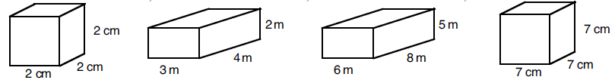
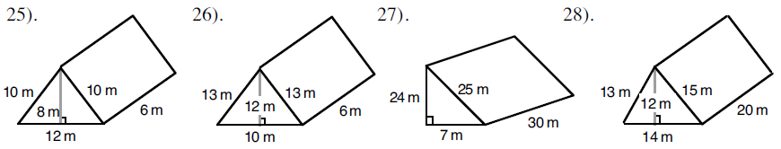
1.
2.
4.
3.
5.
6.
7.
8.
9. Katy wants to wrap a present that is 15cm wide, 18cm deep and 4cm high. How much wrapping paper will she need to use?
10. A length of copper piping is in the shape of a triangular prism. The triangle on it’s end is 9mm tall, 4mm wide. The piece of pipe is 18cm long. What is the surface area of the pipe?
11. A box has no lid. The box measures 1.2m by 30cm by 45cm. What is the surface area of the outside of the box?

Slide 16
Volume of Prisms
Learning Objectives:
Able to calculate the volume of a cuboid
Able to calculate the volume of a
triangular prism
Able to find the missing side, given the
volume
Able to apply this to worded problems

Slide 17
Volume of Prisms
Volume = area of cross-section x depth

Slide 18
Volume of Cuboids
A cuboid is a 3-dimensional object made up of a rectangles and squares
Volume = height x width x depth
Units: cm³, m³, mm³, km³, etc
height
depth
width

Slide 19
Volume of Prisms
Volume = width x height x depth
V = 4 x 3 x 12
V = 144cm³
12cm
3cm
4cm

Slide 20
Volume of Prisms
Volume = Area of cross section x depth
V = 7 x 9 x 3
V = 189cm³
7cm
3cm
9cm

Slide 21
Volume of Prisms
Grade D/C
07/10/2018
Volume = Area of cross-section x depth
11cm
Area of cross section = (11 x 8) ÷ 2
= 44cm²
9cm
8cm
20cm
Volume = 44 x 20
= 880cm³
11cm
1
2
3
7mm
7mm
343mm³
105m³
5cm
80cm³
6m
5m
2cm
7m
8cm
7mm
6m

Slide 22
1
2
7mm
3
7mm
343mm³
105m³
5cm
80cm³
6m
5m
2cm
7m
8cm
7mm
4
6m
5
6
5mm
6m
15cm
165mm³
11m
108cm³
10mm
396m³
3cm
6cm
9mm
6mm
6m
12cm
11mm
In the following, find the length of the missing side.
7
8
9
V = 144cm³
x m
x cm
9cm
x = 3cm
V = 189m³
V = 125cm³
8cm
x = 7m
x = 5cm
3m
x cm
x cm
9m
x cm
12cm

Slide 23
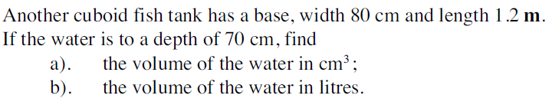
4
5
6
5mm
6m
15cm
165mm³
11m
108cm³
10mm
396m³
3cm
6cm
9mm
6mm
6m
12cm
11mm
In the following, find the length of the missing side.
7
8
9
V = 144cm³
V = 189m³
x m
x cm
9cm
x = 3cm
V = 125cm³
8cm
x = 7m
x = 5cm
x cm
3m
x cm
9m
12cm
x cm
10
V = 672,000cm³
V = 672l

Slide 24
Starter
Calculate the surface area of the triangular prism
Calculate the volume of the triangular prism
11m
7m
17m
9m
Katy wants to wrap a present that is 15cm wide, 18cm deep and 4cm high. How much wrapping paper will she need to use?

Slide 25
Surface Area and Volume: Worded Problems
Learning Objectives:
Able to calculate the surface area of a
prism
Able to calculate the volume of a prism
Able to calculate the surface area or volume
from a worded problem

Slide 26
Worded Problems
Ask yourself:
What shape is it?
Do I need to find the surface area or volume?
Can I draw a sketch of the shape?
‘Outside’ of the shape
‘Space inside’ of the shape

Slide 27
Worded Problems
A length of copper piping is in the shape of a triangular prism. The triangle on it’s end is a right angle, 9mm by 4mm by 10mm. The piece of pipe is 18cm long. What is the surface area of the pipe?
Area of Triangles = (9 x 4) ÷ 2
= 18mm²
= 18 x 2
= 36mm²
10mm
9mm
Front Rectangle = 180 x 10
= 1800mm²
180mm
4mm
Back Rectangle = 180 x 9
= 1620mm²
Total Surface Area = 36 + 1800 + 1620 + 720
= 4176mm²
Base Rectangle = 180 x 4
= 720mm²

Slide 28
Worded Problems
A box measures 50cm by 35cm by 40cm. It is used to hold boxes of drawing pins which themselves measure 8cm by 1cm by 3cm. How many boxes of drawing pins will fit inside the larger box?
Volume of Small Box:
= 8 x 3 x 1
= 24cm³
3cm
1cm
8cm
40cm
Volume of Large Box:
= 50 x 40 x 35
= 70000cm³
Number of small boxes that will fit in the large box:
= 70000 ÷ 24
= 2916.67 (2dp)
35cm
50cm
“2916 boxes of drawing pins will fit inside the box.”

Slide 29
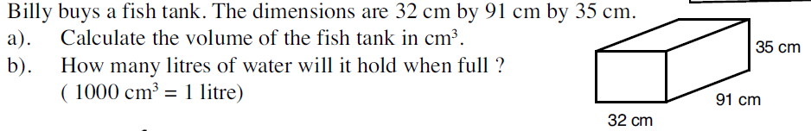
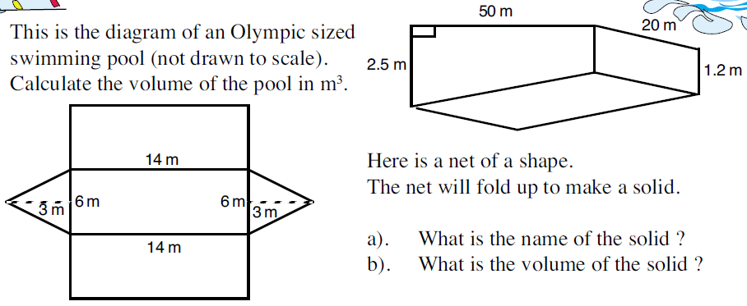
A gold bar is a triangular prism. The triangle on the end is isosceles with a height of 7cm, and a width of 5cm. The bars are 20cm long. Given the bar weighs 350g, calculate it’s density.

Slide 30
Starter
Calculate the area of the following shapes
2cm
4m
2cm
4cm
5m
9cm
6m
5m
4m
3cm
13m

Slide 31
Volume of Prisms
Learning Objectives:
Able to calculate the area of compound shapes
Able to calculate the volume of irregular prisms

Slide 32
Volume of Prisms
Volume = area of cross-section x depth

Slide 33
Volume of Prisms
Area A = 1 x 4 = 4cm²
Area B = 6 x 7 = 42cm²
Area C = 1 x 4 = 4cm²
Total Area of Cross-Section = 4 + 4 + 42
= 50cm²
VOLUME = 50 x 14
= 700cm³
A
1cm
B
7cm
1cm
14cm
C
1cm
4cm
6cm

Slide 34
Volume of Prisms
Area A = 11 x 4 = 44cm²
Area B = 8 x 13 = 104cm²
Area C = 11 x 3 = 33cm²
Total Area of Cross-Section = 44 + 104 + 33
= 181cm²
VOLUME = 181 x 25
= 4525cm³
4cm
A
3cm
20cm
B
C
3cm
25cm
11cm

