Slide 1
Parallel and intersecting slopes
Jenn stillings-one energy

Slide 2


Slide 3
I forgot to show you how to graph when we are given a point and the slope…

Slide 4

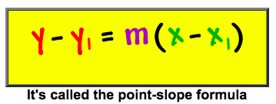



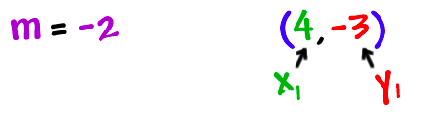
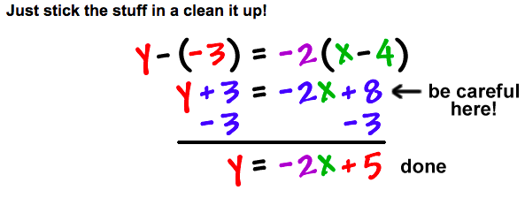
Finding the EQuation of a Line Given a Point and a Slope…
So what is the slope and y-intercept??

Slide 5
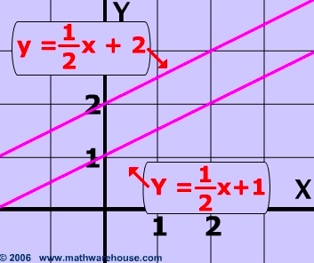
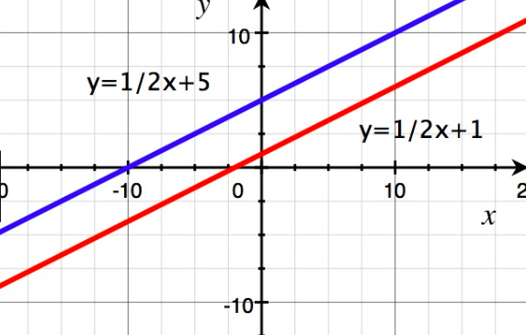
Now onto parallel lines…

Slide 6

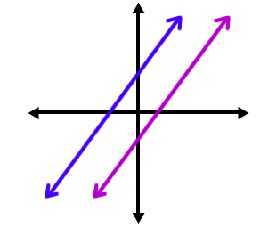

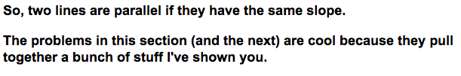
Parallel lines

Slide 7
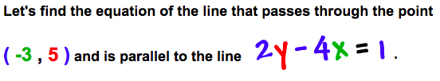



Check it out…
To get the equation of a line we need:
A POINT – WHICH WE HAVE
A SLOPE– WHICH WE CAN GET FROM
Now let’s find the slope…

Slide 8
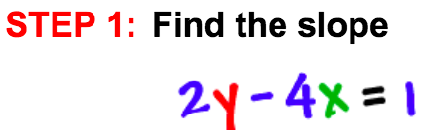
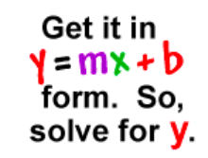
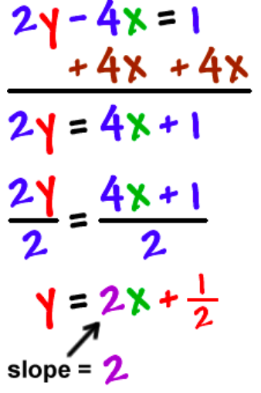
So what did you do in order to find the slope?

Slide 9

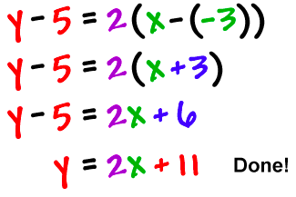
STEP 2: Use the point-slope form with the point( -3 , 5 ) and the slope of 2.
Now graph both lines to check our work.
Are they parallel??

Slide 10
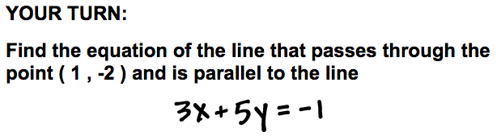
Remember to find the slope first of what you can…

Slide 11
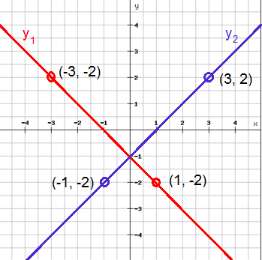
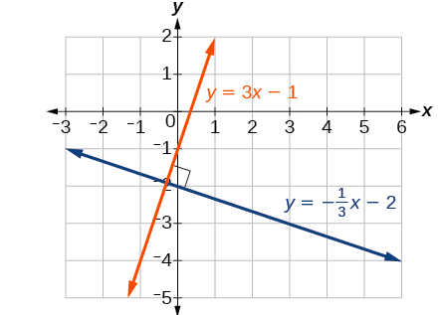
Perpendicular lines…

Slide 12
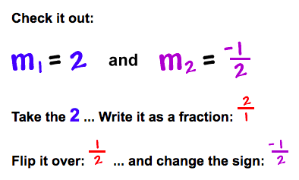
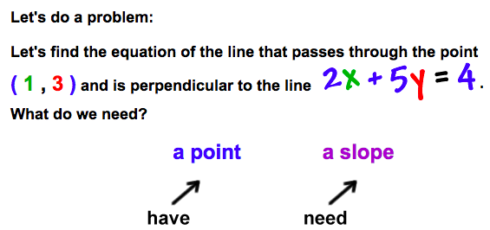
Perpendicular lines…

Slide 13

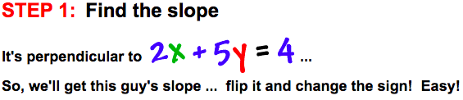
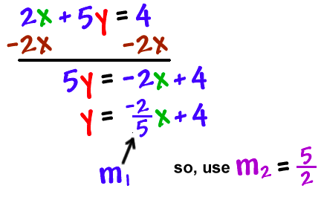
Perpendicular lines…

Slide 14

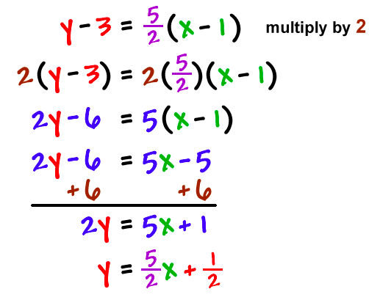

Perpendicular lines…
STEP 2: Use the point-slope formula with (1 , 3) and m =

Slide 15
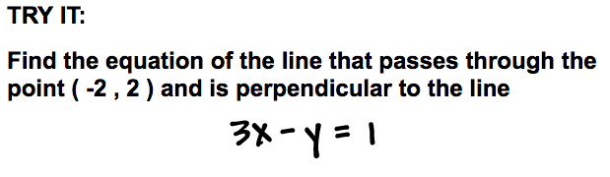
YOUR TURN…

