Slide 1
MULTIPLYING AND DIVIDING MONOMIALS
Jenn Stillings
One Energy

Slide 2
Objectives:
Understand the concept of a monomial
Use properties of exponents to simplify expressions

Slide 3

Monomial
An expression that is either:
a constant
a variable
A product of a constant and 1 or more variables
2x, 4ab², -7m³n⁸

Slide 4
Monomial
Bases… common variables
Ex. b⁴ c⁶
Coefficients… the number being multiplied by a variable.
Ex. -5x 32c

Slide 5
Now let’s multiply
(a³b⁴)(a⁵b²)
You can group like bases… the a’s and the b’s together.
(a³a⁵)(b⁴b²)
When write this out, it looks like this…
(a a a ∗ a a a a a)(b b b b ∗ b b)
Which gives us the answer of ...
a⁸b⁶

Slide 6
Let’s do one together...
(5a⁴b³)(2a⁶b⁵)
Multiply the coefficients
Group like bases
Simplify
Show your work.

Slide 7
Try these!
Answers:
A¹¹b⁴
-15a¹⁶b¹⁴
1. (a²b³)(a⁹b)
2. (3a¹²b⁴)(-5ab²)(a³b⁸)

Slide 8
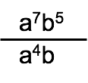
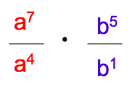
divide
Group like bases
When dividing, subtract the exponents
ANSWER… a³b⁴
(a⁷ ⁻ ⁴)(b⁵ ⁻ ¹)
Notes:
SHow this written out with terms on top and on bottom so that they can see why this works.

Slide 9
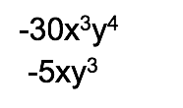
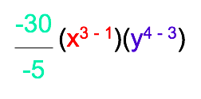
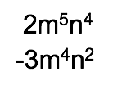
Let’s do this together...
Try this...
Divide the coefficients.
Group like bases
Answer: 6x²y

Slide 10
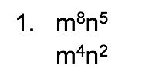
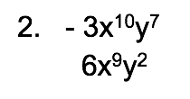

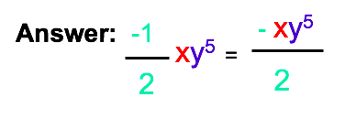
Try these...

Slide 11
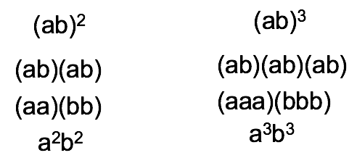
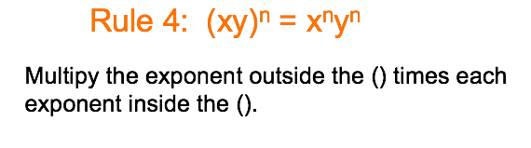
Power of a Product

Slide 12






Look at these...
(a⁹b⁵)³

Slide 13
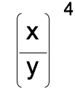
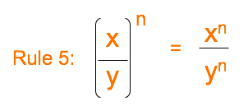
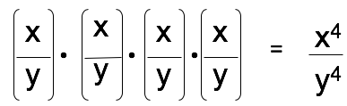
Power of a Product

Slide 14

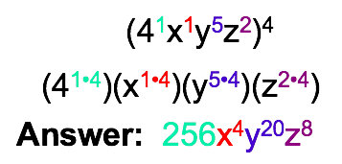
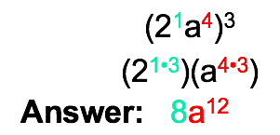
AND now it’s YOUR turn...

Slide 15
