Slide 1

Converting
with
Customary
and
Is it customary
to convert all of your sister’s dolls into mutant zombies?
Metric Units
of
Measure
Made Easy
A Bundled Unit
Created by: Mike’s Math Mall

Slide 2


Customary and Metric Units
There are two main systems of measurement:
1) Customary Units – used mainly in the United States
and
Why doesn’t
the U.S. join in that party?
2) Metric Units – basically used by the rest of the world
It’s complicated!

Slide 3

Customary and Metric Units
We convert units to make numbers easier
to use and understand.
A blue whale might weigh 350,000 pounds…
which is the same as 175 tons.
And why
do we need to
know how to convert
units anyway?
or
A cell phone might measure 0.12 meters,
which is the same as 12 centimeters.

Slide 4

Customary and Metric Units
Here are a few important vocabulary terms that will help during this lesson:
Capacity – the amount of matter that a container can hold.
Mass – the amount of matter that makes up an object.
Weight – the pull of gravity on an object.
Ratio – the amount of one thing compared to a the amount of another (sometimes written as a fraction).
Example of a ratio: $\frac{1 foot}{12 inches}$

Slide 5
Part 1:
Converting
Customary Units
Of Measure

Slide 6
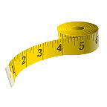
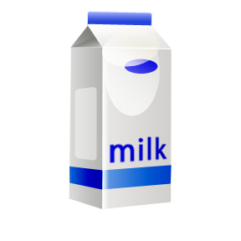
Customary Units
Let’s take a look at the basic
U.S. customary units of measure.
Name some if you can!
Length: Capacity: Weight:
Inches (in.)
Feet (ft)
Yards (yd)
Miles (mi)
Fluid Ounces (fl oz)
Cups (c)
Pints (pt)
Quarts (qt)
Gallons (gal)
Ounces (oz)
Pounds (lb)
Tons (t)

Slide 7
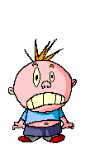
Customary Units
Here are some very useful equivalents (they’re called conversion factors in the big leagues).
See how many you can memorize!
Length: Capacity: Weight:
1 ft = 12 in.
1 yd = 3 ft
1 mi = 5,280 ft
1 c = 8 fl oz
1 pt = 2 c
1 qt = 2 pt
1 gal = 4 qt
1 lb = 16 oz
1 t = 2,000 lb
T…M…I…
Brain…on….fire!
Keep it together, Sparky! You’ll be fine!

Slide 8
Customary Units
I can’t help you with the burrito, Sparticus, but check out a couple of conversion problems and you’ll see that this isn’t so bad!
Sparky needs
a double-beefy, triple-fire, chili-dipped
burrito to help calm
his nerves!
Sparky…
must…drama down!
Sparky…likes the ladies!
That’s my boy!
Besides, this over-dramatic behavior is not going to impress the ladies.

Slide 9
Customary Units
Before we convert customary units, we need to think about choosing appropriate units of measure.
Choose an appropriate unit of measure for each of the following:
1) Length of a soccer field: feet, yards, miles
2) Amount of water in a hot tub: cups, pints, gallons
3) Weight of a car tire: ounces, pounds, tons
4) Height of a basketball rim: inches, feet, yards
5) Capacity of a shampoo bottle: fluid ounces, cups, gallons
6) Weight of a grey whale: ounces, pounds, tons

Slide 10



Converting Customary Units
Now let’s try a conversion!
Example 1: Kayla measured 48 inches from the top of her dresser to the floor. How high is this in feet?
Step 1: Locate the unit you need to convert and write it as a ratio (with its label). Add a multiplication sign.
$\frac{48 inches}{1}$
$×$
$\frac{1 foot}{12 inches}$
Step 2: Locate the unit you want to convert to and use the correct conversion factor. Write it as a ratio also.
Hint #1: To be sure ratios are written correctly, similar units should ALWAYS occur diagonally in the expression.
continued →

Slide 11



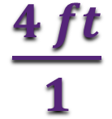


Converting Customary Units
Step 3: Cross-cancel.
Hint #2: Cross-cancelling is really like dividing.
Hint #3: Units that are diagonally across from each other also cancel out.
Step 4: Multiply.
4
$\frac{48 inches}{1}$
$×$
$\frac{1 foot}{12 inches}$
$=$
$\frac{4 ft}{1}$
$=$
4 ft
1
Notice! I’m
not spazzing,
but I could use
more help!
48 in = 4 ft
Then let’s look at another example, Captain Coolio!

Slide 12


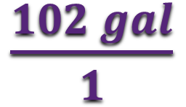
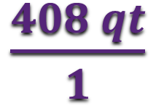

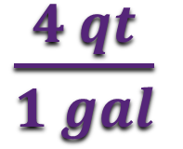
Converting Customary Units
Example 2: Crab boats require 102 gallons of oil to run their engines properly. How much oil does that equal in quarts?
Step 1: Locate the unit that needs converting and write that ratio.
$\frac{102 gal}{1}$
$×$
$\frac{4 qt}{1 gal}$
$=$
$\frac{408 qt}{1}$
$=$
408 qt
Step 2: Locate the unit you want to convert to and use the correct conversion factor. Write it as a ratio also.
Step 3: Cross cancel the same diagonal labels and multiply.

Slide 13

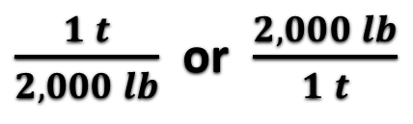

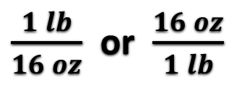






Converting Customary Units
Let’s practice!
Choose the correct conversion factor and then convert .
1) Convert 96 ounces to pounds.
Notice! Conversion factors can
be written two different ways.
6
$\frac{96 oz}{1}$
$\frac{1 lb}{16 oz}$
$\frac{1 lb}{16 oz}$ or $\frac{16 oz}{1 lb}$
$×$
$=$
6 lbs
1
$\frac{1 t}{2,000 lb}$ or $\frac{2,000 lb}{1 t}$
2) Convert 22 tons to pounds.
$\frac{22 t}{1}$
$×$
$\frac{2,000 lb}{1 t}$
$=$
Choose the ratio that helps
cross-cancel the unneeded label.
44,000 lbs

Slide 14


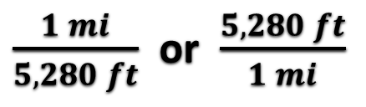

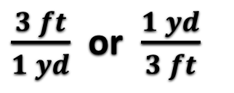

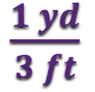






Converting Customary Units
You try some on your own!
1) 7 miles = ? feet.
Conversion factors
$\frac{ 7 mi}{1}$
$×$
$\frac{5,280 ft}{1 mi}$
$=$
$\frac{1 ft}{12 in}$ or $\frac{12 in}{1 ft}$
36,960 ft
2) 930 feet = ? yards.
310
$\frac{3 ft}{1 yd}$ or $\frac{1 yd}{3 ft}$
$\frac{ 930 ft}{1}$
$×$
$\frac{1 yd}{3 ft}$
$=$
310 yd
1
3) 150 inches = ? feet.
12.5
$\frac{1 mi}{5,280 ft}$ or $\frac{5,280 ft}{1 mi}$
$\frac{ 150 in}{1}$
$×$
$\frac{1 ft}{12 in}$
$=$
12.5 ft
1

Slide 15
Customary Units
Hey!
Did anyone else
notice that when you
convert smaller units to
larger units, you really
just divide?
Yep! When you
convert larger units to smaller ones, you really just multiply!
Well, they
don’t call me
Sir Smarticles
for nothing!
Did you happen to notice anything else?
Wow! Someone’s really on their game today!

Slide 16
Customary Units
Well then, Sir Smarticles, you must be ready to convert some metric units!
The last time
I checked, metric rhymes with indigestion!
Did someone
say “snap,” or was that my smarticles
exploding?
If you understood converting customary units, then converting metric units will be a snap!

Slide 17

Part 2:
Converting
Metric Units
of Measure

Slide 18

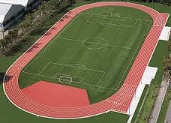
The Metric System
Let’s take a look at the basic metric
units of measure.
Length:
millimeter (mm) – about the width of a dime
centimeter (cm) – about the width of your thumbnail
meter (m) – about the distance from a doorknob to the floor
kilometer (km) – two and a half laps
on a running track

Slide 19

The Metric System
Capacity:
milliliter (mL) – about 20 drops of water
liter (L) – about 4 cups of water
Now that’s tiny!
Mass:
milligram (mg) – a tiny speck of sawdust
gram (g) – about one small paperclip
kilogram (kg) – about half of a solid brick

Slide 20

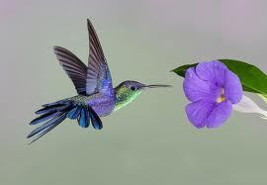
Metric Units
Before we convert metric units, we need to think
about choosing appropriate units of measure.
Choose an appropriate unit of measure for each of the following:
1) Length of a driveway: centimeter, meter, kilometer
2) Amount of gas in a gas tank: milliliter, liter
3) Mass of a bowling ball: milligram, gram, kilogram
4) Wingspan of a hummingbird: millimeter, centimeter, meter
5) Capacity of a medicine dropper: milliliter, liter
6) Mass of a pencil: milligram, gram, kilogram

Slide 21
Converting Metric Units
Will it be painful?
Let me guess! Time to convert?
Heck! I
can walk and chew gum at the
same time.
You guessed right!
Then you’re going to
like this!
Can you walk up and down
stairs while counting?

Slide 22
Converting Metric Units
Think about it!
Metric units are easier to convert than customary units because metrics are based on Powers of 10.
So instead of multiplying or dividing by a bunch of crazy numbers, we only have to move decimals to
the left or right and sometimes add a few zeros!
To help with the conversions, we use what’s called a metric conversion ladder (a kind of stair step).
Heights…
so…scared!

Slide 23
Metric Conversion Ladder
kilo-
1,000
Units
Larger units to smaller units:
Move the decimal to the right the same number of stairs you climb down (× 10 each step)
hecto-
100
Units
deka-
10
Units
meter
liter
gram
(Base)
deci-
0.1
Unit
centi-
0.01
Unit
Move the decimal to the left the same number of stairs you climb up (÷ 10 each step)
milli-
0.001
Unit
Smaller units to larger units:

Slide 24
Converting Metric Units
Let’s see how this works!
Example 1: The record for the highest kite flight is 3.8 km. Find the height of this record flight in meters.
This
is fun!
Jump from kilometers to meters!
kilo-
1,000
Units
hecto-
100
Units
3 steps down = 3 decimal places to the right.
deka-
10
Units
meter
liter
gram
(Base)
3 8
0
0
deci-
0.1
Unit
.
centi-
0.01
Unit
milli-
0.001
Unit
So 3.8 km = 3,800 m

Slide 25
Converting Metric Units
Let’s try another one!
I love
this game!
Example 2: The average African elephant eats 155,295 grams of food per day. How many kilograms of food is this?
kilo-
1,000
Units
Jump from grams to kilograms!
hecto-
100
Units
3 steps up = 3 decimal places to the left.
deka-
10
Units
meter
liter
gram
(Base)
155,295
.
deci-
0.1
Unit
centi-
0.01
Unit
milli-
0.001
Unit
155,295 g = 155.295 kg

Slide 26
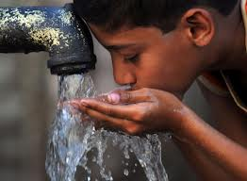
Converting Metric Units
Time for you to try!
Practice 1: In order to function properly, the human body needs about 2 liters of water per day. How many milliliters of water is this?
kilo-
1,000
Units
hecto-
100
Units
3 steps down to the right…
deka-
10
Units
meter
liter
gram
(Base)
2,000 mL
deci-
0.1
Unit
centi-
0.01
Unit
milli-
0.001
Unit

Slide 27
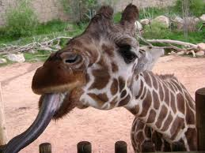
Converting Metric Units
Practice 2: The average adult giraffe’s tongue measures 480 mm? How many centimeters is this?
kilo-
1,000
Units
1 step up to the left…
hecto-
100
Units
deka-
10
Units
meter
liter
gram
(Base)
48 cm
deci-
0.1
Unit
centi-
0.01
Unit
milli-
0.001
Unit

Slide 28
Converting Metric Units
Practice 3: 153 kL = how many L?
153,000 L
Practice 4: 488 m = how many cm?
48,800 cm
kilo-
1,000
Units
Practice 5: 21,877 mm = how many km?
hecto-
100
Units
0.021877 km
deka-
10
Units
meter
liter
gram
(Base)
deci-
0.1
Unit
centi-
0.01
Unit
Try some more!
milli-
0.001
Unit

Slide 29
Converting Metric Units
So how do you feel about converting customary and metric units?
Since me
fancies the metric
system so much, me thinks me might become one of the Queen’s royal
subjects!
This bloke
thinks convertin’ metrics is wicked-brilliant, sir!
Sparky, why are you speaking with
a British accent?
Ok, that’s just weird!

