Slide 1
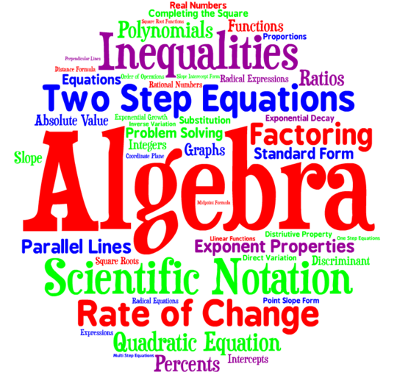
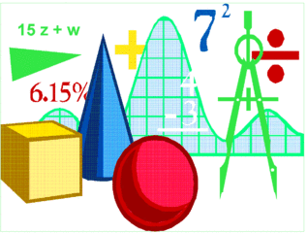
Algebra:
1-Step Equations
Multiplication and Division

Slide 2
Remember
The GOAL of solving equations: Find the value of the variable
To do this, you need to ISOLATE the variable, using INVERSE OPERATIONS.

Slide 3
State the INVERSE of each
Add 23
Subtract 18
Multiply by -15
Divide by 8
Sub 23
Add 18
Divide by -15
Multiply by 8

Slide 4
How do we approach the problem?
Ask yourself:
Where is the variable?
What is done to it?
How can I undo that?
Apply it to BOTH sides.
Solve and Simplify

Slide 5
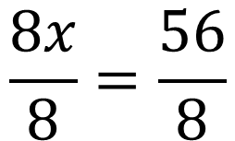
Let’s look at an example problem
8x = 56
Ask:
Where is the variable?
Ask:
What is done to it?
A number by a variable means multiply.
What’s the inverse?
Ask:
How can I undo that?
Do:
Apply it to both sides.
Divide
$$\frac{8x}{8}=\frac{56}{8}$$

Slide 6

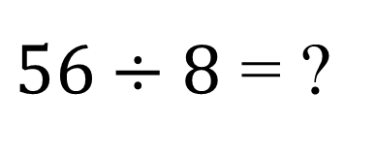
Continued
Check your answer by putting it in for the variable.
8x = 56
8(7) = 56
Does 8 X 7 = 56? Yes
Does 56 = 56? Yes
The statement is true, so you have solved the equation!
8x = 56
8 8
$$x=\frac{56}{8}$$
$56÷8$ = ?
7

Slide 7



Let’s try another one
4x = 32
$$\frac{4x}{4}=\frac{32}{4}$$
Ask yourself the questions:
Where?
What?
How?
$$x=\frac{32}{4}$$
$$32÷4= ?$$
8
Check your answer by replacing the variable
4X = 32 is 4(8) = 32
Does 4 X 8 = 32? Yes
Does 32 = 32? Yes
The statement is TRUE, your solution is correct.

Slide 8
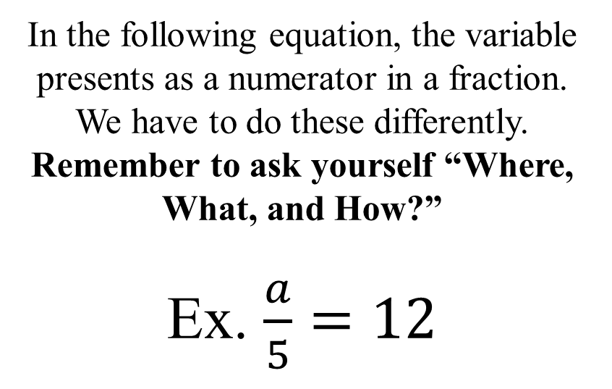
Let’s Look at the other way of solving equations
In the following equation, the variable presents as a numerator in a fraction. We have to do these differently. Remember to ask yourself “Where, What, and How?”
Ex. $\frac{a}{5}=12$

Slide 9

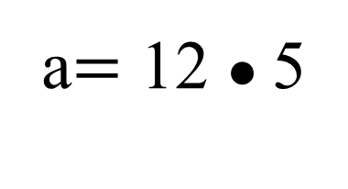
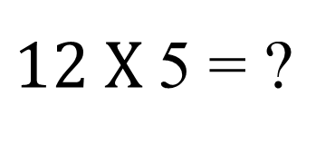

Continued
Check your answer by putting it in for the variable.
$$\frac{60}{5}=12$$
Does 60 ÷ 5 = 12? Yes
Does 12 = 12? Yes
The statement is true, so you have solved the equation!
$\frac{a}{5}=12$
5 ●
●5
a$=$ 12 ● 5
$12 X$5 = ?
60

Slide 10

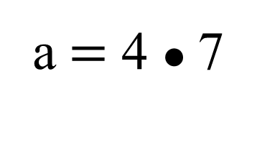
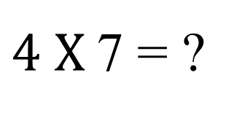
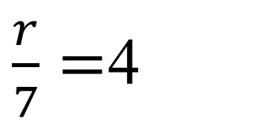
Continued
Check your answer by putting it in for the variable.
$$\frac{28}{7}=4$$
Does 28 ÷ 7 = 4? Yes
Does 4 = 4? Yes
The statement is true, so you have solved the equation!
$\frac{r}{7}=$4
7 ●
●7
a$=$ 4 ● 7
$4 X$7 = ?
28

Slide 11
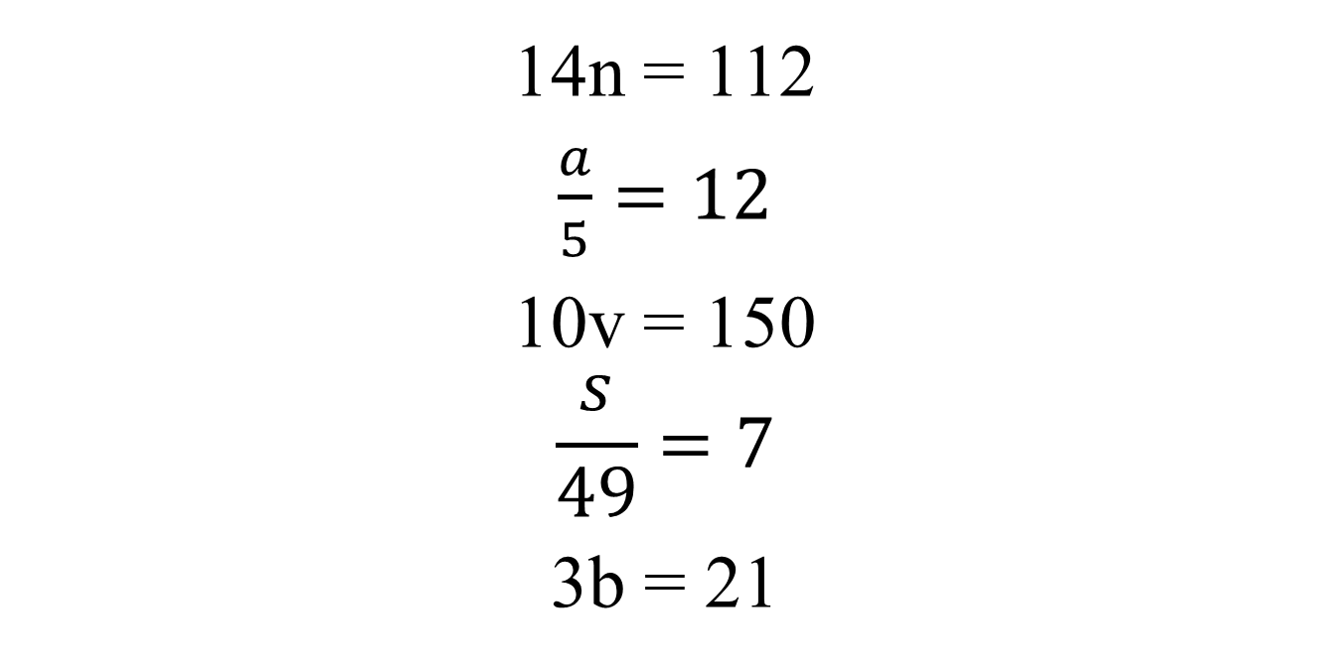
Try these
Remember to show your work!
14n = 112
$\frac{a}{5}=12$
10v = 150
$$\frac{s}{49}=7$$
3b = 21

Slide 12
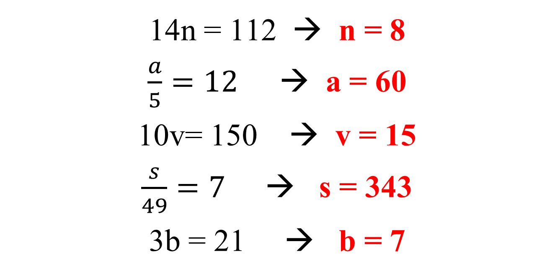
Check your answers
14n = 112 → n = 8
$\frac{a}{5}=12$→ a = 60
10v= 150 → v = 15
$\frac{s}{49}=7$ → s = 343
3b = 21 → b = 7

Slide 13







Multiplicative Inverse
Also known as Reciprocals, the multiplicative inverse is used when a variable is multiplied by a fraction.
First, let’s find the M.I. or Reciprocal of the following fractions:
$\frac{1}{3}$ $\frac{5}{7}$ $\frac{2}{5} \frac{6}{11} \frac{1}{2} \frac{3}{4}$
$$\frac{3}{1}$$
$$\frac{7}{5}$$
$$\frac{5}{2}$$
$$\frac{11}{6}$$
$$\frac{2}{1}$$
$$\frac{4}{3}$$

Slide 14
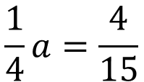


Identifying when to USE the Recip
Here are some examples of equations in which you would use the reciprocal.
$$\frac{3}{5}T=6$$
$$\frac{2}{7}r=8$$
$$\frac{1}{4}a=\frac{4}{15}$$
Let’s approach these one at a time.

Slide 15
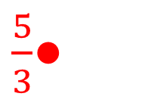

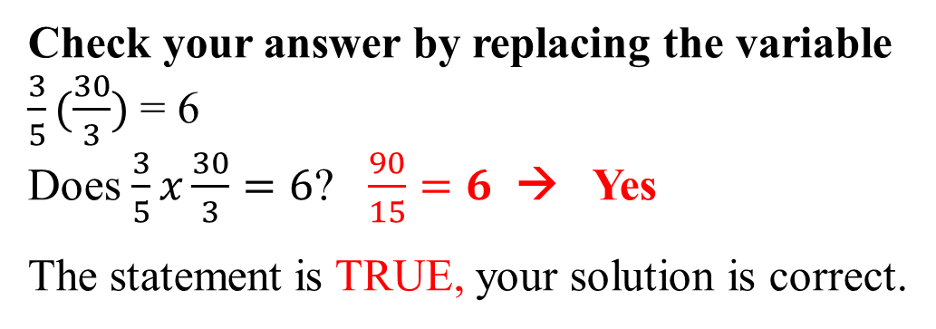
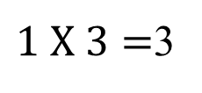
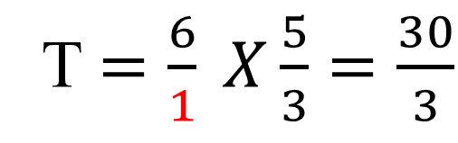


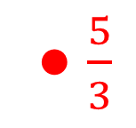
Using the Reciprocal
$$\frac{3}{5}T=6$$
$\frac{5}{3}$●
$\frac{3}{5}T=$ 6
● $\frac{5}{3}$
T $=\frac{6}{1} X\frac{5}{3}=\frac{30}{3}$
Ask yourself the questions:
Where?
What?
How?
$$6 X 5=30$$
$1 X 3=$3
Check your answer by replacing the variable
$\frac{3}{5}(\frac{30}{3})$= 6
Does $\frac{3}{5}x\frac{30}{3}=6$? $\frac{90}{15}=6$ → Yes
The statement is TRUE, your solution is correct.

Slide 16
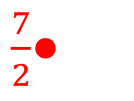

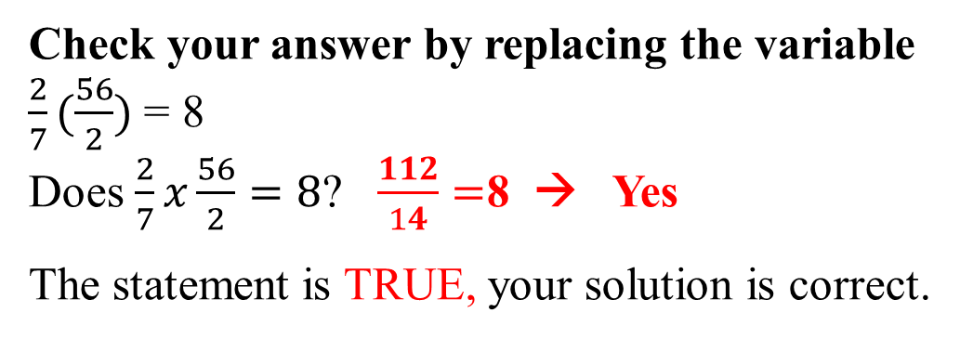
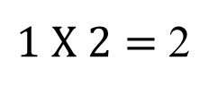



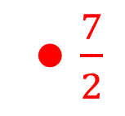
Using the Reciprocal
$$\frac{2}{7}r=8$$
$\frac{7}{2}$●
$\frac{2}{7}r=$ 8
● $\frac{7}{2}$
T $=\frac{8}{1} X\frac{7}{2}=\frac{56}{2}$
Ask yourself the questions:
Where?
What?
How?
$$8 X 7=56$$
$1 X 2=$ 2
Check your answer by replacing the variable
$\frac{2}{7}(\frac{56}{2})$= 8
Does $\frac{2}{7}x\frac{56}{2}=8$? $\frac{112}{14}=$8 → Yes
The statement is TRUE, your solution is correct.

Slide 17
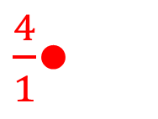

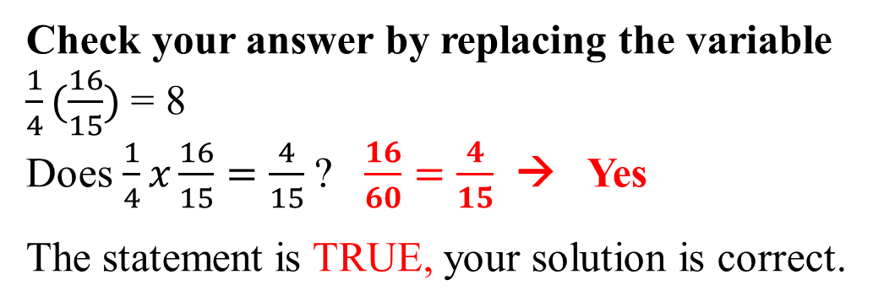
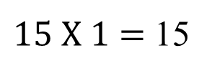
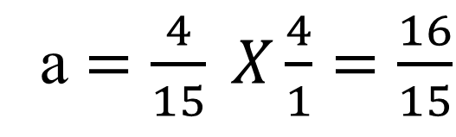


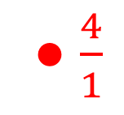
Using the Reciprocal
$$\frac{1}{4}a=\frac{4}{15}$$
$$\frac{1}{4}a=\frac{4}{15}$$
$\frac{4}{1}$●
● $\frac{4}{1}$
a $=\frac{4}{15} X\frac{4}{1}=\frac{16}{15}$
Ask yourself the questions:
Where?
What?
How?
$$4 X 4=16$$
$15 X 1=$ 15
Check your answer by replacing the variable
$\frac{1}{4}(\frac{16}{15})$= 8
Does $\frac{1}{4}x\frac{16}{15}=\frac{4}{15}$? $\frac{16}{60}=\frac{4}{15}$ → Yes
The statement is TRUE, your solution is correct.

Slide 18



Try these for Practice
If you have questions, ask!
$$\frac{3}{4}n=9$$
$$\frac{5}{8}k=25$$
$$\frac{1}{9}t=6$$
n = 12
k = 40
t = 54

