Slide 1
One energy It 101
Jessica Grosso and Carly Good

Slide 2
Meet the Team
Office
  Jessica Grosso
  Carly Good
  Hank Doster
Project
  Jordan Swift

Slide 3
Outline
IT Helpdesk
  Code red examples
  Non code red examples
OE Standard Computers
  Onboarding process
  OE basic software
Security
  OE firewall security (Trendmicro)
  Chromebook vs OE Computer
  Passwords
  Tips and tools
Dropbox
  Changeover
  Do’s and Don’ts
DIY IT

Slide 4
IT helpdesk
IT Helpdesk is an email address you use contact IT with any concerns, requests, or problems you may have.
it@oneenergyllc.com
How to address your email
State your issue
Description of issue (any detail helps)
If it is a code red IT emergency

Slide 5
Code red vs non Code red emergency
Code Red
Preventing business critical work
Blue screen
Virus alert
Big changes to Dropbox that are not expected
Suspicious activity
Non Code red
Wifi (We know!)
Non business critical program
Setting up a new program
Learning a new program
Dropbox change requests
Overall software complaints
Slow running computer
Requests for new software

Slide 6
Oe Standard computers
Our current supplier is Lenovo
Computers come with 2 year onsite warranty plus accidental damage
Onboard process
Submit a computer request form for new employee
  Dropbox\IT – General \Computer_Request_Form
IT will match employee needs with standard computer options
All computers come with standard software:
Standard Computer Options
Standard | ThinkPad 13
Marketing | Yoga 910
High | ThinkPad X1 Carbon
Engineer/Designer | ThinkPad P50s
Special i.e. Jereme | ?
Standard Software
Google Chrome | Slack
Dropbox | KeePass
Google Earth Pro | Office 365
Nitro | Trendmicro
Google Apps Sync | OE Printer

Slide 7
Security
Trendmicro – used for internet security
  It comes installed on your computer, you cannot delete it unless given permission by administrator
  It continuously scans your computer for viruses and threats
Not because we don’t trust you, but because we don’t trust other people, One Energy blocks certain websites from being accessed on your computer
  Types of websites that are blocked:
    Adult
    Gambling
    Violence
    Drugs
    Alcohol/Tobacco
    Hacking
    Internet Radio and TV
If you need access to something that is blocked to do your job, let us know

Slide 8
Chromebook vs OE Computer
OE Computer
Anything related to your job
Online shopping for OE including Amazon
Social media for business purposes
Chromebook
Anything not related to your job
Streaming video and radio
Music
Online shopping
Online banking
Personal email
Netflix
Pinterest
Social media for personal use
Anything your heart desires

Slide 9
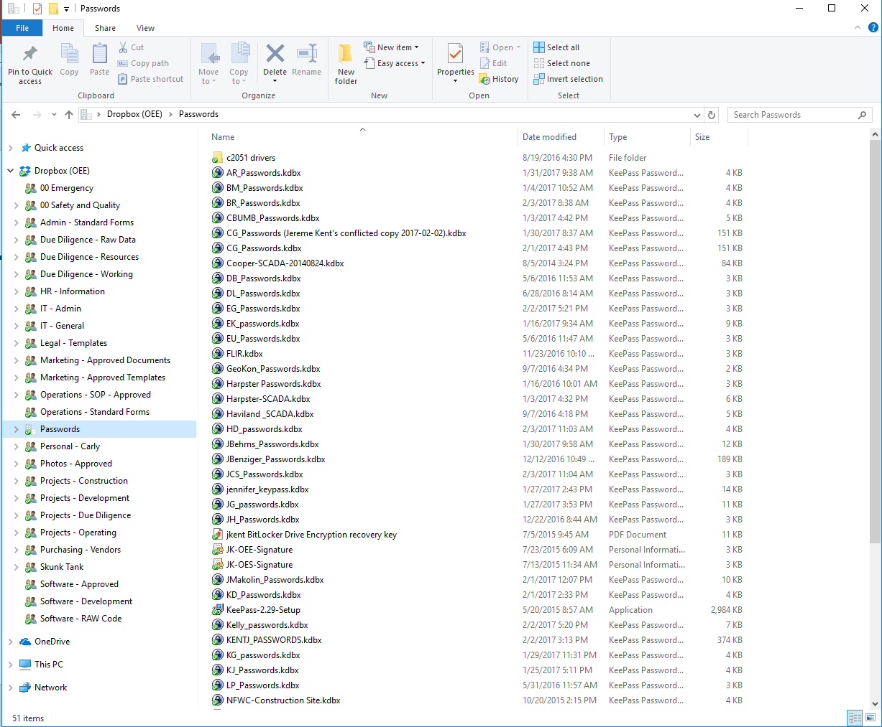
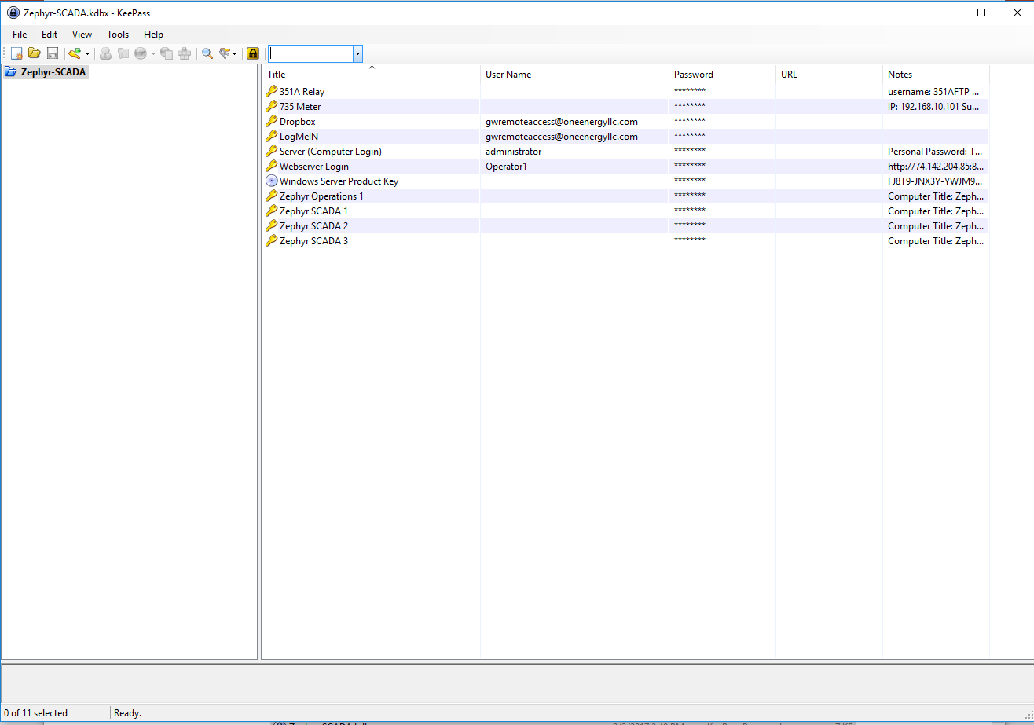
Passwords
We use encrypted software called KeePass to safely store our passwords
These are stored in Dropbox in the “Passwords” folder
  Each KeePass Password file has a unique master password to access
  There is a Dropbox Paper on how to install and setup KeePass
DEMO….

Slide 10
Tips and tools
A strong password is
  More than 8 characters
  Includes letters, numbers, and symbols
  Includes capitals and lowercase
  Phrases are often the best passwords
Two factor authentication for Google and Dropbox is not required but recommended
Do not leave laptop in the car
Email viruses are a BIG problem
  They look like legitimate emails
  Come from people you know or stores you have shopped at
  Look for signs that an email is spam or phishing
    Misspelled words
    Email addresses that don’t match the sender (ex. @bankofamercan)
  Never download email attachments you are not expecting
  Never send money
  Don’t sign into email from an email link (fake Gmail webpages are an issue)

Slide 11
Dropbox
Folders will be assigned to a person to organize by 2/10
Collaborate with people to find the best organization
If you need suggestions contact it@oneenergyllc.com
The goal is to have the Dropbox changeover closed out by 2/10

Slide 12
Dropbox Do’s and Don’ts
DO’s
Date files (YYYYMMDD)
Create OLD folders for OE working folders
Keep only the most recent version in the resource folders
Achieve REALLY OLD files to their proper archive location
Use your personal folder (and organize it!)
DON’Ts
Delete anything ever
Move large amounts of data without notifying IT
Move root folders
Delete root folders
Create your own root folder without notifying IT
Save files locally on your computer if they pertain to OE

Slide 13
DIY IT
When in doubt, reboot!
If frozen or not functioning Ctrl+Alt+Delete to end task
Check Dropbox Paper in IT folder for how to documents before contacting IT
Utilize search function in Dropbox to find missing files or folders (online or locally)
Selective Sync demo
Change default program demo

Slide 14

Conclusion
Be smart with your computer
We are here to help you and make your job easier… but we do have other jobs so please be patient ☺
THANK YOU!!

